Slide 1
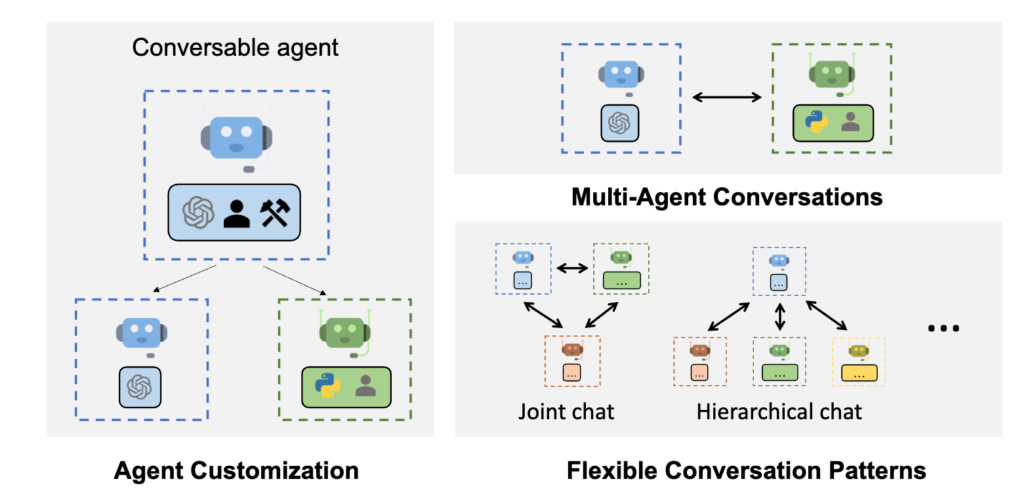
AutoLogGen
Log Analysis from Rohde & Schwarz
Xuyuan Han,
Hanxi Jiang,
Feng Yang,
Zhenghao Zhang

Slide 2



How it works
Multi-agents
Framework
(AutoGen)
Preprocessed Log
Summarization & QA

Slide 3

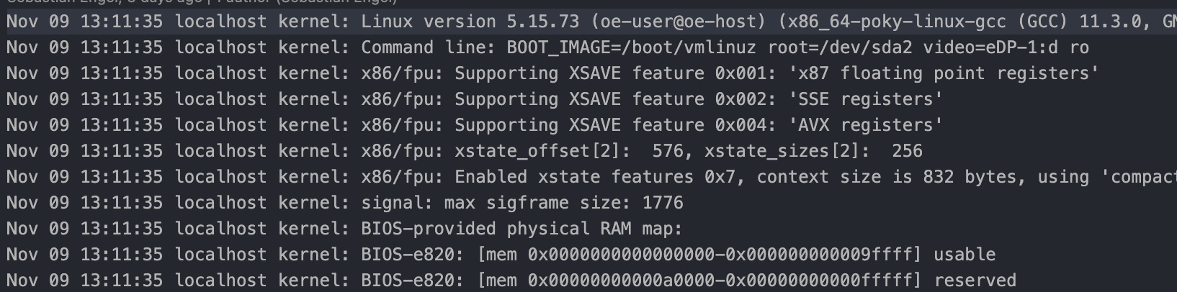
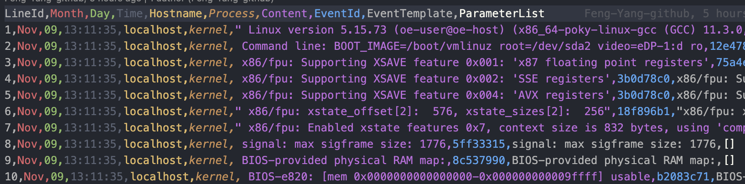
Log Preprocessing
Line Numbers
(Traceability )
Event Information
(Understanding)

Slide 4
Autogen & GPT
User
User (a.k.a. Boss):
Assign the task to our agent and give feedbacks to the outcomes.
Summarizer:
Summarize the given log file, especially interested in the summarization of ssh and abnormal outputs
Analyst:
Talented at answering questions regarding the details.
Summarizer
Analyst

Slide 5
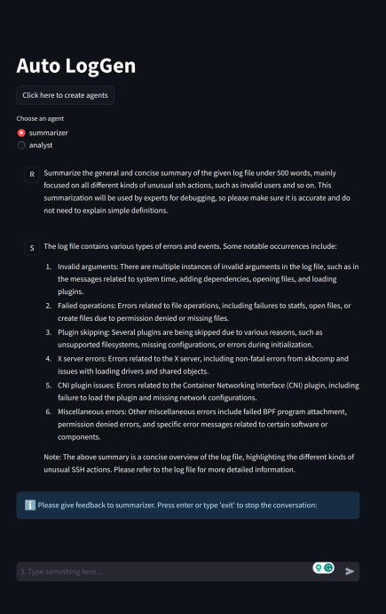
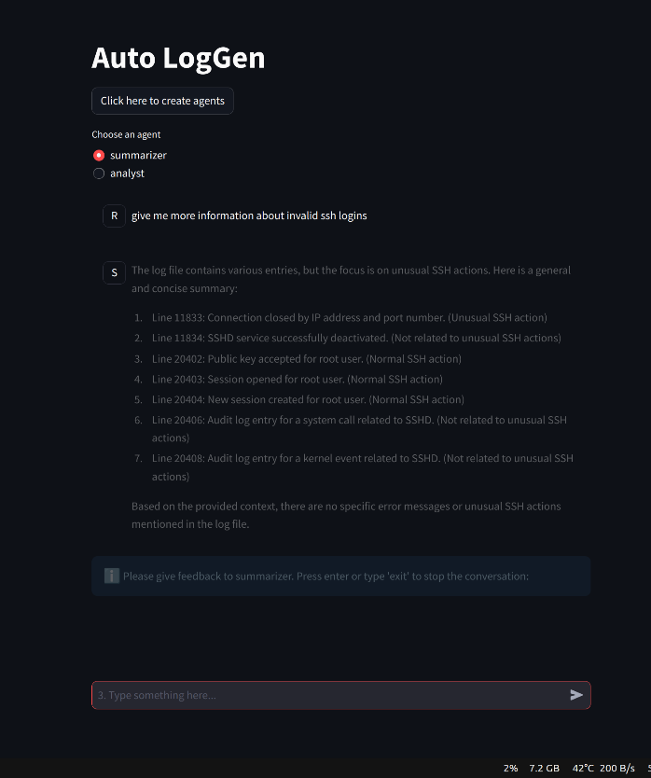
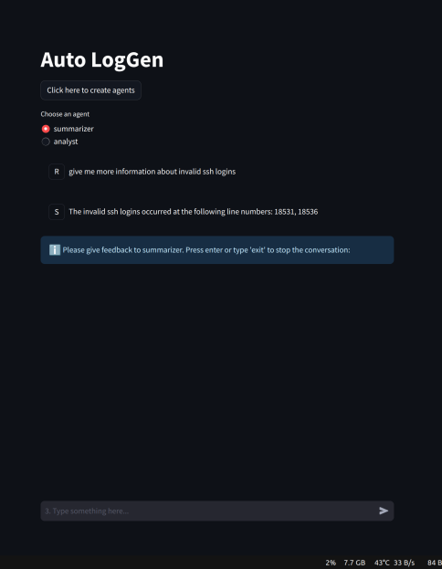
Dynamic Summarization

Slide 6
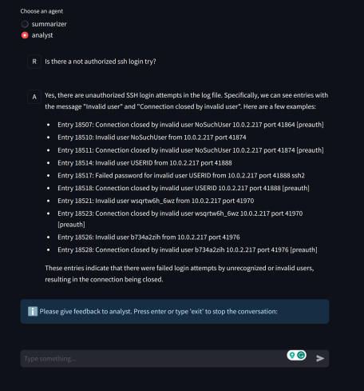
Q & A Tasks
Line Numbers

Slide 7
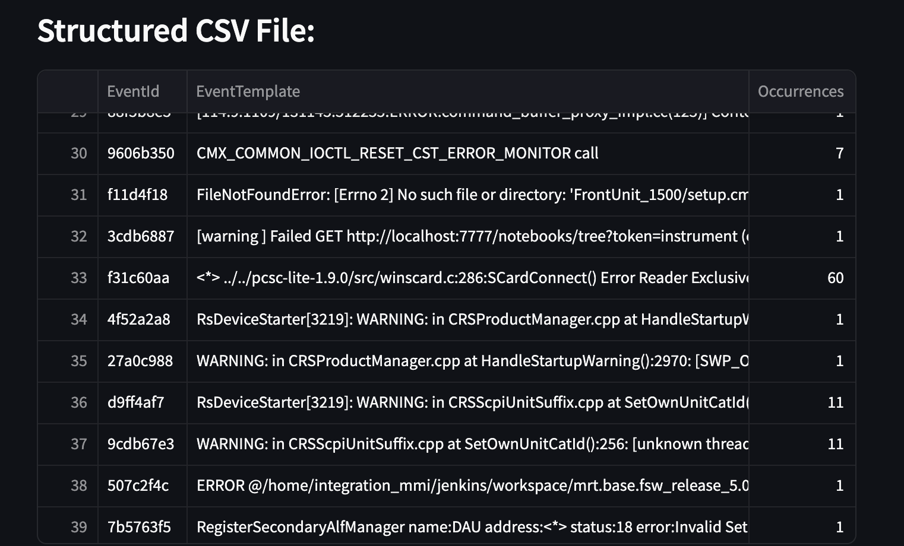
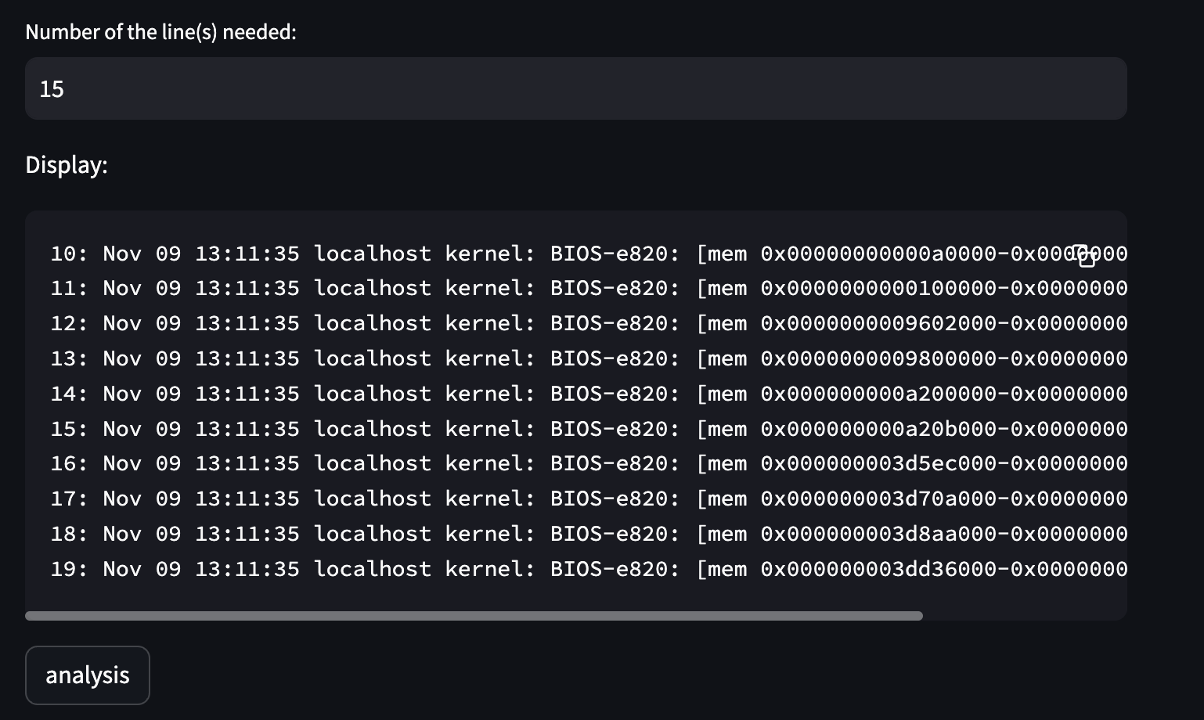

Measurement – classification and trace
Ground Truth from traditional tools
$$x=\frac{Intersection(real error, related error AI find)}{ground truth }$$
Performance on final_logs yet unknown….
BUT 7/7 invalid ssh users found in log_1 !

Slide 8

Any questions?
Thanks for your attention!

Slide 9




We build with…
Python
Autogen
Streamlit
LangChain
LogParser
ChatGPT
…

