Slide 3
Advantages of a Bear Market
Yes there is a positive side to a Bear Market!

Slide 4
Investing in Stocks
Represents ownership in a firm
Earn a return in two ways
Price of the stock rises over time
Dividends are paid to the stockholder
Stockholders have claim on all assets
Right to vote for directors and on certain issues
Two types
Common stock
Right to vote
Receive dividends
Preferred stock
Receive a fixed dividend
Do not usually vote

Slide 5

Investing in Stocks: Sample Corporate Stock Certificate

Slide 6
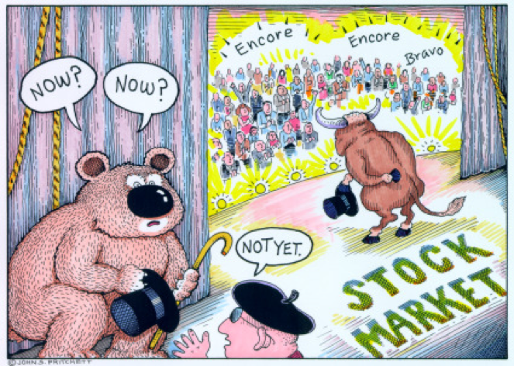
What is a Bear Market?
A decline of 15-20% of the broad market coupled with pessimistic sentiment underlying the stock market.

Slide 7
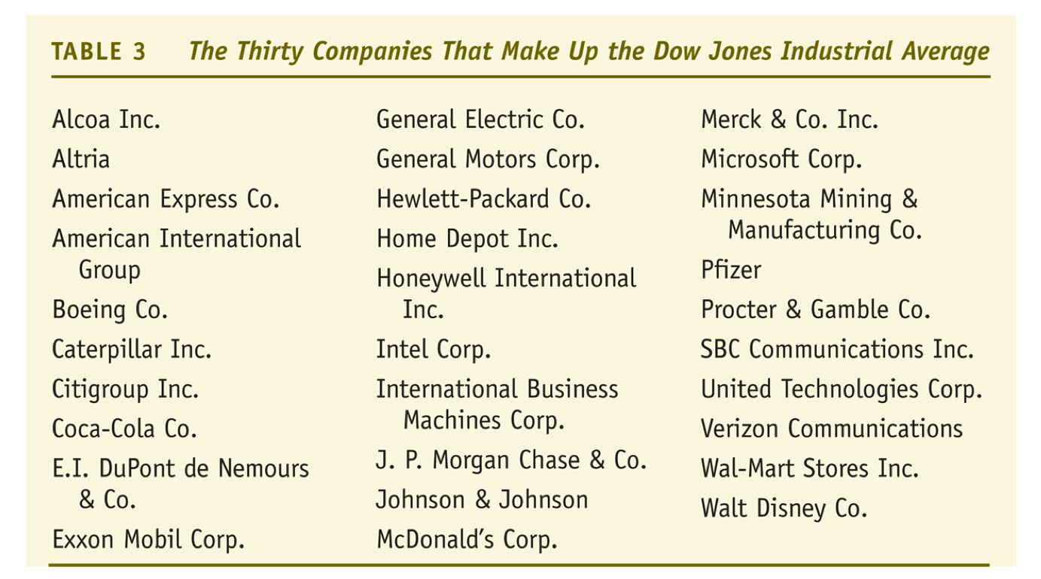
Stock Markets: Dow Jones Industrial Average

Slide 8
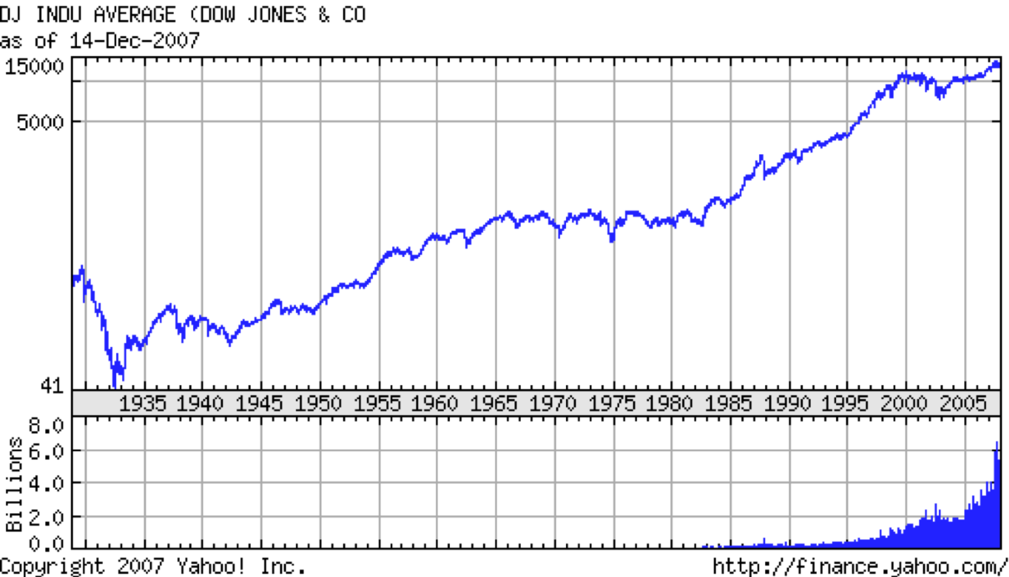
Dow Jones

Slide 9
The Last Bear Market
Sep 30, 2002 Dow 7528
Jan. 5, 2004 Dow 10,568
Oct. 8, 2007 Dow 14093

Slide 10
What do I do in a Bear Market
Decide whether this is a market correction or the start of something more
Review the stocks you own
Review stocks you wanted to own but were too expensive at time of research
Check your portfolio for balance or the type of stocks you own

