Slide 1
MA615 FINAL REPORT

Slide 2
Using Benford's Law to Study the Current Ratio of Corporate Bankruptcy
The current ratio is one of the indicators that analysts use to predict corporate bankruptcy in a financial forecasting period. In this project, Benford’s law is applied to explore whether the distribution of the first leading digits has a pattern that helps analysts be more alert to unusual reports.

Slide 3
INTRODUCTION

Slide 4
The Current Ratio
Current Ratio = Current Assets / Current Liabilities
A term often used in the area of financial analysis. It measures one company’s ability to pay short-term liability and long-term obligations.

Slide 5
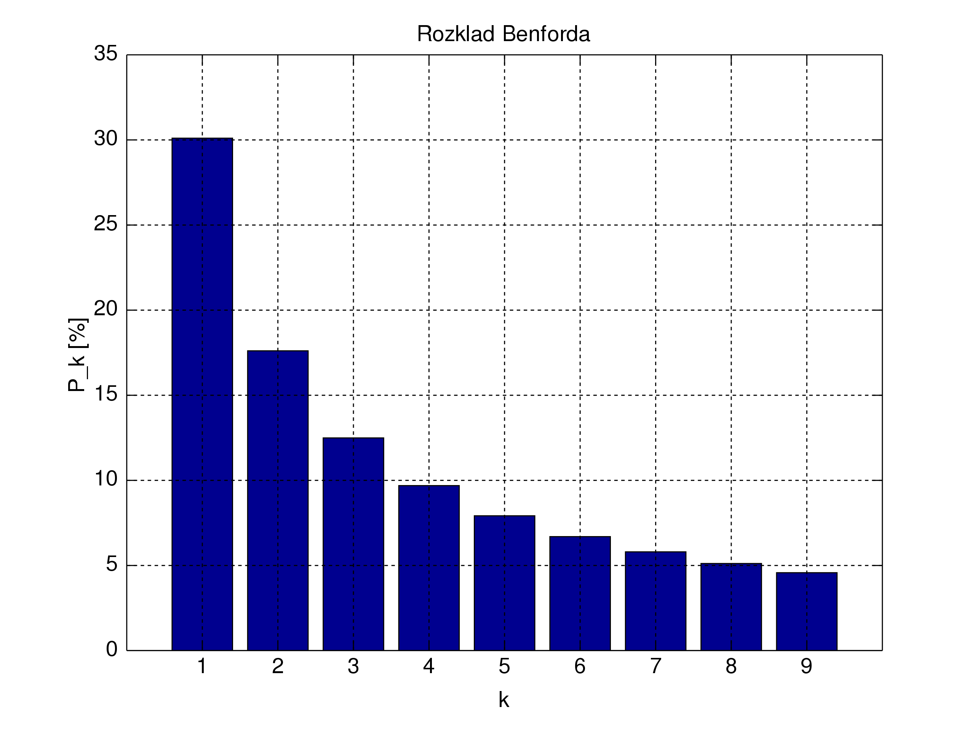
Benford's Law: First Digit Test
The distribution of first digits, according to Benford's law. Each bar represents a digit, and the height of the bar is the percentage of numbers that start with that digit.

Slide 6
Source Data

Slide 7
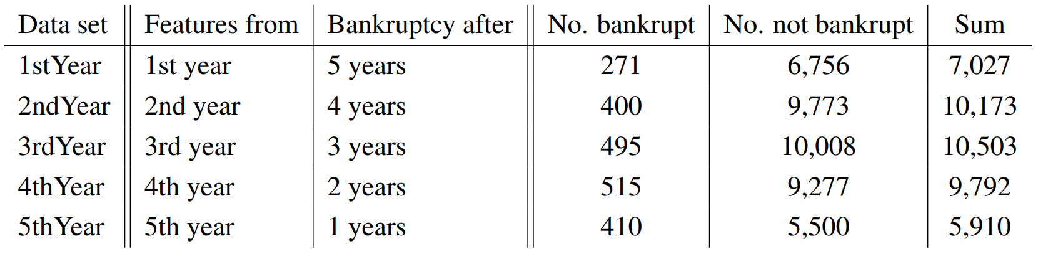
According to UCI Machine Learning Repository, the data is first extracted and used by Zieba, M., Tomczak, S. K., and Tomczak, J. M. (2016)

Slide 8
Analysis

Slide 9
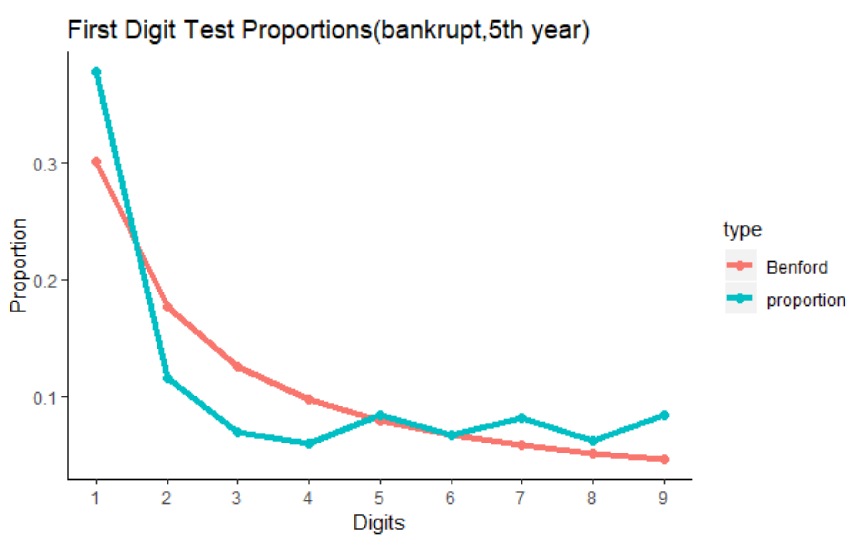
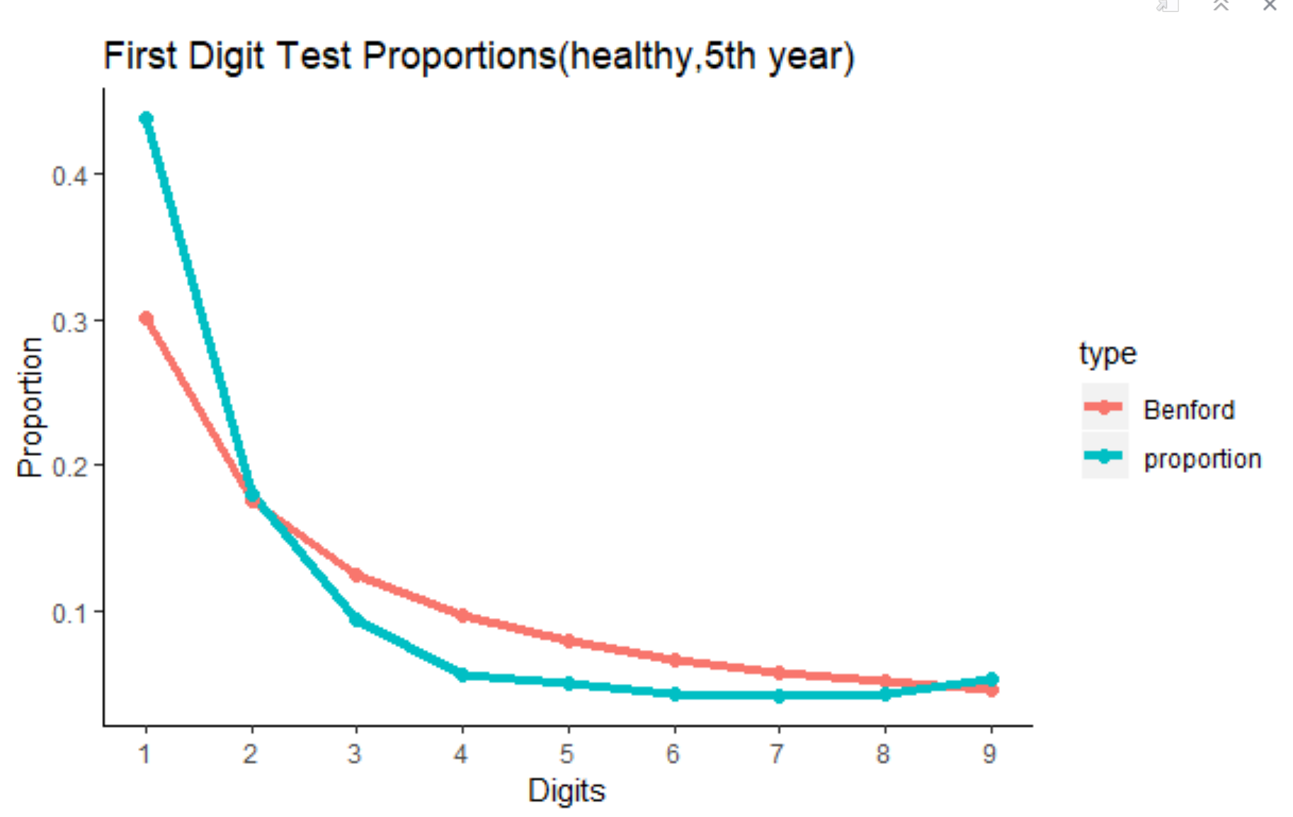
Discovery 1: Significant anomalies occur more with the digits from problematic companies than from the non-problematic

Slide 10
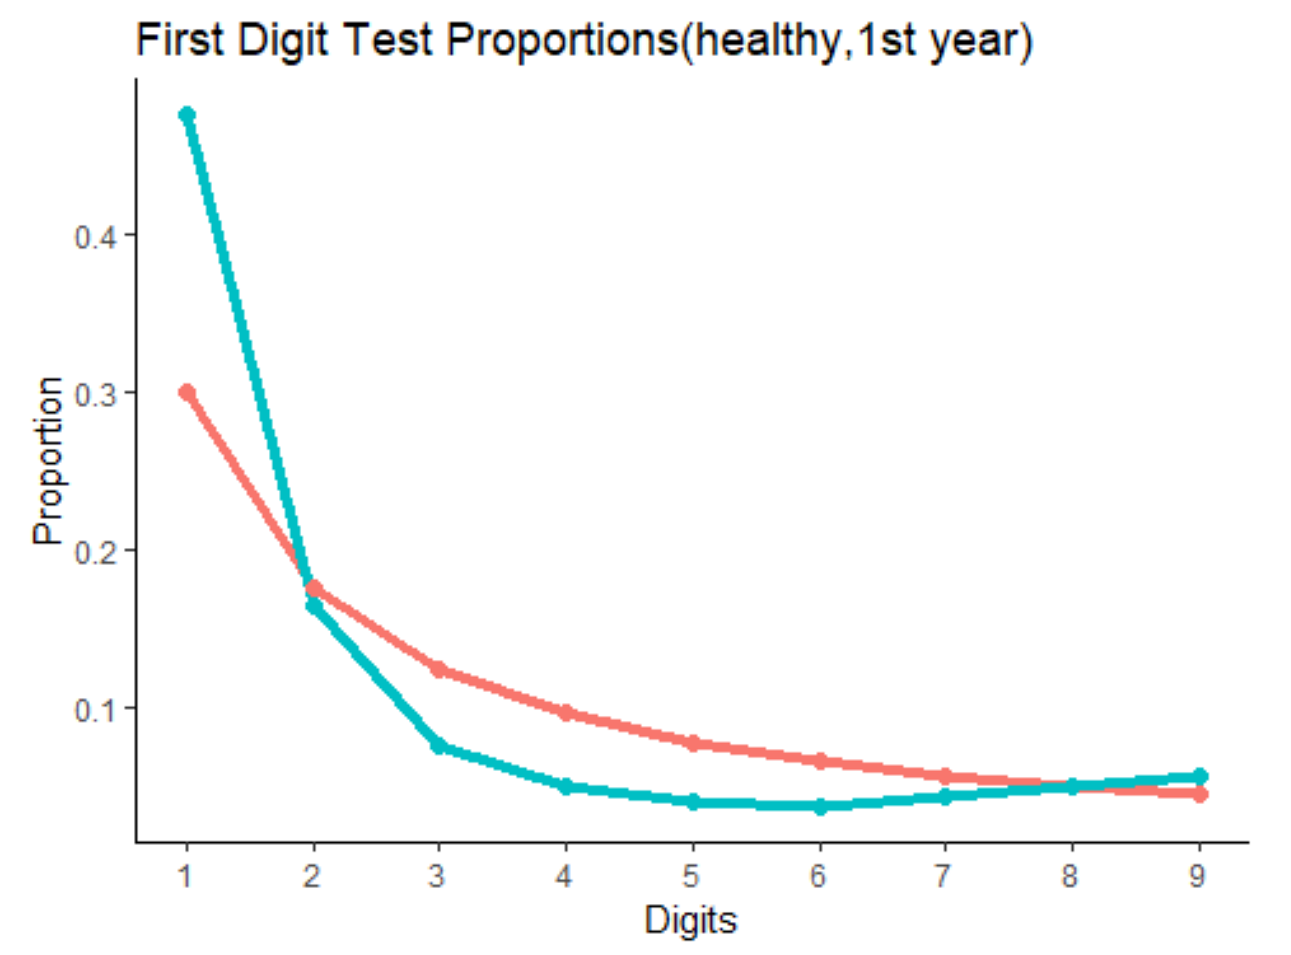
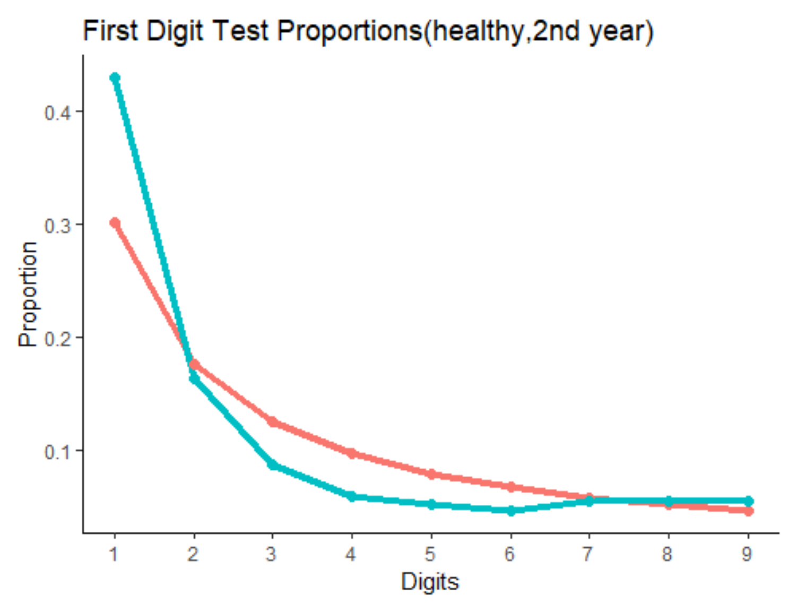
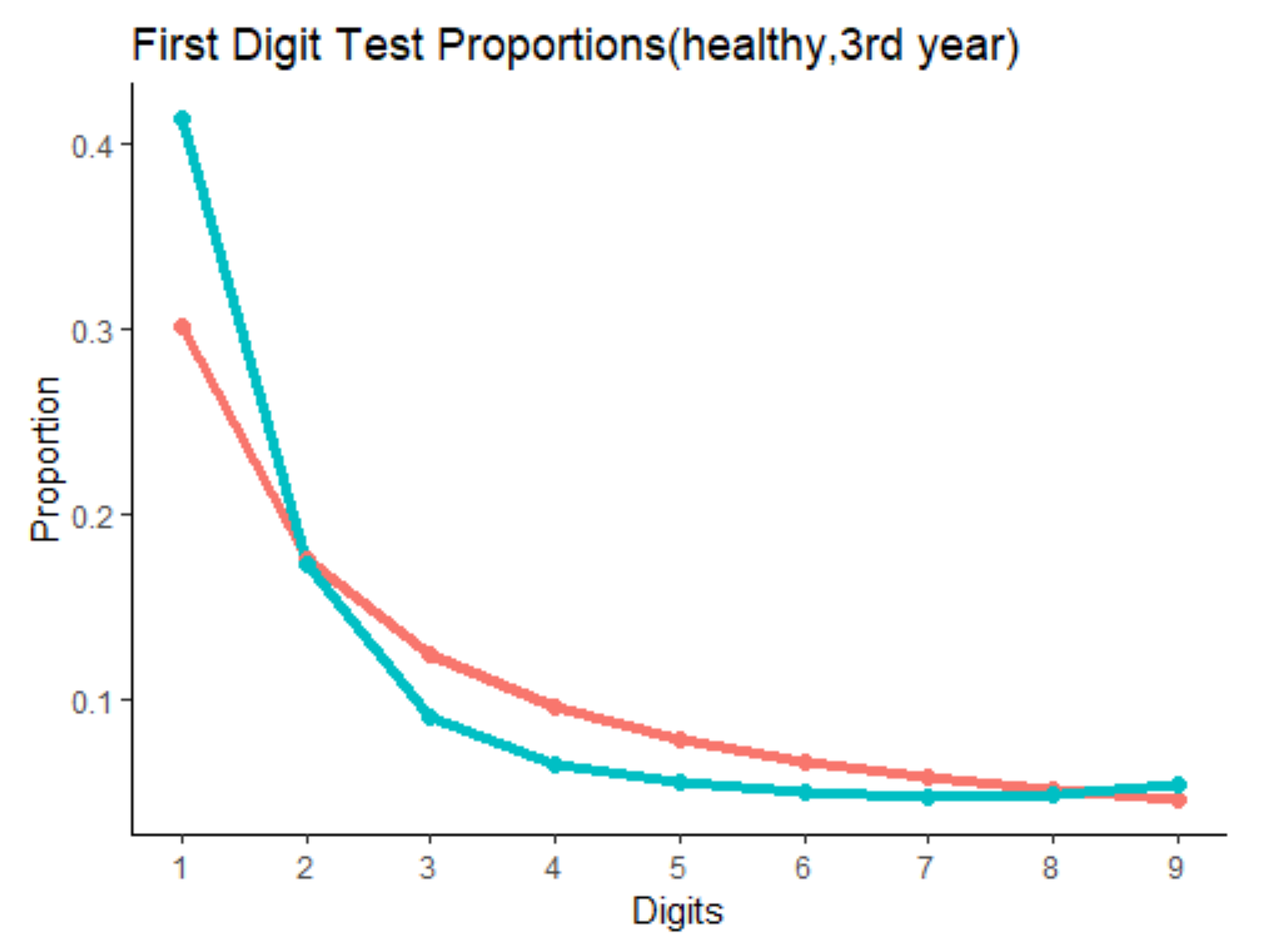
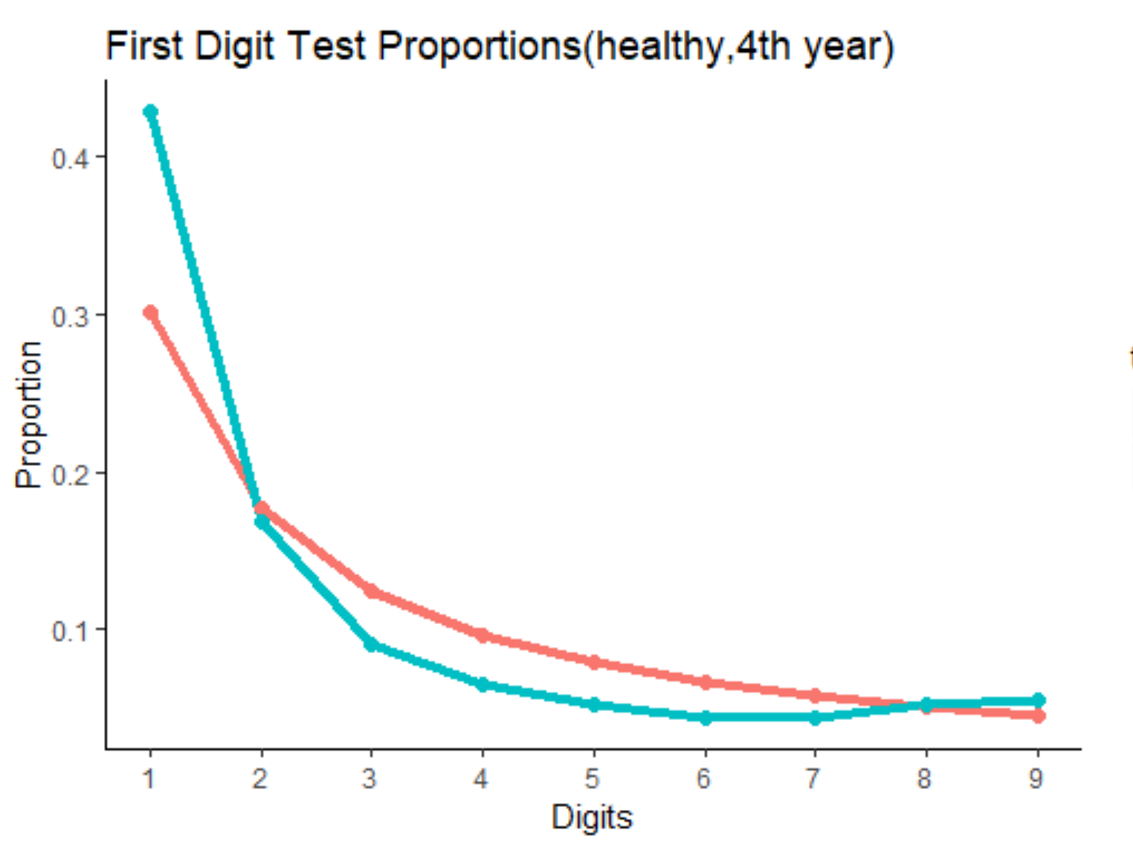
Discovery 2: For financially healthy companies, the shape of the digits frequency is similar to that of theoretical Benford’s Law and does not vary much by year

Slide 11
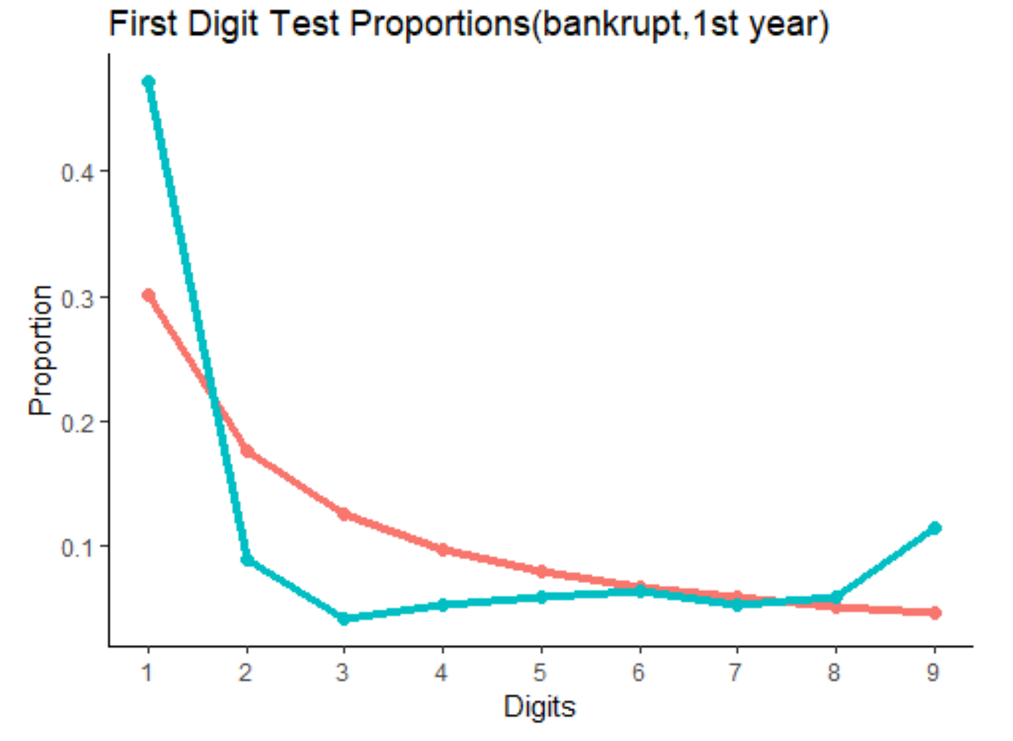
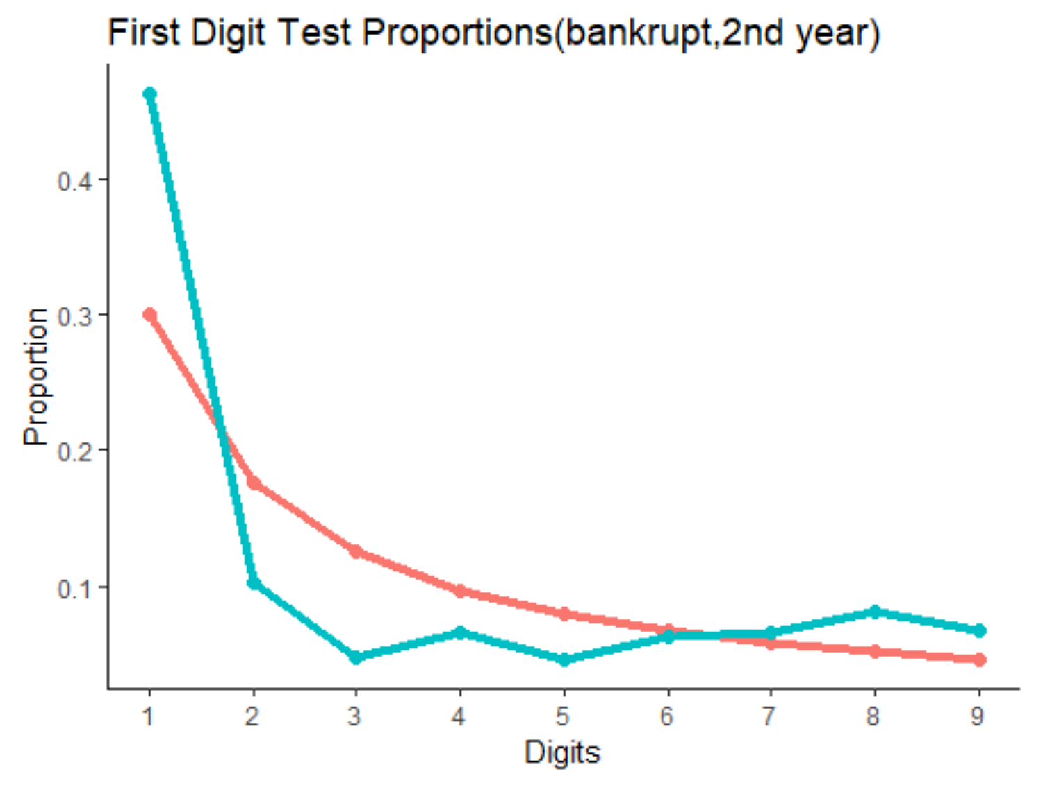
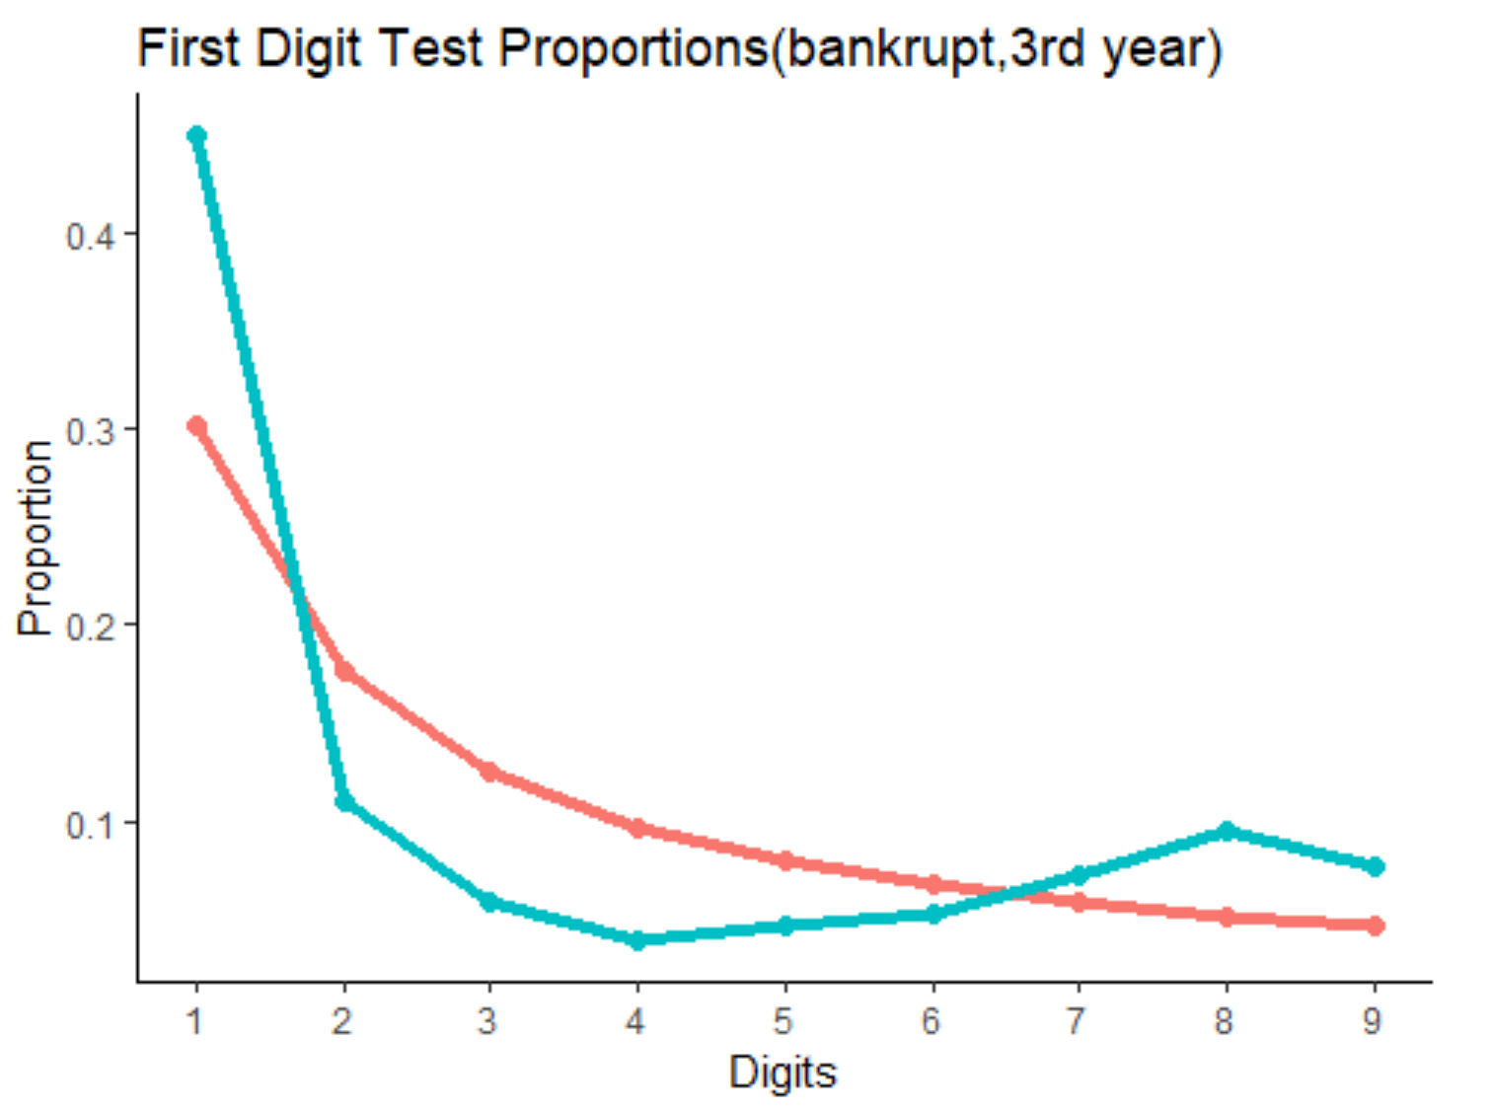
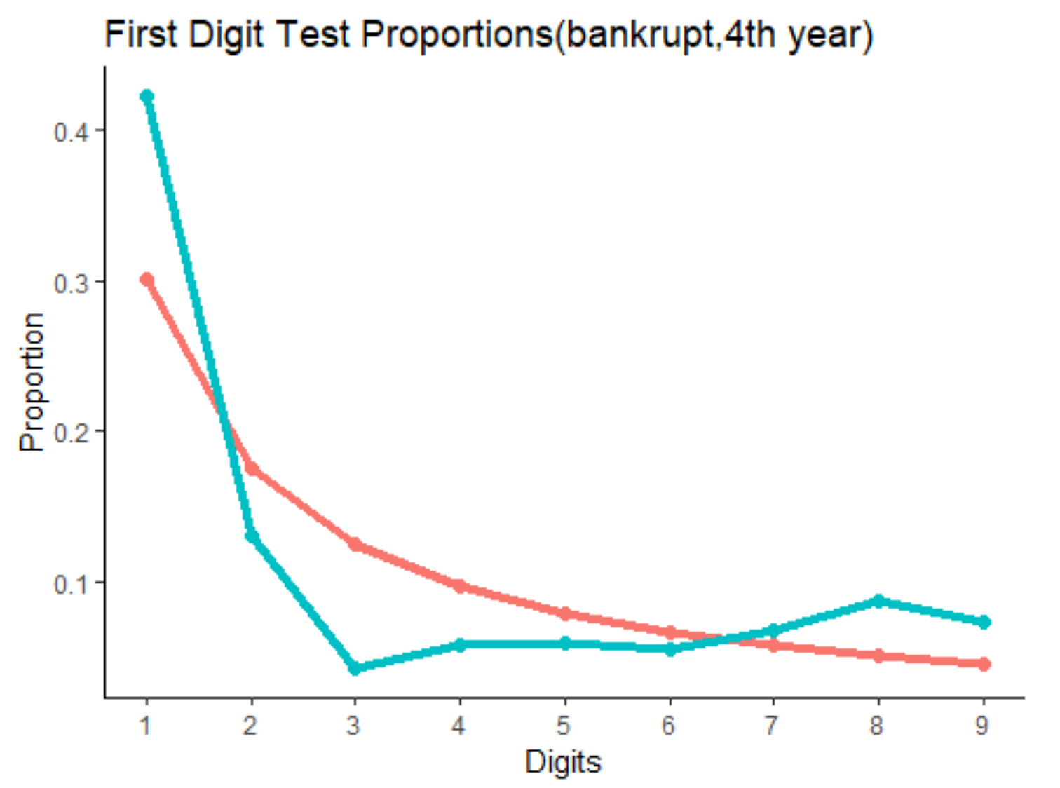
Discovery 3: For bankrupt companies, the tail of the real frequency distribution becomes more and more abnormal as time went closer to the point where it went bankrupt.

Slide 12
Summary
To summarize it, bankrupt companies display a predictable pattern in the manipulation of their current ratio before the year they went bankrupt.
Compared to the frequency of leading digits from companies in good financial status, that of the bankrupt has a heavy tail which can be used as a benchmark in predicting bankruptcy.

Slide 13
Thank you!

