Slide 1

基于Android平台下电力交易推荐系统的研究与实现
我们毕业啦
其实是答辩的标题地方
答辩人
徐振康
指导老师
焦明海 副教授

Slide 2
研究背景
研究方法
研究结果
问题讨论
CONTANTS
论文总结

Slide 3

研究背景
Research Background

Slide 4
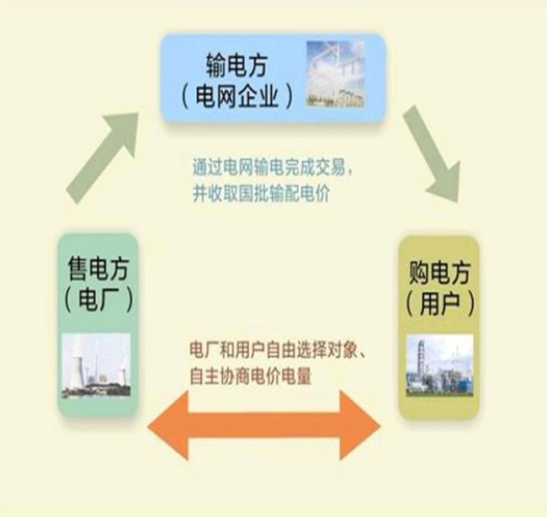
研究背景
研究背景
研究方法
研究结果
问题讨论
论文总结
电力改革
交易模式改变
促进新能源交易比重
Notes:
本文背景是2015年的电力体制改革：
在改革中强调充分发挥电价和交易的市场化作用
交易模式转变成售电方和购电方之间的点对点交易。
符合准入条件的电力用户与发电企业按照自愿参与、自主协商的原则进行的购售电交易，电网企业按规定提供输电服务。

Slide 5
研究背景
研究背景
研究方法
研究结果
问题讨论
论文总结
“
It was the best of times, it was the worst of times; it was the age of wisdom, it was the age of foolishness. It was the epoch of belief, and it was the epoch of incredulity. It was the season of light, and it was the season of darkness. It was the spring of hope, and it was the winter of despair.
It was the best of times, it was the worst of times; it was the age of wisdom, it was the age of foolishness. It was the epoch of belief, and it was the epoch of incredulity. It was the season of light, and it was the season of darkness. It was the spring of hope, and it was the winter of despair.
It was the best of times, it was the worst of times; it was the age of wisdom, it was the age of foolishness. It was the epoch of belief, and it was the epoch of incredulity. It was the season of light, and it was the season of darkness. It was the spring of hope, and it was the winter of despair.
”

Slide 6
研究背景
研究背景
研究方法
研究结果
问题讨论
论文总结
1
It was the best of times, it was the worst of times; it was the age of wisdom, it was the age of foolishness. It was the epoch of belief, and it was the epoch of incredulity. It was the season of light, and it was the season of darkness. It was the spring of hope, and it was the winter of despair.
2
It was the best of times, it was the worst of times; it was the age of wisdom, it was the age of foolishness. It was the epoch of belief, and it was the epoch of incredulity. It was the season of light, and it was the season of darkness. It was the spring of hope, and it was the winter of despair.
3
It was the best of times, it was the worst of times; it was the age of wisdom, it was the age of foolishness. It was the epoch of belief, and it was the epoch of incredulity. It was the season of light, and it was the season of darkness. It was the spring of hope, and it was the winter of despair.

Slide 7
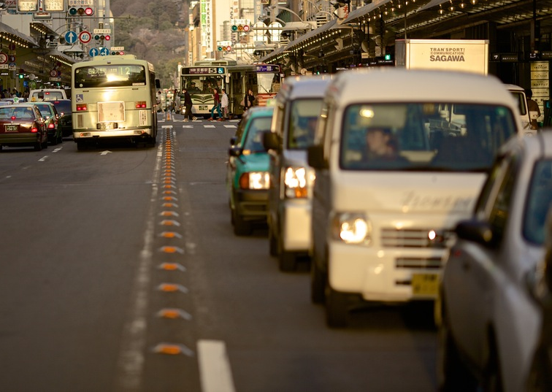
研究背景
研究背景
研究方法
研究结果
问题讨论
论文总结
It was the best of times, it was the worst of times; it was the age of wisdom, it was the age of foolishness. It was the epoch of belief, and it was the epoch of incredulity. It was the season of light, and it was the season of darkness. It was the spring of hope, and it was the winter of despair.
It was the best of times, it was the worst of times; it was the age of wisdom, it was the age of foolishness. It was the epoch of belief, and it was the epoch of incredulity. It was the season of light, and it was the season of darkness. It was the spring of hope, and it was the winter of despair.

Slide 8
研究背景
It was the best of times, it was the worst of times; it was the age of wisdom, it was the age of foolishness.

Slide 9
论文绪论
研究背景
研究方法
研究结果
问题讨论
论文总结
ADD TITLE
It was the best of times, it was the worst of times; it was the age of wisdom, it was the age of foolishness.
ADD TITLE
It was the best of times, it was the worst of times; it was the age of wisdom, it was the age of foolishness.
ADD TITLE
It was the best of times, it was the worst of times; it was the age of wisdom, it was the age of foolishness.

Slide 10
论文绪论
研究背景
研究方法
研究结果
问题讨论
论文总结
TEXT
keyword
TEXT
keyword
keyword
TEXT
keyword
TEXT
TITLE
TITLE
TITLE
TITLE
It was the best of times, it was the worst of times; it was the age of wisdom, it was the age of foolishness. It was the epoch of belief, and it was the epoch of incredulity. It was the season of light, and it was the season of darkness. It was the spring of hope, and it was the winter of despair.
It was the best of times, it was the worst of times; it was the age of wisdom, it was the age of foolishness. It was the epoch of belief, and it was the epoch of incredulity. It was the season of light, and it was the season of darkness. It was the spring of hope, and it was the winter of despair.
It was the best of times, it was the worst of times; it was the age of wisdom, it was the age of foolishness. It was the epoch of belief, and it was the epoch of incredulity. It was the season of light, and it was the season of darkness. It was the spring of hope, and it was the winter of despair.
It was the best of times, it was the worst of times; it was the age of wisdom, it was the age of foolishness. It was the epoch of belief, and it was the epoch of incredulity. It was the season of light, and it was the season of darkness. It was the spring of hope, and it was the winter of despair.

Slide 11
论文绪论
研究背景
研究方法
研究结果
问题讨论
论文总结
TEXT
TEXT
TEXT
TEXT
TEXT
It was the best of times, it was the worst of times; it was the age of wisdom, it was the age of foolishness. It was the epoch of belief, and it was the epoch of incredulity. It was the season of light, and it was the season of darkness. It was the spring of hope, and it was the winter of despair.

Slide 12
研究方法
It was the best of times, it was the worst of times; it was the age of wisdom, it was the age of foolishness.

Slide 13
论文绪论
研究背景
研究方法
研究结果
问题讨论
论文总结
TEXT
TEXT
TEXT
TEXT
It was the best of times, it was the worst of times; it was the age of wisdom, it was the age of foolishness. It was the epoch of belief, and it was the epoch of incredulity.
It was the best of times, it was the worst of times; it was the age of wisdom, it was the age of foolishness. It was the epoch of belief, and it was the epoch of incredulity.
It was the best of times, it was the worst of times; it was the age of wisdom, it was the age of foolishness. It was the epoch of belief, and it was the epoch of incredulity.
It was the best of times, it was the worst of times; it was the age of wisdom, it was the age of foolishness. It was the epoch of belief, and it was the epoch of incredulity.

Slide 14
论文绪论
研究背景
研究方法
研究结果
问题讨论
论文总结
ADD YOUR TITLE
It was the best of times, it was the worst of times; it was the age of wisdom, it was the age of foolishness. It was the epoch of belief, and it was the epoch of incredulity. It was the season of light, and it was the season of darkness. It was the spring of hope, and it was the winter of despair.
ADD YOUR TITLE
It was the best of times, it was the worst of times; it was the age of wisdom, it was the age of foolishness. It was the epoch of belief, and it was the epoch of incredulity. It was the season of light, and it was the season of darkness. It was the spring of hope, and it was the winter of despair.

Slide 15
论文绪论
研究背景
研究方法
研究结果
问题讨论
论文总结
ADD TITLE
ADD TITLE
It was the best of times, it was the worst of times; it was the age of wisdom, it was the age of foolishness.
It was the best of times, it was the worst of times; it was the age of wisdom, it was the age of foolishness.
ADD TITLE
ADD TITLE
It was the best of times, it was the worst of times; it was the age of wisdom, it was the age of foolishness.
It was the best of times, it was the worst of times; it was the age of wisdom, it was the age of foolishness.

Slide 16
研究结果
It was the best of times, it was the worst of times; it was the age of wisdom, it was the age of foolishness.

Slide 17
论文绪论
研究背景
研究方法
研究结果
问题讨论
论文总结
It was the best of times, it was the worst of times; it was the age of wisdom, it was the age of foolishness.
It was the best of times, it was the worst of times; it was the age of wisdom, it was the age of foolishness.

Slide 18
论文绪论
研究背景
研究方法
研究结果
问题讨论
论文总结
TEXT
TEXT
TEXT
It was the best of times, it was the worst of times; it was the age of wisdom, it was the age of foolishness. It was the epoch of belief, and it was the epoch of incredulity. It was the season of light, and it was the season of darkness. It was the spring of hope, and it was the winter of despair.

Slide 19
论文绪论
研究背景
研究方法
研究结果
问题讨论
论文总结
It was the best of times, it was the worst of times; it was the age of wisdom, it was the age of foolishness.

Slide 20
问题讨论
It was the best of times, it was the worst of times; it was the age of wisdom, it was the age of foolishness.

Slide 21
论文绪论
研究背景
研究方法
研究结果
问题讨论
论文总结
ADD TITLE
ADD TITLE
It was the best of times, it was the worst of times; it was the age of wisdom, it was the age of foolishness.
s
It was the best of times, it was the worst of times; it was the age of wisdom, it was the age of foolishness.
T
TEXT
w
o
ADD TITLE
ADD TITLE
It was the best of times, it was the worst of times; it was the age of wisdom, it was the age of foolishness.
It was the best of times, it was the worst of times; it was the age of wisdom, it was the age of foolishness.

Slide 22
论文绪论
研究背景
研究方法
研究结果
问题讨论
论文总结
ADD YOUR TITLE
1
It was the best of times, it was the worst of times; it was the age of wisdom, it was the age of foolishness. It was the epoch of belief, and it was the epoch of incredulity. It was the season of light, and it was the season of darkness. It was the spring of hope, and it was the winter of despair.
TEXT
ADD YOUR TITLE
It was the best of times, it was the worst of times; it was the age of wisdom, it was the age of foolishness. It was the epoch of belief, and it was the epoch of incredulity. It was the season of light, and it was the season of darkness. It was the spring of hope, and it was the winter of despair.
2
3
ADD YOUR TITLE
It was the best of times, it was the worst of times; it was the age of wisdom, it was the age of foolishness. It was the epoch of belief, and it was the epoch of incredulity. It was the season of light, and it was the season of darkness. It was the spring of hope, and it was the winter of despair.

Slide 23
论文总结
It was the best of times, it was the worst of times; it was the age of wisdom, it was the age of foolishness.

Slide 24
论文绪论
研究背景
研究方法
研究结果
问题讨论
论文总结
ADD YOUR TITLE
A
It was the best of times, it was the worst of times; it was the age of wisdom, it was the age of foolishness. It was the epoch of belief, and it was the epoch of incredulity. It was the season of light, and it was the season of darkness. It was the spring of hope, and it was the winter of despair.
ADD YOUR TITLE
B
It was the best of times, it was the worst of times; it was the age of wisdom, it was the age of foolishness. It was the epoch of belief, and it was the epoch of incredulity. It was the season of light, and it was the season of darkness. It was the spring of hope, and it was the winter of despair.
ADD YOUR TITLE
C
It was the best of times, it was the worst of times; it was the age of wisdom, it was the age of foolishness. It was the epoch of belief, and it was the epoch of incredulity. It was the season of light, and it was the season of darkness. It was the spring of hope, and it was the winter of despair.

Slide 25
THANKS
NAME
DAMEN

