Slide 1
LOGO
XX学校
我们毕业啦
其实是答辩的标题地方
扁平蓝色毕业答辩PPT模版第一PPT模板网-WWW.1PPT.COM
答辩人
李某某
指导老师
XX教授

Slide 2
论文绪论
研究背景
研究方法
研究结果
CONTANTS
问题讨论
论文总结

Slide 3

论文绪论
It was the best of times, it was the worst of times; it was the age of wisdom, it was the age of foolishness.

Slide 4
论文绪论
研究背景
研究方法
研究结果
问题讨论
论文总结
“
It was the best of times, it was the worst of times; it was the age of wisdom, it was the age of foolishness. It was the epoch of belief, and it was the epoch of incredulity. It was the season of light, and it was the season of darkness. It was the spring of hope, and it was the winter of despair.
It was the best of times, it was the worst of times; it was the age of wisdom, it was the age of foolishness. It was the epoch of belief, and it was the epoch of incredulity. It was the season of light, and it was the season of darkness. It was the spring of hope, and it was the winter of despair.
It was the best of times, it was the worst of times; it was the age of wisdom, it was the age of foolishness. It was the epoch of belief, and it was the epoch of incredulity. It was the season of light, and it was the season of darkness. It was the spring of hope, and it was the winter of despair.
”

Slide 5
论文绪论
研究背景
研究方法
研究结果
问题讨论
论文总结
1
It was the best of times, it was the worst of times; it was the age of wisdom, it was the age of foolishness. It was the epoch of belief, and it was the epoch of incredulity. It was the season of light, and it was the season of darkness. It was the spring of hope, and it was the winter of despair.
2
It was the best of times, it was the worst of times; it was the age of wisdom, it was the age of foolishness. It was the epoch of belief, and it was the epoch of incredulity. It was the season of light, and it was the season of darkness. It was the spring of hope, and it was the winter of despair.
3
It was the best of times, it was the worst of times; it was the age of wisdom, it was the age of foolishness. It was the epoch of belief, and it was the epoch of incredulity. It was the season of light, and it was the season of darkness. It was the spring of hope, and it was the winter of despair.

Slide 6
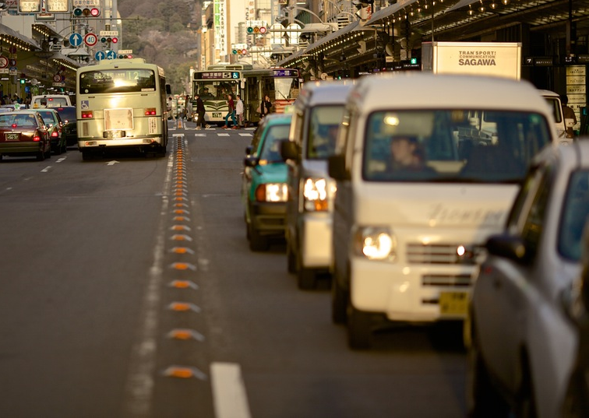
论文绪论
研究背景
研究方法
研究结果
问题讨论
论文总结
It was the best of times, it was the worst of times; it was the age of wisdom, it was the age of foolishness. It was the epoch of belief, and it was the epoch of incredulity. It was the season of light, and it was the season of darkness. It was the spring of hope, and it was the winter of despair.
It was the best of times, it was the worst of times; it was the age of wisdom, it was the age of foolishness. It was the epoch of belief, and it was the epoch of incredulity. It was the season of light, and it was the season of darkness. It was the spring of hope, and it was the winter of despair.

Slide 7
研究背景
It was the best of times, it was the worst of times; it was the age of wisdom, it was the age of foolishness.

Slide 8
论文绪论
研究背景
研究方法
研究结果
问题讨论
论文总结
ADD TITLE
It was the best of times, it was the worst of times; it was the age of wisdom, it was the age of foolishness.
ADD TITLE
It was the best of times, it was the worst of times; it was the age of wisdom, it was the age of foolishness.
ADD TITLE
It was the best of times, it was the worst of times; it was the age of wisdom, it was the age of foolishness.

Slide 9
论文绪论
研究背景
研究方法
研究结果
问题讨论
论文总结
TEXT
keyword
TEXT
keyword
keyword
TEXT
keyword
TEXT
TITLE
TITLE
TITLE
TITLE
It was the best of times, it was the worst of times; it was the age of wisdom, it was the age of foolishness. It was the epoch of belief, and it was the epoch of incredulity. It was the season of light, and it was the season of darkness. It was the spring of hope, and it was the winter of despair.
It was the best of times, it was the worst of times; it was the age of wisdom, it was the age of foolishness. It was the epoch of belief, and it was the epoch of incredulity. It was the season of light, and it was the season of darkness. It was the spring of hope, and it was the winter of despair.
It was the best of times, it was the worst of times; it was the age of wisdom, it was the age of foolishness. It was the epoch of belief, and it was the epoch of incredulity. It was the season of light, and it was the season of darkness. It was the spring of hope, and it was the winter of despair.
It was the best of times, it was the worst of times; it was the age of wisdom, it was the age of foolishness. It was the epoch of belief, and it was the epoch of incredulity. It was the season of light, and it was the season of darkness. It was the spring of hope, and it was the winter of despair.

Slide 10
论文绪论
研究背景
研究方法
研究结果
问题讨论
论文总结
TEXT
TEXT
TEXT
TEXT
TEXT
It was the best of times, it was the worst of times; it was the age of wisdom, it was the age of foolishness. It was the epoch of belief, and it was the epoch of incredulity. It was the season of light, and it was the season of darkness. It was the spring of hope, and it was the winter of despair.

Slide 11
研究方法
It was the best of times, it was the worst of times; it was the age of wisdom, it was the age of foolishness.

Slide 12
论文绪论
研究背景
研究方法
研究结果
问题讨论
论文总结
TEXT
TEXT
TEXT
TEXT
It was the best of times, it was the worst of times; it was the age of wisdom, it was the age of foolishness. It was the epoch of belief, and it was the epoch of incredulity.
It was the best of times, it was the worst of times; it was the age of wisdom, it was the age of foolishness. It was the epoch of belief, and it was the epoch of incredulity.
It was the best of times, it was the worst of times; it was the age of wisdom, it was the age of foolishness. It was the epoch of belief, and it was the epoch of incredulity.
It was the best of times, it was the worst of times; it was the age of wisdom, it was the age of foolishness. It was the epoch of belief, and it was the epoch of incredulity.

Slide 13
论文绪论
研究背景
研究方法
研究结果
问题讨论
论文总结
ADD YOUR TITLE
It was the best of times, it was the worst of times; it was the age of wisdom, it was the age of foolishness. It was the epoch of belief, and it was the epoch of incredulity. It was the season of light, and it was the season of darkness. It was the spring of hope, and it was the winter of despair.
ADD YOUR TITLE
It was the best of times, it was the worst of times; it was the age of wisdom, it was the age of foolishness. It was the epoch of belief, and it was the epoch of incredulity. It was the season of light, and it was the season of darkness. It was the spring of hope, and it was the winter of despair.

Slide 14
论文绪论
研究背景
研究方法
研究结果
问题讨论
论文总结
ADD TITLE
ADD TITLE
It was the best of times, it was the worst of times; it was the age of wisdom, it was the age of foolishness.
It was the best of times, it was the worst of times; it was the age of wisdom, it was the age of foolishness.
ADD TITLE
ADD TITLE
It was the best of times, it was the worst of times; it was the age of wisdom, it was the age of foolishness.
It was the best of times, it was the worst of times; it was the age of wisdom, it was the age of foolishness.

Slide 15
研究结果
It was the best of times, it was the worst of times; it was the age of wisdom, it was the age of foolishness.

Slide 16
论文绪论
研究背景
研究方法
研究结果
问题讨论
论文总结
It was the best of times, it was the worst of times; it was the age of wisdom, it was the age of foolishness.
It was the best of times, it was the worst of times; it was the age of wisdom, it was the age of foolishness.

Slide 17
论文绪论
研究背景
研究方法
研究结果
问题讨论
论文总结
TEXT
TEXT
TEXT
It was the best of times, it was the worst of times; it was the age of wisdom, it was the age of foolishness. It was the epoch of belief, and it was the epoch of incredulity. It was the season of light, and it was the season of darkness. It was the spring of hope, and it was the winter of despair.
毕业论文题目

Slide 18
论文绪论
研究背景
研究方法
研究结果
问题讨论
论文总结
It was the best of times, it was the worst of times; it was the age of wisdom, it was the age of foolishness.

Slide 19
问题讨论
It was the best of times, it was the worst of times; it was the age of wisdom, it was the age of foolishness.

Slide 20
论文绪论
研究背景
研究方法
研究结果
问题讨论
论文总结
ADD TITLE
ADD TITLE
It was the best of times, it was the worst of times; it was the age of wisdom, it was the age of foolishness.
s
It was the best of times, it was the worst of times; it was the age of wisdom, it was the age of foolishness.
T
TEXT
w
o
ADD TITLE
ADD TITLE
It was the best of times, it was the worst of times; it was the age of wisdom, it was the age of foolishness.
It was the best of times, it was the worst of times; it was the age of wisdom, it was the age of foolishness.

Slide 21
论文绪论
研究背景
研究方法
研究结果
问题讨论
论文总结
ADD YOUR TITLE
1
It was the best of times, it was the worst of times; it was the age of wisdom, it was the age of foolishness. It was the epoch of belief, and it was the epoch of incredulity. It was the season of light, and it was the season of darkness. It was the spring of hope, and it was the winter of despair.
TEXT
ADD YOUR TITLE
It was the best of times, it was the worst of times; it was the age of wisdom, it was the age of foolishness. It was the epoch of belief, and it was the epoch of incredulity. It was the season of light, and it was the season of darkness. It was the spring of hope, and it was the winter of despair.
2
3
ADD YOUR TITLE
It was the best of times, it was the worst of times; it was the age of wisdom, it was the age of foolishness. It was the epoch of belief, and it was the epoch of incredulity. It was the season of light, and it was the season of darkness. It was the spring of hope, and it was the winter of despair.

Slide 22
论文总结
It was the best of times, it was the worst of times; it was the age of wisdom, it was the age of foolishness.

Slide 23
论文绪论
研究背景
研究方法
研究结果
问题讨论
论文总结
ADD YOUR TITLE
A
It was the best of times, it was the worst of times; it was the age of wisdom, it was the age of foolishness. It was the epoch of belief, and it was the epoch of incredulity. It was the season of light, and it was the season of darkness. It was the spring of hope, and it was the winter of despair.
ADD YOUR TITLE
B
It was the best of times, it was the worst of times; it was the age of wisdom, it was the age of foolishness. It was the epoch of belief, and it was the epoch of incredulity. It was the season of light, and it was the season of darkness. It was the spring of hope, and it was the winter of despair.
ADD YOUR TITLE
C
It was the best of times, it was the worst of times; it was the age of wisdom, it was the age of foolishness. It was the epoch of belief, and it was the epoch of incredulity. It was the season of light, and it was the season of darkness. It was the spring of hope, and it was the winter of despair.

Slide 24
THANKS
NAME
DAMEN

Slide 25



可以在下列情况使用
不限次数的用于您个人/公司、企业的商业演示。
拷贝模板中的内容用于其它幻灯片母版中使用。
不可以在以下情况使用
用于任何形式的在线付费下载。
收集整理我们发布的免费资源后，刻录光碟销售。
PPT模板下载：www.1ppt.com/moban/ 行业PPT模板：www.1ppt.com/hangye/
节日PPT模板：www.1ppt.com/jieri/ PPT素材下载：www.1ppt.com/sucai/
PPT背景图片：www.1ppt.com/beijing/ PPT图表下载：www.1ppt.com/tubiao/
优秀PPT下载：www.1ppt.com/xiazai/ PPT教程： www.1ppt.com/powerpoint/
Word教程： www.1ppt.com/word/ Excel教程： www.1ppt.com/excel/
资料下载： www.1ppt.com/ziliao/ PPT课件下载：www.1ppt.com/kejian/
范文下载： www.1ppt.com/fanwen/ 试卷下载： www.1ppt.com/shiti/
教案下载： www.1ppt.com/jiaoan/ PPT论坛： www.1ppt.cn

