Slide 1
Bayesian Matting
THE PLAN
Presenter/s Name — Calibri Bold 16pt
Title — Calibri Regular 16pt
Date 00/00/00

Slide 2
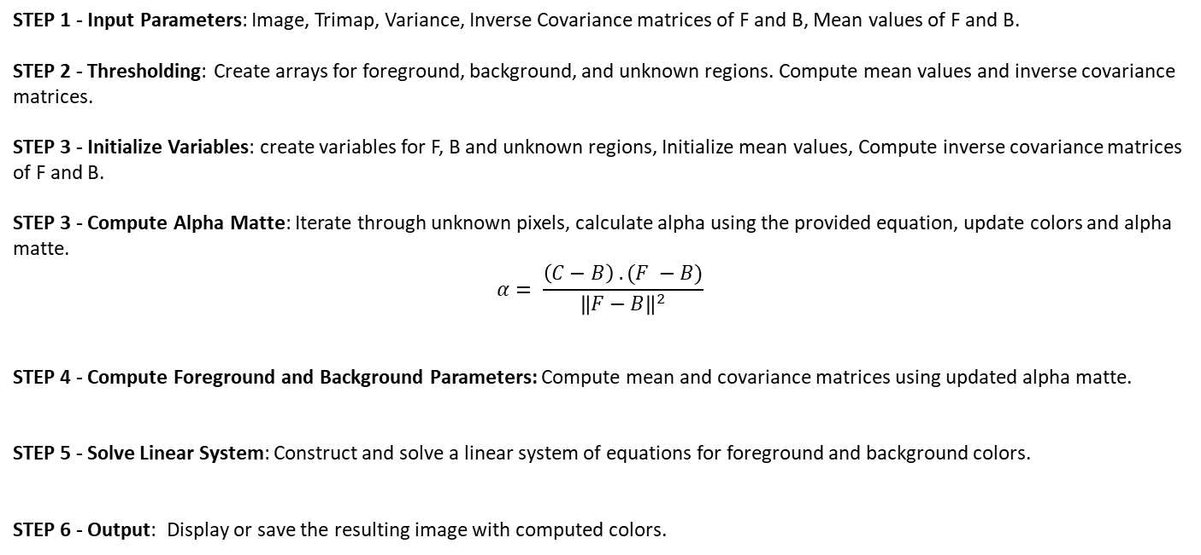
Algorithm
STEP 1 - Input Parameters: Image, Trimap, Variance, Inverse Covariance matrices of F and B, Mean values of F and B.
STEP 2 - Thresholding: Create arrays for foreground, background, and unknown regions. Compute mean values and inverse covariance matrices.
STEP 3 - Initialize Variables: create variables for F, B and unknown regions, Initialize mean values, Compute inverse covariance matrices of F and B.
STEP 3 - Compute Alpha Matte: Iterate through unknown pixels, calculate alpha using the provided equation, update colors and alpha matte.
$$α= \frac{\left(C−B\right) . (F −B)}{{\left\|F−B\right\|}^{2}}$$ STEP 4 - Compute Foreground and Background Parameters: Compute mean and covariance matrices using updated alpha matte.
STEP 5 - Solve Linear System: Construct and solve a linear system of equations for foreground and background colors.
STEP 6 - Output: Display or save the resulting image with computed colors.
2

Slide 3


Flow diagram of implementation
Start
Images
Input
Thresholding
Initialise variables
$σ_{c}^{2}$, $σ_{f, }^{−1},σ_{b }^{−1},\overline{B}, \overline{F}$
Foreground
Background
$$α= \frac{\left(C−B\right) . (F −B)}{{\left\|F−B\right\|}^{2}}$$
Compute alpha matte
Compute F and B parameters
Solve linear system
Output
Images with computed colours
Stop
3

Slide 4
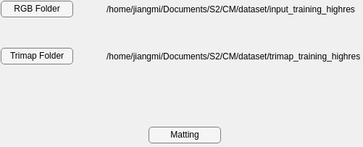
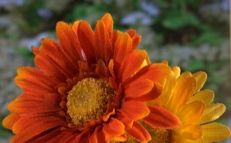

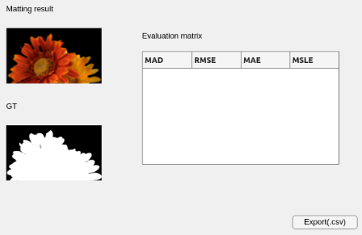
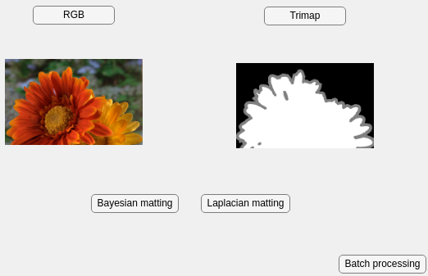
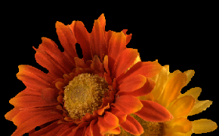

Code structure
Subfunction and GUI
Read image
Input:
Image path
Output:
Image data
Batch input
Match image
Input:
Image data
Output :
Mean,
Covariance
Matting image
Input:
Mean,
Covariance
Output :
Foreground,
Background
Output and evaluation
Single input
Key takeaway: Use three main functions to read, match and matting images. With the help of GUI, it can operate easily.

Slide 5
Unit test
matlab.unittest.TestCase
Resolution: Limitations on input images, Whether the input and output match.
Read Image
Channel: 3-channel image，1-channel trimap.
Match Image
Correctness: Calculate the mean and variance correctly
Position x, y: Checking that the positional values are within the resolution range.
Matting
Alpha: Checking that the Alpha within the range [0, 1].

Slide 6
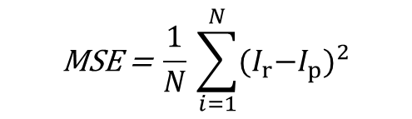
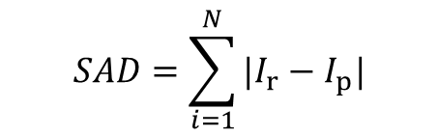
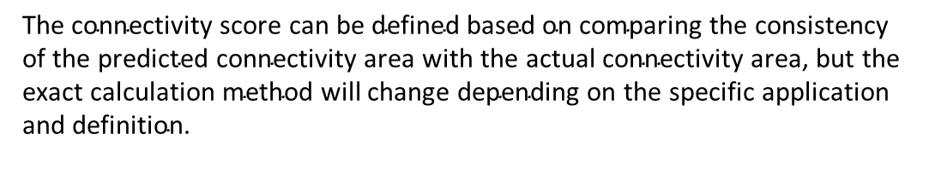
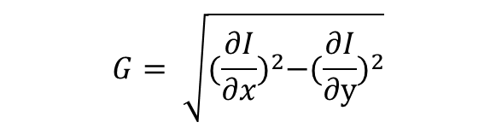
Evaluation
$$SAD=\sum_{i=1}^{N}{{|I}_{r}−I_{p}|}$$
SAD (Sum of Absolute Differences):
MSE (Mean Squared Error):
Gradient:
Connectivity:
$$\text{MSE} \text{=} \frac{1}{N}\text{​}\sum_{i=1}^{N}{{{(I}_{r}−I_{p})}^{2}}$$
$$G= \sqrt{{(\frac{∂I}{∂x})}^{2}−{(\frac{∂I}{∂y})}^{2}}$$
$$\text{The} \text{connectivity} \text{score} \text{can} \text{be} \text{defined} \text{based} \text{on} \text{comparing} \text{the} \text{consistency} \text{of} \text{the} \text{predicted} \text{connectivity} \text{area} \text{with} \text{the} \text{actual} \text{connectivity} \text{area}\text{, }\text{but} \text{the} \text{exact} \text{calculation} \text{method} \text{will} \text{change} \text{depending} \text{on} \text{the} \text{specific} \text{application} \text{and} \text{definition}\text{.}$$

Slide 7
Thank You

