Slide 1
Bayesian Matting
Subtitle — Calibri Regular 16pt
Presenter/s Name — Calibri Bold 16pt
Title — Calibri Regular 16pt
Date 00/00/00

Slide 2
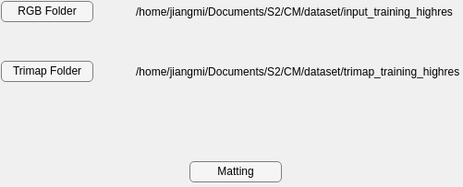


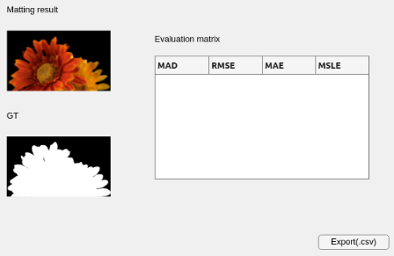
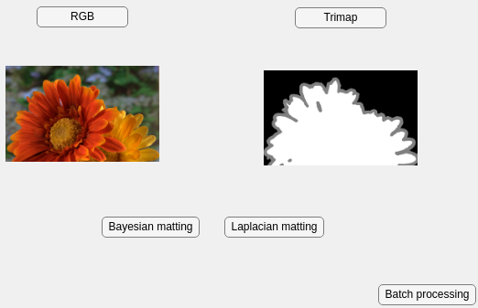


Code structure
Subfunction and GUI
Read image
Input:
Image path
Output:
Image data
Batch input
Match image
Input:
Image data
Output :
Mean,
Covariance
Matting image
Input:
Mean,
Covariance
Output :
Foreground,
Background
Output and evaluation
Single input
Key takeaway: Use three main functions to read, match and matting images. With the help of GUI, it can operate easily.

Slide 3
Thank You

