Slide 1
Bayesian Matting
Subtitle — Calibri Regular 16pt
Presenter/s Name — Calibri Bold 16pt
Title — Calibri Regular 16pt
Date 00/00/00

Slide 2
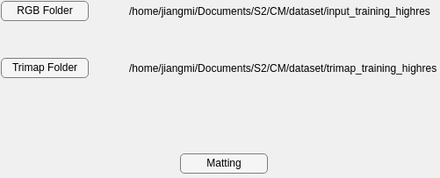
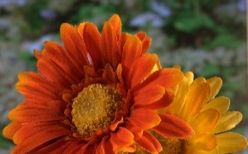

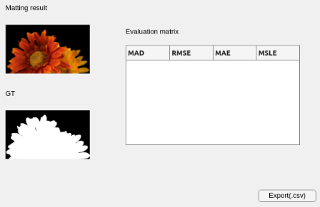
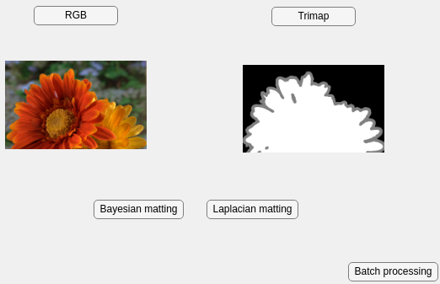
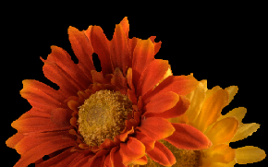

Code structure
Subfunction and GUI
Read image
Input:
Image path
Output:
Image data
Batch input
Match image
Input:
Image data
Output :
Mean,
Covariance
Matting image
Input:
Mean,
Covariance
Output :
Foreground,
Background
Output and evaluation
Single input
Key takeaway: Use three main functions to read, match and matting images. With the help of GUI, it can operate easily.

Slide 3
Unit test
matlab.unittest.TestCase
Resolution: Limitations on input images, Whether the input and output match.
Read Image
Channel: 3-channel image，1-channel trimap.
Match Image
Correctness: Calculate the mean and variance correctly
Position x, y: Checking that the positional values are within the resolution range.
Matting
Alpha: Checking that the Alpha within the range [0, 1].

Slide 4
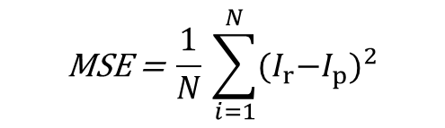
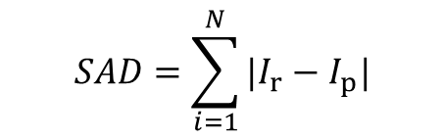
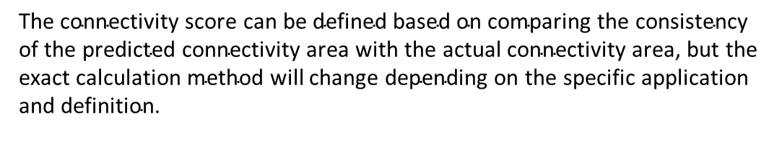
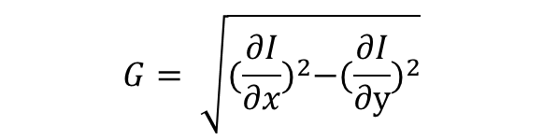
Evaluation
$$SAD=\sum_{i=1}^{N}{{|I}_{r}−I_{p}|}$$
SAD (Sum of Absolute Differences):
MSE (Mean Squared Error):
Gradient:
Connectivity:
$$\text{MSE} \text{=} \frac{1}{N}\text{​}\sum_{i=1}^{N}{{{(I}_{r}−I_{p})}^{2}}$$
$$G= \sqrt{{(\frac{∂I}{∂x})}^{2}−{(\frac{∂I}{∂y})}^{2}}$$
$$\text{The} \text{connectivity} \text{score} \text{can} \text{be} \text{defined} \text{based} \text{on} \text{comparing} \text{the} \text{consistency} \text{of} \text{the} \text{predicted} \text{connectivity} \text{area} \text{with} \text{the} \text{actual} \text{connectivity} \text{area}\text{, }\text{but} \text{the} \text{exact} \text{calculation} \text{method} \text{will} \text{change} \text{depending} \text{on} \text{the} \text{specific} \text{application} \text{and} \text{definition}\text{.}$$

Slide 5
Thank You

