Slide 1
Bayesian Matting
KEITH DONOGHUE
JIANG MINSHUAI
SONG XUZHE
SHREYA UDAY KUMAR KODGI
Date: 14/2/2024

Slide 2
Contents
Introduction
  Timeline and milestones.
Matting
  Code structure.
Bayesian matting
  Algorithm.
  Flow diagram of implementation.
Testing
  Functional Test.
  Unit test.
Roles
Task : | Name: | Cross Check
Code Dev. | Jiang | Shreya
Algorithm Dev. | Shreya | Jiang
Test | Keith | Song
 | Song | Keith

Slide 3
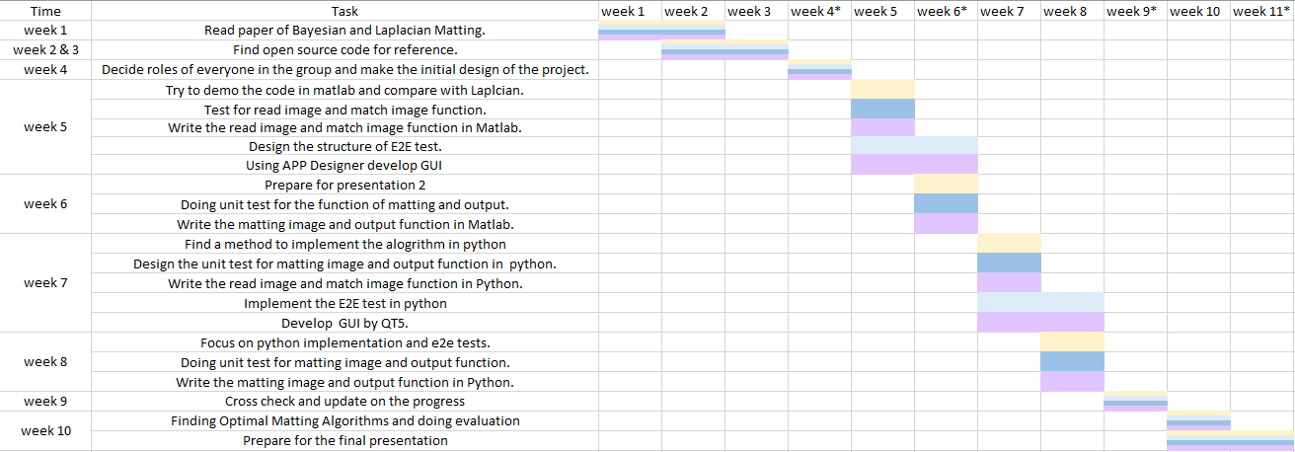

Introduction
Timeline and milestones
Milestones
Week 4 : Finish the code design
Week 6 : Finish the MATLAB part
Week 9 : Finish the Python part
Week 11 : Finish the final presentation

Slide 4
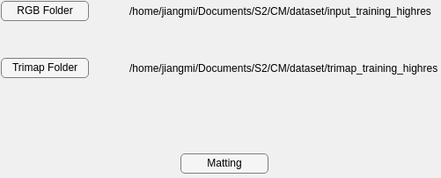
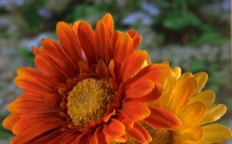

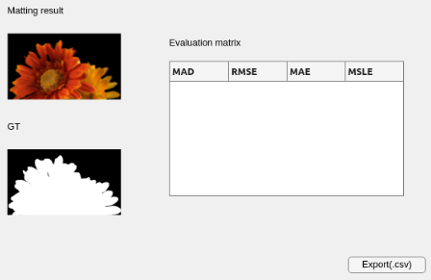
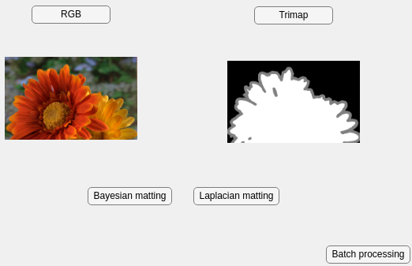


Matting
Code structure
Read image
Input:
Image path
Output:
Image data
Batch input
Match image
Input:
Image data
Output :
Foreground
Background
Unknown
Matting image
Input:
Foreground
Background
Unknown
Output :
Alpha matte
Foreground,
Background
Output and evaluation
Single input
Key takeaway: Use functions to read and match images. With the help of GUI, it can operate easily.

Slide 5
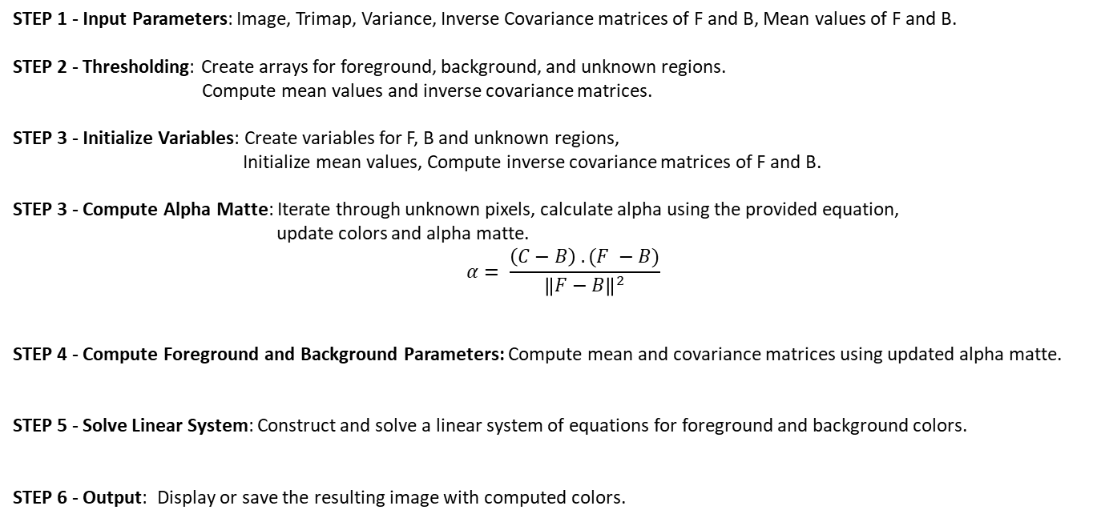
Bayesian matting
Algorithm
STEP 1 - Input Parameters: Image, Trimap, Variance, Inverse Covariance matrices of F and B, Mean values of F and B.
STEP 2 - Thresholding: Create arrays for foreground, background, and unknown regions. Compute mean values and inverse covariance matrices.
STEP 3 - Initialize Variables: Create variables for F, B and unknown regions, Initialize mean values, Compute inverse covariance matrices of F and B.
STEP 3 - Compute Alpha Matte: Iterate through unknown pixels, calculate alpha using the provided equation, update colors and alpha matte.
$$α= \frac{\left(C−B\right) . (F −B)}{{\left\|F−B\right\|}^{2}}$$
STEP 4 - Compute Foreground and Background Parameters: Compute mean and covariance matrices using updated alpha matte.
STEP 5 - Solve Linear System: Construct and solve a linear system of equations for foreground and background colors.
STEP 6 - Output: Display or save the resulting image with computed colors.
5

Slide 6


Bayesian matting
Flow diagram of implementation
Start
Images
Input
Thresholding
Initialise variables
$σ_{c}^{2}$, $σ_{f, }^{−1},σ_{b }^{−1},\overline{B}, \overline{F}$
Foreground
Background
$$α= \frac{\left(C−B\right) . (F −B)}{{\left\|F−B\right\|}^{2}}$$
Compute alpha matte
Compute F and B parameters
Solve linear system
Output
Images with computed colours
Stop
6

Slide 7
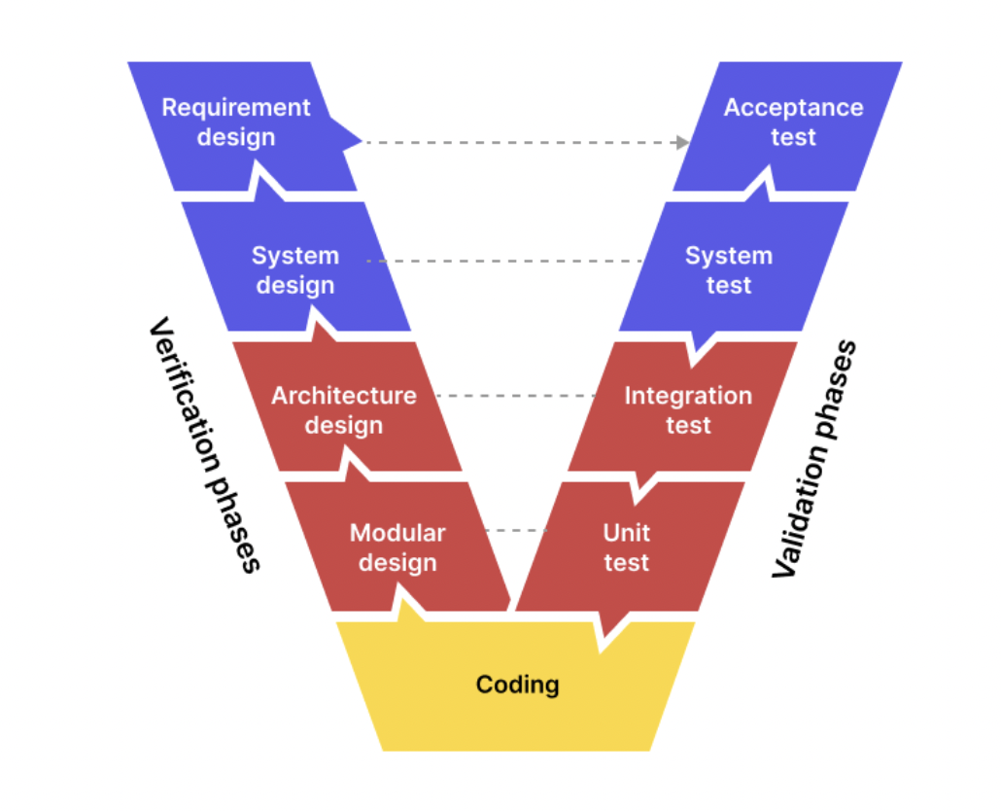

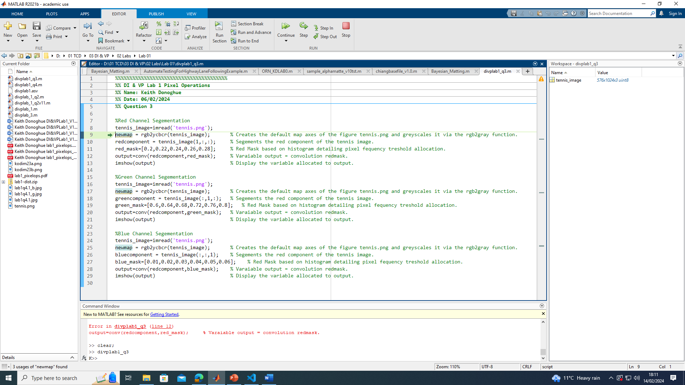
Functional Test
Guidance ISO/ IEC/IEEE 29119-3
  Objectives.
Test Methodology
  Compare Output Against Expected Output.
  Unit Test.
  Assert Known Errors
  Sequential Execution. print(“This is a Test")
Reporting
  Risk Register.
  Test Completion Evaluation.

Slide 8
Unit test
matlab.unittest.TestCase
Resolution: Limitations on input images, Whether the input and output match.
Read Image
Channel: 3-channel image，1-channel trimap.
Match Image
Correctness: According to the trimap, find if the images(foreground, background, unknown) are match correctly.
Position x, y: Checking that the positional values are within the resolution range.
Matting
Alpha: Checking that the Alpha within the range [0, 1].

Slide 9
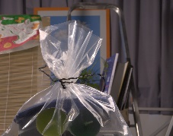
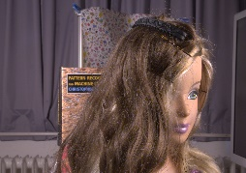


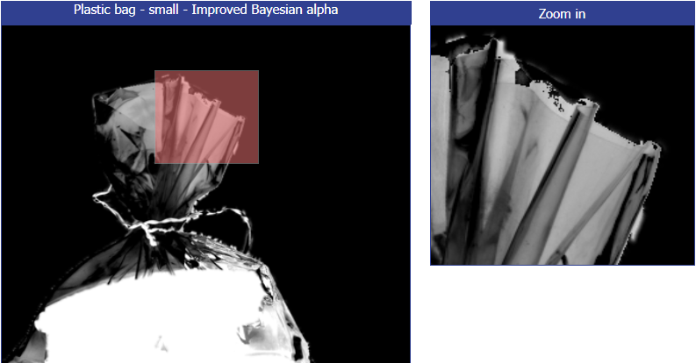
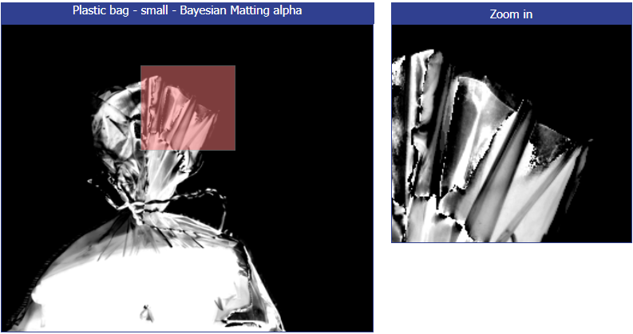
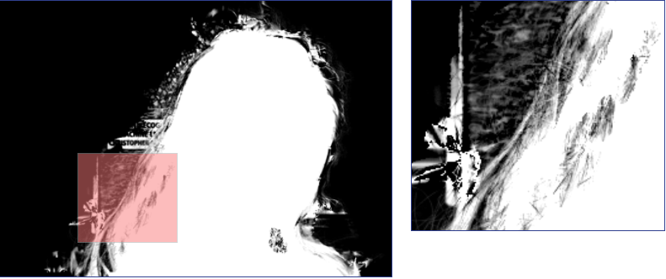
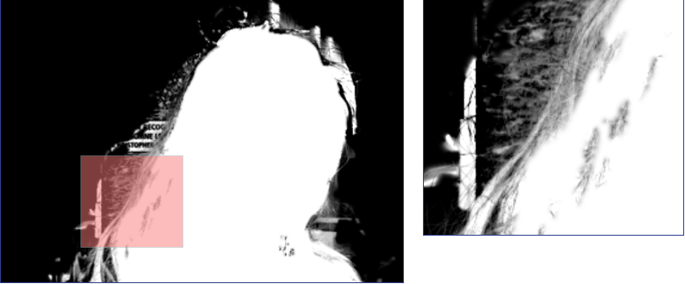
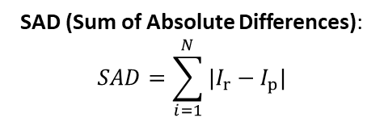
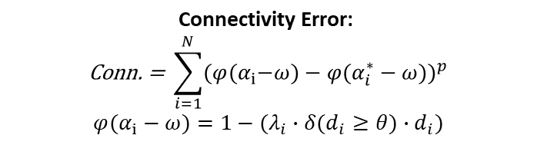
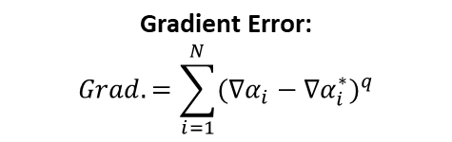
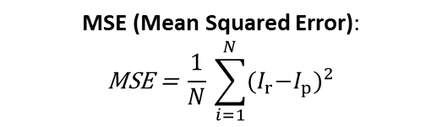
Evaluation
SAD (Sum of Absolute Differences):
$$SAD=\sum_{i=1}^{N}{{|I}_{r}−I_{p}|}$$
MSE (Mean Squared Error):
$$\text{MSE} \text{=} \frac{1}{N}\text{​}\sum_{i=1}^{N}{{{(I}_{r}−I_{p})}^{2}}$$
$$\text{Gradient} \text{Error}\text{:}$$
$$Grad.=\sum_{i=1}^{N}{{(∇α_{i}−∇α_{i}^{∗})}^{q}}$$
$$\text{Connectivity} \text{Error}\text{: }$$
$$\text{Conn}\text{. }\text{=} \text{​}\sum_{i=1}^{N}{{{(φ(α}_{i}−ω)−φ(α_{i}^{∗}−ω))}^{p}}$$
$${φ(α}_{i}−ω)=1−(λ_{i}∙δ(d_{i}≥θ)∙d_{i})$$
Gradient error = 1.7
Gradient error = 3.1
Connectivity error = 4.1
Connectivity error = 2.8

Slide 10
Q & A
Thank You

