Slide 1
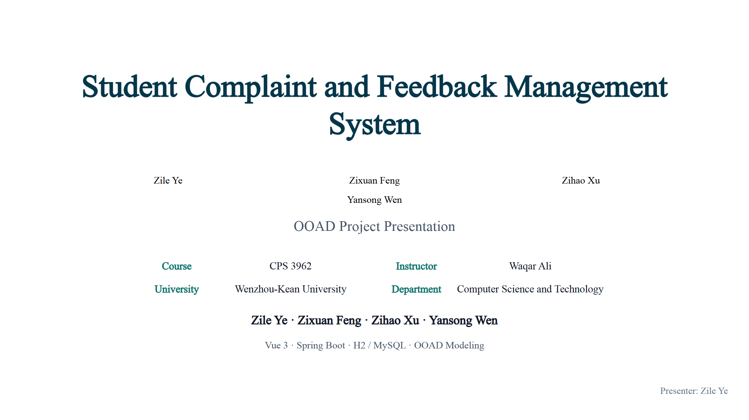
Notes:
Ye: Good morning everyone. Our project is the Student Complaint and Feedback Management System, a full-stack course-project prototype for CPS 3962. Today we will briefly introduce the problem, requirements analysis, OOAD design, architecture, prototype demonstration, testing results, and conclusion.

Slide 2
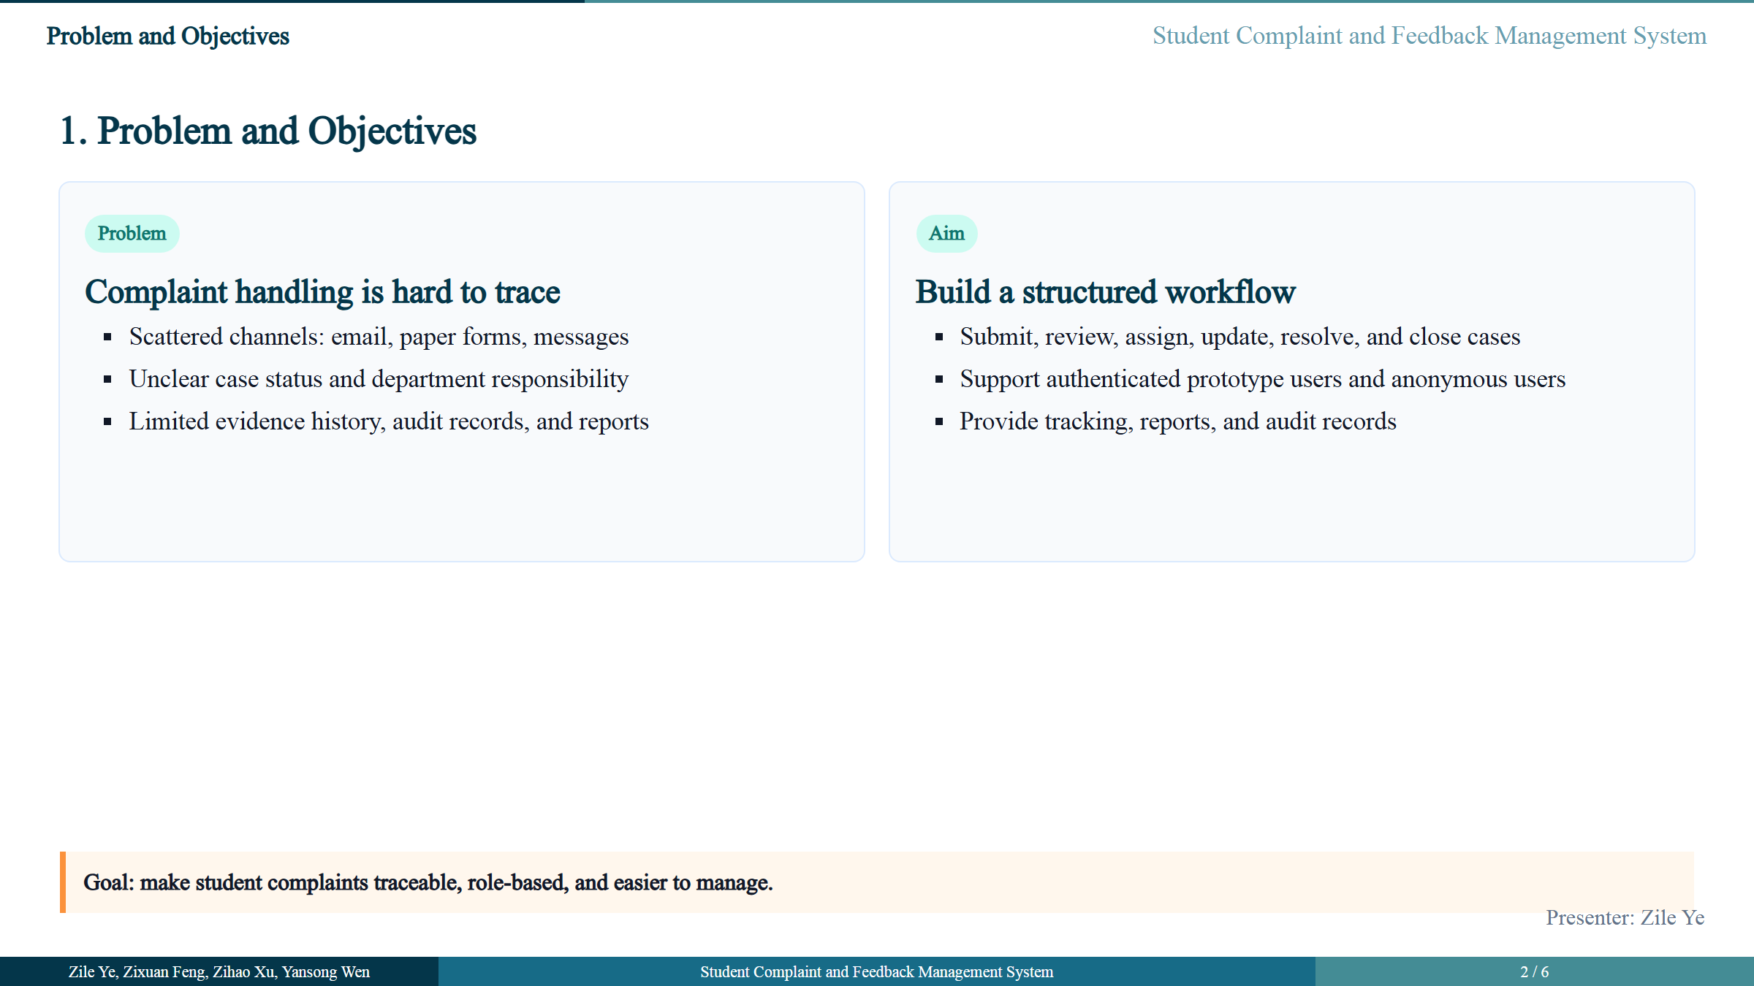
Notes:
Ye: The problem we want to solve is that student complaints are often handled through emails, paper forms, or informal messages. In that situation, case status, evidence, department responsibility, and final resolution can become difficult to track. Our aim is to provide one structured platform where complaints can be submitted, reviewed, assigned, updated, and closed with proper records. The system also supports anonymous complaints, because some students may prefer to report sensitive issues without revealing their identity. The main objectives are role-based access, complaint submission, anonymous tracking, officer review, department processing, admin management, reports, and audit records.

Slide 3
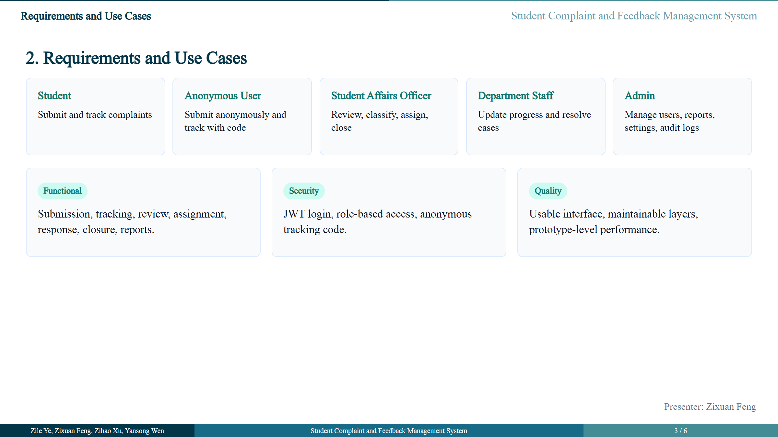
Notes:
Feng: In requirements analysis, we identified five actors: Student, Anonymous User, Student Affairs Officer, Department Staff, and Admin. Students can log in, submit complaints, upload evidence, track cases, provide additional information, and request follow-up review. Anonymous users can submit complaints and track progress using a case number and tracking code. Student Affairs Officers review, classify, request more information, assign departments, and close cases. Department Staff update assigned cases and provide responses. Admins manage users, departments, categories, reports, settings, and audit logs. The use-case model shows that every actor has a clear responsibility, and it separates user goals from internal system actions such as validation, case number generation, and tracking code generation.

Slide 4
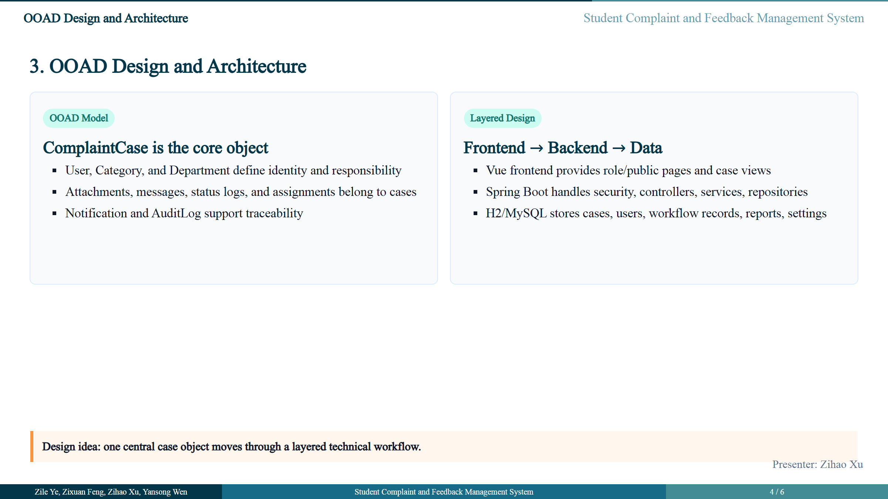
Notes:
Xu: For OOAD design, ComplaintCase is the central class. Every complaint becomes a case with status, priority, category, assignment, messages, attachments, status logs, and resolution information. In the class diagram, User represents identity and role information. Category controls classification and anonymous policy. Department represents responsibility after assignment. Attachments, messages, status logs, and assignments are owned by ComplaintCase, so they are modeled as case-related records. The architecture follows a layered design. Users interact with the Vue frontend. The frontend sends REST requests to the Spring Boot backend. The backend uses Spring Security, controllers, services, repositories, and audit logic. Repositories connect to H2 for development and MySQL for deployment. The ER diagram follows the same idea, with cases as the central table.

Slide 5
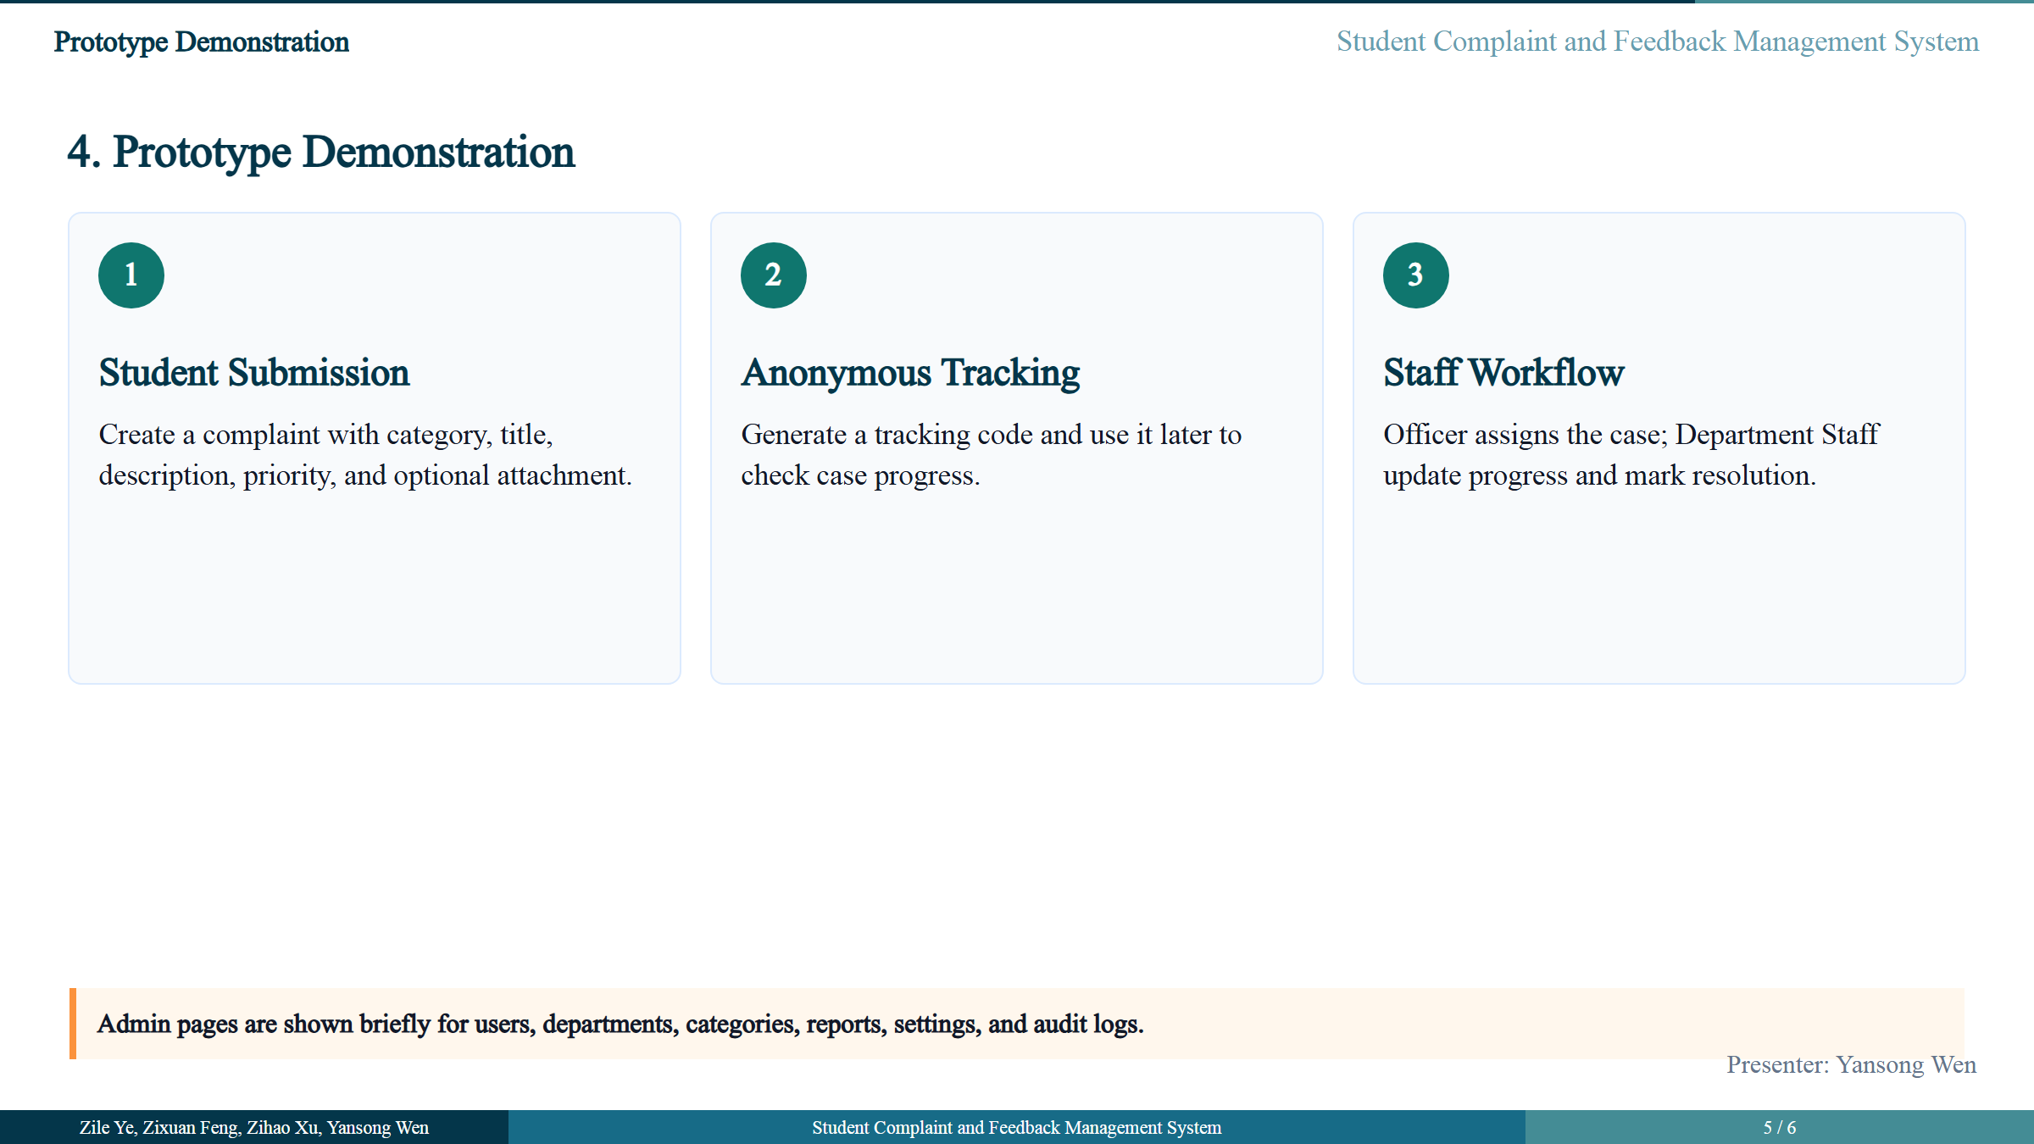
Notes:
Wen: Now we will demonstrate the main workflow. First, we show a student submitting a complaint with category, title, description, priority, and optional attachment. The system creates a case number. Second, we show anonymous submission. For anonymous cases, the system generates a tracking code and displays it once. This allows the anonymous user to check progress later. Third, we show the staff workflow. The Student Affairs Officer reviews the case and assigns it to a department. Then Department Staff update progress, provide a response, and mark the case as resolved. Finally, the admin side provides management functions such as users, departments, categories, reports, settings, and audit logs.

Slide 6
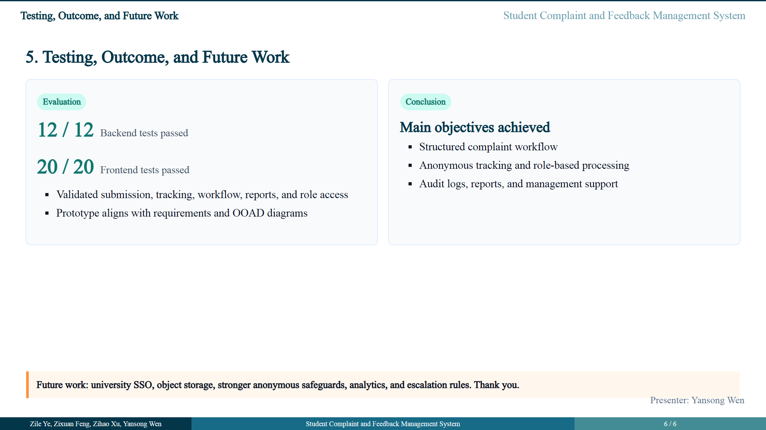
Notes:
Wen: For testing, our backend tests passed 12 out of 12, and frontend tests passed 20 out of 20. The prototype supports the main requirements, including complaint submission, anonymous tracking, officer workflow, department processing, admin management, reports, and audit logs. In conclusion, this project achieves the objective as a course-project prototype. Future improvements include university SSO integration, object storage for attachments, stronger safeguards for anonymous reporting, advanced analytics, and escalation rules. Thank you. We are ready to answer questions.

