Slide 1
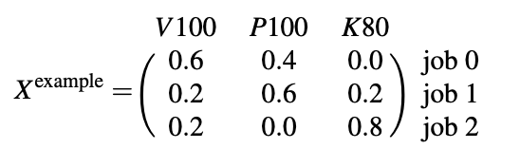
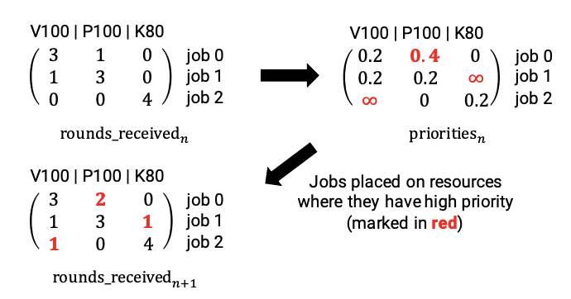
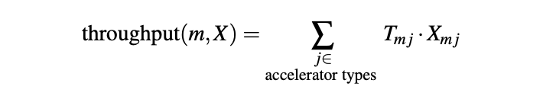

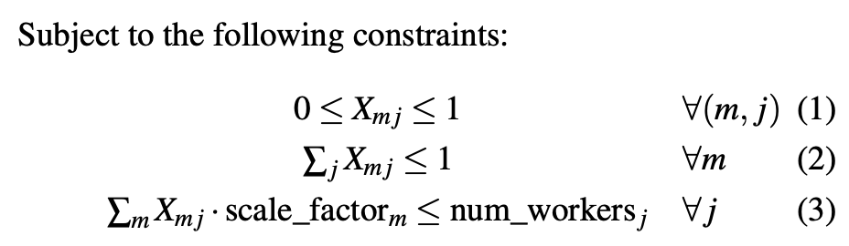
Introduction:
Performance Heterogeneity: Commonly used models show heterogeneous performance behavior across accelerator types due to various architectural differences. Existing schedulers like Gandiva, Tiresias, and Themis do not consider this heterogeneous performance behavior.
Generality across Policies: Cluster operators might want to implement different scheduling policies based on their business goals, such as optimizing for time to complete a set of batch jobs (makespan), fairness for ad-hoc jobs, or more sophisticated hierarchical policies that divide resources among high-level entities (e.g., departments) using one policy, and then individual jobs within the entity using another
Colocation and Placement Optimizations:
Heterogeneity-Aware Cluster Scheduling Policies for Deep Learning Workloads
System Overview:
3.1 Heterogeneity-Aware Policies:
A matrix X can represent allocations on a single accelerator type (homogeneous setting), on multiple accelerator types (heterogeneous setting), as well as with other optimizations.
3.2 Round-based Scheduling Mechanism:
A matrix X can represent allocations on a single accelerator type (homogeneous setting), on multiple accelerator types (heterogeneous setting), as well as with other optimizations.
Gavel finds an optimal value for the matrix X given a policy expressed as an optimization problem. To construct the optimization problem for a given policy, Gavel requires a throughput matrix T with each job’s throughput (in training iterations per second) on different accelerators.
3.3 Throughput Estimator:
Gavel’s throughput estimator maps a new job to a set of preprofiled reference jobs. The throughputs of the closest reference job can then be used as the initial performance estimate for the new job’s combinations. For individual jobs, the throughput estimator is not needed, since throughputs can be estimated on the fly as jobs run on different resource types.
Notes:
在计算出矩阵X后，Gavel使用一个基于轮询的调度机制为每个模型分配资源，在每一个round结束后，会根据X(m, j)/模型m在加速器j上已经分配的时间片计算优先级，根据优先级高低决定下一轮的资源分配：

Slide 2


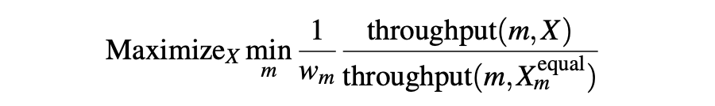
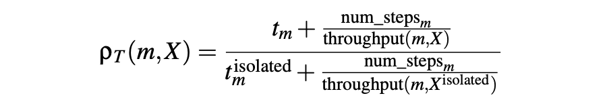
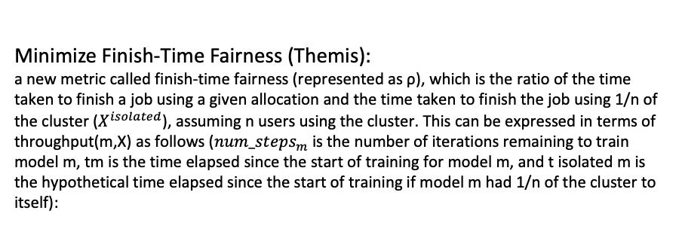
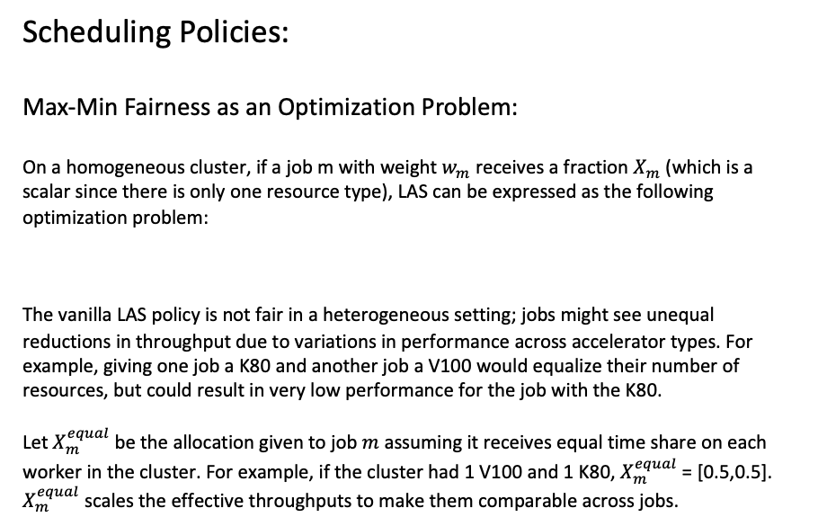
Heterogeneity-Aware Cluster Scheduling Policies for Deep Learning Workloads
Scheduling Policies:
Max-Min Fairness as an Optimization Problem:
On a homogeneous cluster, if a job m with weight $w_{m}$ receives a fraction $X_{m}$ (which is a scalar since there is only one resource type), LAS can be expressed as the following optimization problem:
The vanilla LAS policy is not fair in a heterogeneous setting; jobs might see unequal reductions in throughput due to variations in performance across accelerator types. For example, giving one job a K80 and another job a V100 would equalize their number of resources, but could result in very low performance for the job with the K80.
Let $X_{m}^{equal}$be the allocation given to job $m$ assuming it receives equal time share on each worker in the cluster. For example, if the cluster had 1 V100 and 1 K80, $X_{m}^{equal}$= [0.5,0.5]. $X_{m}^{equal}$ scales the effective throughputs to make them comparable across jobs.
Minimize Makespan:
If num_stepsm is the number of iterations remaining to train model m, then the makespan is the maximum of the durations of all active jobs, where the duration of job m is the ratio of the number of iterations to throughput(m,X) (expressed in iterations / second). Overall, this can be framed as:
Minimize Finish-Time Fairness (Themis):
a new metric called finish-time fairness (represented as ρ), which is the ratio of the time taken to finish a job using a given allocation and the time taken to finish the job using 1/n of the cluster ($X^{isolated}$), assuming n users using the cluster. This can be expressed in terms of throughput(m,X) as follows ($num_steps_{m}$is the number of iterations remaining to train model m, tm is the time elapsed since the start of training for model m, and t isolated m is the hypothetical time elapsed since the start of training if model m had 1/n of the cluster to itself):
Introduction:
Performance Heterogeneity: Commonly used models show heterogeneous performance behavior across accelerator types due to various architectural differences. Existing schedulers like Gandiva, Tiresias, and Themis do not consider this heterogeneous performance behavior.
Generality across Policies: Cluster operators might want to implement different scheduling policies based on their business goals, such as optimizing for time to complete a set of batch jobs (makespan), fairness for ad-hoc jobs, or more sophisticated hierarchical policies that divide resources among high-level entities (e.g., departments) using one policy, and then individual jobs within the entity using another
Colocation and Placement Optimizations:

Slide 3
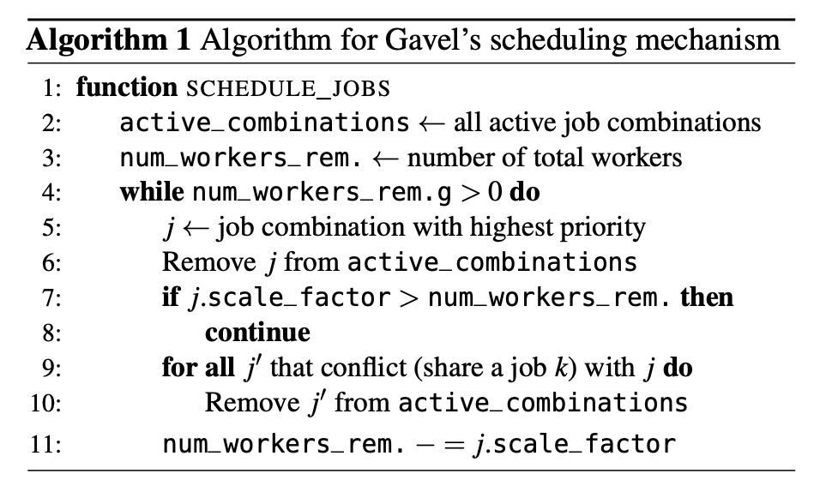
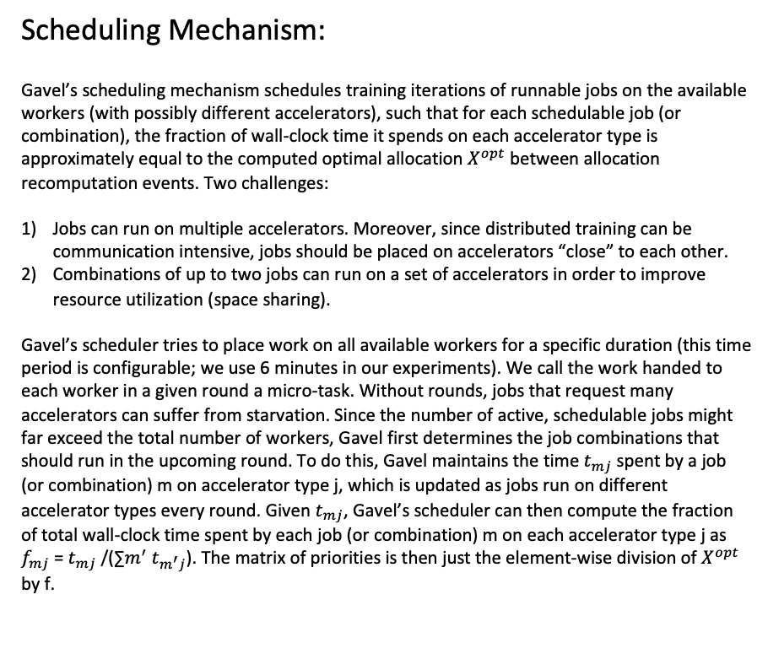
Heterogeneity-Aware Cluster Scheduling Policies for Deep Learning Workloads
Scheduling Mechanism:
Gavel’s scheduling mechanism schedules training iterations of runnable jobs on the available workers (with possibly different accelerators), such that for each schedulable job (or combination), the fraction of wall-clock time it spends on each accelerator type is approximately equal to the computed optimal allocation $X^{opt}$ between allocation recomputation events. Two challenges:
Jobs can run on multiple accelerators. Moreover, since distributed training can be communication intensive, jobs should be placed on accelerators “close” to each other.
Combinations of up to two jobs can run on a set of accelerators in order to improve resource utilization (space sharing).
Gavel’s scheduler tries to place work on all available workers for a specific duration (this time period is configurable; we use 6 minutes in our experiments). We call the work handed to each worker in a given round a micro-task. Without rounds, jobs that request many accelerators can suffer from starvation. Since the number of active, schedulable jobs might far exceed the total number of workers, Gavel first determines the job combinations that should run in the upcoming round. To do this, Gavel maintains the time $t_{mj}$ spent by a job (or combination) m on accelerator type j, which is updated as jobs run on different accelerator types every round. Given $t_{mj}$, Gavel’s scheduler can then compute the fraction of total wall-clock time spent by each job (or combination) m on each accelerator type j as $f_{mj}$ = $t_{mj}$/(∑$m^{′}$ $t_{m^{′}j}$). The matrix of priorities is then just the element-wise division of $X^{opt}$ by f.
Introduction:
Performance Heterogeneity: Commonly used models show heterogeneous performance behavior across accelerator types due to various architectural differences. Existing schedulers like Gandiva, Tiresias, and Themis do not consider this heterogeneous performance behavior.
Generality across Policies: Cluster operators might want to implement different scheduling policies based on their business goals, such as optimizing for time to complete a set of batch jobs (makespan), fairness for ad-hoc jobs, or more sophisticated hierarchical policies that divide resources among high-level entities (e.g., departments) using one policy, and then individual jobs within the entity using another
Colocation and Placement Optimizations:

Slide 4
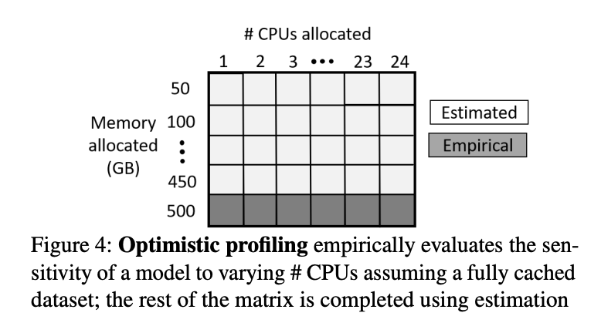
Introduction:
Performance Heterogeneity: Commonly used models show heterogeneous performance behavior across accelerator types due to various architectural differences. Existing schedulers like Gandiva, Tiresias, and Themis do not consider this heterogeneous performance behavior.
Generality across Policies: Cluster operators might want to implement different scheduling policies based on their business goals, such as optimizing for time to complete a set of batch jobs (makespan), fairness for ad-hoc jobs, or more sophisticated hierarchical policies that divide resources among high-level entities (e.g., departments) using one policy, and then individual jobs within the entity using another
Colocation and Placement Optimizations:
Synergy: Resource Sensitive DNN Scheduling in Multi-Tenant Clusters
System Overview:
Synergy is a round-based scheduler that arbitrates multi-dimensional resources (GPU, CPU, and memory) in a homogeneous cluster.
3.1 Optimistic Profiling:
Synergy exploits the predictability of DNN computation to measure the job throughput as we vary the amount of CPU and memory allocated to the job. This is performed offline by the Synergy scheduler, prior to job execution on the cluster. However, profiling all possible combinations of CPU, and memory values is computationally expensive. Therefore, Synergy introduces optimistic profiling; it empirically profiles the job throughput for varying CPU allocations, assuming maximum memory allocation. It then analytically estimates the job throughput for all combinations of CPU and memory.A key insight that makes such analytical modelling feasible is the predictable nature of job performance to memory allocation when using DNN-aware caching like MinIO.
Synergy introduces an optimistic profiling technique that exploits the predictability in the relationship between job throughput and memory allocation. We observe that, with DNN-specific, application-level caches like MinIO, it is easy to model the job throughput behaviour as we vary the amount of memory allocated to a job at fixed CPU allocation. Therefore, we only need to empirically profile (empirical results obtained by training the job for 2 epochs) the job for varying CPU values at full memory allocation as shown in Figure 4. All the other entries can be estimated using the above technique.
To further optimize profiling time, we observe that we do not require exact throughput values for a job with varying CPU allocations. We instead need a curve depicting the empirical job throughput. Therefore, instead of profiling the job for all possible CPU values, we pick discrete points for CPU profiling using the following algorithm. We start with the maximum CPU allocation and do a binary search on the CPU values to estimate job throughput. If the profiled point resulted in a throughput improvement that is less than a fixed threshold (say 10%), then we continue binary search on the lower half of CPU values, else we profile more points on the upper half. The idea here is to empirically profile CPU regions that show significant difference in job throughput, while skip those regions with little to no improvement in throughput.
Notes:
在计算出矩阵X后，Gavel使用一个基于轮询的调度机制为每个模型分配资源，在每一个round结束后，会根据X(m, j)/模型m在加速器j上已经分配的时间片计算优先级，根据优先级高低决定下一轮的资源分配：

Slide 5
Introduction:
Performance Heterogeneity: Commonly used models show heterogeneous performance behavior across accelerator types due to various architectural differences. Existing schedulers like Gandiva, Tiresias, and Themis do not consider this heterogeneous performance behavior.
Generality across Policies: Cluster operators might want to implement different scheduling policies based on their business goals, such as optimizing for time to complete a set of batch jobs (makespan), fairness for ad-hoc jobs, or more sophisticated hierarchical policies that divide resources among high-level entities (e.g., departments) using one policy, and then individual jobs within the entity using another
Colocation and Placement Optimizations:
Synergy: Resource Sensitive DNN Scheduling in Multi-Tenant Clusters
3.3 Synergy-GREEDY: Greedy Scheduling
Given a job demand vector, the greedy algorithm picks the next runnable job decided by the scheduling policy, and places it on the server that can satisfy the job’s demands in all dimensions. If no such server exists, the job is skipped over for this round and the next runnable job is checked for schedulability. Synergy-GREEDY thus introduces two major problems in the cluster:
It can result in auxiliary resources being exhausted by jobs, while leaving GPUs underutilized, and fragmented.
It also hurts the fairness of the scheduling policy as some jobs can be skipped over for a long time if their resource demands cannot be satisfied in the cluster.
The challenge ahead of us is to design a scheduling mechanism that eliminates GPU under-utilization due to fragmentation, and upholds the fairness properties of the given scheduling policy, while performing multi-dimensional resource allocation.
System Overview:
Synergy is a round-based scheduler that arbitrates multi-dimensional resources (GPU, CPU, and memory) in a homogeneous cluster.
3.2 Scheduling mechanism:
Synergy performs round-based scheduling. At the beginning of each scheduling round, Synergy identifies a set of runnable jobs from the scheduling queue that can be packed on the cluster in the current round duration.
To pack the jobs onto servers, we first construct a job demand vector that indicates the GPU demand, and best-case CPU and memory requirements for the job. We identify the best-case values using the resource sensitivity matrix. We pick the minimum value of CPU and memory that saturates the job throughput. Packing a job with multi-dimensional resource demands is analogous to multi-dimensional bin packing problem which is NP hard [53]. Therefore, we first evaluate the efficacy of a naive greedy scheduling mechanism as an approximation to tackle the multi-dimensional resource allocation problem.
Notes:
在计算出矩阵X后，Gavel使用一个基于轮询的调度机制为每个模型分配资源，在每一个round结束后，会根据X(m, j)/模型m在加速器j上已经分配的时间片计算优先级，根据优先级高低决定下一轮的资源分配：

Slide 6
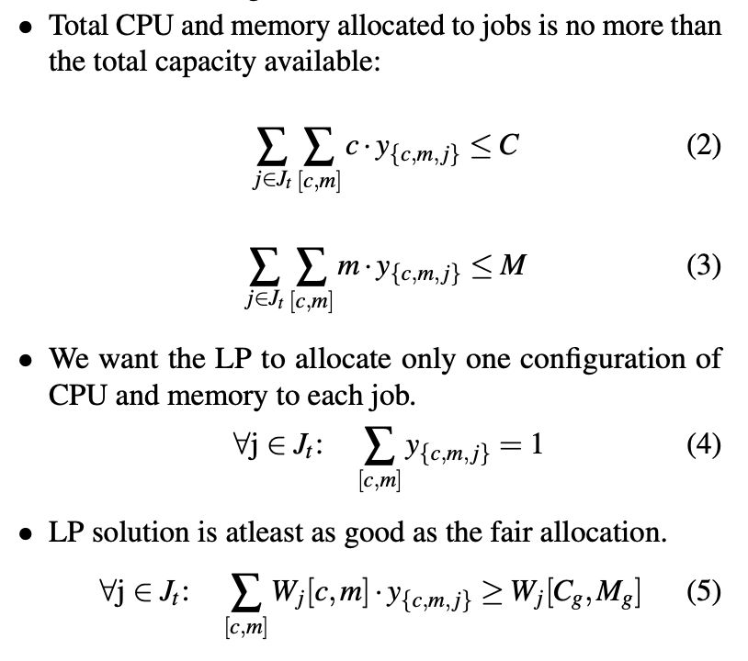
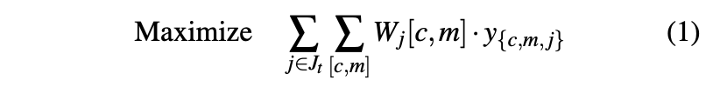
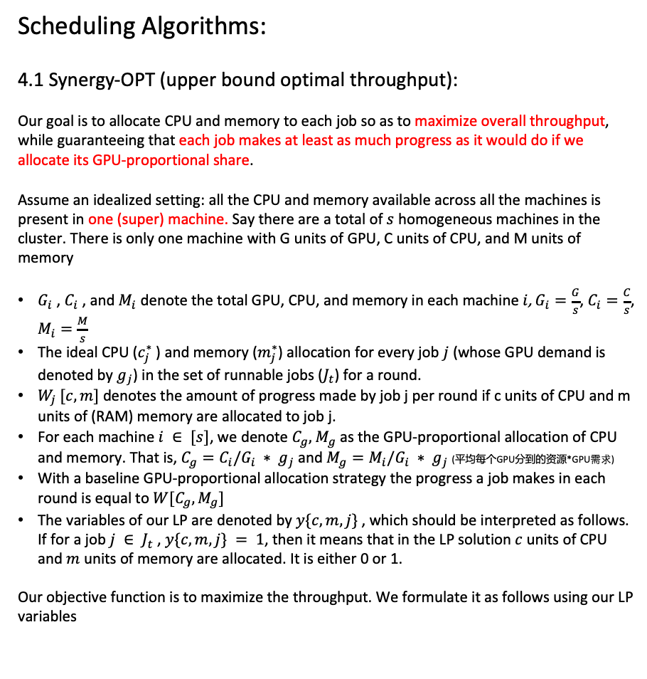
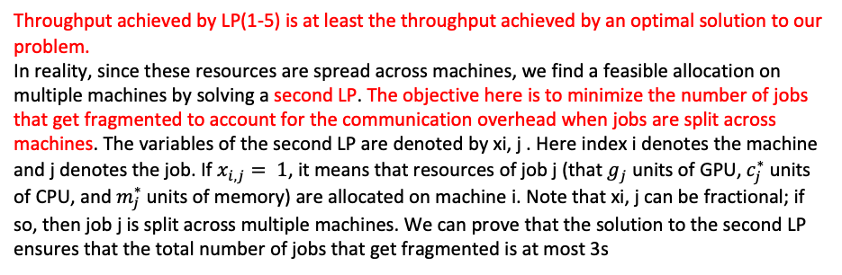
Introduction:
Performance Heterogeneity: Commonly used models show heterogeneous performance behavior across accelerator types due to various architectural differences. Existing schedulers like Gandiva, Tiresias, and Themis do not consider this heterogeneous performance behavior.
Generality across Policies: Cluster operators might want to implement different scheduling policies based on their business goals, such as optimizing for time to complete a set of batch jobs (makespan), fairness for ad-hoc jobs, or more sophisticated hierarchical policies that divide resources among high-level entities (e.g., departments) using one policy, and then individual jobs within the entity using another
Colocation and Placement Optimizations:
Synergy: Resource Sensitive DNN Scheduling in Multi-Tenant Clusters
Scheduling Algorithms:
4.1 Synergy-OPT (upper bound optimal throughput):
Our goal is to allocate CPU and memory to each job so as to maximize overall throughput, while guaranteeing that each job makes at least as much progress as it would do if we allocate its GPU-proportional share.
Assume an idealized setting: all the CPU and memory available across all the machines is present in one (super) machine. Say there are a total of $s$ homogeneous machines in the cluster. There is only one machine with G units of GPU, C units of CPU, and M units of memory
$G_{i}$ , $C_{i}$ , and $M_{i}$ denote the total GPU, CPU, and memory in each machine $i$, $G_{i}=\frac{G}{s}$, $C_{i}=\frac{C}{s}$, $M_{i}=\frac{M}{s}$
The ideal CPU ($c_{j}^{∗}$) and memory ($m_{j}^{∗}$) allocation for every job $j$ (whose GPU demand is denoted by $g_{j}$) in the set of runnable jobs ($J_{t}$) for a round.
$W_{j} [c,m]$ denotes the amount of progress made by job j per round if c units of CPU and m units of (RAM) memory are allocated to job j.
For each machine $i ∈ [s]$, we denote $C_{g},{ M}_{g}$as the GPU-proportional allocation of CPU and memory. That is, $C_{g}=C_{i}/G_{i} ∗ g_{j}$ and $M_{g}=M_{i}/G_{i} ∗ g_{j}$ (平均每个GPU分到的资源*GPU需求)
With a baseline GPU-proportional allocation strategy the progress a job makes in each round is equal to $W[C_{g},M_{g}]$
The variables of our LP are denoted by $y\{c,m, j\}$, which should be interpreted as follows. If for a job $j ∈ J_{t}$ , $y\{c,m, j\} = 1$, then it means that in the LP solution $c$ units of CPU and $m$ units of memory are allocated. It is either 0 or 1.
Our objective function is to maximize the throughput. We formulate it as follows using our LP variables
Constraints:
Throughput achieved by LP(1-5) is at least the throughput achieved by an optimal solution to our problem.
In reality, since these resources are spread across machines, we find a feasible allocation on multiple machines by solving a second LP. The objective here is to minimize the number of jobs that get fragmented to account for the communication overhead when jobs are split across machines. The variables of the second LP are denoted by xi, j . Here index i denotes the machine and j denotes the job. If $x_{i,j}= 1$, it means that resources of job j (that $g_{j}$ units of GPU, $c_{j}^{∗}$ units of CPU, and $m_{j}^{∗}$units of memory) are allocated on machine i. Note that xi, j can be fractional; if so, then job j is split across multiple machines. We can prove that the solution to the second LP ensures that the total number of jobs that get fragmented is at most 3s
While the allocations identified by Synergy-OPT provides an upper bound on the optimal cluster throughput, it is challenging to materialize these allocations in the real world due to two main reasons:
Solving two LPs per scheduling round is computationally expensive
The allocation matrix obtained with the second LP can result in fractional GPU allocations when jobs are split across servers
Notes:
在计算出矩阵X后，Gavel使用一个基于轮询的调度机制为每个模型分配资源，在每一个round结束后，会根据X(m, j)/模型m在加速器j上已经分配的时间片计算优先级，根据优先级高低决定下一轮的资源分配：

Slide 7
Introduction:
Performance Heterogeneity: Commonly used models show heterogeneous performance behavior across accelerator types due to various architectural differences. Existing schedulers like Gandiva, Tiresias, and Themis do not consider this heterogeneous performance behavior.
Generality across Policies: Cluster operators might want to implement different scheduling policies based on their business goals, such as optimizing for time to complete a set of batch jobs (makespan), fairness for ad-hoc jobs, or more sophisticated hierarchical policies that divide resources among high-level entities (e.g., departments) using one policy, and then individual jobs within the entity using another
Colocation and Placement Optimizations:
Synergy: Resource Sensitive DNN Scheduling in Multi-Tenant Clusters
Scheduling Algorithms:
4.2 Synergy-TUNE (an empirically close-to-optimal heuristic solution):
We now describe Synergy-TUNE, our heuristic scheduling mechanism. Our goal is to design a scheduling mechanism that performs multi-dimensional resource allocation for DNN jobs, where the GPU demand is fixed, but the auxiliary resource allocations are fungible, such that:
we do not affect the fairness properties of the scheduling policy used
the expensive GPU resources are not underutilized
Allocation Requirements: Synergy-TUNE’s allocation must satisfy the following requirements:
The GPU, CPU, and memory resources requested by a single-GPU job must all be allocated on the same server
A multi-GPU distributed-training job can either be consolidated on one machine, or split across multiple machines.
We need to ensure that no job runs at a throughput lower than what it would have achieved if we allocated a GPU-proportional share of CPU and memory resources. Additionally, we need to respect the priority order of jobs identified by the scheduling policy.
Synergy-TUNE greedily packs each of these runnable jobs along multiple resource dimensions on one of the available servers, with the objective of minimizing fragmentation.
To achieve this, Synergy-TUNE sorts the runnable jobs by their GPU demands, followed by CPU, and memory demand.
For each job j in order, Synergy-TUNE then picks the server with the least amount of free resources just enough to fit the demand vector of j. If it is a multi-GPU job, then we find a minimum set of servers with sufficient GPU availability that can fit the job’s demands in entirety.
However, it is possible that the job cannot fit in the cluster along all dimensions. In such a case,
We check if the job’s demand vector is greater than proportional share of resources, In this case, we switch the job’s demand to GPU-proportional share and retry
If the job still does not fit the cluster, or if the job’s demand vector was less than or equal to GPU proportional allocation in step (1), then, we do the following:
a). We repeat step (1) ignoring the job’s CPU and memory requirements. We find a server that can just satisfy the job’s GPU requirements. We know by construction that there is at least one job on this server, which is allocated more than GPU-proportional share of resources. We identify the job or a set of jobs (Js) on this server by switching whom to GPU-proportional share, we can release just as much resources required by the current job j. We switch the jobs in Js to fair-share and by design, job j will fit this server.
(b) We continue this recursively for all runnable jobs.
In the worst case, all the running jobs in a round could be allocated GPU-proportional share of resources. Therefore, Synergy ensures that its allocations results in job throughputs that are never worse than GPU-proportional allocation.
Notes:
在计算出矩阵X后，Gavel使用一个基于轮询的调度机制为每个模型分配资源，在每一个round结束后，会根据X(m, j)/模型m在加速器j上已经分配的时间片计算优先级，根据优先级高低决定下一轮的资源分配：

