Slide 1
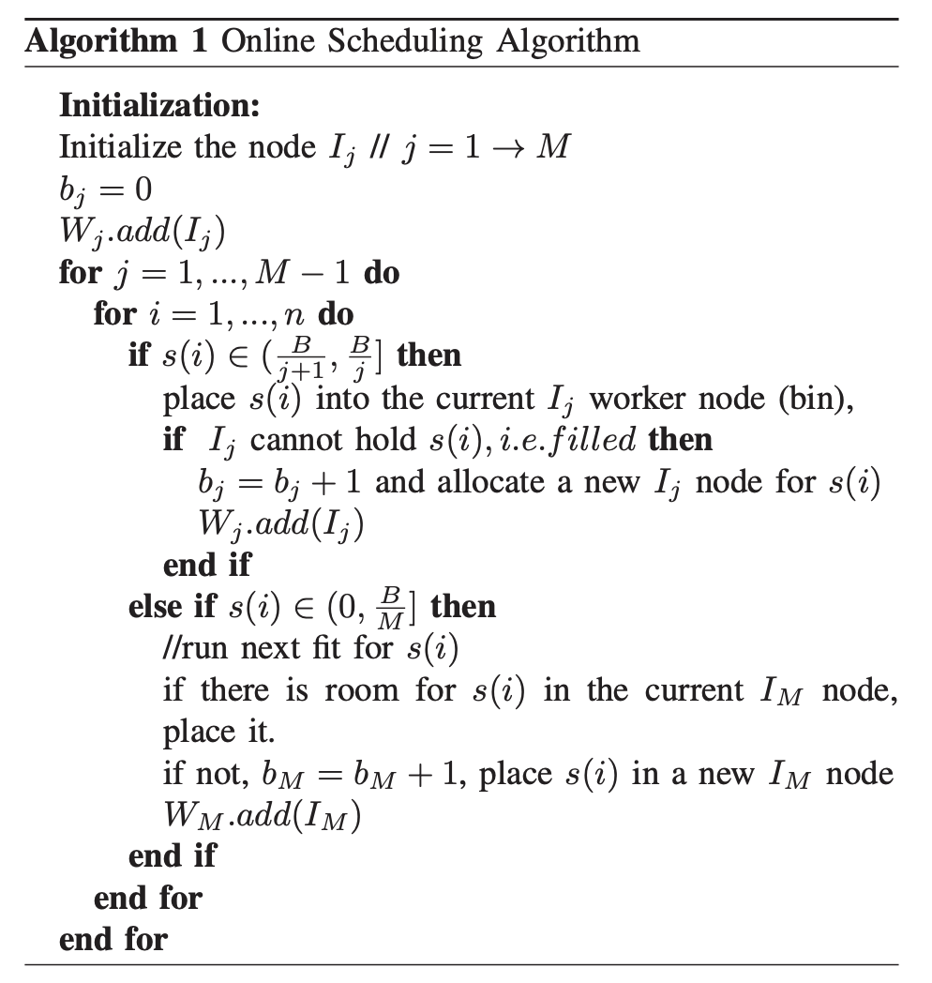
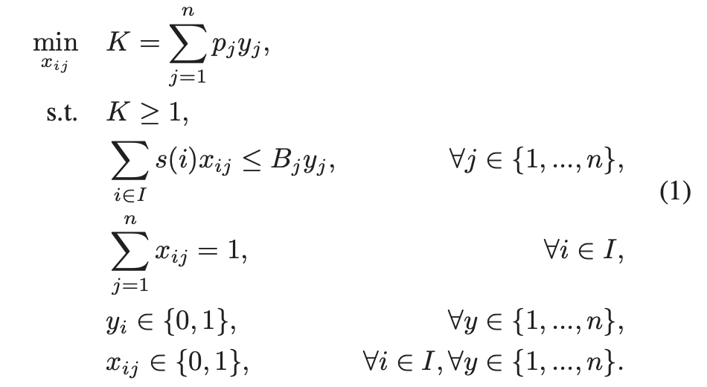
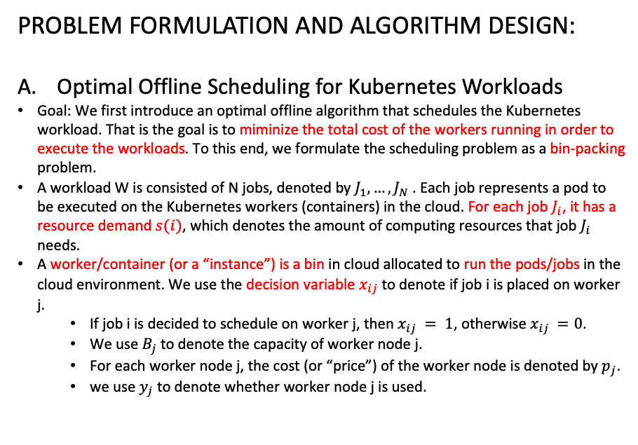
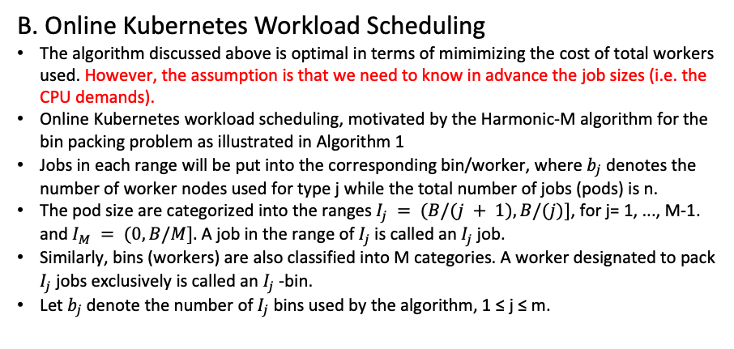
HPKS: High Performance Kubernetes Scheduling for Dynamic Blockchain Workloads in Cloud Computing
PROBLEM FORMULATION AND ALGORITHM DESIGN:
Optimal Offline Scheduling for Kubernetes Workloads
Goal: We first introduce an optimal offline algorithm that schedules the Kubernetes workload. That is the goal is to miminize the total cost of the workers running in order to execute the workloads. To this end, we formulate the scheduling problem as a bin-packing problem.
A workload W is consisted of N jobs, denoted by $J_{1},…,J_{N}$. Each job represents a pod to be executed on the Kubernetes workers (containers) in the cloud. For each job $J_{i}$, it has a resource demand $s(i)$, which denotes the amount of computing resources that job $J_{i}$ needs.
A worker/container (or a “instance”) is a bin in cloud allocated to run the pods/jobs in the cloud environment. We use the decision variable $x_{ij}$ to denote if job i is placed on worker j.
If job i is decided to schedule on worker j, then $x_{ij} = 1$, otherwise $x_{ij} =0$.
We use $B_{j}$to denote the capacity of worker node j.
For each worker node j, the cost (or “price”) of the worker node is denoted by $p_{j}$.
we use $y_{j}$ to denote whether worker node j is used.
B. Online Kubernetes Workload Scheduling
The algorithm discussed above is optimal in terms of mimimizing the cost of total workers used. However, the assumption is that we need to know in advance the job sizes (i.e. the CPU demands).
Online Kubernetes workload scheduling, motivated by the Harmonic-M algorithm for the bin packing problem as illustrated in Algorithm 1
Jobs in each range will be put into the corresponding bin/worker, where $b_{j}$ denotes the number of worker nodes used for type j while the total number of jobs (pods) is n.
The pod size are categorized into the ranges$I_{j} = (B/(j + 1),B/(j)]$, for j= 1, ..., M-1. and $I_{M} = (0, B/M].$ A job in the range of $I_{j}$is called an $I_{j}$job.
Similarly, bins (workers) are also classified into M categories. A worker designated to pack $I_{j}$ jobs exclusively is called an $I_{j}$ -bin.
Let $b_{j}$denote the number of $I_{j}$ bins used by the algorithm, 1 ≤ j ≤ m.
Introduction:
Performance Heterogeneity: Commonly used models show heterogeneous performance behavior across accelerator types due to various architectural differences. Existing schedulers like Gandiva, Tiresias, and Themis do not consider this heterogeneous performance behavior.
Generality across Policies: Cluster operators might want to implement different scheduling policies based on their business goals, such as optimizing for time to complete a set of batch jobs (makespan), fairness for ad-hoc jobs, or more sophisticated hierarchical policies that divide resources among high-level entities (e.g., departments) using one policy, and then individual jobs within the entity using another
Colocation and Placement Optimizations:

Slide 2
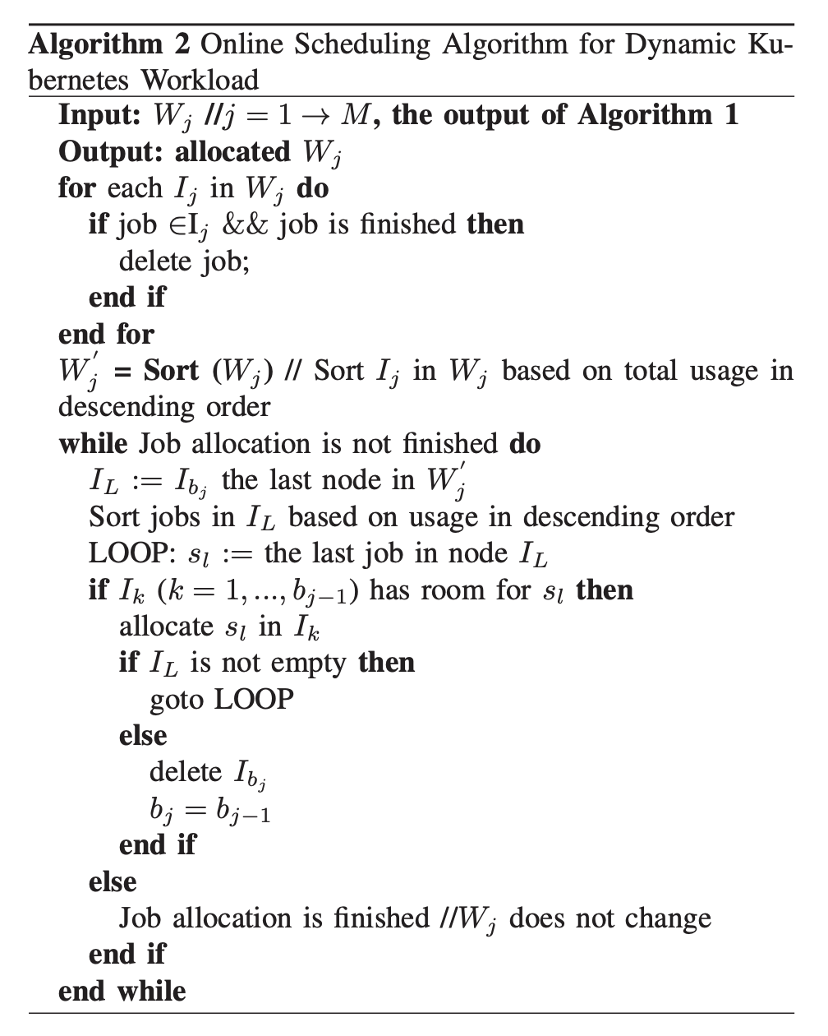
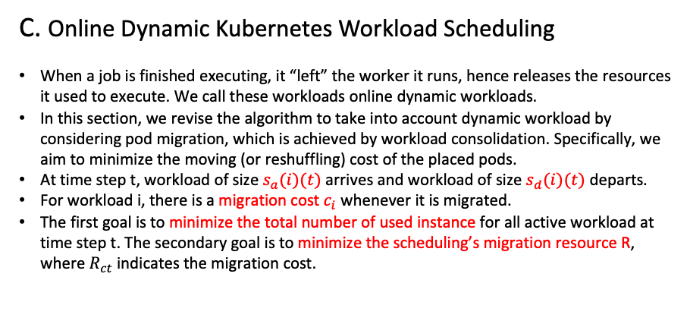
HPKS: High Performance Kubernetes Scheduling for Dynamic Blockchain Workloads in Cloud Computing
C. Online Dynamic Kubernetes Workload Scheduling
When a job is finished executing, it “left” the worker it runs, hence releases the resources it used to execute. We call these workloads online dynamic workloads.
In this section, we revise the algorithm to take into account dynamic workload by considering pod migration, which is achieved by workload consolidation. Specifically, we aim to minimize the moving (or reshuffling) cost of the placed pods.
At time step t, workload of size $s_{a}(i)(t)$arrives and workload of size $s_{d}(i)(t)$ departs.
For workload i, there is a migration cost $c_{i}$ whenever it is migrated.
The first goal is to minimize the total number of used instance for all active workload at time step t. The secondary goal is to minimize the scheduling’s migration resource R, where $R_{ct}$ indicates the migration cost.
Introduction:
Performance Heterogeneity: Commonly used models show heterogeneous performance behavior across accelerator types due to various architectural differences. Existing schedulers like Gandiva, Tiresias, and Themis do not consider this heterogeneous performance behavior.
Generality across Policies: Cluster operators might want to implement different scheduling policies based on their business goals, such as optimizing for time to complete a set of batch jobs (makespan), fairness for ad-hoc jobs, or more sophisticated hierarchical policies that divide resources among high-level entities (e.g., departments) using one policy, and then individual jobs within the entity using another
Colocation and Placement Optimizations:

