Slide 1
Wwtitle hereWW

Slide 2
Executive Summary

Slide 3
Business Question

Slide 4
Why auto-parts competitors matter for WWW
Auto parts are a high-margin category
AZ reported 52.6% gross margin in FY2025,
OO reported 51.6%, and
AA reported 43.9% adjusted gross margin.
Competition is intensifying through store expansion: OOOO opened xxx net new stores in 2025 and guided to xxxx net new stores in 2026, increasing local competitive pressure.
The market is large and growing: the U.S. light-vehicle aftermarket was projected to reach $435B in 2025, supported by older vehicles and more repair needs.
Specialty players compete on depth, urgency, and service: AZ, AA, and OO can win trips where customers need immediate parts availability, staff expertise, or repair-focused advice—not just low prices.
The risk for Www is not only lost auto-part sales: competitor entry may reduce www auto-department sales, but also the broader shopping basket if auto-related trips no longer start at www.

Slide 5
Hypothesis

Slide 6
Data Overview
WWW store-level sales data: We use to measure how sales evolve before and after nearby auto-parts competitor openings.
Competitor entry events: We identify new entries using merchant location data, capturing store openings for AutoZone, Advance Auto Parts, and O’Reilly Auto Parts.
Event sample: The analysis includes approximately 69 openings per competitor, giving us a balanced set of entry events across the three major auto-parts chains.
Unit of analysis: The core panel is built at the WWW store × time period level, allowing us to compare treated stores to similar untreated stores before and after competitor entry.

Slide 7


Outcome: WMT sales definition
Primary outcome: WWW store-level sales, measured as total dollar sales by store and time period.
Analysis granularity: Sales are aggregated at the WWW store × week level to smooth daily noise while preserving enough variation around competitor entry.
Core metric: We focus on auto-related category sales where available, and use total store sales as a secondary outcome to test whether competitor entry affects the broader shopping basket.
Normalization: Outcomes can be analyzed in log sales or indexed to the pre-entry average so that stores with different baseline sales levels are comparable.
Event-time structure: For each exposed WWW store, sales are aligned relative to the competitor opening date, with a pre-period used to build the synthetic control and a post-period used to estimate impact.
$$Y_{it}=log (W_sales_{i,t} )$$
$$Y_{it}=Y_{it} −Y_{it}^{Synthetic}$$
Notes:
Our main outcome is weekly WWW sales at the store level, transformed to log sales and aligned around competitor entry dates

Slide 8
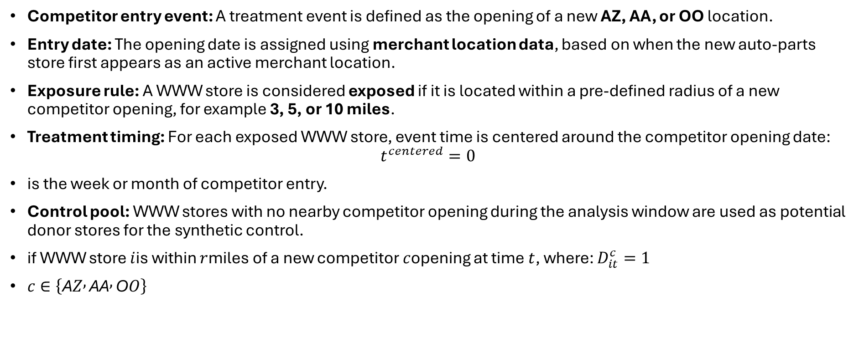
Competitor entry/exposure definition
Competitor entry event: A treatment event is defined as the opening of a new AZ, AA, or OO location.
Entry date: The opening date is assigned using merchant location data, based on when the new auto-parts store first appears as an active merchant location.
Exposure rule: A WWW store is considered exposed if it is located within a pre-defined radius of a new competitor opening, for example 3, 5, or 10 miles.
Treatment timing: For each exposed WWW store, event time is centered around the competitor opening date:
$$t^{centered}=0$$
is the week or month of competitor entry.
Control pool: WWW stores with no nearby competitor opening during the analysis window are used as potential donor stores for the synthetic control.
if WWW store $i$is within $r$miles of a new competitor $c$opening at time $t$, where: $D_{it}^{c}=1$
$c∈\left\{\text{A}Z , \text{A}\text{A} , \text{O}O\right\}$
Notes:
We define treatment as local exposure to a new auto-parts competitor opening. A WWW store enters the treated group when a new AutoZone, Advance Auto, or O’Reilly opens within a chosen trade-area radius.

Slide 9
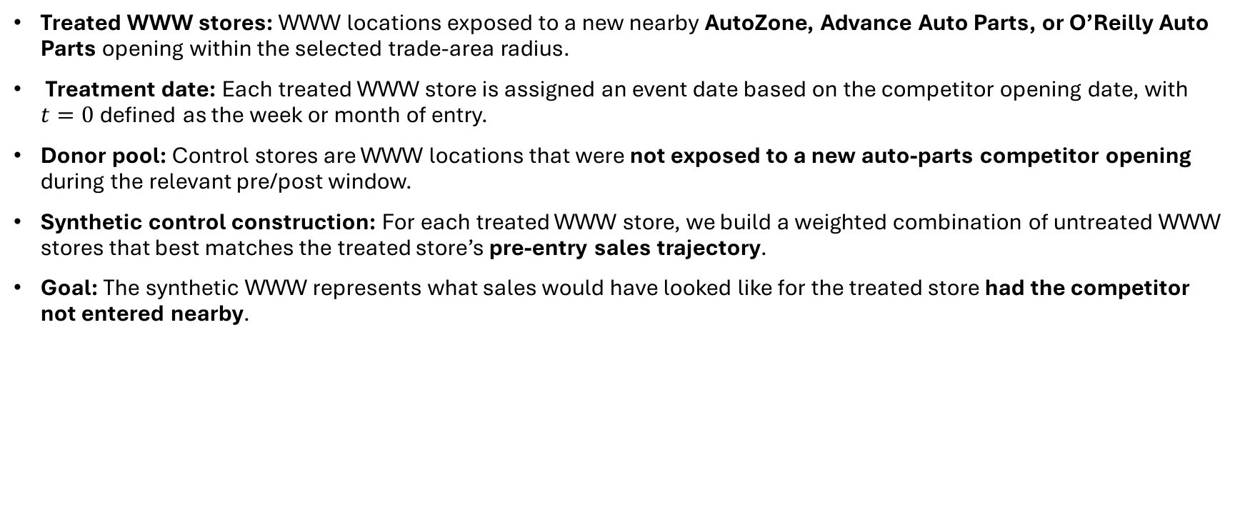
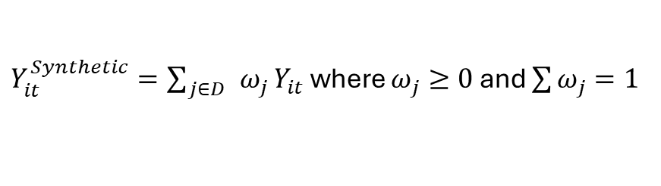
Treatment Control Construction
Treated WWW stores: WWW locations exposed to a new nearby AutoZone, Advance Auto Parts, or O’Reilly Auto Parts opening within the selected trade-area radius.
Treatment date: Each treated WWW store is assigned an event date based on the competitor opening date, with $t=0$ defined as the week or month of entry.
Donor pool: Control stores are WWW locations that were not exposed to a new auto-parts competitor opening during the relevant pre/post window.
Synthetic control construction: For each treated WWW store, we build a weighted combination of untreated WWW stores that best matches the treated store’s pre-entry sales trajectory.
Goal: The synthetic WWW represents what sales would have looked like for the treated store had the competitor not entered nearby.
$Y_{it}^{Synthetic}=\sum_{j∈D }{ω_{j}}Y_{it}$ where $ω_{j}≥0$ and $\sum{ω_{j}}=1$
Notes:
We compare each exposed WWW store to a synthetic WWW built from similar, unexposed stores that closely matched its sales path before competitor entry.

Slide 10
Why Synthetic Controls
Competitor openings are not randomized: AutoZone, Advance Auto Parts, and O’Reilly choose locations strategically, so simple treated-vs-control comparisons may be biased.
We need a credible counterfactual: Synthetic control estimates what WWW sales would have looked like without nearby competitor entry.
It uses the pre-entry sales pattern: Instead of relying only on store characteristics, synthetic control matches treated WWW stores to a weighted combination of untreated WWW stores based on their pre-period sales trajectory.
It is intuitive for business audiences: The method creates a “synthetic WWW” that can be plotted directly against the actual WWW store before and after entry.
It works well for localized shocks: Competitor openings are local market events, making synthetic controls a natural framework for estimating store-level sales impact.
Notes:
Synthetic controls let us compare each exposed WWW store to a data-driven benchmark that behaved similarly before competitor entry, making the post-entry gap easier to interpret as competitive impact.

Slide 11
Synthetic Controls Intuition
Core idea: For each exposed WWW store, we create a “synthetic WWW” using a weighted average of similar WWW stores that were not exposed to a nearby competitor opening.
Before entry: The synthetic WWW is chosen to closely track the treated WWW’s sales path in the pre-entry period.
After entry: Once the competitor opens, any gap between actual WWW sales and synthetic WWW sales is interpreted as the estimated impact of entry.
Why weights matter: Some control stores receive more weight because they look more similar to the treated store before entry; unrelated stores receive little or zero weight.
Visual intuition: If actual WWW sales fall below the synthetic WWW after entry, that suggests the new competitor may have diverted sales away from WWW.
Notes:
Synthetic control asks: “What combination of unexposed WWW stores best reproduces this store before entry, and what happens after the competitor opens?”

Slide 12
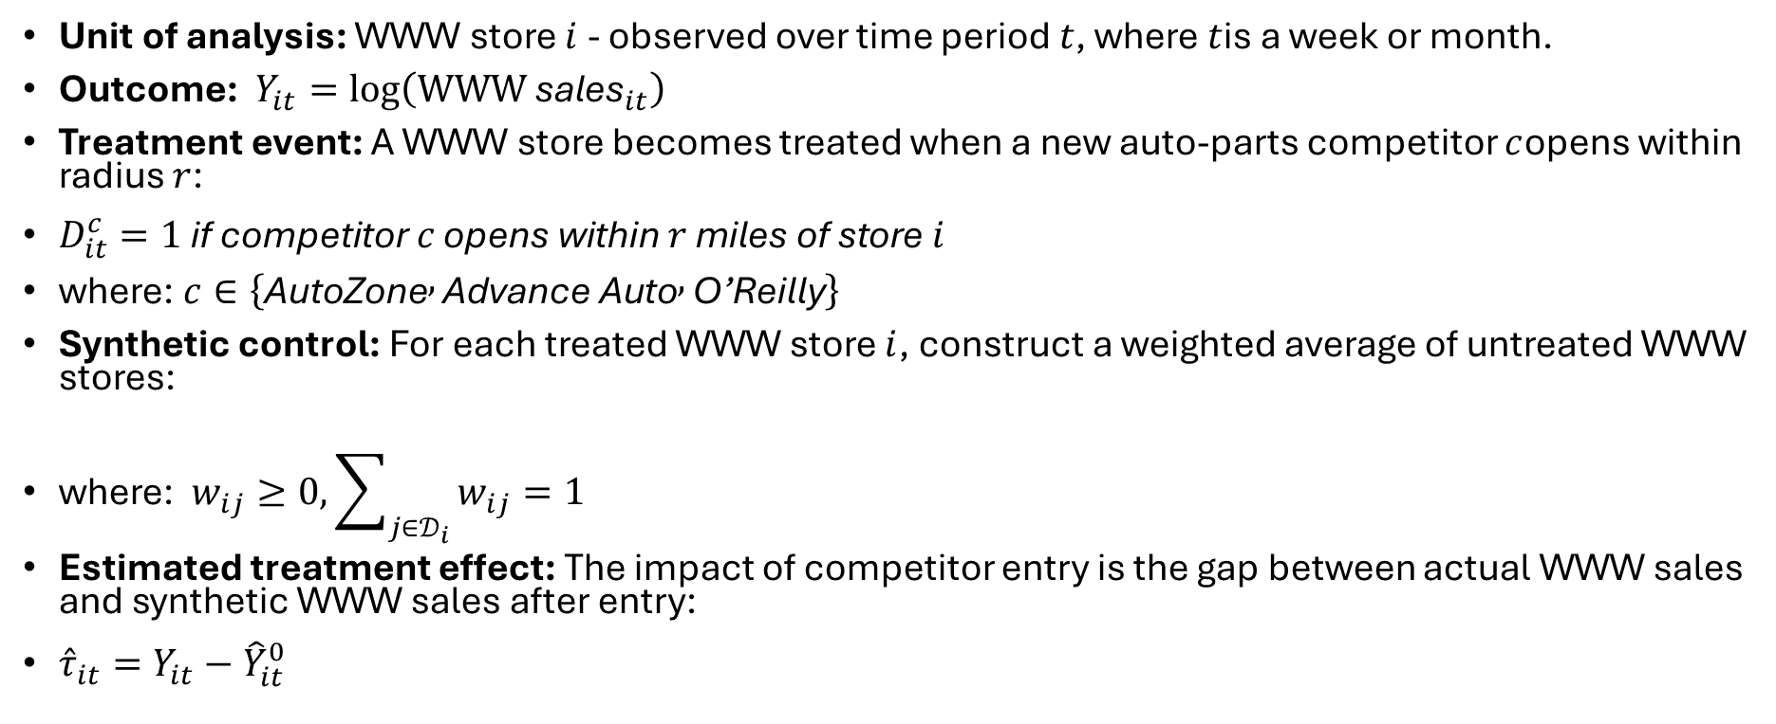

Formal Setup
Unit of analysis: WWW store $i$ - observed over time period $t$, where $t$is a week or month.
Outcome: $Y_{it}=log⁡\left({WWW \text{sales}}_{it}\right)$
Treatment event: A WWW store becomes treated when a new auto-parts competitor $c$opens within radius $r$:
$D_{it}^{c}=1 \text{if} \text{competitor} c \text{opens} \text{within} r \text{miles} \text{of} \text{store} i$
where: $c∈\left\{\text{AutoZone} , \text{Advance} \text{Auto} , \text{O}\text{’}\text{Reilly}\right\}$
Synthetic control: For each treated WWW store $i$, construct a weighted average of untreated WWW stores:
where: $w_{ij}≥0, \sum_{j∈𝒟_{i}}{w_{ij}}=1$
Estimated treatment effect: The impact of competitor entry is the gap between actual WWW sales and synthetic WWW sales after entry:
${\hat{τ}}_{it}=Y_{it}−{\hat{Y}}_{it}^{0}$
$${\hat{Y}}_{it}^{0}=\sum_{j∈𝒟_{i}}{w_{ij}}Y_{jt}$$
Notes:
We estimate the effect of competitor entry as the post-opening gap between exposed WWW sales and a synthetic counterfactual built from similar unexposed WWW stores.

Slide 13
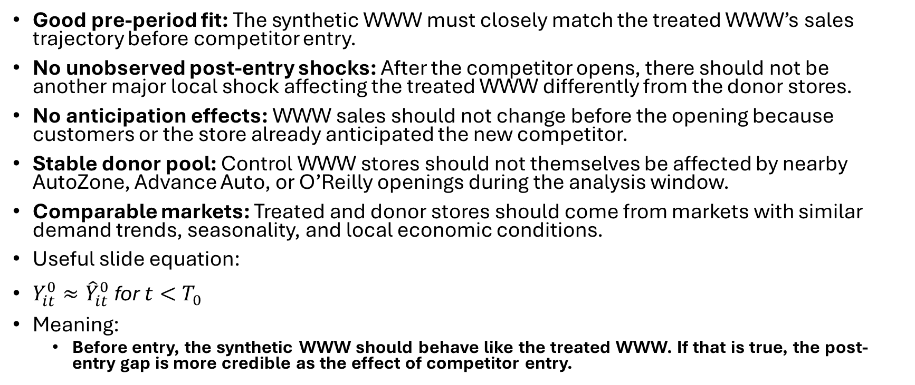
Identification Assumptions
Good pre-period fit: The synthetic WWW must closely match the treated WWW’s sales trajectory before competitor entry.
No unobserved post-entry shocks: After the competitor opens, there should not be another major local shock affecting the treated WWW differently from the donor stores.
No anticipation effects: WWW sales should not change before the opening because customers or the store already anticipated the new competitor.
Stable donor pool: Control WWW stores should not themselves be affected by nearby AutoZone, Advance Auto, or O’Reilly openings during the analysis window.
Comparable markets: Treated and donor stores should come from markets with similar demand trends, seasonality, and local economic conditions.
Useful slide equation:
$Y_{it}^{0}≈{\hat{Y}}_{it}^{0} \text{for} t<T_{0}$
Meaning:
Before entry, the synthetic WWW should behave like the treated WWW. If that is true, the post-entry gap is more credible as the effect of competitor entry.
Notes:
The key assumption is that, absent competitor entry, the treated WWW would have continued to track its synthetic control.

Slide 14
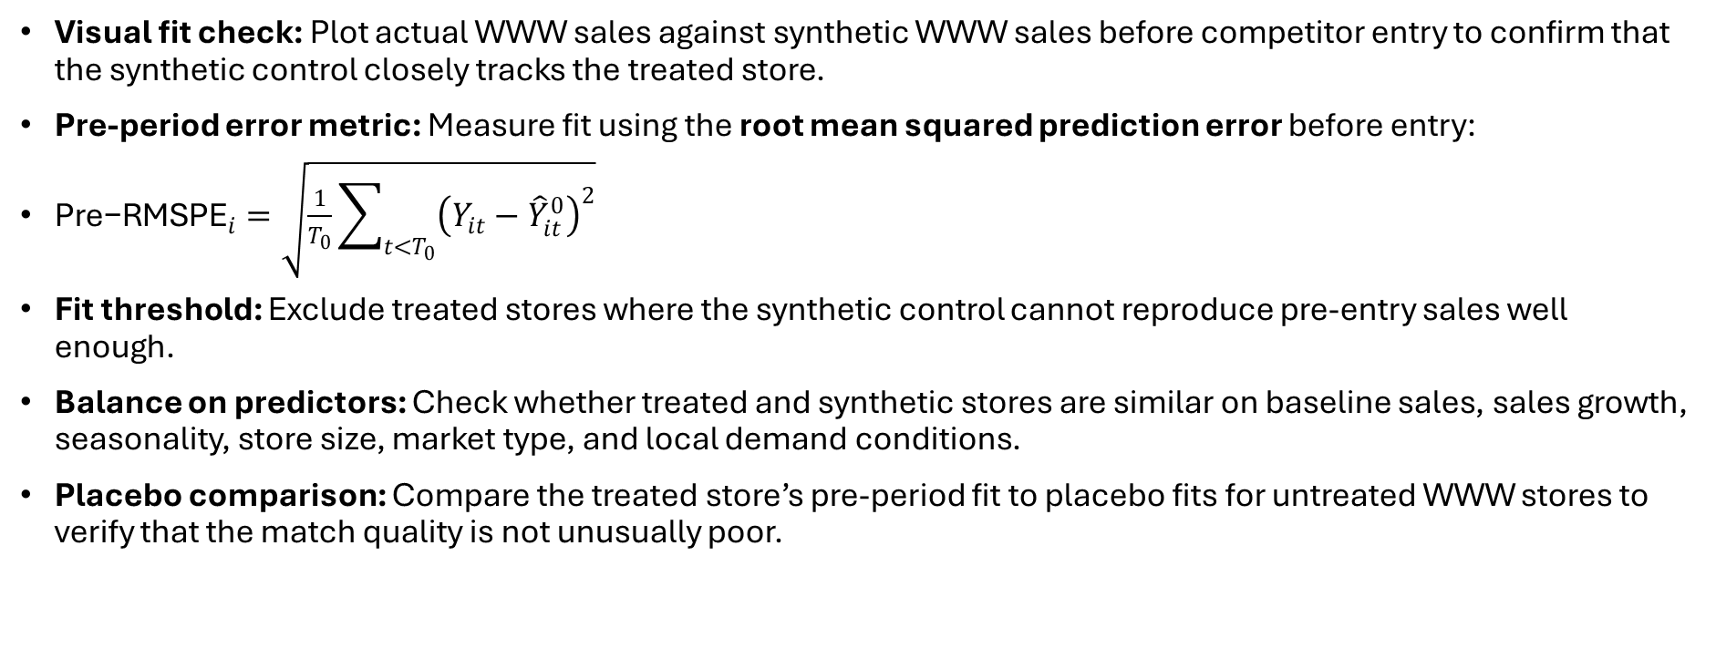
Pre-period fit diagnostics
Visual fit check: Plot actual WWW sales against synthetic WWW sales before competitor entry to confirm that the synthetic control closely tracks the treated store.
Pre-period error metric: Measure fit using the root mean squared prediction error before entry:
${\text{Pre}\text{−}\text{RMSPE}}_{i}=\sqrt{\frac{1}{T_{0}}\sum_{t<T_{0}}{{\left(Y_{it}−{\hat{Y}}_{it}^{0}\right)}^{2}}}$
Fit threshold: Exclude treated stores where the synthetic control cannot reproduce pre-entry sales well enough.
Balance on predictors: Check whether treated and synthetic stores are similar on baseline sales, sales growth, seasonality, store size, market type, and local demand conditions.
Placebo comparison: Compare the treated store’s pre-period fit to placebo fits for untreated WWW stores to verify that the match quality is not unusually poor.
Notes:
A credible synthetic control should look almost identical to the treated WWW before competitor entry; otherwise, the post-entry gap is hard to interpret causally.
Line chart: Actual WMT vs. Synthetic WMT sales
X-axis: weeks relative to competitor opening
Y-axis: indexed or log WWW sales
Vertical line: competitor opening date
Pre-period: lines should overlap closely
Post-period: gap becomes the estimated impact

Slide 15
Main Results: AAA

Slide 16
Main Results: BBBB

Slide 17
Main Results: CCC

Slide 18
Heterogeneity by market/store type

Slide 19
Robustness Checks

Slide 20
Placebo tests

Slide 21
Limitations

Slide 22
Economic Interpretation

