Slide 1
EGH419: Advanced Design and Entrepreneurship
Workshop 6: System Architecture, Trade Studies, WBS and Timeline.
Lecturer: Fernando Vanegas
Tutor: Sebastien Boiteau

Slide 2
OUTLINE
System Architecture
Trade Studies
WBS
Timeline
Meeting minutes
30 min
30 min
20 min
20 min
10 min

Slide 3
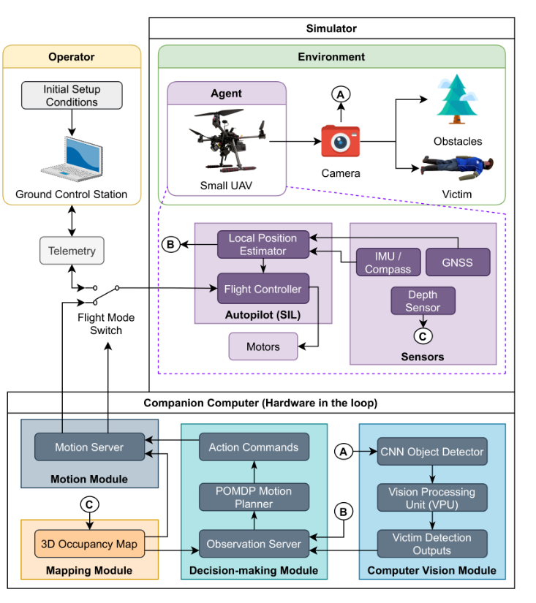
System Architecture
Diagram showing the overall structure of the entire system, including its components, subsystems, and interactions.
This the example of a smart UAV used for search and rescue.
Your system architecture should stay high-level
Sandino, J.; Maire, F.; Caccetta, P.; Sanderson, C.; Gonzalez, F. Drone-Based Autonomous Motion Planning System for Outdoor Environments under Object Detection Uncertainty. Remote Sens. 2021, 13, 4481. https://doi.org/10.3390/rs13214481

Slide 4
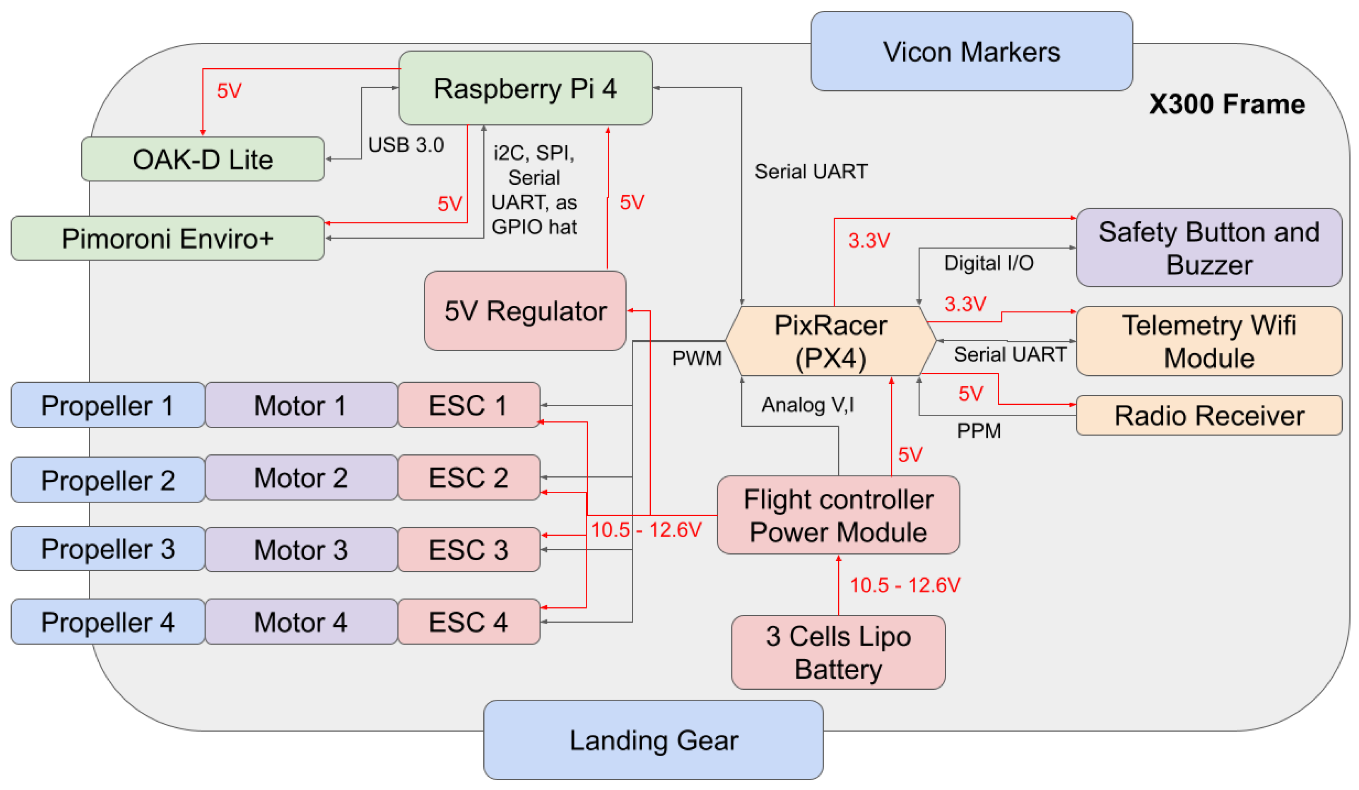
Subsystem Architecture
Subsystem architecture describes the internal structure of one subsystem identified in the system architecture
This the example of an “UAV” subsystem.
Subsystem architectures should be more detailed compared to the system architecture.
Galvez-Serna, J.; Vanegas, F.; Brar, S.; Sandino, J.; Flannery, D.; Gonzalez, F. UAV4PE: An Open-Source Framework to Plan UAV Autonomous Missions for Planetary Exploration. Drones 2022, 6, 391. https://doi.org/10.3390/drones6120391

Slide 5
System vs Subsystem architecture
 | System Architecture | Subsystem Architecture
Scope | Entire system | One subsystem
Level of detail | High-level | More detailed
Elements | Subsystems and interfaces | Components inside a subsystem
Role | Organize the system | Design subsystem implementation

Slide 6
Group Activity
Create the first draft of your system architecture.
Keep your system architecture high-level (generic). Do not get too specific about the components you are using or the interfaces between them.
The system architecture in assessment 2 is a GROUP COMPONENT
The subsystem architecture in assessment 2 is an INDIVIDUAL COMPONENT

Slide 7
Trade Studies
Decision-making study that evaluates different design options to optimize a system’s performance.
Define the problem
Define constraints. These are derived from the System Requirements (customer needs → HLOs→ system requirements).
Find several solutions (maximum 5).
Evaluation Criteria (Criteria that will be used to assess the solution).
Weight Factors (Importance of the criteria relative to each other).
Normalization Scale (This will give us a numerical value for each criteria).
Rank the solutions.

Slide 8
Trade Studies
Example: Purchasing a new phone
I want to find the best option for a new phone.
Need to be recent and/or in the top 10 best seller of 2023 and 512gb.
Solutions: Apple iPhone 15 Pro Max, Apple iPhone 14, Samsung Galaxy S23 Ultra.
Cost, charging time, battery.
Weight Factor: Cost (2), Charging Time (3), Battery (1). Most important is the highest.

Slide 9
Trade Studies
Normalization Scale:
Cost (AUD) | 500-1000 | 1000-1500 | 1500-2000 | 2000-2500 | 2500-3000
Scale | 5 | 4 | 3 | 2 | 1
Battery (days) | 0.5-1 | 1-1.5 | 1.5-2 | 2-2.5 | 2.5-3
Scale | 1 | 2 | 3 | 4 | 5
Charge (hours) | 0.5-1 | 1-1.5 | 1.5-2 | 2-2.5 | 2.5-3
Scale | 5 | 4 | 3 | 2 | 1

Slide 10
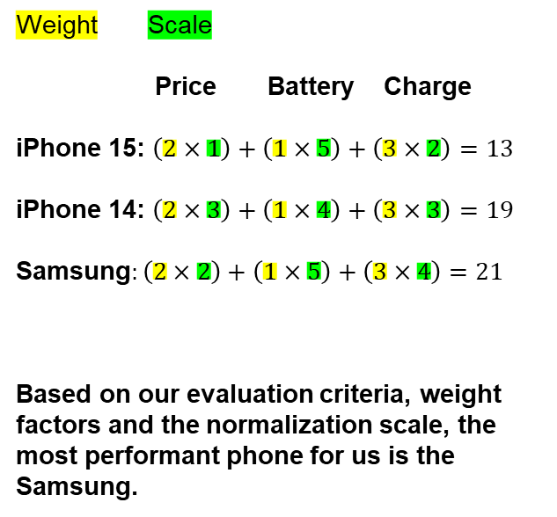
Trade Studies
 | Price (AUD) | Battery | Charge Time
iPhone 15 Pro Max | 2549.00 | 2 days 21h | 2h01
iPhone 14 | 1849.00 | 2 days 5h | 1h56
Samsung Galaxy A14 | 2249.00 | 2 days 19h | 1h21
Weight Scale
Price Battery Charge
iPhone 15: $\left(2×1\right)+\left(1×5\right)+\left(3×2\right)=13$
iPhone 14: $\left(2×3\right)+\left(1×4\right)+\left(3×3\right)=19$
Samsung$:\left(2×2\right)+\left(1×5\right)+\left(3×4\right)=21$
Based on our evaluation criteria, weight factors and the normalization scale, the most performant phone for us is the Samsung.
 | Price (scale) | Battery (scale) | Charge (scale)
iPhone 15 Pro Max | 1 | 5 | 2
iPhone 14 | 3 | 4 | 3
Samsung Galaxy A14 | 2 | 5 | 4

Slide 11
Group Activity
Define a problem for your product
Define the constraints
Find 3 solutions
Define your evaluation criteria
Define weight factors
Define normalization scale
This section in assessment 2 is INDIVIDUAL. One trade study per person.

Slide 12
Work Breakdown Structure
A Work Breakdown Structure (WBS) is a hierarchical outline of tasks and outputs needed to complete a project. It covers all the elements of the system across its life cycle.
In this subject, your WBS need to show the tasks and output needed to design your first prototype.
Entrepreneurship (problem identification / ideation, market research, customer persona…)
System Engineering (HLOs, CONOPs, system requirements…)
How do the Entrepreneurship and the System Engineering overlap?

Slide 13
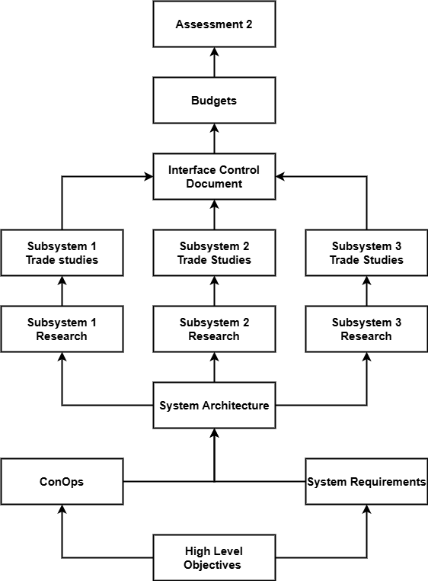
Work Breakdown Structure
Example of a WBS from last year, showing the work packets needed in system engineering to complete their Assessment 2.
This is just an example.
You are required to define the work packets you need (entrepreneurship + system engineering) to design, test and validate a first working prototype.

Slide 14
Group Activity
Draw the first draft of your WBS
What have you done so far in the subject?
What do you need to do to design/test/validate your first prototype?
This section in assessment 2 is a GROUP COMPONENT
Useful tools for designing diagrams:
Miro Draw.io

Slide 15
Timeline
Gantt Chart: Project management tool that shows activities (tasks or events) displayed against time.
At a first glance, we should be able to see:
The activities
Start and end of each activity
The scheduled length of each activity
The start and end date of the whole project
Your timeline should be derived from your WBS. It can be refined and iterated after your preliminary design.
Same as the WBS, the timeline should only cover the tasks and output needed to design, test and validate a first working prototype.

Slide 16
Group Activity
Find a template online for your Gantt Chart.
Use the first tasks that you completed in this subject to start your timeline.
This section in assessment 2 is a GROUP COMPONENT

Slide 17
Group Activity
Meeting minute:
System Architecture
Trade Studies
WBS
Timeline

