Slide 1
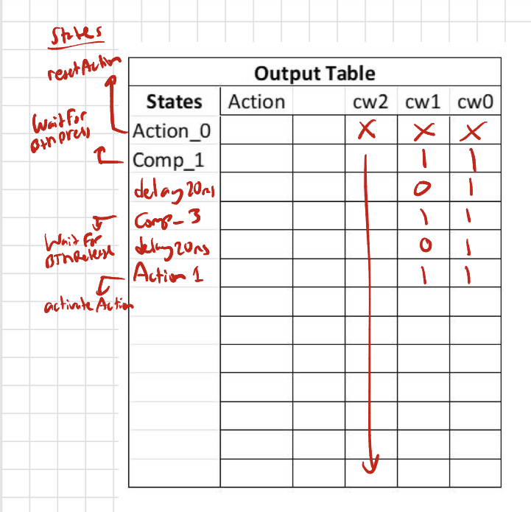
button_debounce
HW7_cu
button = 0
HW7_dp
reset
Init i = 0
State: delay_20msec
Comp_2:
cw
2
reset
cw
clk
clk
Comp_1
State: WaitForBtnPress
counter
Action_0:
State: resetAction
button = 1
i < 2000 (sw = 0)
11
2000
Inc_1: i++
11
Inc_2: i++
i >= 2000 (Below) (sw = 1)
sw
=
Comparator
i >= 2000 (sw = 1)
button = 1
i < 2000 (sw = 0)
Comp_4
Comp_3 State: WaitForBtnRelease
Action_1:
State: activateAction
Init i = 0
State: delay_20msec
button = 0
Button
Action

Slide 2
hw07_tb
button_debounce
tb
clk
Lec10
clk
clk
clk
reset
reset
reset
reset
action
crtl
‘0’
Q
button
button
button
counter

Slide 3
