Slide 1
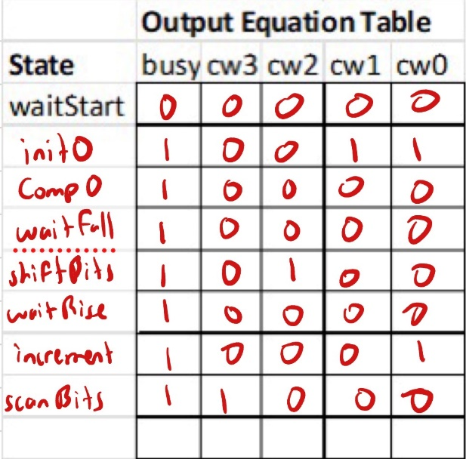
Lec11_cu
kbclk
Lec11_dp
cw
4
2
reset
reset
kbclk
Comp0:
count < 33
waitFall
cw
cw
clk
cw(1:0)
Counter
clk
kbclk’
6
33
waitStart
kbclk’
Init0:
count = 0
kbclk’
shiftBits
6
sw
sw
L Comparator
scanBits
kbclk’
increment:
count++
kbclk
waitRise
cw(2)
Shift Right 1
8
cw(3)
Register
cw
8
kbclk
kbData
scan
Busy
kbData
scan
Keyboard
kbclk
kbdata

Slide 2
Lec11_tb
Lec11
clk
clk
Lec11_dp
reset
clk
clk
Keyboard
reset
reset
sw
sw
kbclk
reset
kbclk
kbclk
cw
cw
scan
scan
kbdata
kbdata
kbdata
kbdata
kbdata
busy
busy
scan
scan
Lec11_cu
clk
clk
reset
cw
cw
reset
kbclk
kbclk
scan
scan
sw
sw

