Slide 1
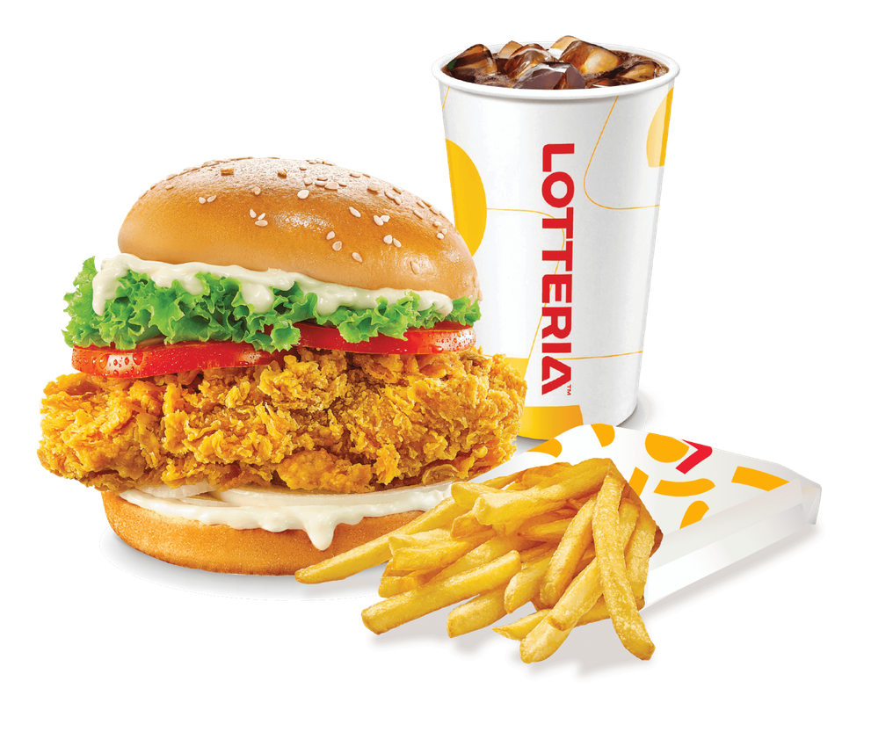
LOTTERIA
PHILIPPINES
40-Pyeong Franchise
Cost Presentation
Full-service quick-service restaurant setup guide for a Philippine dine-in branch
Investor Planning Deck
Estimated Total Initial Investment
₱23.5M to ₱46.9M
Recommended capital preparation: ₱30M to ₱50M
Planning estimate only. Subject to official franchise agreement, quotations, lease terms and LGU requirements.

Slide 2
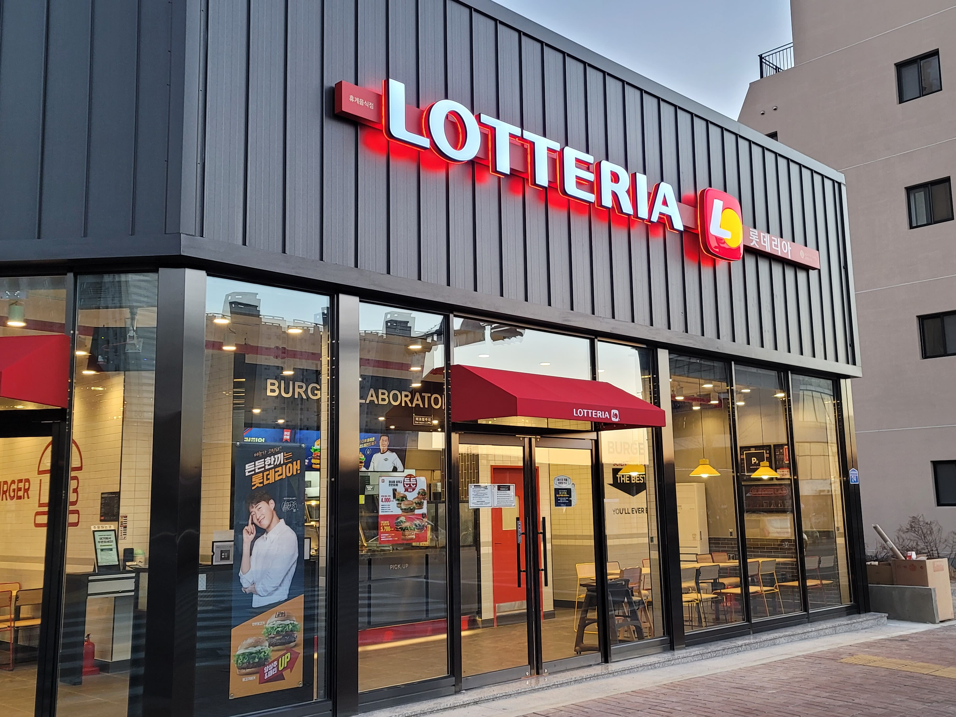
Executive Investment Snapshot
A 40-pyeong branch is a complete dine-in fast-food store format for mall or high-foot-traffic locations.
STORE SIZE
40 pyeong / 132 sqm
ESTIMATED INVESTMENT
₱23.5M – ₱46.9M
RECOMMENDED PREPARATION
₱30M – ₱50M
PRIMARY COST DRIVERS
Fit-Out
• Designed for dine-in, takeout and delivery-ready operations • Largest cash requirement comes before opening day • Capital buffer protects against construction, permit and landlord changes
₱6.5M–₱11M
Kitchen Equipment
₱7M–₱12M
Other Setup
₱3.5M–₱8M
This deck presents the cost model as a Philippine franchise investment guide. Amounts remain estimates until verified by official documents.
Lotteria Philippines 40-Pyeong Franchise Cost Estimate | Planning figures only, verify through official quotations
02

Slide 3
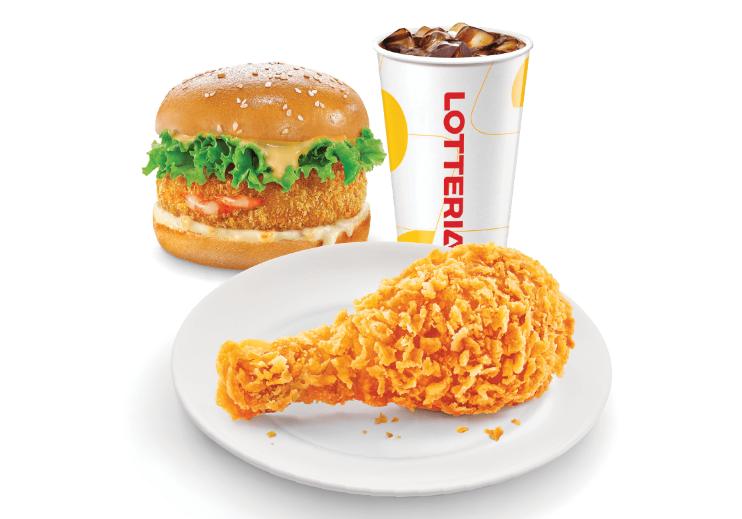
What a 40-Pyeong Store Covers
Approximately 132 sqm, suitable for a complete quick-service restaurant with customer and back-of-house zones.
Dining Area
Tables, chairs, waiting zone and customer circulation
Service Counter
Cashier, pickup counter, menu board and queue flow
Kitchen Line
Fryers, grills, assembly tables and holding equipment
Cold & Dry Storage
Freezers, chillers, dry goods and packaging stocks
132 sqm working footprint
The store size supports both sales volume and operational separation.
Staff & Utility Area
Lockers, handwash, cleaning area and office/storage
Planning assumption: standard dine-in fast-food branch, not kiosk or express-only format.
Lotteria Philippines 40-Pyeong Franchise Cost Estimate | Planning figures only, verify through official quotations
03

Slide 4
Total Investment Guidance
The practical planning range depends heavily on site condition, landlord requirements and store location.
₱23.5M to ₱46.9M
Recommended capital preparation
Estimated Total Initial Investment
₱30M to ₱50M
BUDGET LOGIC
INVESTMENT RANGE VIEW
• Base investment includes the store build, kitchen, signage, technology, inventory, training and launch costs. • Recommended capital includes a safer allowance for deposits, delays, import costs, supplier adjustments and contingency. • Prime malls and flagship locations normally require a higher buffer because landlord and engineering costs are stricter.
Low estimate
₱23.5M–₱30M
Core range
₱30M–₱40M
Prime/flagship
₱40M–₱50M
Premium buffer
₱50M–₱55M
Use the recommended capital range for serious investor preparation, especially where landlord, mall and imported equipment variables are unknown.
Lotteria Philippines 40-Pyeong Franchise Cost Estimate | Planning figures only, verify through official quotations
04

Slide 5
Core Build-Out Budget
These costs convert the site into a brand-compliant, operating fast-food branch.
Store Fit-Out
Kitchen Equipment
Furniture & Fixtures
₱6.5M – ₱11.0M
₱7.0M – ₱12.0M
₱1.5M – ₱3.0M
Construction, interiors, MEPF works, counter, lighting, walls, ceiling, flooring and finishing.
Fryers, grills, freezers, chillers, prep tables, exhaust, warmers and stainless fixtures.
Dining tables, chairs, service fixtures, storage cabinets, waiting area and customer fixtures.
Signage & Branding
POS & Technology
Core build-out subtotal focus
₱800K – ₱1.8M
₱600K – ₱1.5M
Outdoor signage, lightbox, menu boards, indoor branding, wall graphics and opening materials.
POS terminal, printers, kitchen display, order monitor, internet, CCTV and store systems.
The fit-out and kitchen package are the heavy engines of the project. These two categories can represent more than half of the cash requirement before opening.
Actual amount may change due to shell condition, landlord standards, exhaust routing, utility capacity and brand-approved supplier requirements.
Lotteria Philippines 40-Pyeong Franchise Cost Estimate | Planning figures only, verify through official quotations
05

Slide 6
Opening Readiness Budget
These costs prepare the store to open legally, operate smoothly and launch with demand.
Franchise Fee / Brand Rights
Permits & Legal
Opening Inventory
₱1.0M – ₱3.0M
₱300K – ₱900K
₱1.0M – ₱2.2M
Brand rights, manuals, onboarding, operating system, store standards and launch support.
Business registration, barangay clearance, mayor’s permit, BIR, sanitary, fire safety and occupancy.
Food ingredients, packaging, drinks, sauces, cleaning supplies, uniforms and disposables.
Training & Pre-Opening
Marketing & Launch
Other Setup Expenses
₱600K – ₱1.5M
₱700K – ₱2.0M
₱3.5M – ₱8.0M
Recruitment, crew training, manager training, mock operations, soft opening and manuals.
Grand opening promos, social ads, flyers, local marketing, influencers and opening discounts.
Rent advance, deposits, insurance, professional fees, delivery app setup and contingency.
Other setup expenses are often underestimated. They are the project’s buffer against surprise costs.
Lotteria Philippines 40-Pyeong Franchise Cost Estimate | Planning figures only, verify through official quotations
06

Slide 7
Store Fit-Out Scope
The fit-out turns a bare commercial space into a compliant, branded and customer-ready restaurant.
ESTIMATED FIT-OUT
INVESTOR NOTE
₱6.5M – ₱11.0M
Mall locations may require approved contractors, construction bonds, fire-rated materials, specific exhaust routing and stricter design approval.
• Civil works: flooring, ceiling, walls, partitions and finishing • Electrical works: panels, wiring, lighting, outlets and power load preparation • Plumbing and sanitary: waterlines, drainage, grease trap provisions and handwash points • Mechanical works: ventilation, exhaust coordination and air-conditioning provisions • Front counter and customer area finishing with brand-compliant materials
Why it matters
Fit-out affects customer experience, kitchen flow, safety compliance and opening timeline.
Typical share of total
₱6.5M–₱11M
Fit-out quotation should be supported by architectural plans, engineering plans, bill of materials and contractor proposal.
Lotteria Philippines 40-Pyeong Franchise Cost Estimate | Planning figures only, verify through official quotations
07

Slide 8
Kitchen Equipment Scope
The kitchen package protects speed, consistency, food safety and daily production capacity.
ESTIMATED KITCHEN PACKAGE
₱7.0M – ₱12.0M
COOKING LINE
COLD CHAIN
BACK-OF-HOUSE
• Commercial fryers • Burger grills / patty equipment • Chicken fryers • Food warmers and holding cabinets
• Freezers • Chillers • Prep tables • Sauce and condiment stations
• Exhaust hood system • Stainless work tables • Beverage equipment • Smallwares and utensils
Potential cost movers
• Imported equipment or brand-approved vendors • Custom stainless fabrication • Higher kitchen capacity for flagship or delivery-heavy sites • Lead time changes, shipping, duties and installation requirements
Equipment should be verified against the official Lotteria store equipment list and supplier quotations.
Lotteria Philippines 40-Pyeong Franchise Cost Estimate | Planning figures only, verify through official quotations
08

Slide 9
Customer Experience & Store Systems
Furniture, branding and technology complete the restaurant’s front-of-house identity and operating rhythm.
Furniture & Fixtures
Signage & Branding
POS & Technology
₱1.5M – ₱3.0M
₱800K – ₱1.8M
₱600K – ₱1.5M
• Dining tables and chairs • Waiting area and queue fixtures • Storage cabinets and shelves • Condiment and service-area fixtures
• Outdoor signage and lightbox • Menu boards and wall graphics • Window stickers and promo displays • Brand-compliant color and layout
• POS terminals and printers • Kitchen display system • CCTV and internet setup • Order monitor and delivery integration
Investor emphasis
These categories are smaller than fit-out and kitchen equipment, but they strongly influence customer perception, order flow and sales reporting control.
Lotteria Philippines 40-Pyeong Franchise Cost Estimate | Planning figures only, verify through official quotations
09

Slide 10
Compliance & Pre-Opening Operations
Legal, inventory and training work must be completed before the first official trading day.
PERMITS & LEGAL
OPENING INVENTORY
TRAINING & PRE-OPENING
₱300K – ₱900K
₱1.0M – ₱2.2M
₱600K – ₱1.5M
• SEC or DTI setup, barangay clearance, mayor’s permit and BIR registration • Sanitary permit, staff health cards, fire safety certificate and occupancy compliance • Signage permits, waste disposal requirements and local inspections
• Initial stock of patties, buns, chicken, fries, sauces, drinks and packaging • Cleaning supplies, gloves, disposables, uniforms and store supplies • Higher buffer for grand opening week and delivery-app promos
• Manager and crew training, kitchen procedures, cashier workflow and service standards • Mock operations, soft opening, manuals and pre-opening payroll • Team readiness before marketing brings the crowd
Operational principle: opening day should test demand, not basic readiness.
Lotteria Philippines 40-Pyeong Franchise Cost Estimate | Planning figures only, verify through official quotations
10

Slide 11
Launch Budget & Working Capital Buffer
Marketing creates the opening wave, while deposits and contingency keep the project steady.
MARKETING & LAUNCH
₱700K – ₱2.0M
• Grand opening promotion, social media ads and local store marketing • Flyers, mall advertising, influencer support and opening discounts • Photo/video content, delivery app visibility and community awareness
OTHER SETUP EXPENSES
₱3.5M – ₱8.0M
The buffer is not extra luxury. It is the shock absorber of the opening project.
• Rent advance, security deposit, construction bond and utility deposits • Insurance, professional fees, delivery app onboarding and logistics • Contingency fund for delays, repairs, design revisions and supplier changes
Lotteria Philippines 40-Pyeong Franchise Cost Estimate | Planning figures only, verify through official quotations
11

Slide 12
Suggested Capital Preparation Scenarios
Choose capital planning based on site quality, landlord demands and desired safety margin.
Minimum Working Estimate
₱23.5M – ₱30M
Basic branch preparation with limited buffer. Suitable only when site condition and quotes are very clear.
Standard Mall / Commercial Branch
₱30M – ₱40M
Recommended for typical mall or commercial spaces with normal deposits and standard fit-out requirements.
Prime Mall / Flagship Branch
₱40M – ₱50M
Better for high-traffic malls, premium visibility, stricter landlord rules or stronger launch marketing.
Larger Buffer / Premium Location
₱50M+
Most conservative preparation for expensive sites, imported equipment, longer lead times and heavier contingency.
Advisor recommendation: prepare ₱30M–₱50M unless the location, landlord terms and supplier quotations are already finalized.
Lotteria Philippines 40-Pyeong Franchise Cost Estimate | Planning figures only, verify through official quotations
12

Slide 13
Verification Checklist & Next Steps
Before presenting the amount as final, confirm every major cost line with official documents.
1
Franchise Agreement
Confirm franchise fee, package inclusions, territory rules, royalties and brand obligations.
2
Supplier Quotations
Secure kitchen equipment, signage, POS, furniture and opening inventory quotes.
3
Lease & Landlord Terms
Review rent advance, deposit, construction bond, design rules, utilities and turnover condition.
4
Construction Bid
Validate fit-out through plans, engineering scope, material specs and contractor pricing.
5
LGU Compliance
Confirm business permits, sanitary, fire safety, occupancy and city-specific requirements.
Final reminder: this presentation is a projected investment estimate. Verify all figures through official quotations, franchise agreements, supplier proposals, lease terms and local government requirements.
Lotteria Philippines 40-Pyeong Franchise Cost Estimate | Planning figures only, verify through official quotations
13

