Slide 1
Using Artificial Neural Networks for
Making Race Strategy Decisions
in Formula One
WEI Wei
MA Yuxuan
WU Weiheng
2024.11.29

Slide 2
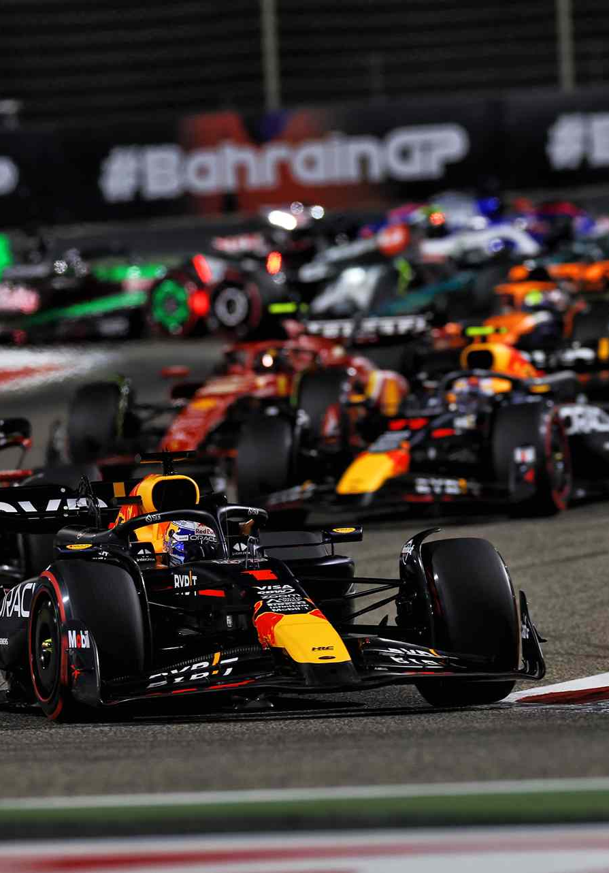
Outline
Introduction
Purpose
Methodology
Conclusion

Slide 3
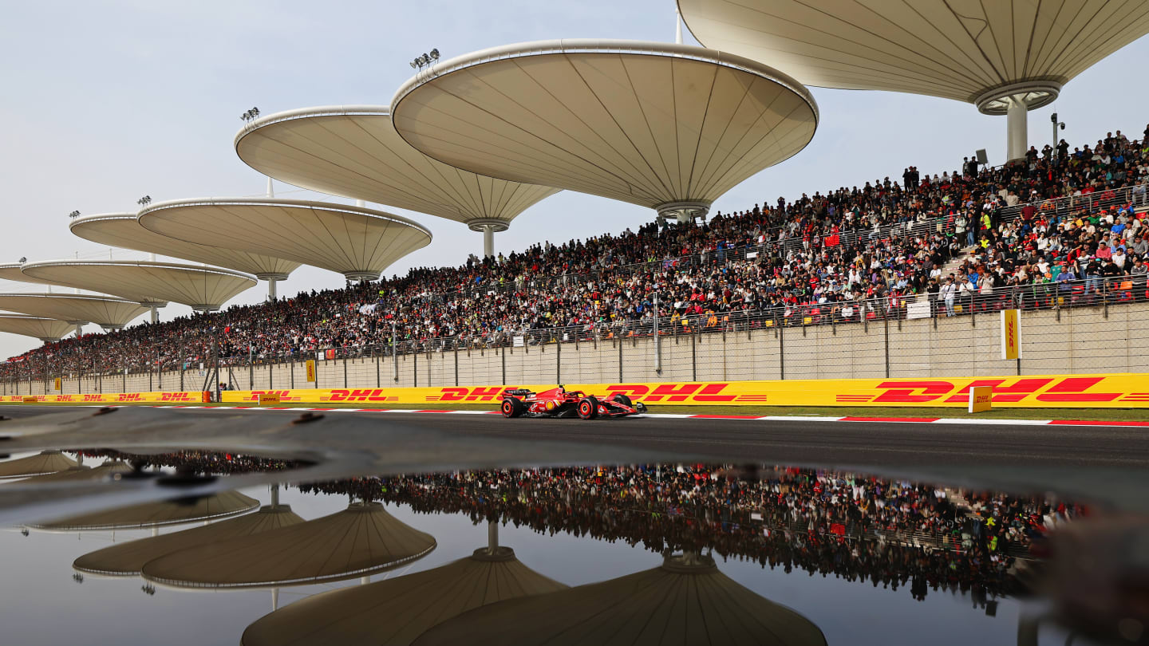
Introduction
What is Formula 1
The highest class of international motorsport
1
74
years of history (since 1950)
24
races one season
10
teams
20
drivers
200k-400k
attendance every race week
3

Slide 4
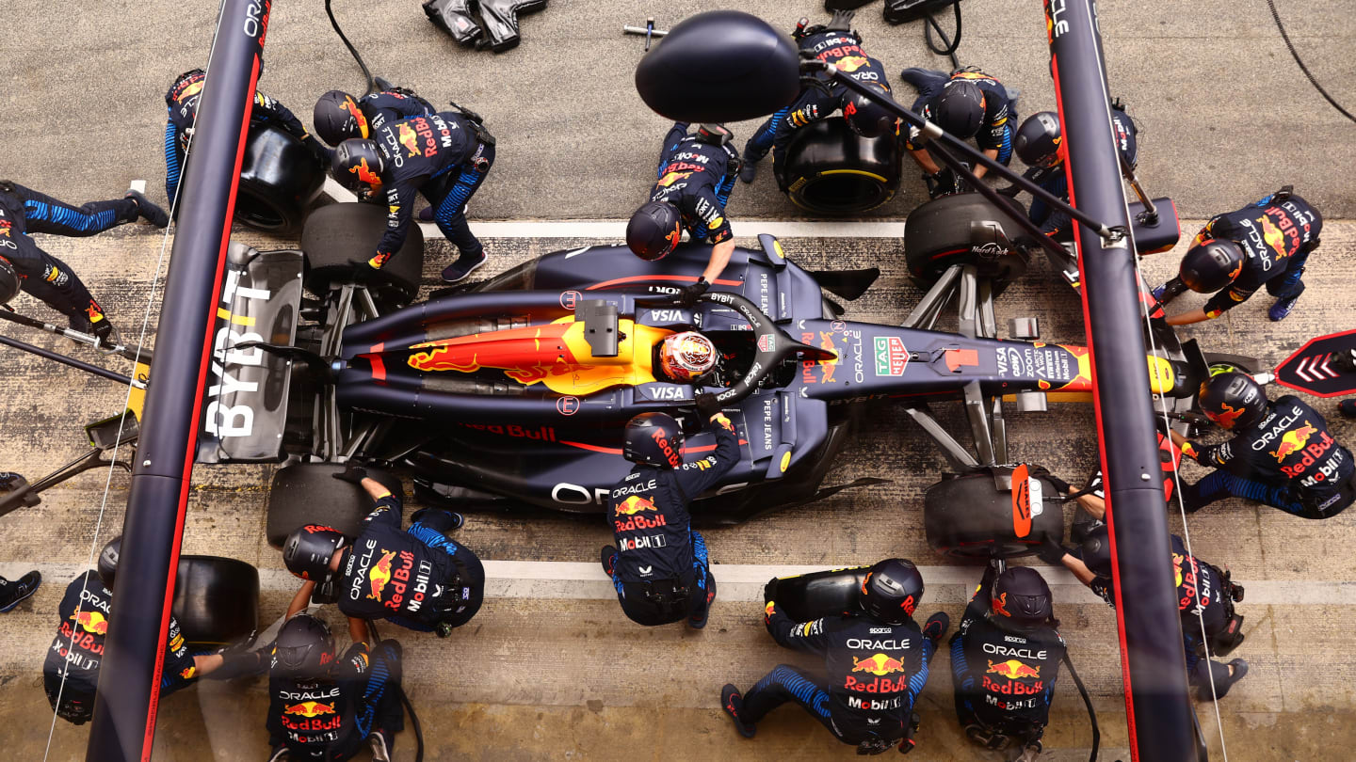
Introduction
Pit-stop and Strategy
In a race, every car MUST has
at least 1 pit-stop to change tyres
at least 2 tyre compounds used
An efficient way to gain advantage
2.5
22
seconds
in average
team members
involved
4

Slide 5
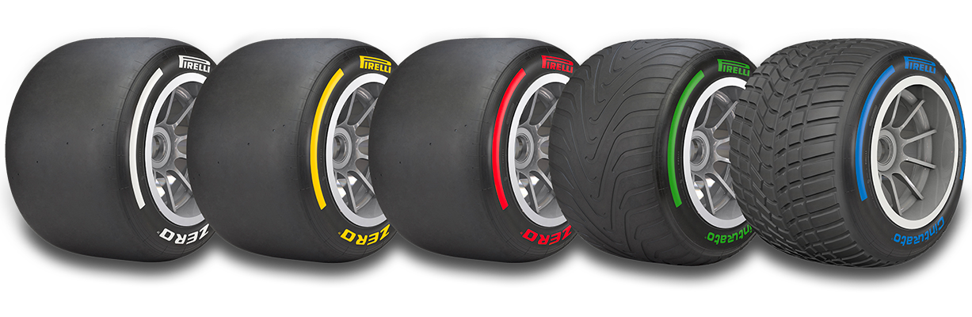
Introduction
Tyre Compounds
C0 C1 C2 C3 C4 C5
3 are chosen in a race
Hard Medium Soft
5

Slide 6
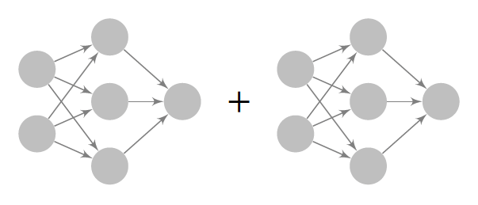
Purpose
To predict
WHEN to pit-stop &
WHICH tyre compound to change
combined as an optimal pit-stop strategy
Pit-stop
Decision
Tyre Compound
Decision
Feature
Input
Strategy
Output
6

Slide 7
Methodology
Variable Name | Description
initial_pos | Initial starting position of the racer.
sc_lap | Lap number when the safety car is deployed.
sc_laps_travelled | Laps travelled for the current tyre set.
sc_laps_remaining | Laps remained of the race.
sc_tyre_compound | Current tyre compound.
before_pit_pos | Current position (before pitstop).
Temperature | Track temperature.
Humidity | Track humidity.
Altitude | Track maximum altitude change.
Turns | Track number of turns in a lap.
RaceDistance | Track race distance / total number of laps.
TrackLength | Track total length of race (in km).
TeamAbility | Team Ability from previous season points
DriverAbility | Driver Ability from previous season drivers' points).
final_pos_gained | Final position gain or loss, reflecting the success of different strategies.
Data Processing
Pit-stop Decision
Dataset
Race data of 2016-2020
Work has done
Extract variables we need
Consider two conditions:
normal
under safety car
7

Slide 8
Methodology
Data Processing
Tyre Compound
Variable Name | Description
sc_laps_remaining | Laps remained of the race.
sc_tyre_compound | Current tyre compound.
Temperature | Track temperature.
Humidity | Track humidity.
Altitude | Track maximum altitude change.
Turns | Track number of turns in a lap.
RaceDistance | Track race distance / total number of laps.
TrackLength | Track total length of race (in km).
8

Slide 9
Methodology
Hyperparameter | Value
Number of hidden layers | 3
Number of neurons per layer | 64
Activation functions | ReLU (hidden layers), sigmoid (output layer)
Optimizer | Nadam
Loss function | Binary cross entropy
Training batch size | 256
Network Architecture
Pit-stop Decision Network
Output: TRUE or FALSE
Tyre Compound Decision Network
Hyperparameter | Value
Number of hidden layers | 1
Number of neurons per layer | 32
Activation functions | ReLU (hidden layers), softmax (output layer)
Optimizer | Nadam
Loss function | Sparse categorical cross entropy
Training batch size | 32
Output: Soft, Medium, Hard
9

Slide 10
Conclusion
Results
10

Slide 11
Conclusion
Future Works
Strategy of opponents
Wet conditions and wet tyres
And many other factors make F1 game fascinating
11

Slide 12
Reference
[1] Pirelli, Formula 1 and Pirelli, https://www.pirelli.com/tyres/en-ww/motorsport/car/formula-1
[2] F1, What is F1, https://www.formula1.com/en/page/what-is-f1
[3] jackchan0528, f1-stop-strategy, https://github.com/jackchan0528/f1-pitstop-strategy
[4] Heilmeier, Alexander et al. “Virtual Strategy Engineer: Using Artificial Neural Networks for Making Race Strategy Decisions in Circuit Motorsport.” Applied Sciences (2020): n. pag.
[5] Syeda, Jennifer “Deep-Racing: An Embedded Deep Neural Network (EDNN) Model to Predict the Winning Strategy in Formula One Racing” International Journal of Machine Learning(2023)
12

Slide 13
THANK YOU
Using Artificial Neural Networks for
Making Race Strategy Decisions
in Formula One
WEI Wei
MA Yuxuan
WU Weiheng

