Slide 1
Using Artificial Neural Networks for
Making Race Strategy Decisions
in Formula One
WEI Wei
MA Yuxuan
WU Weiheng
2024.11.29

Slide 2
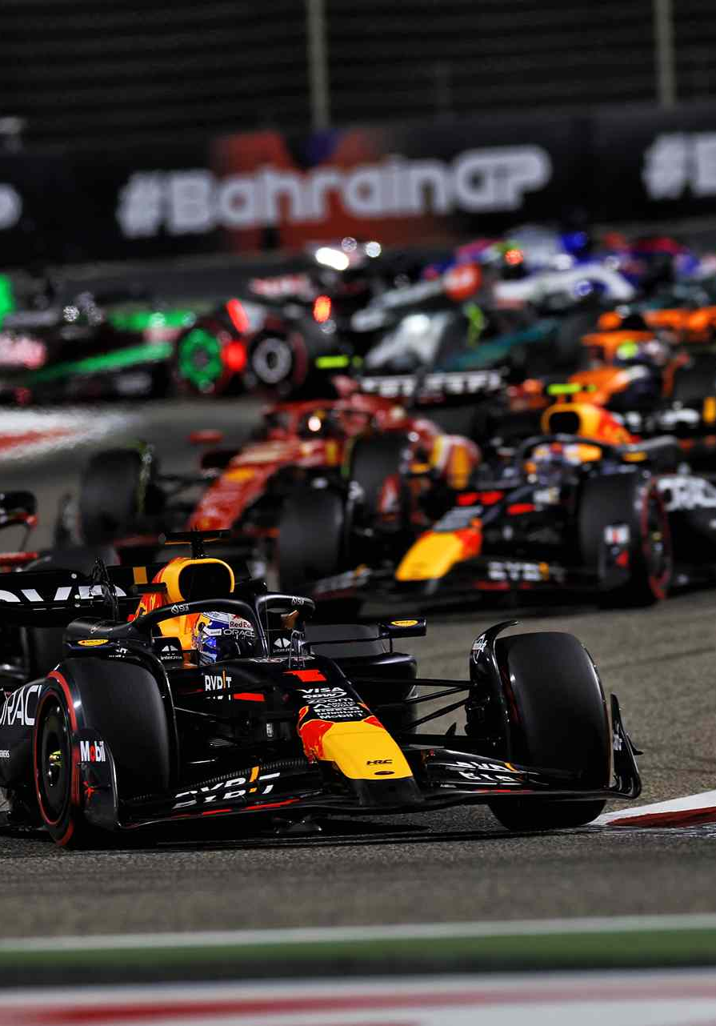
Outline
Introduction
Purpose
Methodology
Conclusion

Slide 3
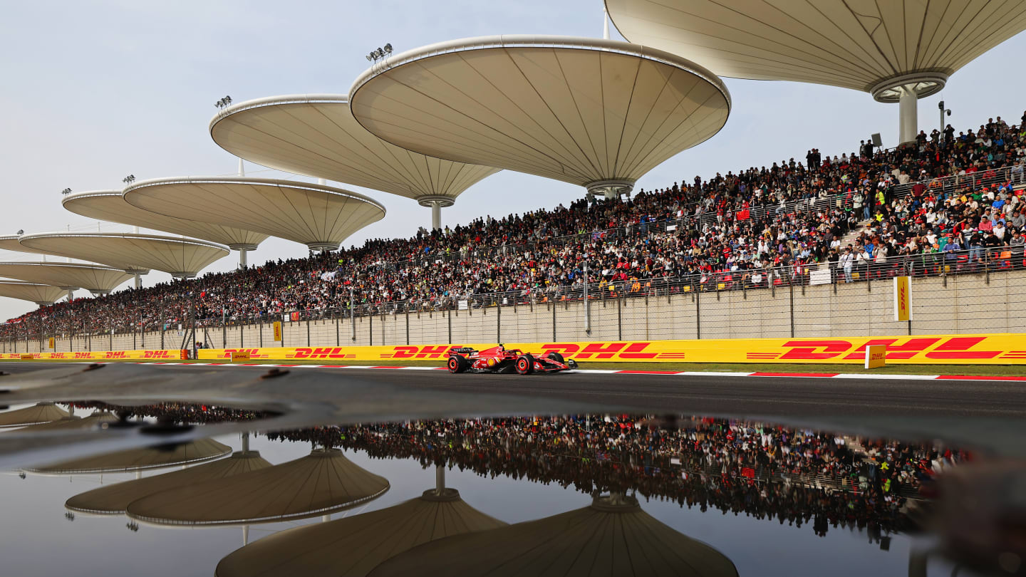
Introduction
What is Formula 1
The highest class of international motorsport
1
74
years of history (since 1950)
24
races one season
10
teams
20
drivers
200k+
attendance every race week
3

Slide 4
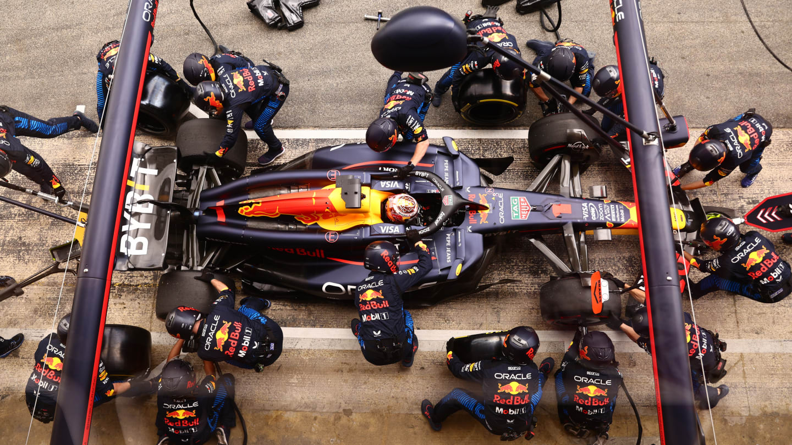
Introduction
Pit-stop and Strategy
In a race, every car MUST has
at least 1 pit-stop to change tyres
at least 2 tyre compounds used
An efficient way to gain advantage
2.5
22
seconds
in average
team members
involved
4

Slide 5
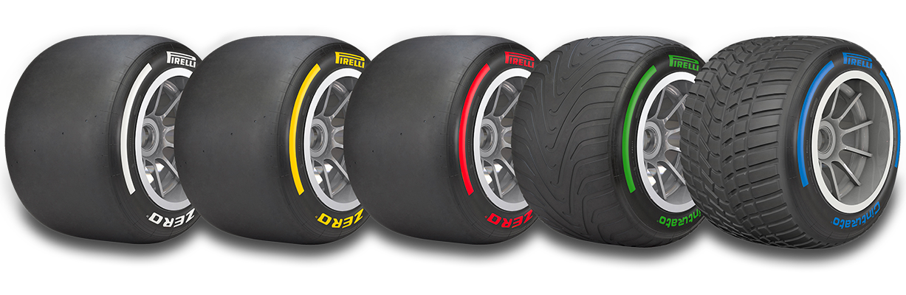
Introduction
Tyre Compounds
C0 C1 C2 C3 C4 C5
3 are chosen in a race
Hard Medium Soft
5

Slide 6
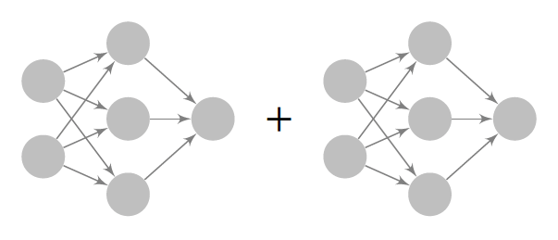
Purpose
To predict
WHEN to pit-stop &
WHICH tyre compound to change
combined as an optimal pit-stop strategy
Pit-stop
Decision
Tyre Compound
Decision
Feature
Input
Strategy
Output
6

Slide 7
Methodology
Starting position
Data Processing
Pit-stop Decision
Current position
Race Situation
Laps raced
Laps remaining
Dataset
Race data of 2016-2021
…
Temperature
Track Condition
Humidity
Work Done
Extract variables we need
Use position gained to evaluate
…
Team ability
Performance
Driver ability
…
7
Notes:
Objective conditions

Slide 8
Methodology
Data Processing
Tyre Compound
Variable Name | Description
laps_remaining | Laps remained of the race.
tyre_compound | Current tyre compound.
laps_used | Laps used of the tyres.
TrackId | Track at where raced.
Temperature | Track temperature.
Humidity | Track humidity.
Altitude | Track maximum altitude change.
8

Slide 9
Methodology
Hyperparameter | Value
Number of hidden layers | 3
Number of neurons per layer | 64
Activation functions | ReLU (hidden layers), sigmoid (output layer)
Optimizer | Nadam
Loss function | Binary cross entropy
Training batch size | 256
Network Architecture
Pit-stop Decision Network
Output: TRUE or FALSE
Tyre Compound Network
Hyperparameter | Value
Number of hidden layers | 1
Number of neurons per layer | 32
Activation functions | ReLU (hidden layers), softmax (output layer)
Optimizer | Nadam
Loss function | Sparse categorical cross entropy
Training batch size | 32
Output: Soft, Medium, Hard
9
Notes:
Reletive simple

Slide 10
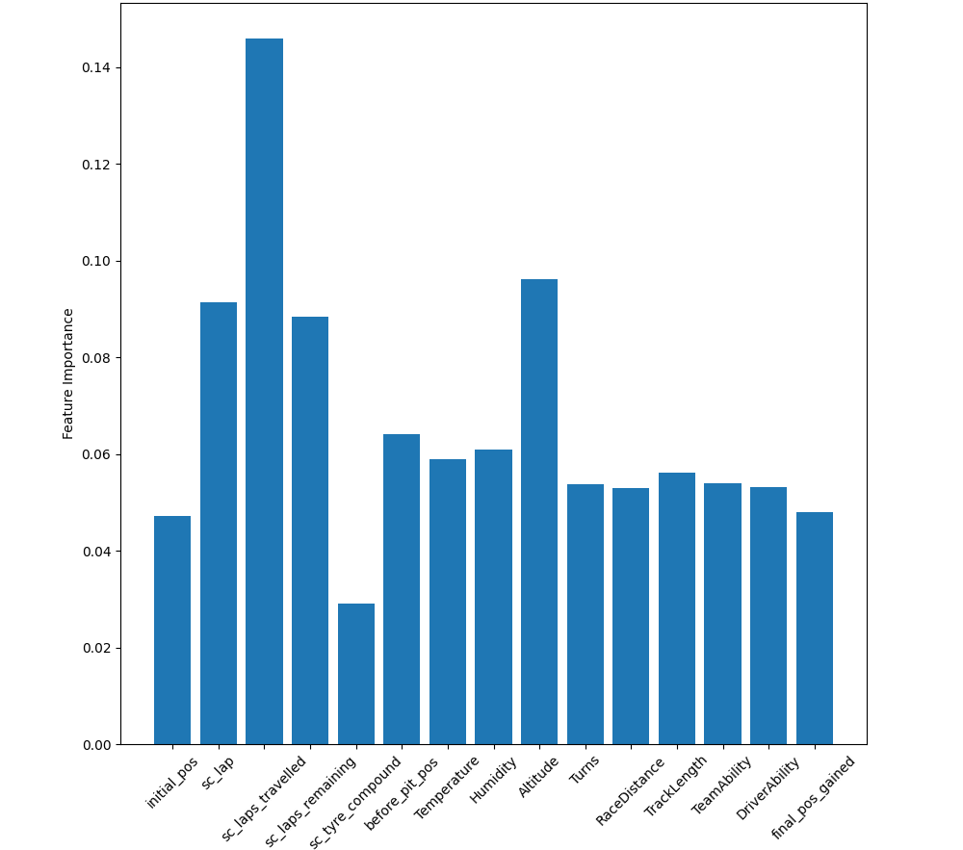
Conclusion
Feature Importance
Results for
Pit-stop Decision
10
Notes:
Using random forest, Take out some factors not that important

Slide 11
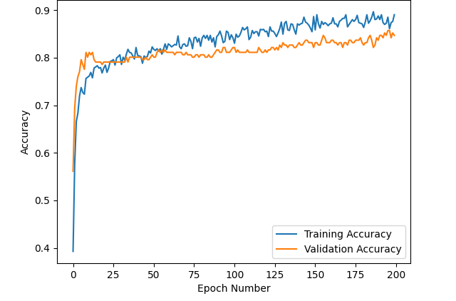
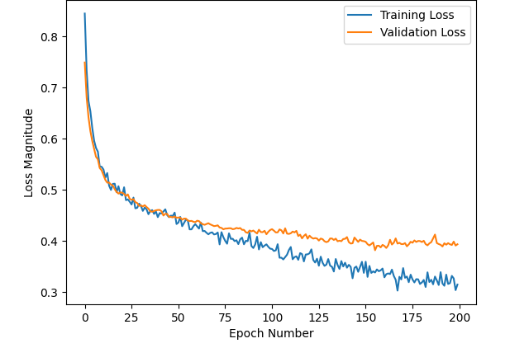
Conclusion
Results for
Pit-stop Decision
Accuracy
Loss
11

Slide 12
Conclusion
Future Works
Real-time prediction for every-lap data
Strategy of opponents
Wet conditions and wet tyres
And many other factors make F1 game fascinating
12

Slide 13
Reference
[1] Pirelli, Formula 1 and Pirelli, https://www.pirelli.com/tyres/en-ww/motorsport/car/formula-1
[2] F1, What is F1, https://www.formula1.com/en/page/what-is-f1
[3] jackchan0528, f1-stop-strategy, https://github.com/jackchan0528/f1-pitstop-strategy
[4] Heilmeier, Alexander et al. “Virtual Strategy Engineer: Using Artificial Neural Networks for Making Race Strategy Decisions in Circuit Motorsport.” Applied Sciences (2020): n. pag.
[5] Syeda, Jennifer “Deep-Racing: An Embedded Deep Neural Network (EDNN) Model to Predict the Winning Strategy in Formula One Racing” International Journal of Machine Learning(2023)
13

Slide 14
THANK YOU
Using Artificial Neural Networks for
Making Race Strategy Decisions
in Formula One
WEI Wei
MA Yuxuan
WU Weiheng

