Slide 1
Using Artificial Neural Networks for
Making Race Strategy Decisions
in Formula One
WEI Wei
MA Yuxuan
WU Weiheng
2024.11.29

Slide 2
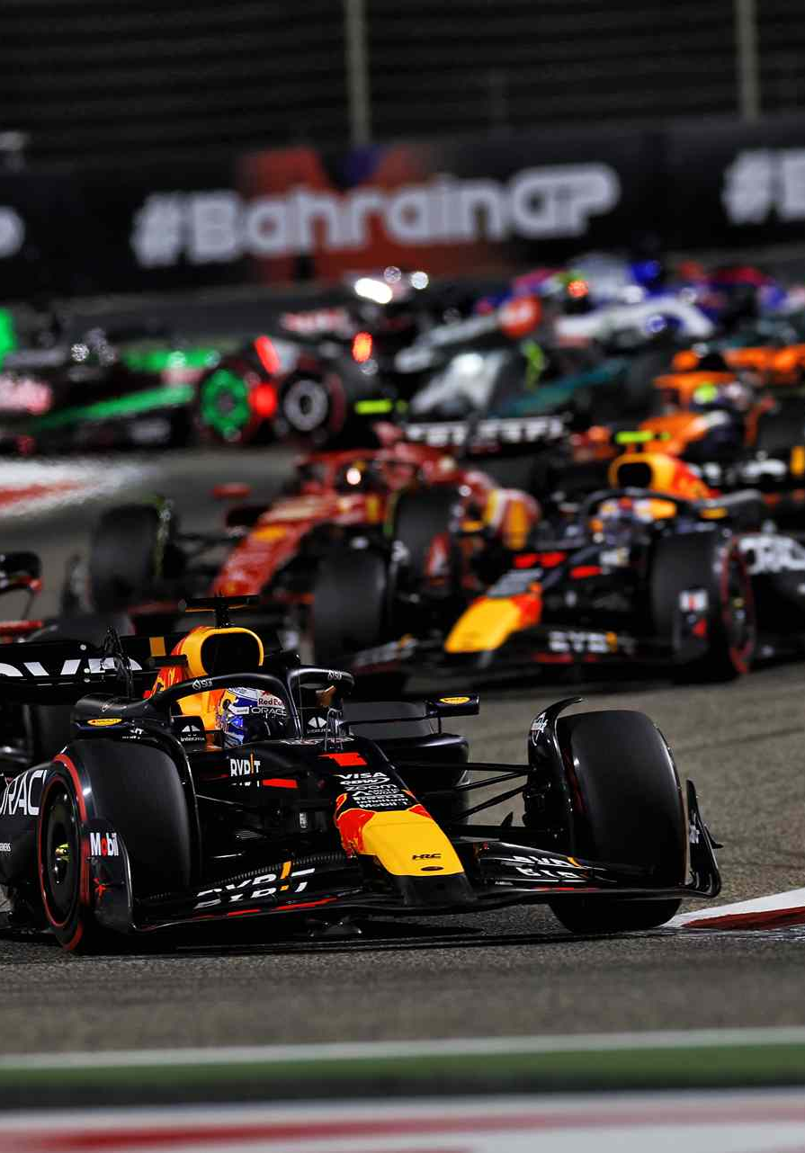
Outline
Introduction
Purpose
Methodology
Result

Slide 3
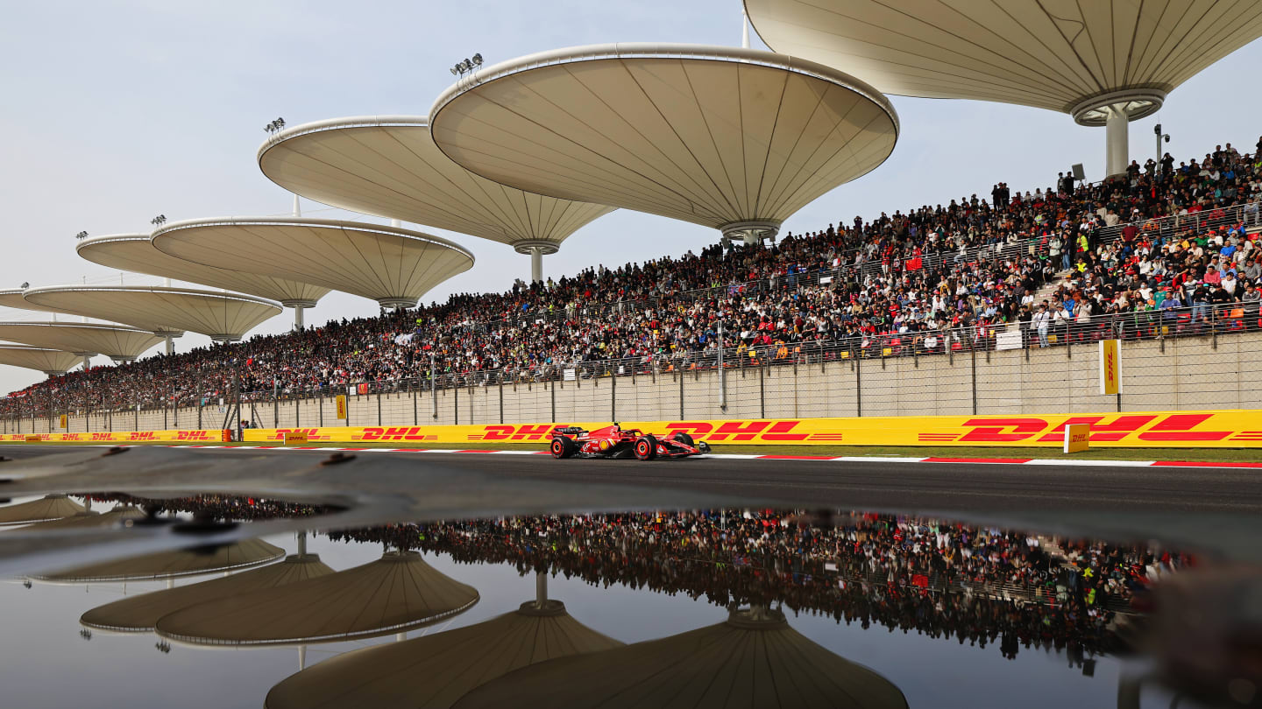
Introduction
What is Formula 1
The highest class of international motorsport
1
74
years of history (since 1950)
24
races one season
10
teams
20
drivers
200k-400k
attendance every race week

Slide 4
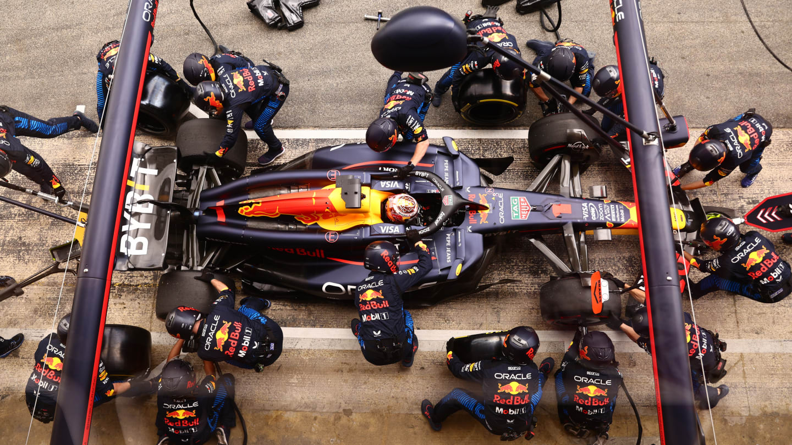
Introduction
Pit-stop and Strategy
In a race, every car MUST has
at least 1 pit-stop to change tires
at least 2 tire compounds used
An efficient way to gain advantage
2.5
22
seconds
in average
team members
involved

Slide 5
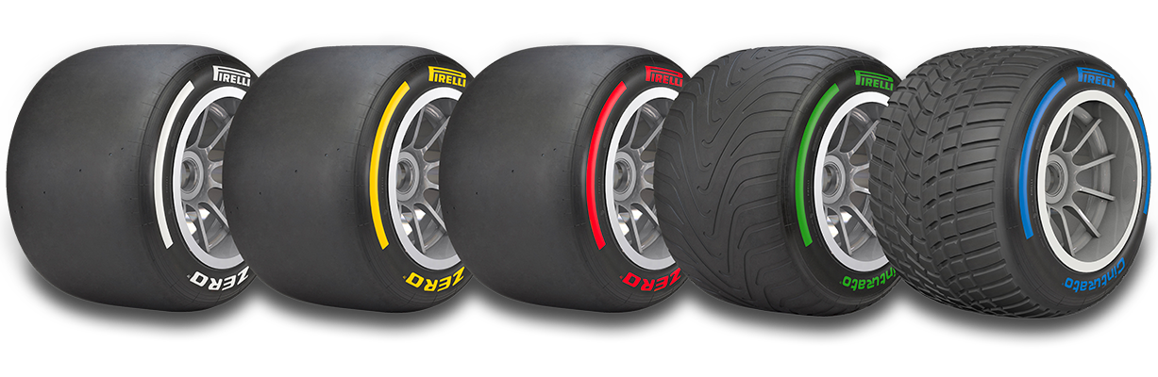
Introduction
Tire Compounds
C0 C1 C2 C3 C4 C5
3 are chosen in a race
Hard Medium Soft

Slide 6
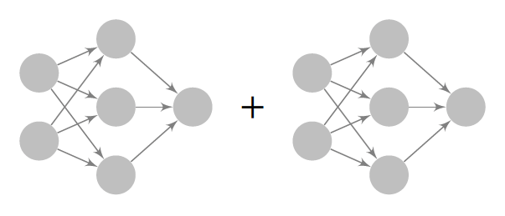
Purpose
To predict
WHEN to pit-stop
WHICH tire compound to change
Pit-stop
Decision
Tire Compound
Decision
Feature
Input
Strategy
Output

Slide 7
Methodology
Data processing

Slide 8
Methodology
Network Architecture

Slide 9
Result

Slide 10
Reference

Slide 11
THANK YOU
Using Artificial Neural Networks for
Making Race Strategy Decisions
in Formula One
WEI Wei
MA Yuxuan
WU Weiheng

