Slide 1
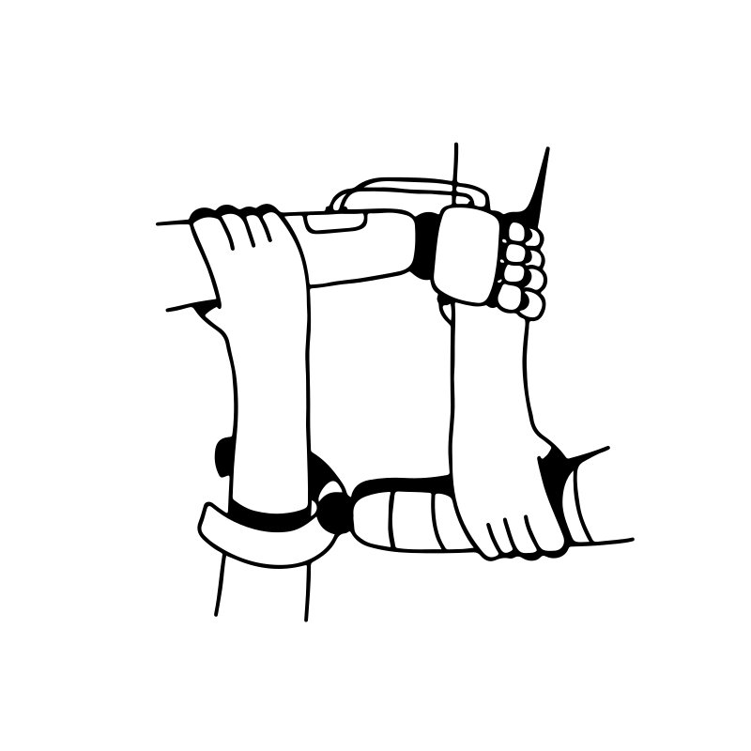
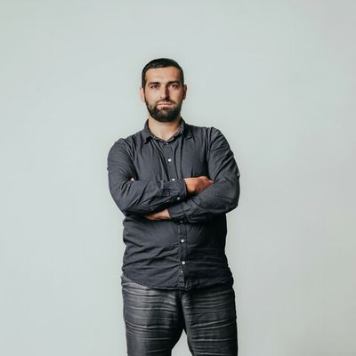
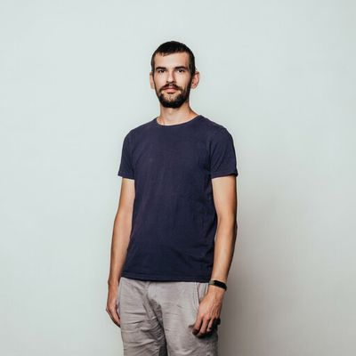
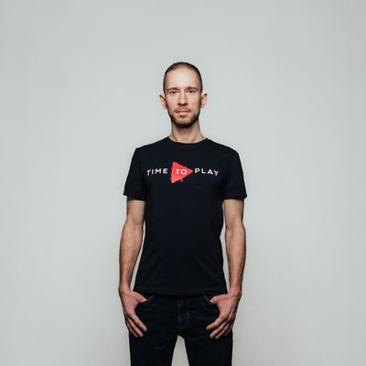
SOLID Workshop NoC
Vojtech Juhász
Tibor Pethő
Adam Pavlik
#backend
#family
#backend
#grill-chef
#.NEThero
#HikingAndAdventures

Slide 2
…aký je Váš „favourite“ programovaci jazyk?
…a prečo?

Slide 3
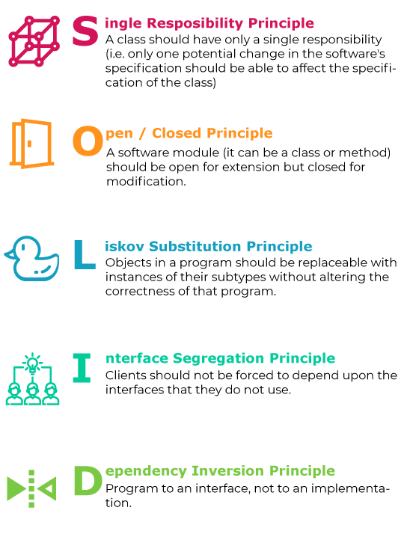
Why not Spagetti?
Deliver better application designs
Clean: SOLID principles make code clean and standardized.
Maintainable: with the help of SOLID principles our code becomes more manageable and easier to maintain.
Readable: SOLID principles make the code easy and readable.
Scalable: Easy to refactor or change code.
Redundancy: SOLID principles avoid redundant code.
Reusable: code becomes reusable.
Testable: can be easily unit tested.
Independent: code becomes independent by reducing dependencies.

Slide 4
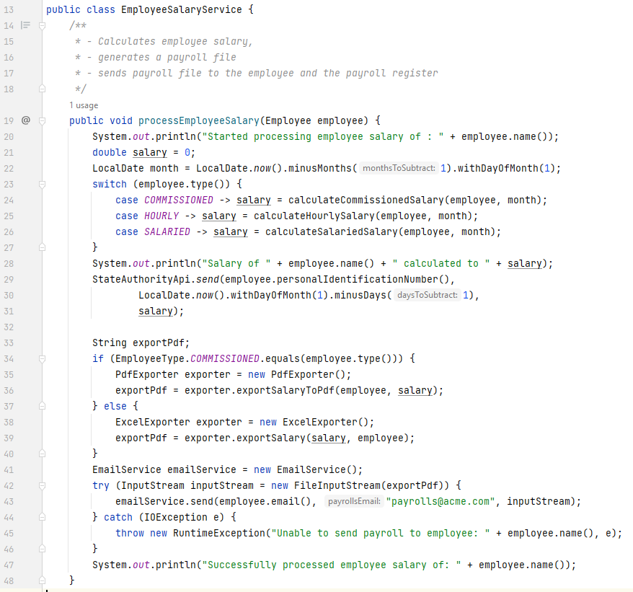
SRP
Anything wrong here … ?
Multiple responsibilities:
Logging (to console)
Determines payroll calculation date
Calculates salary
Different calculations for different employee types
Notifies the tax authorities about the salary
Exports payroll to file
Determines the format
Sends the exported file to the employee and the payroll registry
Service/Dependency instantiations

Slide 5

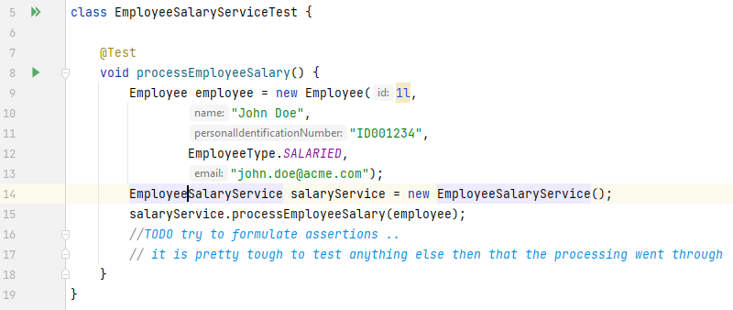
SRP
Everything is wrong there!
What’s wrong with a tasty spaghetti?!
Let’s try to taste it

Slide 6
SRP
Split by responsibilities
First day of
previous month
How?
Let the client provide
the effective month
service instances
Calculates salary in SalaryCalulationService
Notifies the tax authorities about the salary
Exports payroll to file
Sends the exported file to the employee and the payroll registry
Last day of
previous month

Slide 7
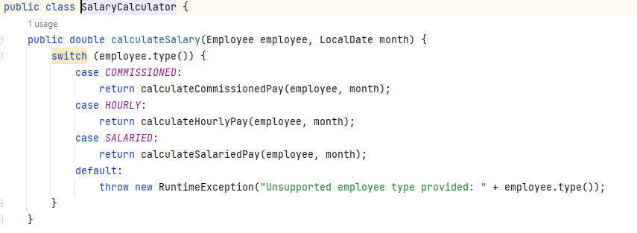
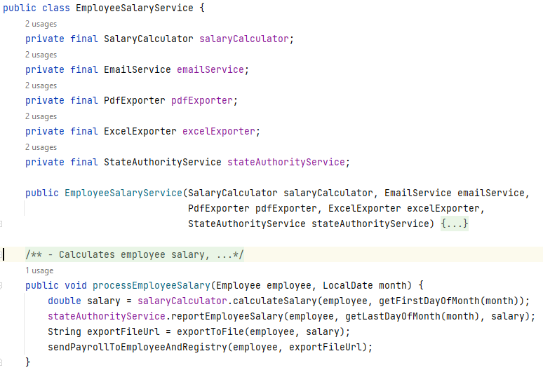
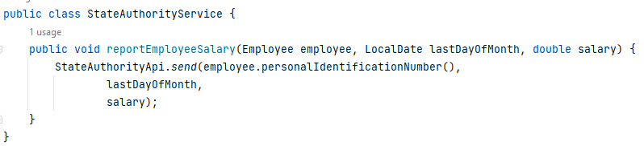
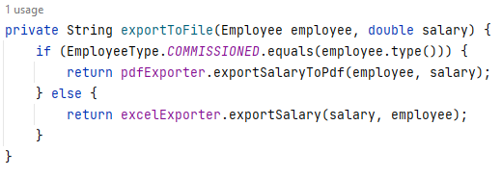
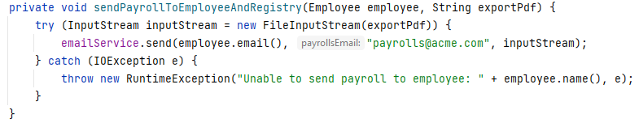
SRP
Split by responsibilities
How?
Let the client provide
the effective month
service instances
Calculates salary in SalaryCalulationService
Notifies the tax authorities about the salary
Exports payroll to file
Sends the exported file to the employee and the payroll registry
What are the benefits of these changes?

Slide 8
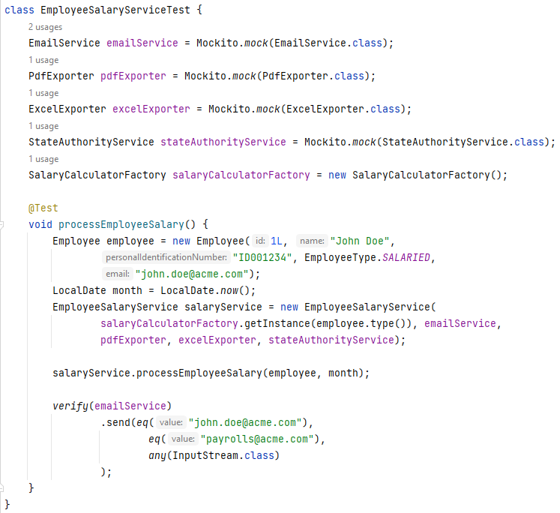
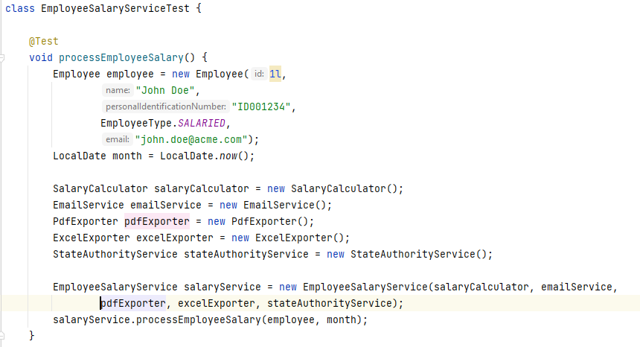
SRP
Everything is wrong there!
Testing the (spaghetti) code
Assertions made available
Not much different .. OR?

Slide 9
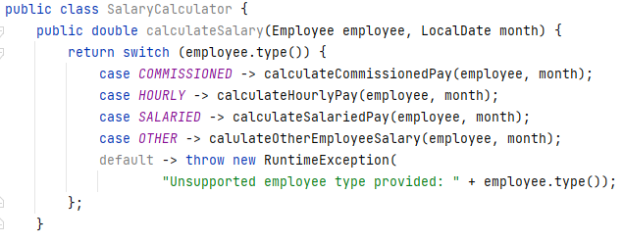
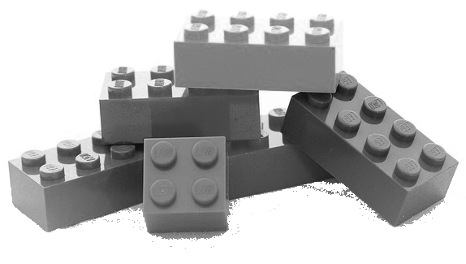
OCP
Furter refactoring
SWITCH-CASE / IF-ELSE
hint
Go4: Strategy & Factory patterns

Slide 10
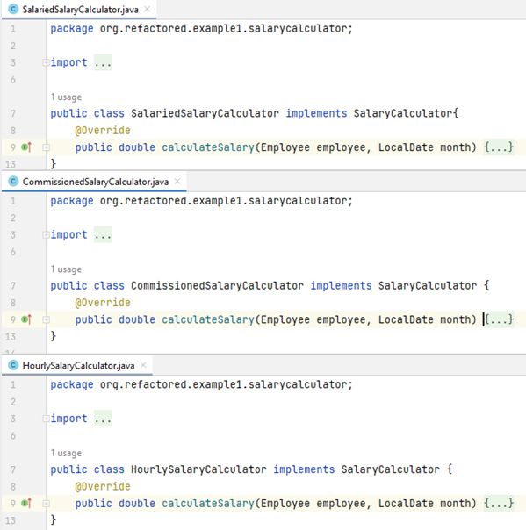
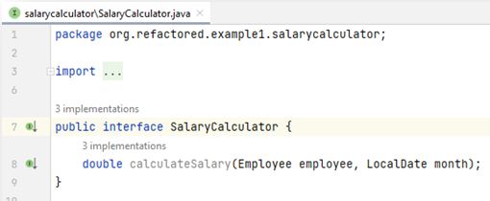
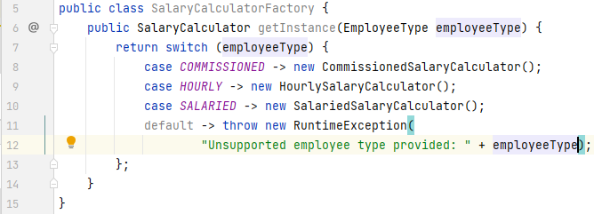
OCP
Make SalaryCalculator extendible
Define & implement a strategy
Strategy = interface
Implement factory to select the proper strategy
Go4: Strategy & Factory patterns

Slide 11
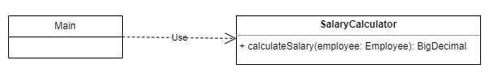
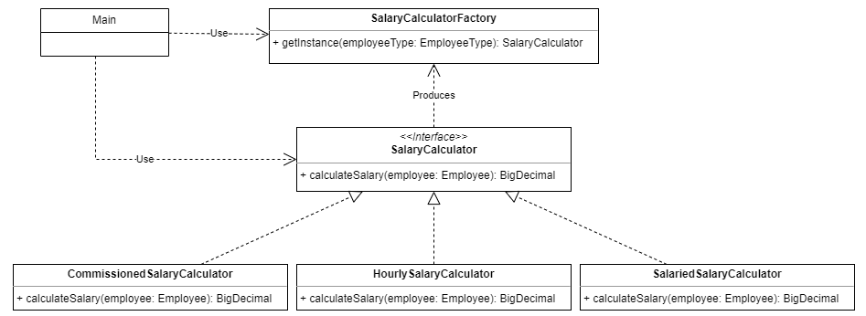
OCP
Class diagram changed
What is changed?
Developed by abstraction instead of implementation
No client dependency on implementation
Various implementations are well separated
Testability, maintainability

Slide 12
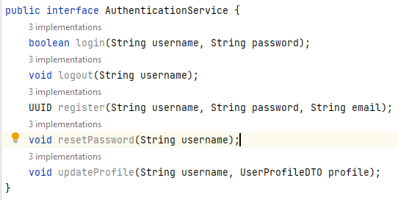
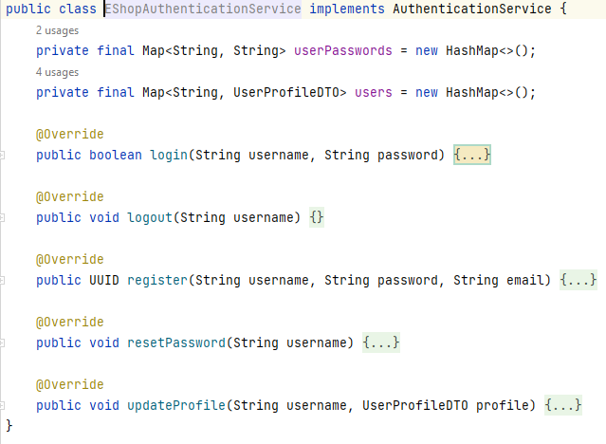
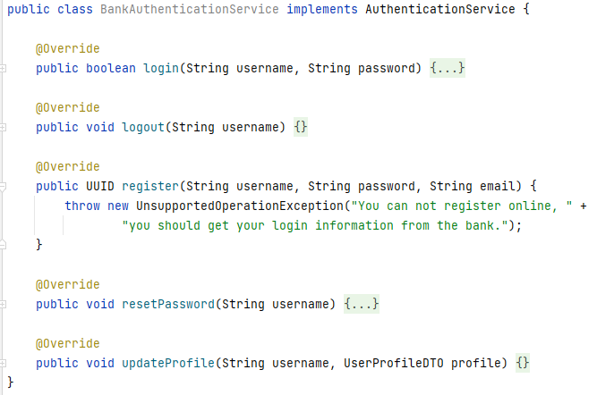
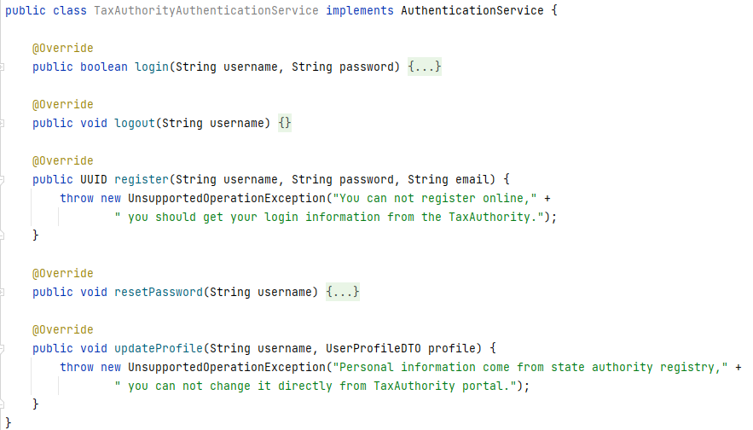

ISP
Webshop authentication API
Required operations:
Login - logout
Reset password
Register
Update profile
Successful implementation
We can provide it to some other customers: Bank / TaxAuthority
No online registration for Bank
No online registration or profile update for TaxAuthority
Any issues here?

Slide 13
ISP / LSP
Clients should not be forced to depend upon interfaces that they do not use.
Fat interface - Violates SRP
UnsupportedOperationsException - Violates LSP
implementing them is unwanted and could lead to side effects
Break application interfaces into smaller ones

Slide 14
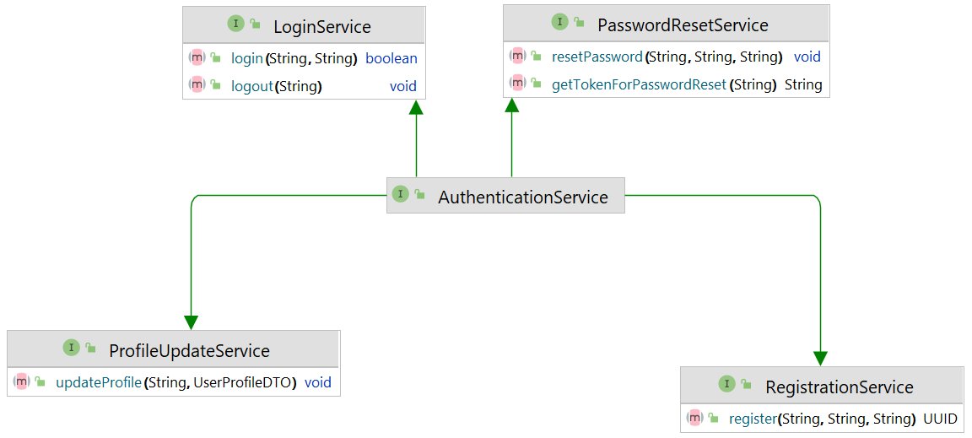
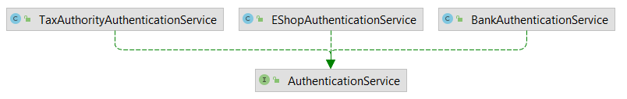
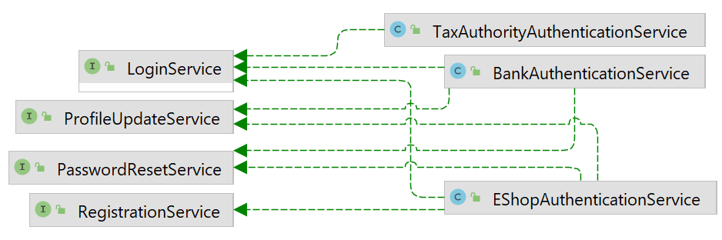
ISP
Let’s split the interface
Interface split by usage – related methods are kept together
Implement only interfaces with the necessary methods

Slide 15
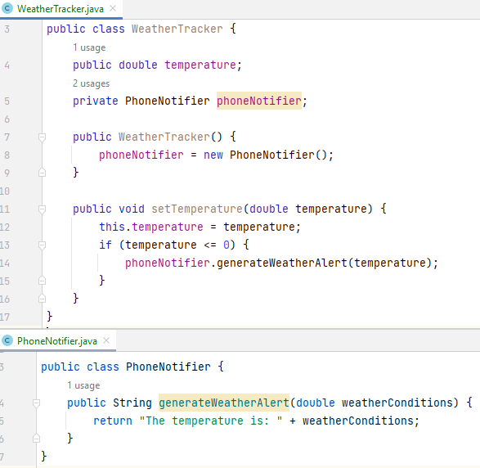
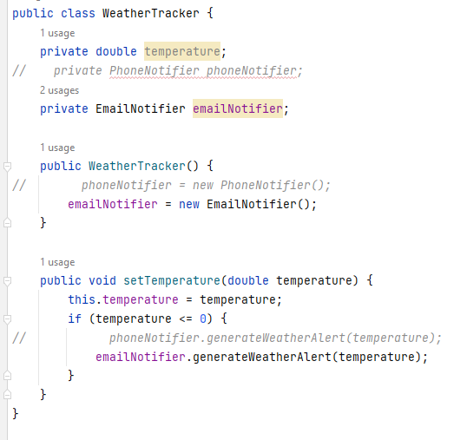
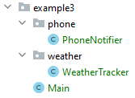
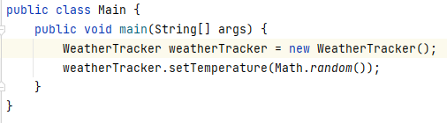
DIP
Weather notification
Tracks the weather
Notifies if the temperature is below the freezing temperature
PhoneNotfier is implemented in a separate package
What do we have here?
High level component
Low level component
How to change to other forms of notifications, e.g. emails?

Slide 16
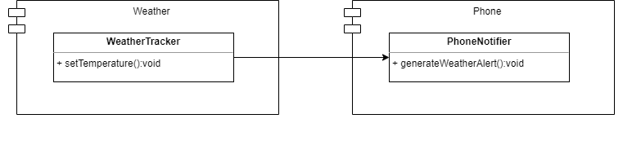

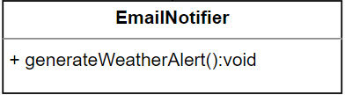
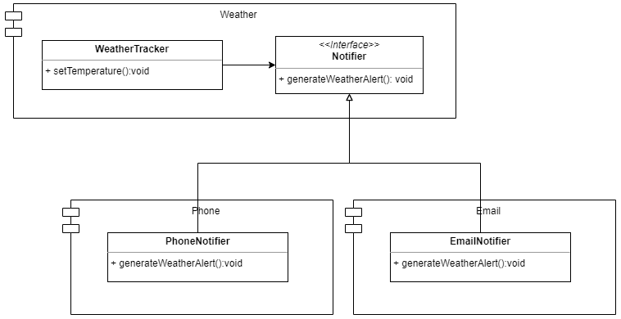
DIP
Change to email notifications
?
Replace PhoneNotifier by an EmailNotifier
Define as an interface
Where to place the interface?
High & low-level components
High-level = business logic
Low-level = technical details

Slide 17
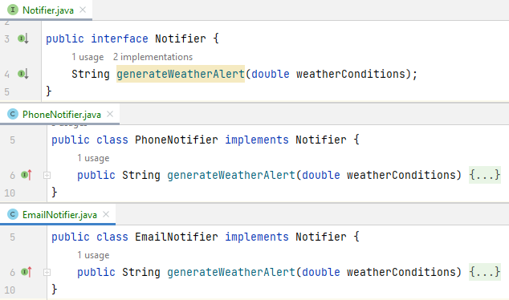
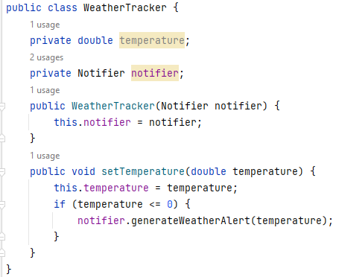
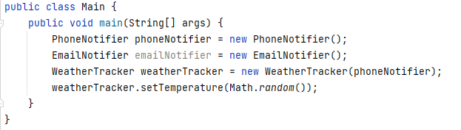
DIP
The implementation
Define Notifier interface & create implementations
Adjust WeatherTracker for the inverted dependency
Adjust the usage of WeatherTracker and the Notifier implementation

Slide 18
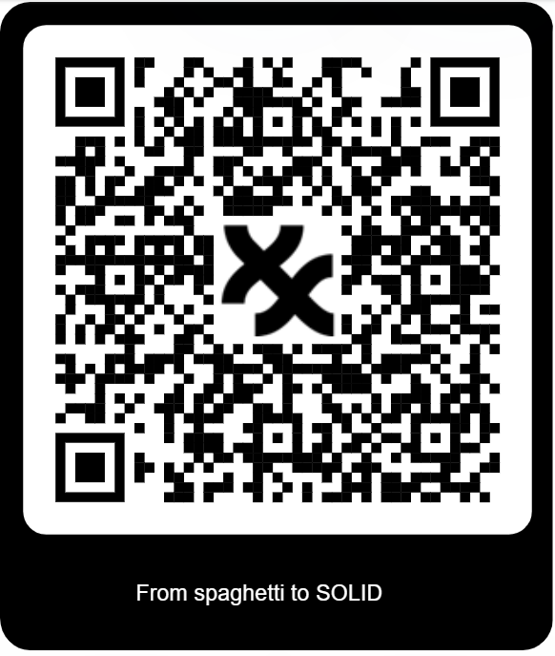

GIT Repository
Workshop repository
TODO Link a QR sem dajme
4 priklady
3 riešenia
1 príklad je bez riešenia
Cena pre víťaza
JBL Sluchátka a pozvanie do nášho BA office na kávu a koláčik
Kritéria
Clean code
Code coveradge
Documentation

Slide 19

Next Steps
Fork workshop repository
Vyrieš úlohu č.4 do 29.3.2023
Pingni nas s linkom na tvoje repository
Vojtech.Juhasz@exxeta.com
Peter.Dodok@exxeta.com
Porota vyberie naj naj riešenie
Dostaneš od nás pozvánku do nášho officu
A keď k nám prídeš,
Bude káva/čaj
Bude koláčik
Dostaneš cenu
Môžeš s nami pokecať o veciach čo ťa zaujímajú

