Slide 1
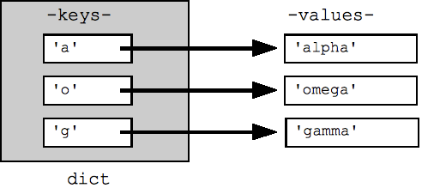
CompSci 101 Lab 8 Dictionaries

Slide 2
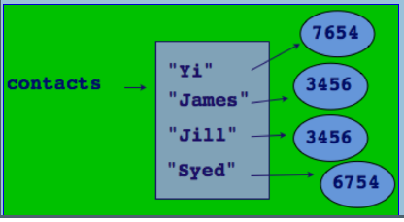
Dictionaries
A dictionary is a mapping from a key to its associated data value.
A dictionary is not a sequence.
A dictionary is a collection of key : value pairs
Each key maps to a value.

Slide 3
Dictionary Keys and Values
Keys
The key in a dictionary must be unique.
The key must be an immutable object type
(e.g. int, string, tuple)
Values
The values can be any type and do not have to be unique.
Example:
room_dictionary = { "Ann" : 413, "Adriana" : 415}
key
value
key
value

Slide 4
Creating a Dictionary
Syntax
Dictionaries are enclosed in curly braces.
Dictionaries consist of key : value pairs.
The key and value are separated by a colon.
Each item is separated by a comma.
{} is an empty dictionary.
Examples:
counts_dictionary = {}
counts_dictionary = dict()
room_dictionary = { "Ann" : 413, "Adriana" : 415}

Slide 5
Changing a Dictionary
Adding or Updating an item
key:value pairs can be updated or added using assignment statements
Example:
room_dictionary = { "Ann" : 413, "Adriana" : 415}
room_dictionary["Angela"] = 414
room_dictionary["Ann"] = 479

Slide 6
Order of items in a dictionary
Depending on the Python version you are using, there is usually no predictable order to the key:value pairs.
Example:
room_dictionary = { "Ann" : 413, "Adriana" : 415}
room_dictionary["Angela"] = 414
print(room_dictionary)
{'Ann': 413, 'Angela': 414, 'Adriana': 415}

Slide 7
Accessing a value with a particular key
The value associated with a certain key can be accessed using square brackets to enclose the key.
Example:
room_dictionary = { "Ann" : 413, "Adriana" : 415}
anns_room = room_dictionary["Ann"]
print(anns_room)
413

Slide 8
The number of items in the dictionary
The len() function can be used to find out how many key:value pairs are in a dictionary.
Example:
initials_dictionary = { ‘AC’ : ‘Ann’, ‘AF’ : ‘Adriana’}
initials_dictionary[‘DA’] = ‘Damir’
initials_dictionary[‘AH’] = ‘Alec’
number_of_items = len(initials_dictionary)
4

Slide 9
Deleting an item from a dictionary
The del operator is used to delete a key:value pair from a dictionary.
The del operator gives an error if the key is not in the dictionary.
So you should always check to make sure the key is in the dictionary before deleting the key:value pair.
Example:
if "AC" in initials_dictionary:
del(initials_dictionary["AC "]

Slide 10
Traversing the pairs in a dictionary
Use a for … in loop to traverse the dictionary:
Example:
room_dictionary = {'Ann': 413, 'Angela': 414, 'Adriana': 415}
for person in room_dictionary:
room = room_dictionary[person]
print(person, ‘is in Room’, room)
Ann is in Room 413
Angela is in Room 414
Adriana is in Room 415

Slide 11
Dictionary Methods
keys() – used to access all the keys
values() – used to access all the values
Items() – used to access all the key-value pairs as tuples
Example:
room_dictionary = {'Ann': 413, 'Angela': 414, 'Adriana': 415}
for person, room in room_dictionary.items():
print(person, ‘is in Room’, room)
Ann is in Room 413
Angela is in Room 414
Adriana is in Room 415

Slide 12
Sorting the keys
If you need to access the items in ascending order, you can create a list of keys using the keys() method sort the list of keys, then loop through the list of sorted keys:
Example:
room_dictionary = {'Ann': 413, 'Angela': 414, 'Adriana': 415}
keys_list = list(room_dictionary.keys())
keys_list.sort()
for person in keys_list:
print(person, ‘is in Room’, room_dictionary[person])
Adriana is in Room 415
Angela is in Room 414
Ann is in Room 413

Slide 13
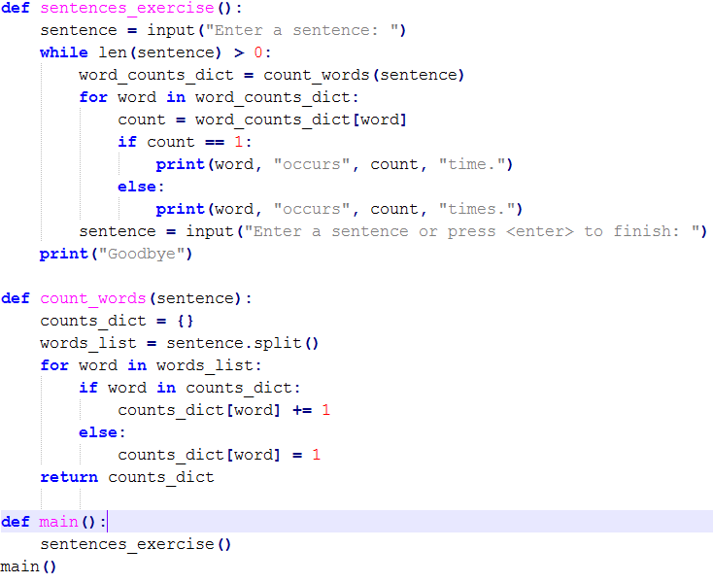
Example Program

Slide 14
Next Week
That’s all for this week ☺
Next week we will be doing a lab on tkinter and nested for loops

