Slide 1







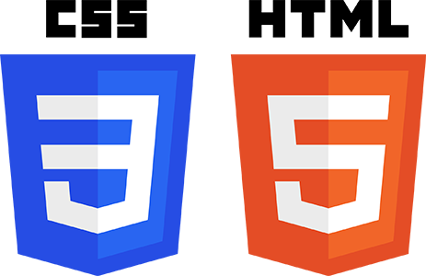



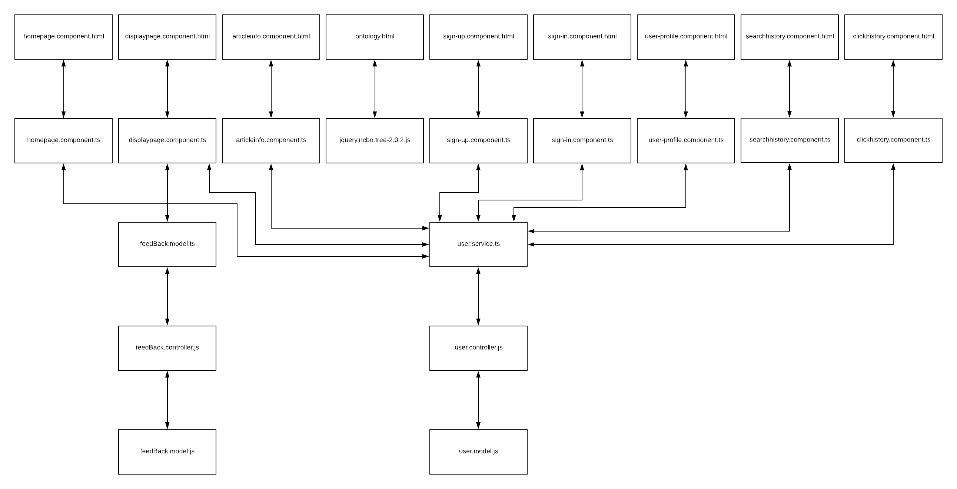
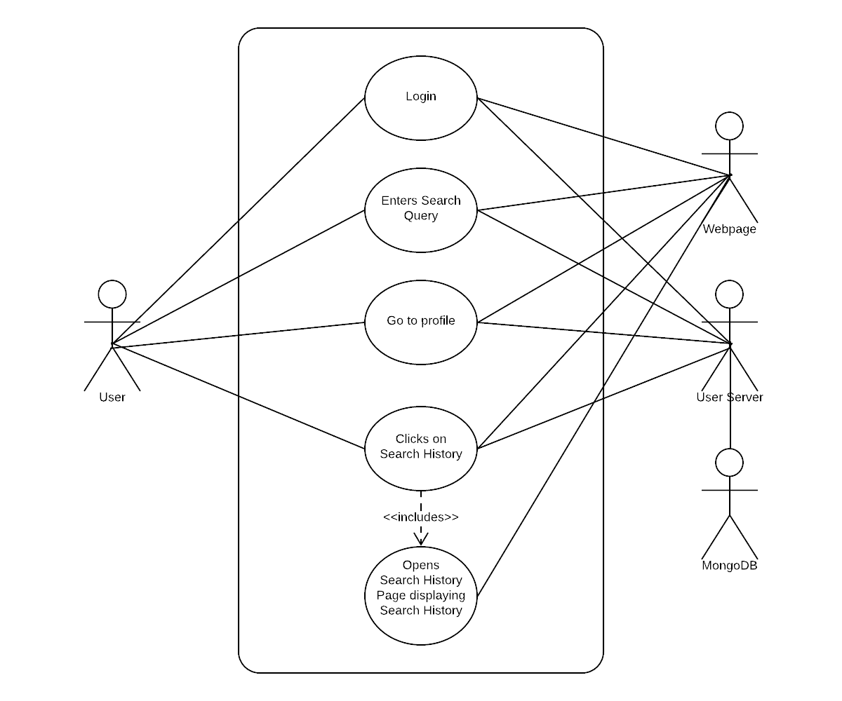
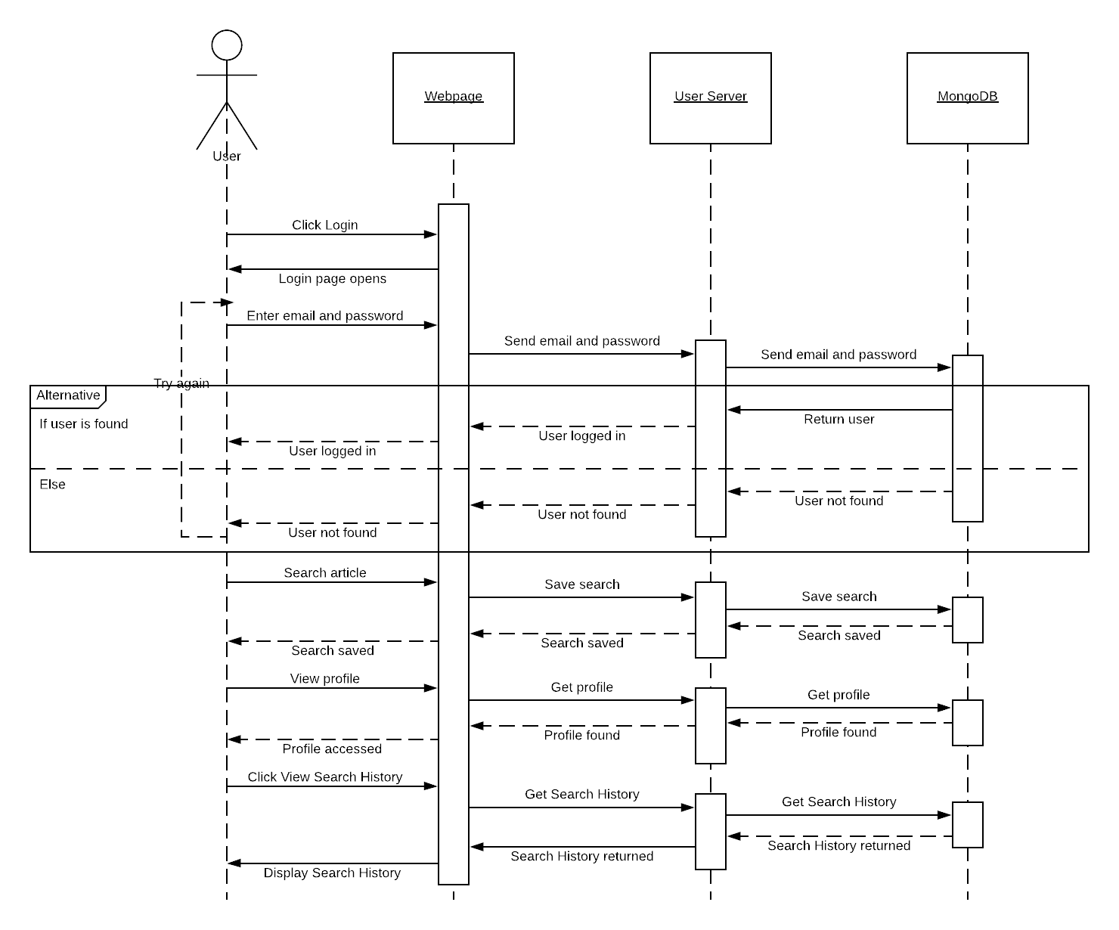
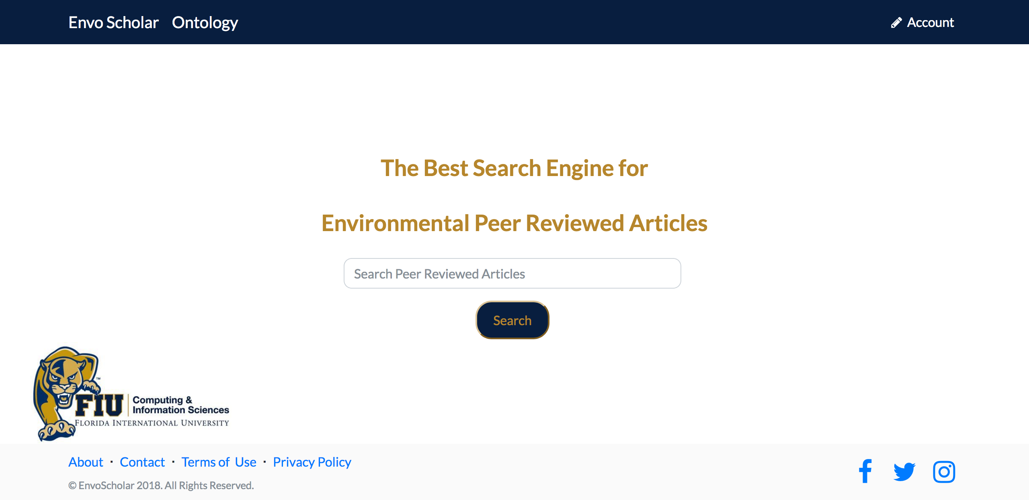
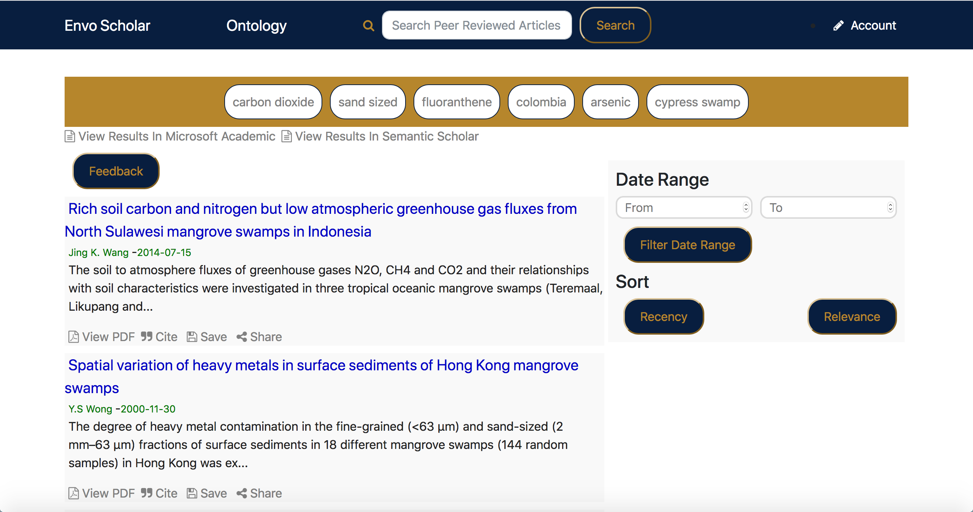
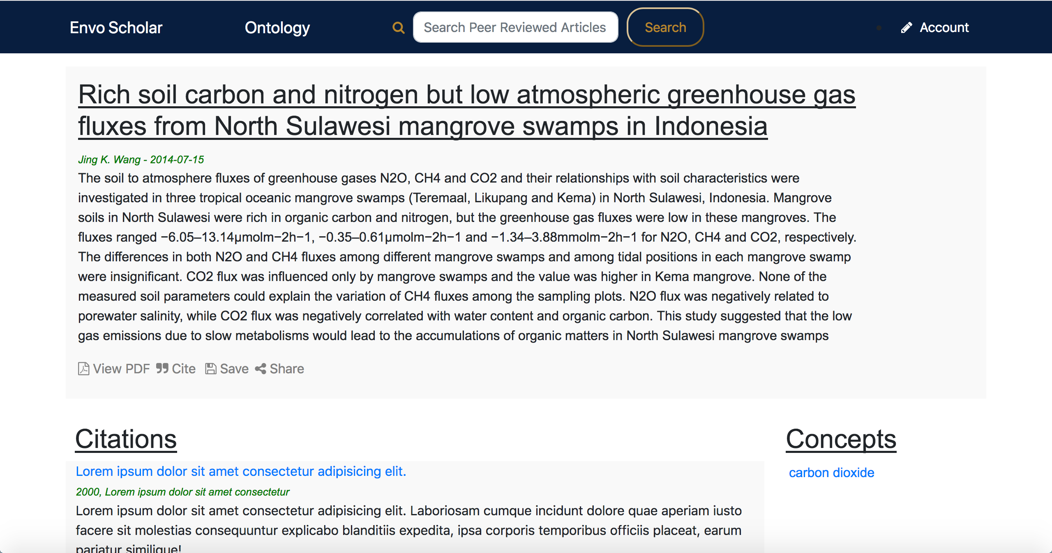
Envo Scholar v 1.0 Fall 2018 Senior Design Project
Students: Bryan Bastida, Andrew Castillo
Product Owner: Dr. Mark Finlayson
Instructor: Dr. Masoud Sadjadi, Florida International University
Problem
Current System
Requirements
Environmental Scientists need to find papers in order to further their research. They rely on academic search engines to help them find those papers, but there isn’t a search engine solely dedicated to environmental science papers. This is where Envo Scholar comes into play.
The current system allows users to:
Enter a search query.
Click on an article to view more information on that article.
Go to the articles Science Direct page.
Leave feedback on user experience
Create an account.
Save articles.
View the history of
  Search queries they have entered.
  Articles they have clicked on.
  Articles they have saved.
View the ontology
For my contributions, a user should be
Displayed a set of articles.
Able to view the article information.
Able to go to the Science Direct page.
Able to create an account.
Able to save articles.
Able to view their history.
Able to view the ontology.
Object Design
Minimal Class Diagram
Example Use Case Diagram: View Search History
Example Sequence Diagram: View Search History
Implementation
Screenshots
Summary
Angular 6 was used to create the functionality of the front end.
HTML5, CSS, and Bootstrap Studio were used to style and edit the front end.
Elasticsearch was used to enhance the GET requests to the PostgreSQL database containing the articles.
NodeJS and Express were used to create the server that connects to the Mongo Database containing the users.
JWT and Passport were used for user authentication
Envo Scholar was created with the intention of assisting environmental scientists in their research. The focus of version 1 was to get basic functionality such as searching for articles and allowing users to create their own profiles, and we’ve been able to accomplish much more than that. Going into this project, my partner and I were unequipped with the set of skills it takes to build a website. But we came out strong and created something that we are both extremely proud of and cannot wait to see the continuation of Envo Scholar.
Verification
System Design
Example for Display Results
Test case ID: NVOS-3-Display-Results
Description/Summary of Test: User has entered a search into the search box and the display
Page loads the related articles
Pre-condition: User has entered a
search query on any page with a search bar. User has submitted the search.
Expected Results: Articles related to the search will appear on the screen.
Actual Result: Articles related to the search appeared on the screen.
Status (Fail/Pass): Pass
Article Information
User Information
Acknowledgement
The material presented in this poster is based upon the work supported by Dr. Masoud Sadjadi and Dr. Mark Finlayson. I thank Andrew Castillo, Maria Presa, and Deya Banisakher for assistance, cooperation and mentorship that I received throughout this process

