Slide 1
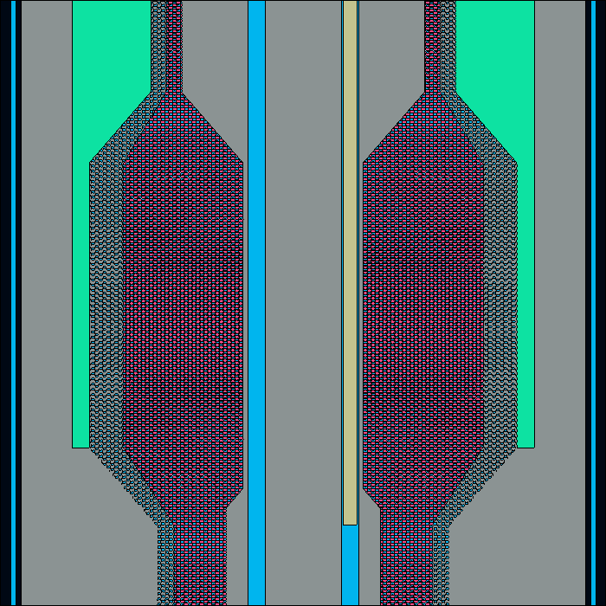
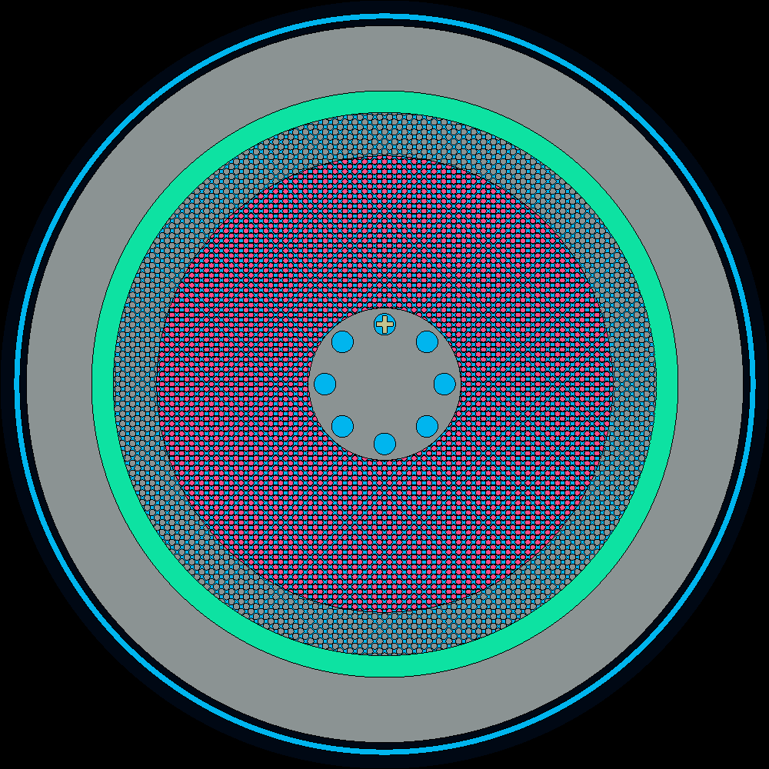

Vessel
(SS316)
Blanket
(Graphite pbs + coolant)
Fuel
(Fuel pbs + coolant)
Outer reflector
(graphite)
Inner reflector
(graphite)
Downcomer
(flibe)
Core Barrel
(SS316)
Coolant channels
(flibe+graphite)
Coolant channels
(flibe)
Control rod
(B4C)

Slide 2

Vessel
(SS316)
Blanket
(Graphite pbs + coolant)
Fuel
(Fuel pbs + coolant)
Outer reflector
(graphite)
Inner reflector
(graphite)
Downcomer
(flibe)
Core Barrel
(SS316)
Coolant channels
(flibe+graphite)
Coolant channels
(flibe)
Control rod
(B4C)

