Slide 1
Xiaoming Wang
HPCCSystems Cloud with Serverless Containers Exploration

Slide 2
Table of Contents
Introduction
Azure Container Instances (ACI)
AWS Fargate
Future Work

Slide 3
Introduction

Slide 4
Introduction
What is Serverless Containers
Enable cloud users to run containers, but outsource the effort of managing the actual servers or computing infrastructure they are running on.
Serverless Containers are the Future of Container Infrastructure
What are the benefits of Serverless Containers in Kubernetes
Cost: Serverless architecture helps to decrease costs in two critical ways.
management of the servers
Only pay CPU/Memory when Pod/Job is Deployed
Scalability and Flexibility in Auto-Scaling

Slide 5
Introduction
Current providers for serverless containers
Azure Container Instance (ACI)
AWS Fargate
Google Cloud Run
Knative (Open-Source Framework for Serverless Deployment)
Both ACI and AWS Fargate are supported by Kubernetes Kubelet, an open source kubelet implementation connecting Kubernetes to other APIs.

Slide 6
Azure Container Instances (ACI)

Slide 7
ACI
Virtual nodes:
Virtual nodes enable network communication between pods that run in Azure Container Instances (ACI) and the AKS cluster. To support this communication, a virtual network subnet is created and delegated permissions are assigned. Virtual nodes only work with AKS clusters created using advanced networking (Azure CNI).
Virtual nodes and ACI limitation:
Not support Persistent Volume (PV) and Persistent Volume Claim (PVC)
Start time is slow ~ 2 min 30 seconds either from Docker Hub or Azure Container Registry (ACR).
Pod/Job from ACI maps localhost ip, 127.0.0.1 to hostname in /etc/hosts. This prevent slave incorrectly registered in Thor master.

Slide 8
ACI
Can’t have a privileged container
can’t spin a new Pod/Job
Storage Azurefile mount as root even mountOption set as non-root user and group
DaemonSets won’t deploy pods/job to the virtual nodes
Don’t support the Container hook’s feature
Using IPv6 isn’t supported

Slide 9
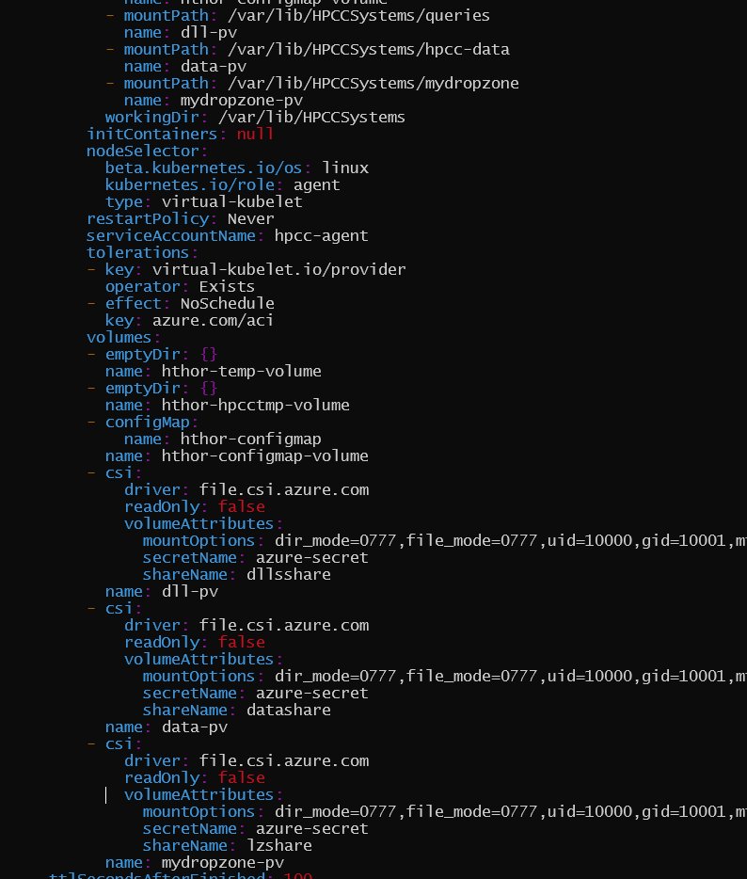
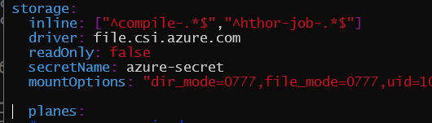
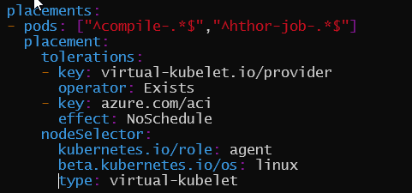
ACI
Generated deployment Yaml file
Schedule Hthor Jobs to Virtual Node (ACI)
Values.yaml
Inline Storage
No PV/PVC support in ACI
Compile and hthor jobs assigned to virtual node
Hthor and eclccserver cannot be assigned to virtual node

Slide 10
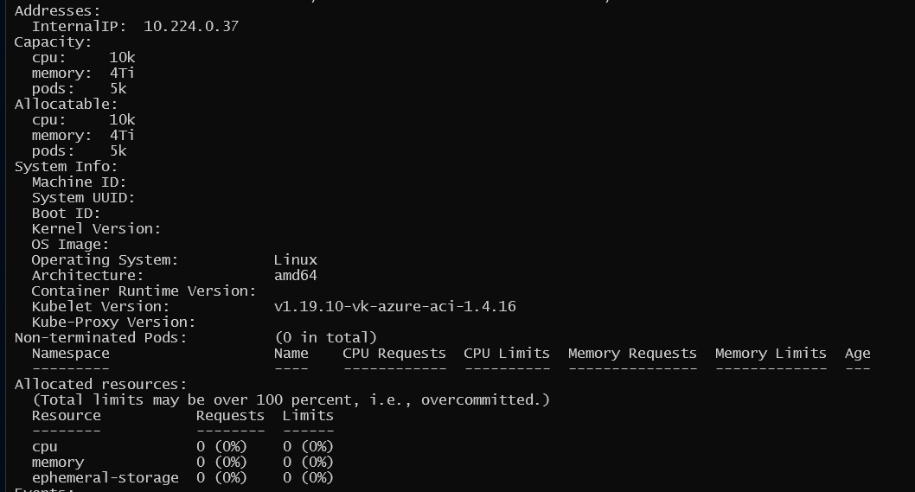
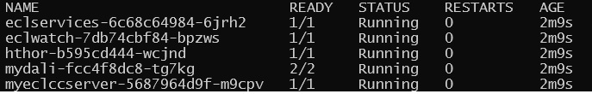
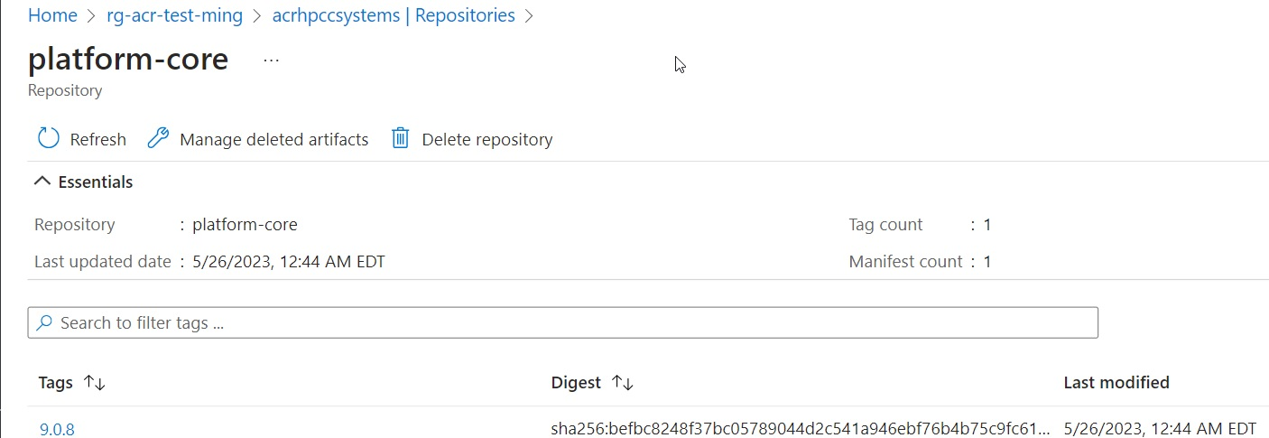
ACI
AKS with Virtual Node
HPCC Cluster Deployment (hthor)
Container Image
Describe virtual-node

Slide 11
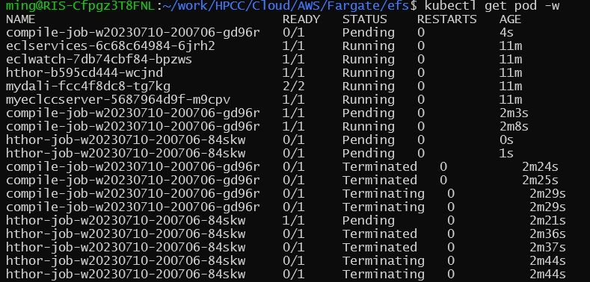
ACI – Container start time too long
Hthor jobs for default playground app
Jobs assigned to Virtual Node
Start time are too long
Possible solutions from Azure
(https://learn.microsoft.com/en-us/azure/container-instances/container-instances-troubleshooting)
Reduce image size: make a smaller Docker image for worker, like compile, hthor, thor-slaves, etc?
Image location: already using the image in Azure Container Registry (ACR).
Cached images: need further explore and work with Azure support team
But the main issue is related to prevision VM in the Virtual Node (Need Azure ACI/AKS improvement)

Slide 12
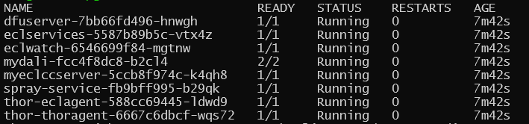
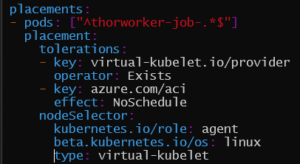
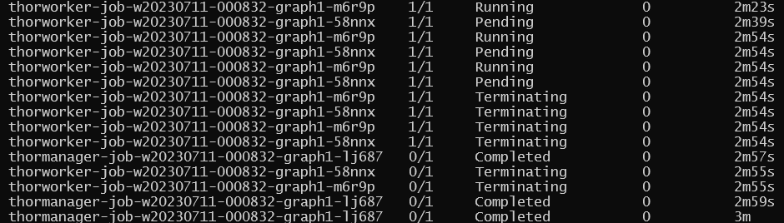
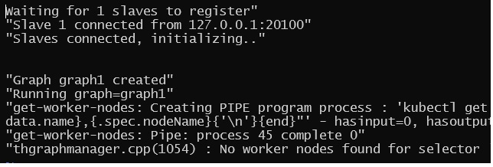
ACI – IP mapped to localhost
Only assign thor worker to virtual node
Thor Cluster Deployment with ACI
Run Data Tutorial for thor target.
Since thor-slave register as 127.0.0.1:20100 thor-master can’t find thor slave

Slide 13
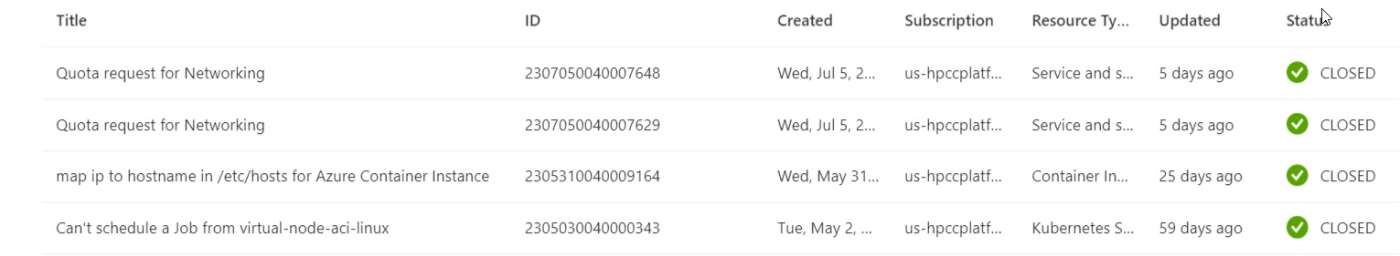
ACI – IP mapped to localhost
ACI container has localhost ip, 127.0.01 mapped in /etc/hosts
Possible solutions:
Wait for Azure to remove the entry in /etc/hosts. Don’t know when since there is a reason Azure has this now.
Use Kuernetes C++ API in our code to get the real ip of the thor slave. Not sure if it is worth or not. It’s better to wait Kubernetes standardize the serverless deployment.
Opened Azure support tickets for ACI related issues:

Slide 14
AWS Fargate

Slide 15
Fargate
Fargate is a technology that provides on-demand, right-sized compute capacity for containers. With Fargate, you don't have to provision, configure, or scale groups of virtual machines on your own to run containers. You also don't need to choose server types, decide when to scale your node groups, or optimize cluster packing.
Amazon EKS integrates Kubernetes with Fargate by using controllers that are built by AWS using the upstream, extensible model provided by Kubernetes.
You can control which Pods start on Fargate and how they run with Fargate profiles through “Selectors” which can have “Namespace” and optional “Labels”.

Slide 16
Fargate
Some consideration when using Fargate on EKS
Each Pod that runs on Fargate has its own isolation boundeary. They don't share the underlying kernel, CPU resources, memory resources, or elastic network interface with another Pod.
Need install Load Balancer for pure Fargate EKS cluster
Fargate exposed service only run on targate type IP mode, and not on node IP mode.
Pods must match a Fargate profile at the time that they’re scheduled to run on Fargate
Daemonsets aren’t supported on Fargate
Privileged containers aren't supported on Fargate.
Pods running on Fargate can’t specify HostPort or HostNetwork in the Pod manifest

Slide 17
Fargate
GPUs aren’t currently available on Fargate
Pods that run on Fargate are only supported on private subnets (with NAT gateway access to AWS services, but not a direct route to an Internet Gateway)
You can use the Vertical Pod Autoscaler to set the initial correct size of CPU and memory for your Fargate Pods, and then use the Horizontal Pod Autoscaler to scale those Pods.
The Amazon EC2 instance metadata service (IMDS) isn't available to Pods that are deployed to Fargate nodes.
Amazon EKS must periodically patch Fargate Pods to keep them secure. We attempt the updates in a way that reduces impact, but there are times when Pods must be deleted if they aren't successfully evicted.

Slide 18
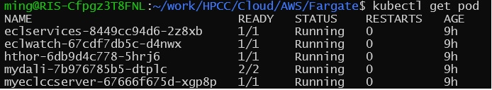
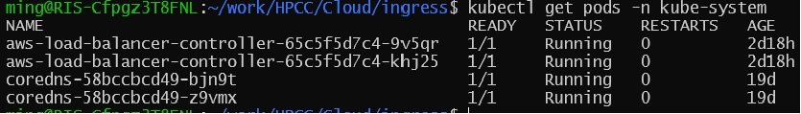
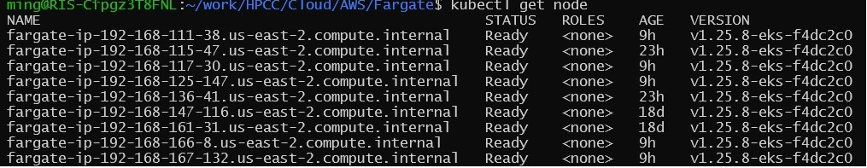
Fargate
Create a pure Fargate/EKS cluster:
eksctl create cluster --name <name> --region <region --fargate --tags <key=value>
Hthor cluster:
Nodes:

Slide 19
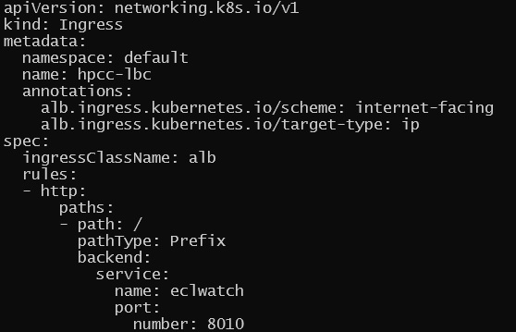
Fargate
How install aws-load-balancer-controller: https://archive.eksworkshop.com/beginner/180_fargate/prerequisites-for-alb/
Ingress for EclWatch service:
Ingress:

Slide 20
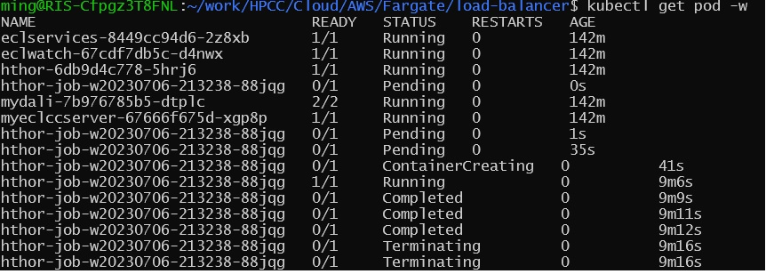
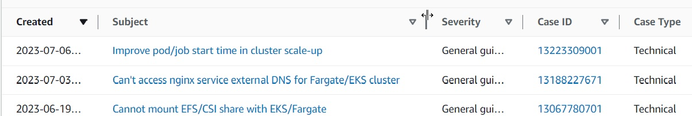
Fargate
Hthor job start-time too long
Other consideration: add label for job in values.yaml to schedule on Fargate.
Opened AWS support cases related Fargate

Slide 21
Future Work

Slide 22
Future Work
Open a JIRA ticket as a place holder for Serverless Deployment
Cloud Provider Annual Events (Online Recording)
Microsoft Ignite Nov 15-16, 2023
AWS re: Invent Nov 27- Dec 1 2023
Google Cloud Next’23 August 29-31
Serverless Deployment Standardization in Kubernetes
Virtual Kubelet: https://virtual-kubelet.io/
Kubernetes Blog: https://kubernetes.io/blog/

Slide 23
Questions ?

