Slide 1
Belief Propagation
by Jakob Metzler

Slide 2
Outline
Motivation
Pearl’s BP Algorithm
Turbo Codes
Generalized Belief Propagation
Free Energies

Slide 3
Probabilistic Inference
From the lecture we know:
Computing the a posteriori belief of a variable in a general Bayesian Network is NP-hard
Solution: approximate inference
  MCMC sampling

Slide 4
Probabilistic Inference
From the lecture we know:
Computing the a posteriori belief of a variable in a general Bayesian Network is NP-hard
Solution: approximate inference
  MCMC sampling
  Belief Propagation

Slide 5
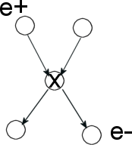

Belief Propagation
In BBNs, we can define the belief BEL(x) of a node x in a graph in the following way:
In BP, the pi and lambda terms are messages sent to the node x from its parents and children, respectively
BEL(x) = P(x|e) = P(x|e⁺,e⁻)
= P(e⁻|x, e⁺) * P(x|e⁺) / P(e⁻|e⁺)

Slide 6
Pearl’s BP Algorithm
Initialization
  For nodes with evidence e
    λ(x_{i}) = 1 wherever x_{i} = e_{i} ; 0 otherwise
    π(x_{i}) = 1 wherever x_{i} = e_{i} ; 0 otherwise
  For nodes without parents
    π(x_{i}) = p(x_{i}) - prior probabilities
  For nodes without children
    λ(x_{i}) = 1 uniformly (normalize at end)

Slide 7


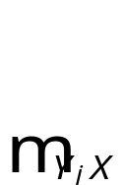
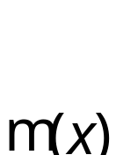
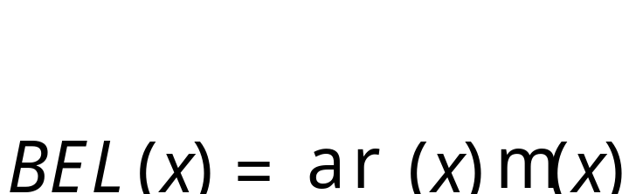

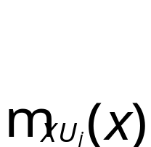
Pearl’s BP Algorithm
1. Combine incoming messages from all parents U={U₁,…,U_{n}} into
2. Combine incoming messages from all children Y={Y₁,…Y_{n}} into
3. Compute
4. Send messages to children Y
5. Send messages to parents X

Slide 8


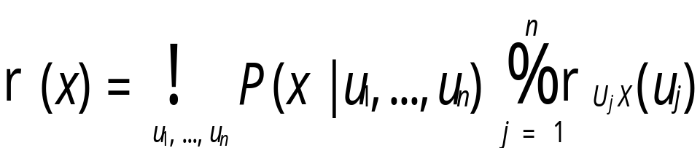
Pearl’s BP Algorithm
U₁
U₂
X
Y₁
Y₂

Slide 9
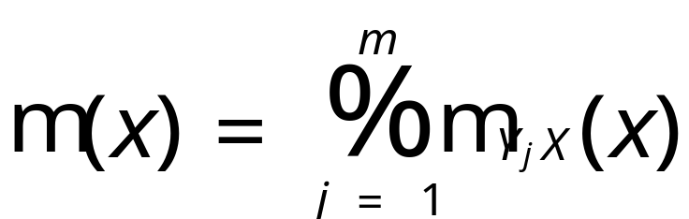

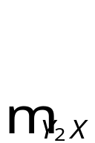
Pearl’s BP Algorithm
U₁
U₂
X
Y₁
Y₂

Slide 10


Pearl’s BP Algorithm
U₁
U₂
X
Y₁
Y₂

Slide 11

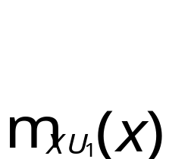
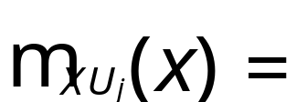
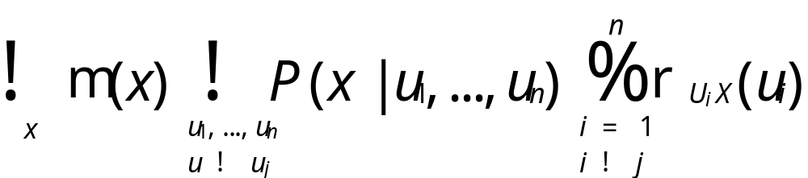
Pearl’s BP Algorithm
U₁
U₂
X
Y₁
Y₂

Slide 12
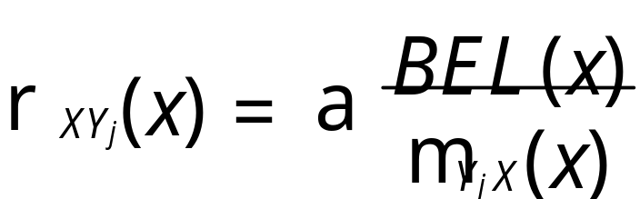


Pearl’s BP Algorithm
U₁
U₂
X
Y₁
Y₂

Slide 13
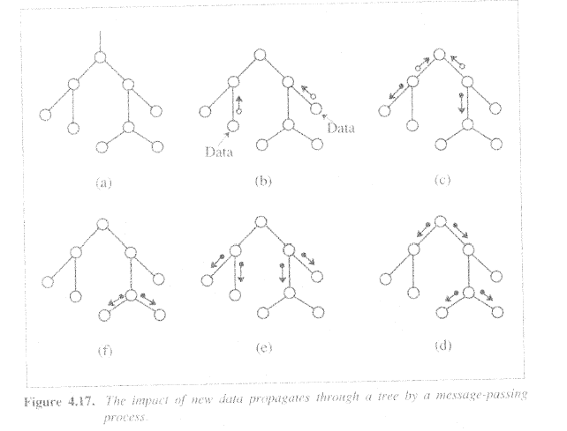
Example of BP in a tree

Slide 14
Properties of BP
Exact for polytrees
  Each node separates Graph into 2 disjoint components
On a polytree, the BP algorithm converges in time proportional to diameter of network – at most linear
Work done in a node is proportional to the size of CPT
  Hence BP is linear in number of network parameters
For general BBNs
  Exact inference is NP-hard
  Approximate inference is NP-hard

Slide 15
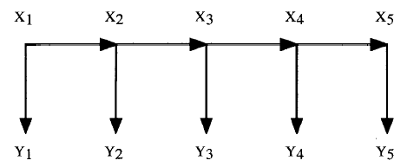
Properties of BP
Another example of exact inference: Hidden Markov chains
Applying BP to its BBN representation yields the forward-backward algorithm

Slide 16
Loopy Belief Propagation
Most graphs are not polytrees
  Cutset conditioning
  Clustering
    Join Tree Method
  Approximate Inference
    Loopy BP

Slide 17
Loopy Belief Propagation
If BP is used on graphs with loops, messages may circulate indefinitely
Empirically, a good approximation is still achievable
  Stop after fixed # of iterations
  Stop when no significant change in beliefs
  If solution is not oscillatory but converges, it usually is a good approximation
Example: Turbo Codes

Slide 18
Outline
Motivation
Pearl’s BP Algorithm
Turbo Codes
Generalized Belief Propagation
Free Energies

Slide 19
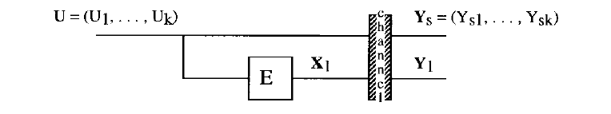
Decoding Algorithms
Information U is to be transmitted reliably over a noisy, memoryless channel
U is encoded systematically into codeword X=(U, X₁)
  X₁ is a “codeword fragment
It is received as Y=(Y_{s}, Y₁)
The noisy channel has transition probabilities defined by p(y|x) = Pr{Y=y|X=x}

Slide 20


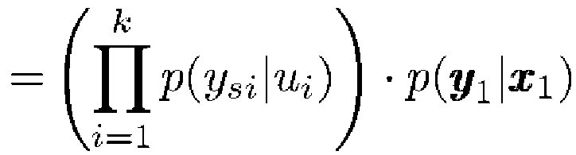
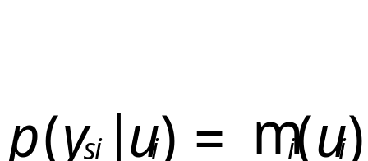
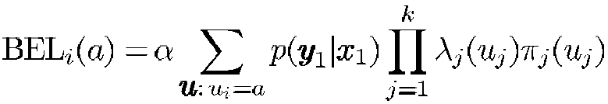
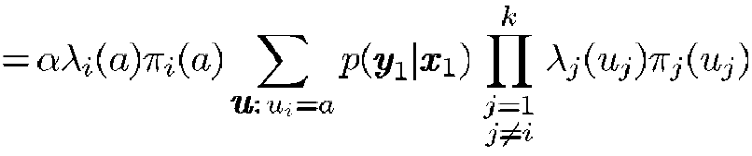
Decoding Algorithms
Since it is also memoryless, we have
The decoding problem: Infer U from observed values Y by maximizing the belief:
If we define the belief is given by

Slide 21
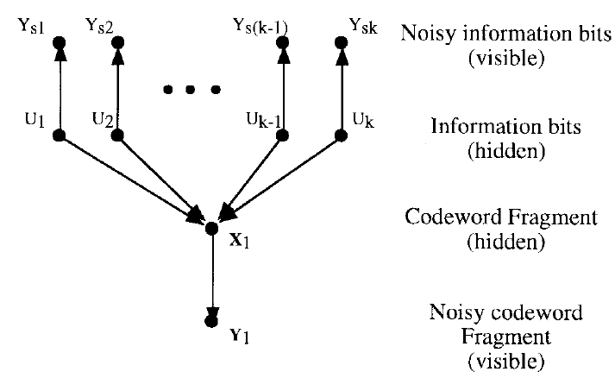
Decoding using BP
We can also represent the problem with a bayesian network:
Using BP on this graph is another way of deriving the solution mentioned earlier.

Slide 22
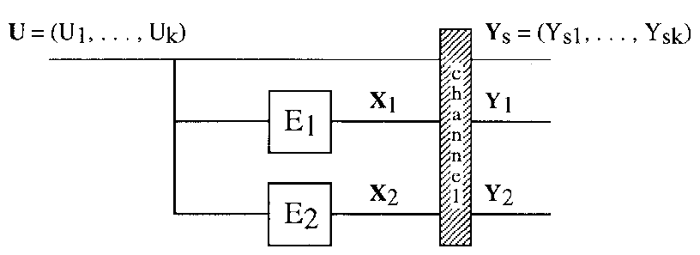
Turbo Codes
The information U can also be encoded using 2 encoders:
Motivation: using 2 simple encoders in parallel can produce a very effective overall encoding
  Interleaver causes permutation of inputs

Slide 23
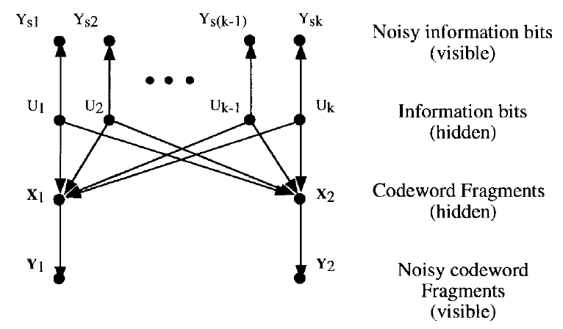
Turbo Codes
The bayesian network corresponding to the decoding problem is not a polytree any more but has loops:

Slide 24
Turbo Codes
We can still approximate the optimal beliefs by using loopy Belief Propagation
  Stop after # of iterations
Choosing the order of belief updates among the nodes derives “different” previously known algorithms
  Sequence U->X₁->U->X₂->U->X₁->U etc. yields the well-known turbo decoding algorithm
  Sequence U->X->U->X->U etc. yields a general decoding algorithm for multiple turbo codes
  and many more

Slide 25
Turbo Codes Summary
BP can be used as a general decoding algorithm by representing the problem as a BBN and running BP on it.
Many existing, seemingly different decoding algorithms are just instantiations of BP.
Turbo codes are a good example of successful convergence of BP on a loopy graph.

Slide 26
Outline
Motivation
Pearl’s BP Algorithm
Turbo Codes
Generalized Belief Propagation
Free Energies

Slide 27



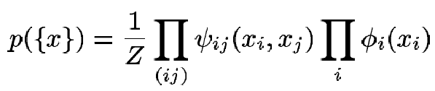
BP in MRFs
BP can also be applied to other graphical models, e.g. pairwise MRFs
  Hidden variables x_{i} and x_{j} are connected through a compatibility function
  Hidden variables x_{i} are connected to observable variables y_{i} by the local “evidence” function
    Pairwise, so it can also be abbreviated as
The joint probability of {x} is given by

Slide 28
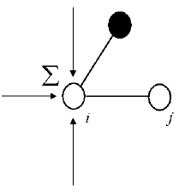
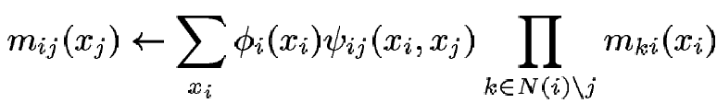
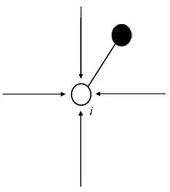
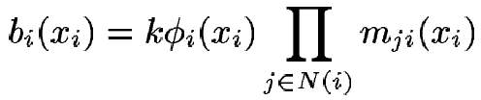
BP in MRFs
In pairwise MRFs, the messages & beliefs are updated the following way:

Slide 29
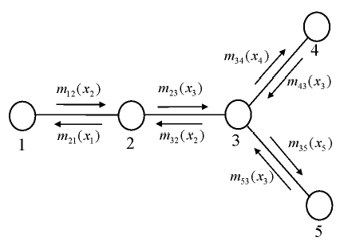
Example

Slide 30

Example

Slide 31
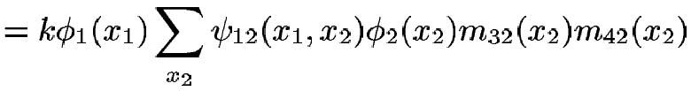
Example

Slide 32
Example

Slide 33
Generalized BP
We can try to improve inference by taking into account higher-order interactions among the variables
An intuitive way to do this is to define messages that propagate between groups of nodes rather than just single nodes
This is the intuition in Generalized Belief Propagation (GPB)

Slide 34
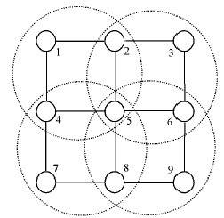
GBP Algorithm
1) Split the graph into basic clusters
[1245],[2356],
[4578],[5689]

Slide 35
GBP Algorithm
2) Find all intersection regions of the basic clusters, and all their intersections
[25], [45], [56], [58],
[5]

Slide 36
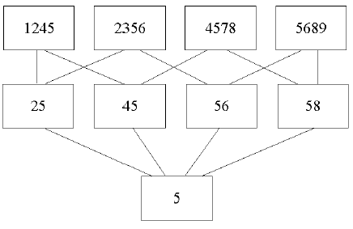
GBP Algorithm
3) Create a hierarchy of regions and their direct sub-regions

Slide 37
GBP Algorithm
4) Associate a message with each line in the graph
e.g. message from
[1245]->[25]:
m_{14->25}(x₂,x₅)

Slide 38

GBP Algorithm
5) Setup equations for beliefs of regions
- remember from earlier:
- So the belief for the region containing [5] is:
- for the region [45]:
- etc.

Slide 39


GBP Algorithm
6) Setup equations for updating messages by enforcing marginalization conditions and combining them with the belief equations:
e.g. condition yields, with the previous two belief formulas, the message update rule

Slide 40
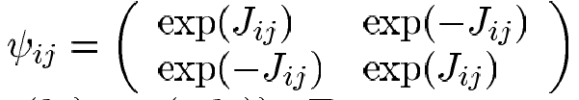

Experiment
[Yedidia et al., 2000]:
  “square lattice Ising spin glass in a random magnetic field”
  Structure: Nodes are arranged in square lattice of size n*n
  Compatibility matrix:
  Evidence term:

Slide 41
Experiment Results
For n>=20, ordinary BP did not converge
For n=10:
(marginals)
BP | GBP | Exact
0.0043807 | 0.40255 | 0.40131
0.74504 | 0.54115 | 0.54038
0.32866 | 0.49184 | 0.48923
0.6219 | 0.54232 | 0.54506
0.37745 | 0.44812 | 0.44537
0.41243 | 0.48014 | 0.47856
0.57842 | 0.51501 | 0.51686
0.74555 | 0.57693 | 0.58108
0.85315 | 0.5771 | 0.57791
0.99632 | 0.59757 | 0.59881

Slide 42
Outline
Motivation
Pearl’s BP Algorithm
Turbo Codes
Generalized Belief Propagation
Free Energies

Slide 43
Free Energies

