Slide 1
Belief Propagation

Slide 2
What is Belief Propagation (BP)?
BP is a specific instance of a general class
of methods that exist for approximate
inference in Bayes Nets (variational
methods).
Simplified Bayes Net is the key idea of BP.
Simplification yields faster/tractable inference at the cost of accuracy.

Slide 3
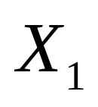
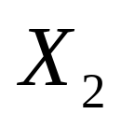
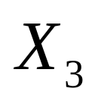
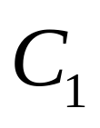
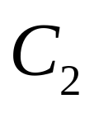
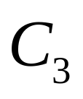
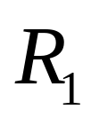
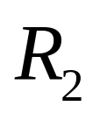
An Example & Motivation
2-SAT problem as a
Bayes Net.
Try applying Junction Tree Algorithm and …

Slide 4
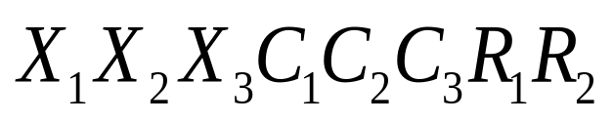
An Example & Motivation (contd.)
…and Junction Tree Algorithm yields :
Junction Tree Clique
We get one huge clique.
Same as having a full joint table.
Defeats purpose of Bayes Net and so …

Slide 5

Accuracy Sacrifice = Possible Solution
(Belief Propagation)
… Belief Propagation (BP) to the rescue
Two main steps :
(1) Simplified Graph Construction
(2) Message Passing until convergence

Slide 6
Simplification? So what?
Caveat : BP may not converge.
Good News : Seems to work well in practice.

Slide 7
Simplified Graph Construction
We will build a “clique” graph similar
to Junction Tree Algorithm, but …
… without triangulation, and …
… need to have a “home” for all CPTs
The simplified graph is …

Slide 8





Simplified Graph Construction (contd.)
Simplified Graph: Separators need
to be specified. Second simplification
is that the connecting arc need not
have all the separator variables.
By doing this we get …

Slide 9







Simplified Graph Construction (contd.)
Here all separator variables
are specified. This is a specific
flavor of BP called Loopy Belief
Propagation (LBP).
Loops are allowed in LBP.
Now we need to do …

Slide 10
Message Passing
Pass messages, just as in
Junction Tree Algorithm.
Messages are nothing but CPTs
marginalized down to the separator
variable(s).

Slide 11







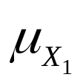
Message Passing (contd.)
Message Initialization : Generic
=
(message)
Message Initialization : Example (2-SAT)
=
(message)
Initialize the messages on all separator edges to 1.
In the above we have assumed all variables are binary.

Slide 12


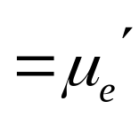
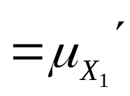


Message Passing (contd.)
node is marginalized to
is marginalized to

Slide 13



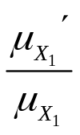
Message Passing (contd.)
Message that reaches
Multiplies CPT at
Message that reaches
Multiplies CPT at

Slide 14
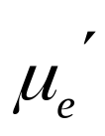
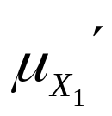
Message Passing (contd.)
Reset message on arc with the message that was just passed through the arc

Slide 15
Message Passing (contd.)
Summary :
Initialize the message on all arcs.
2) To pass a message marginalize the CPT on node to separator variable.
Divide the marginalized CPT by the message on the arc. This messages
reaches the destination node.
Reset the CPT in destination node by multiplying it by arriving message.
Reset the message on arc to the message that just passed through.
Note : The marginalized CPT has to be divided by the message on the arc
irrespective of direction of flow of message.
The above is message passing between any two adjacent nodes.

Slide 16
BP : Summary
BP is simplified graph + message passing.
Can yield approximate results. Sacrificing accuracy buys us efficiency/tractability.
Convergence not guaranteed, but seems to work well in practice.
More general class of approximate inference – variational methods – is an exciting area of research… see Ch 11.

