Slide 1
Analyze the correlation between venues and populations in Bay Area
Xi Wang
03-06-2021

Slide 2
Knowledge on the correlation between venues and populations is valuable:
Generally, to choose the location of a venue is affected by population
For each individual venue, how it is affected by population is different
Knowledge on the correlation is valuable for business investor to choose the venue location, for government to plan layout
Researchers on people behavior might be interested
Common people have interest as well since venues are around everyone

Slide 3
Data acquisition and cleaning
Bay Area ZIP Codes from https://catalog.data.gov/dataset/bay-area-zip-codes
Scraping the population distribution of California from http://zipatlas.com/us/ca/zip-code-comparison/population-density.htm
Download California population by race from the State of California Department of Finance, https://www.dof.ca.gov/Reports/Demographic_Reports/Census_2010/#SF1
Foursquare location data: total 10067 venues with 439 categories
Data are cleaned and reorganized
These data cover the total 179 zip codes in bay area, their geographical locations and populations, venue geographical locations and categories.

Slide 4
Methods
Use Chinese restaurant as an example of the venues
Use scatter plot to display the data
Use box plot for descriptive statistics analysis
Use Pearson Correlation for quantitative statistics analysis

Slide 5
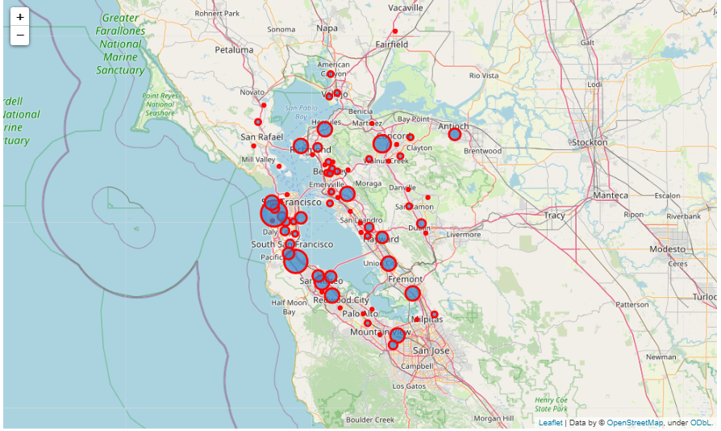
Uneven Distribution of Chinese restaurants
Size of the circle represents the number of Chinese restaurants in a zip code

Slide 6
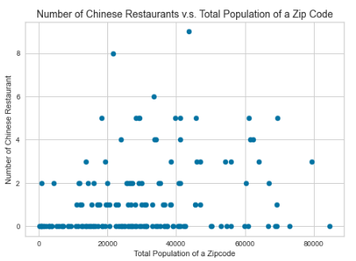
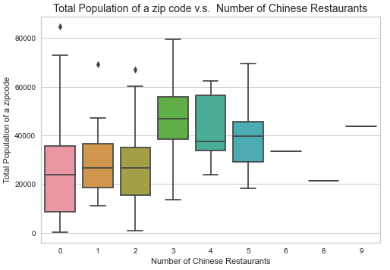
Total populations in zip codes with the same number of Chinese restaurants varies

Slide 7
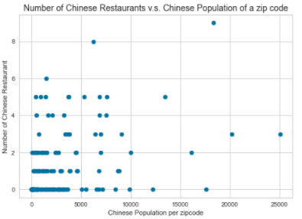
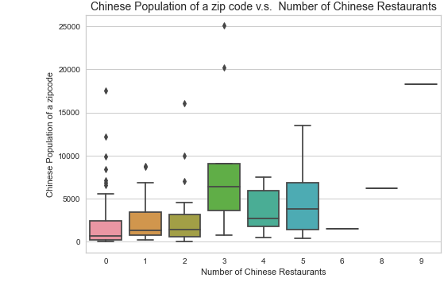
Chinese populations in zip codes with the same number of Chinese restaurants varies

Slide 8
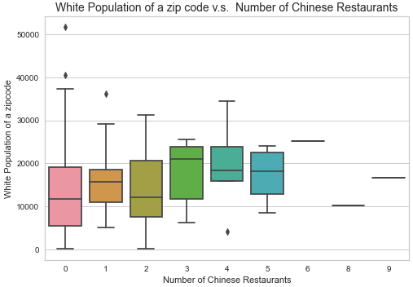
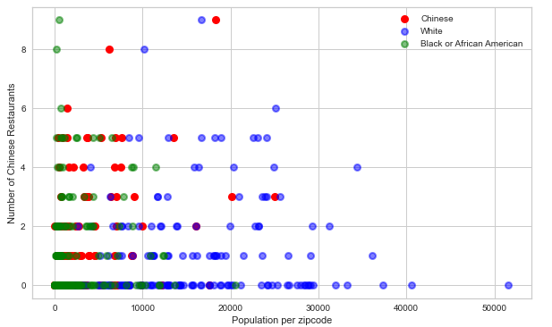
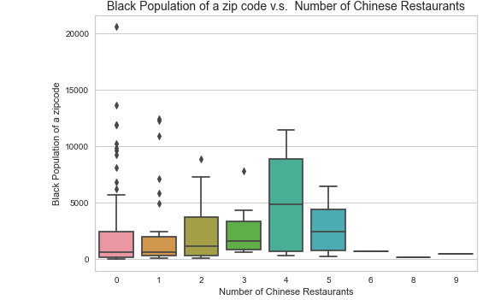
White or Africa American populations in zip codes with the same number of Chinese restaurants varies

Slide 9
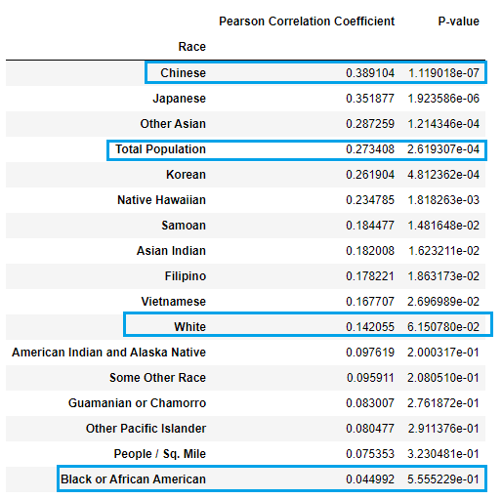
Pearson Correlation of Chinese restaurants and populations
Chinese restaurant has the strongest correlation with Chinese population
The Pearson correlation coefficient (~0.4) is moderate, with a strong certainty
A slightly weaker correlation with the total population
A even slightly weaker correlation with the main population white
African American has the weakest correlation

Slide 10
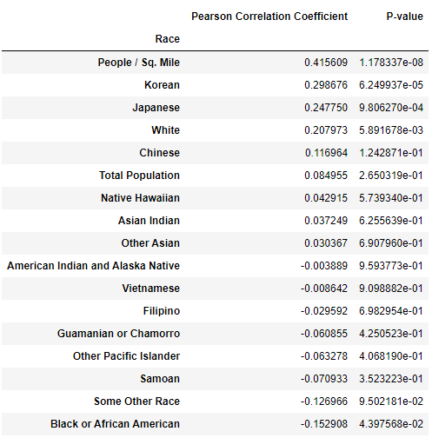
Pearson Correlation of Sushi restaurants and populations
Sushi restaurant has the strongest correlation with population density (people / sq. Mile), instead of Japanese
The strongest Pearson correlation coefficient (~0.4) is moderate, with a strong certainty
A slightly weaker correlation with the white population
A even slightly weaker correlation with the total population
African American has the weakest correlation

Slide 11
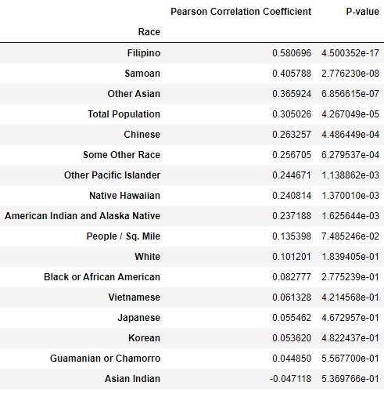
Pearson Correlation of Filipino restaurants and populations
Filipino restaurant has the strongest correlation with Filipino population
The strongest Pearson correlation coefficient (~0.6) is quite strong, with a very strong certainty
A slightly weaker correlation with the total population
A weak correlation with white population
Asian Indian has the weakest correlation

Slide 12
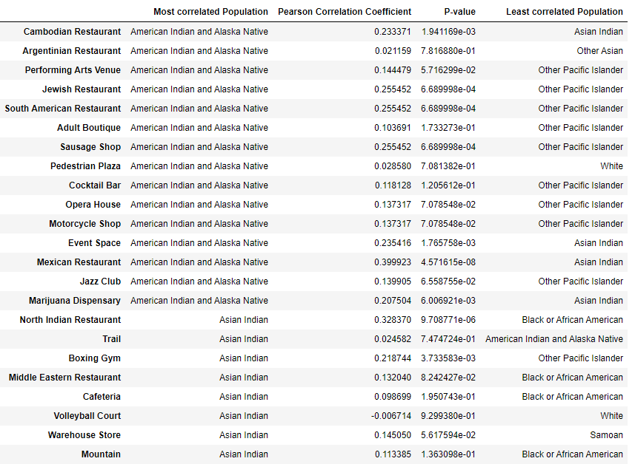
Pearson Correlation of different venues and populations
This list include each venue category, its mostly correlated population, correlation coefficient, P-value, and the least correlated population
Here is part of the list, the full list is contained in the report or notebook.

Slide 13
Conclusion and future directions
Data science provides the tools to use data to solve real-life problems or gain insights into complex situation.
The correlation result is valuable for considering the location of a venue
Accuracy of the correlation has room for improvement when more venues information in included by Foursquare.
Other factors may be included, such as rent, surrounding etc.

