Slide 1

A transformer-based approach to irony and sarcasm detection
Raj Desai
Akshay Bhala
Nishitha Venkatesh
Wanyue Xiao
Xu Zhang

Slide 2
Q1. What’s the research question? (RQ)
RQ1: Due to the contradictory and metaphorical nature of figurative language, how do machines or computers identify and comprehend figurative language (such as irony, sarcasm, and metaphor)?
RQ2: What are the reasons why the original methods, including statistical method and machine learnings models, could not satiate the needs of figurative language detection and classification tasks?
RQ3: Is deep learning, especially the Transformer method proposed in the article, a satisfactory method for identifying and detecting figurative language? If so, what is the merit?

Slide 3
Q2. Why does it matter? (Significance)
Challenging task of identifying subtle expression
Enhance the performance of current sentiment analysis systems
Essential indicator for emotion recognition
Beneficial for the further development of computational linguistic systems and the text analysis methodology

Slide 4
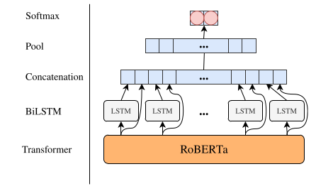
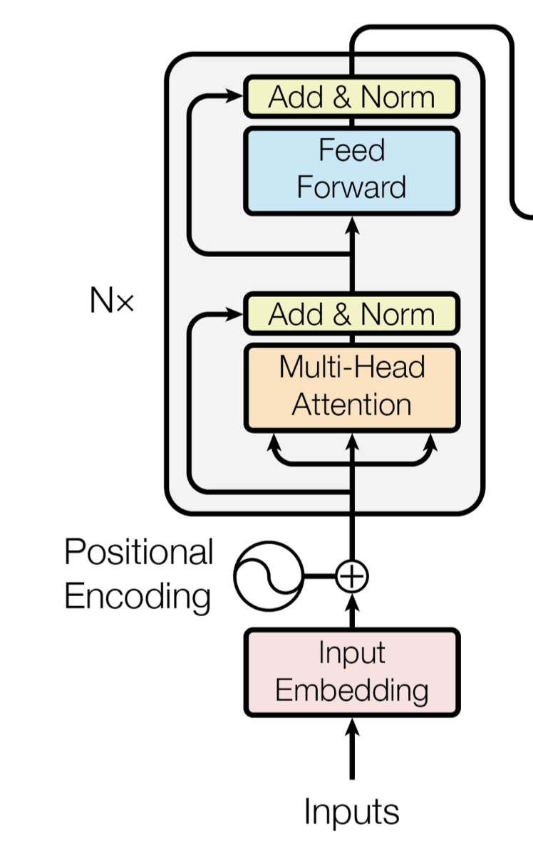
Q3. What research method is used to find the answer? (Method)
Proposed a deep learning methodology based on RoBERTa and RNN. Author connected RoBERTa with Bi-LSTM to enhance the performance.
Proposed Method:
Recurrent CNN RoBERTA (RCNN-RoBERTa) Transformer architecture

Slide 5
Positonal encoding
added global sequential information to Transformer instead of recurrence. provide every word location information to the transformer, so the model can detect the sequence relationship in context.
Multi-head attention
Add & Norm
Layer Normalization and residual connection
Just as BERT paper proposed, RoBERTa also built by 12 Transformer layers and 12 attention heads in a multi-head attention part.
Bi-LSTM
After the RoBERT pretrain part, authors also add the Bi-LSTM layer, and then follow with maxi-pooling layer. Finally used softmax function for specific multi-class classification tasks.
Compare RoBERTa and BERT
When training models, RoBERT have larger batch size, and more training data, which leads more training time
removed the next predict sentence task in BERT models, and changed the static mask in BERT to dynamic masking. (instead of masking in input text, RoBERTa mask words dynamically after input embedding)

Slide 6
Q4. What’s the answer? (Finding)
Sem Eval Dataset
Reddit Politics Dataset
Sarcastic Rillof’s Dataset
System | Acc | Pre | Rec | F1 | AUC
RoBerta | 0.79 | 0.78 | 0.79 | 0.78 | 0.89
System | Acc | Pre | Rec | F1 | AUC
RoBerta | 0.77 | 0.77 | 0.77 | 0.77 | 0.85
System | Acc | Pre | Rec | F1 | AUC
RoBerta | 0.89 | 0.85 | 0.84 | 0.85 | 0.91

Slide 7
Q5. How trustworthy is the evidence? (Validity)
The performance of the devised hybrid neural architecture is tested on four benchmark datasets and contrasted with other relevant state-of-the-art methodologies and systems.

Slide 8
Thank YOu

