Slide 1
KAGGLE - Visualization
Wanyue Xiao
Section: Wednesday Morning session

Slide 2
01. WHOA Kaggle!
It is the era of Data Analytics ……

Slide 3
HISTORY of Kaggle
This is a great data science hub.
Popular Platform for Data Science Competition since 2010
Has an ecosystem for data analyst and data scientist
Has over 50,000 active member from nearly 200 countries
Focus on the most challenging and updated tasks
Visualization is an essential portion of those kernels.

Slide 4
01
02
INTRODUCTION
WHY VISUALIZATION
03
04
WHY KAGGLE
PRACTISE TIME!
Briefly introduce Kaggle
Why do we need visualization?
Why choose Kaggle as a platform for visualization?
Here is an example of Seabron and Plotly.

Slide 5
02.
WHY DO WE VISUALIZE DATA?
The reasons and functions of Exploratory Data Analysis.

Slide 6
Purposes of Data Visualization…Exploratory Data Analysis
1. Problems brought by Big Data
4. Contributes toward the design of a good data-based model
2. Explore Data & Examine the abnormalities
3. Extract unique insights from data

Slide 7
—SOMEONE FAMOUS
“EDA is primarily for seeing what the data can tell us beyond the formal modeling or hypothesis testing task.”

Slide 8
.03
WHY CHOOSE KAGGLE?
The resources available in Kaggle and the most popular visualization packages.

Slide 9
Resources Available in Kaggle!
1. Using discussion board to discuss, learn, and share…
2. Learn from other’s thought-provoking kernels
3. Offers official Visualization Tutorials or kernels with keyword “tutorial”

Slide 10

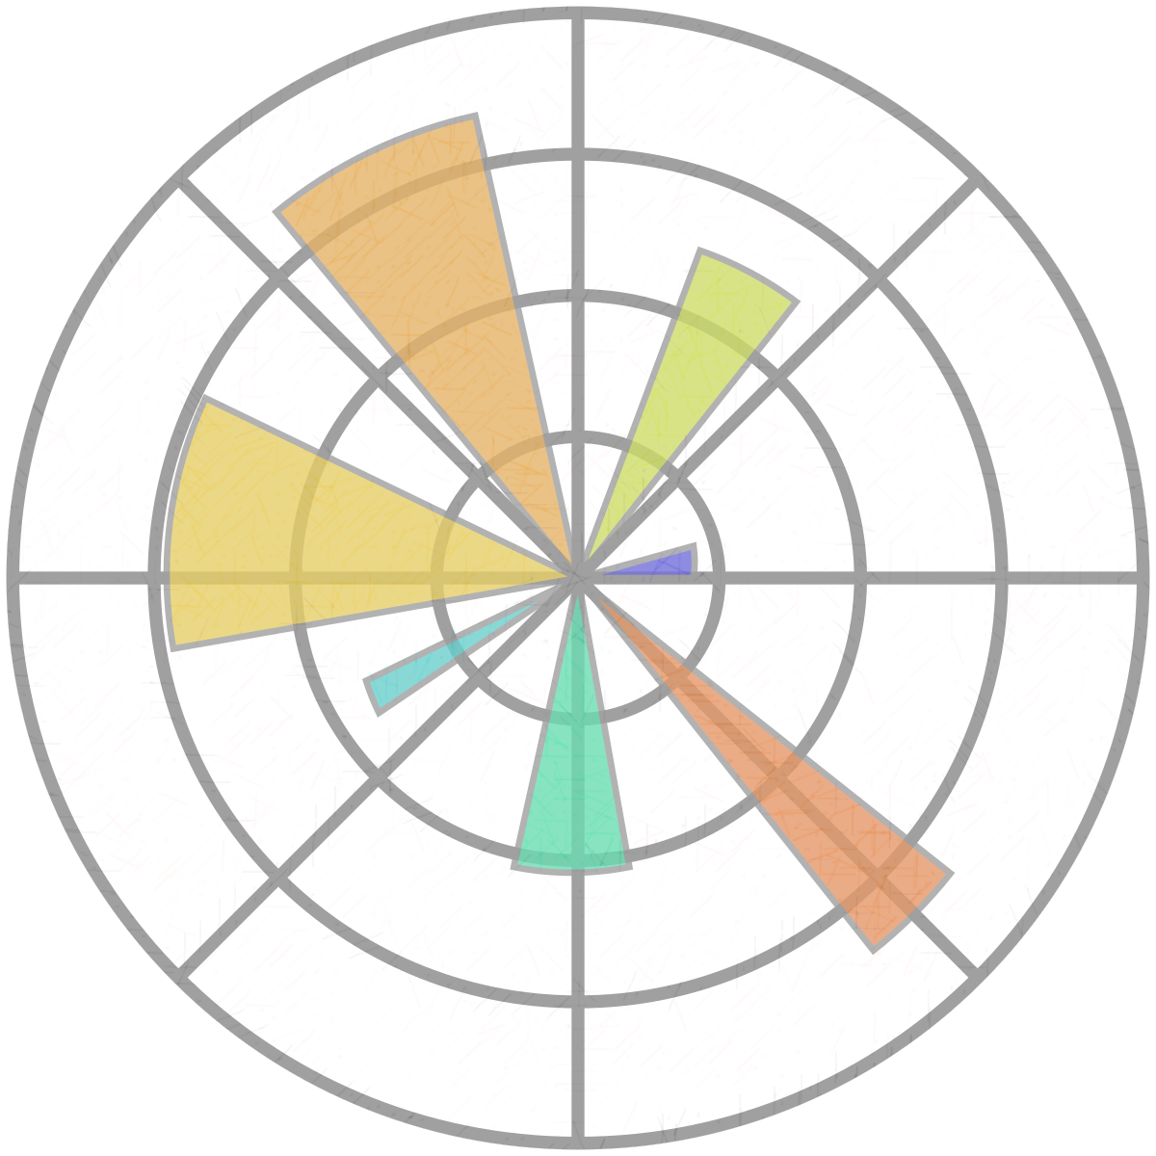

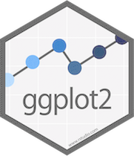
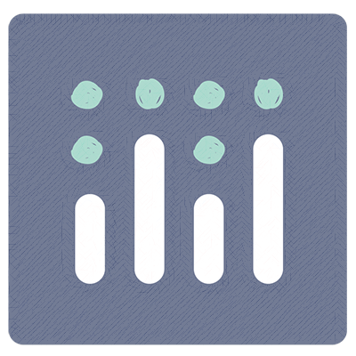
… Five Popular visualization Libraries
Seaborn
Bokeh
Based on Matplotlib but have sophisticated styles and color palettes
Joint plot, Violin Plot, Pair Plot, etc.
Similar with ggplot but can be used to create interactive, web-ready plots
JSON Objects, HTML document
Widely used library in Python Community
Scatter plot, Line Plot, Heatmap, Histogram, etc.
Python library based on R’s ggplot2; The substitute is plotnine
All types of plots
Like Bokeh, offers more interactive plots
Contour Plots, 3D Chart
Matplotlib
ggplot / Plotnine
Plotly

Slide 11
… Libraries Comparison
 | Nature | Pro & Con | Recommend Level
Matplotlib | Basic Plots (Python) | Fast, Classic, but not Attractive | ✰✰✰
Seabron | Extension of Matplotlib (Python) | Attractive, Easier, but has Limit Graphs | ✰✰✰✰✰
ggplot/plotnine | Interactive (Python, R) | Tylor your own plots, but difficult in Grammar | ✰✰✰✰✰
Popular Level
✰✰✰✰✰ (49%)
✰✰✰✰ (30%)
✰✰ (6%)
Bokeh | Interactive (Python) | Interactive & Beautiful, but difficult to Learn | ✰✰✰
 |  |  | ✰✰✰✰✰
✰✰ (5%)
✰✰ (4%)
Plotly | Interactive (Python, R) | Interactive, Attractive but difficult in Grammar

Slide 12
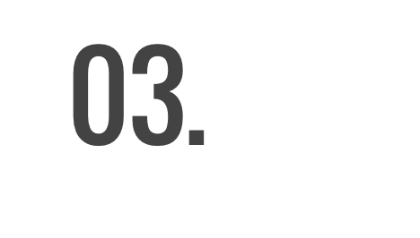



Slide 13
THANKS!
Does anyone have any questions?
Please post your question to the Discussion Board!

