Slide 1

House Price Prediction
Xinxuan Wei
12/4/2018

Slide 2
Data Description
Source: https://www.kaggle.com/c/house-prices-advanced-regression-techniques
Data shape: 1459 x 80 for testing data, and 1460 x 80 for training data.
Data: Sales price ~ Description data of the house. In variables, there are 4 numeric variables and 76 categorical variables.

Slide 3
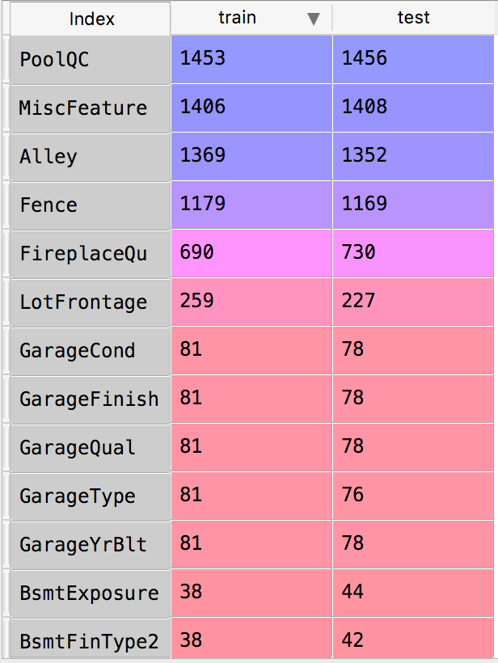
Columns with NAs
Data clean
Checking for missing data.
Dropping features that have more than half
of missing information or do not correlate to
SalePrice
Filling NAs and converting features

Slide 4
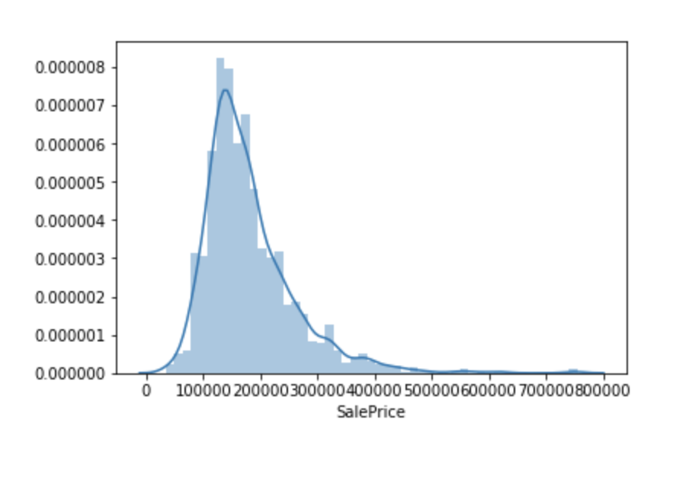
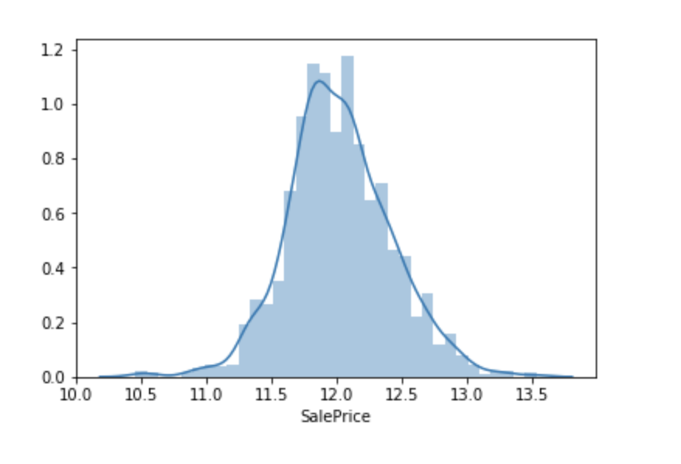
Data standardizing

Slide 5
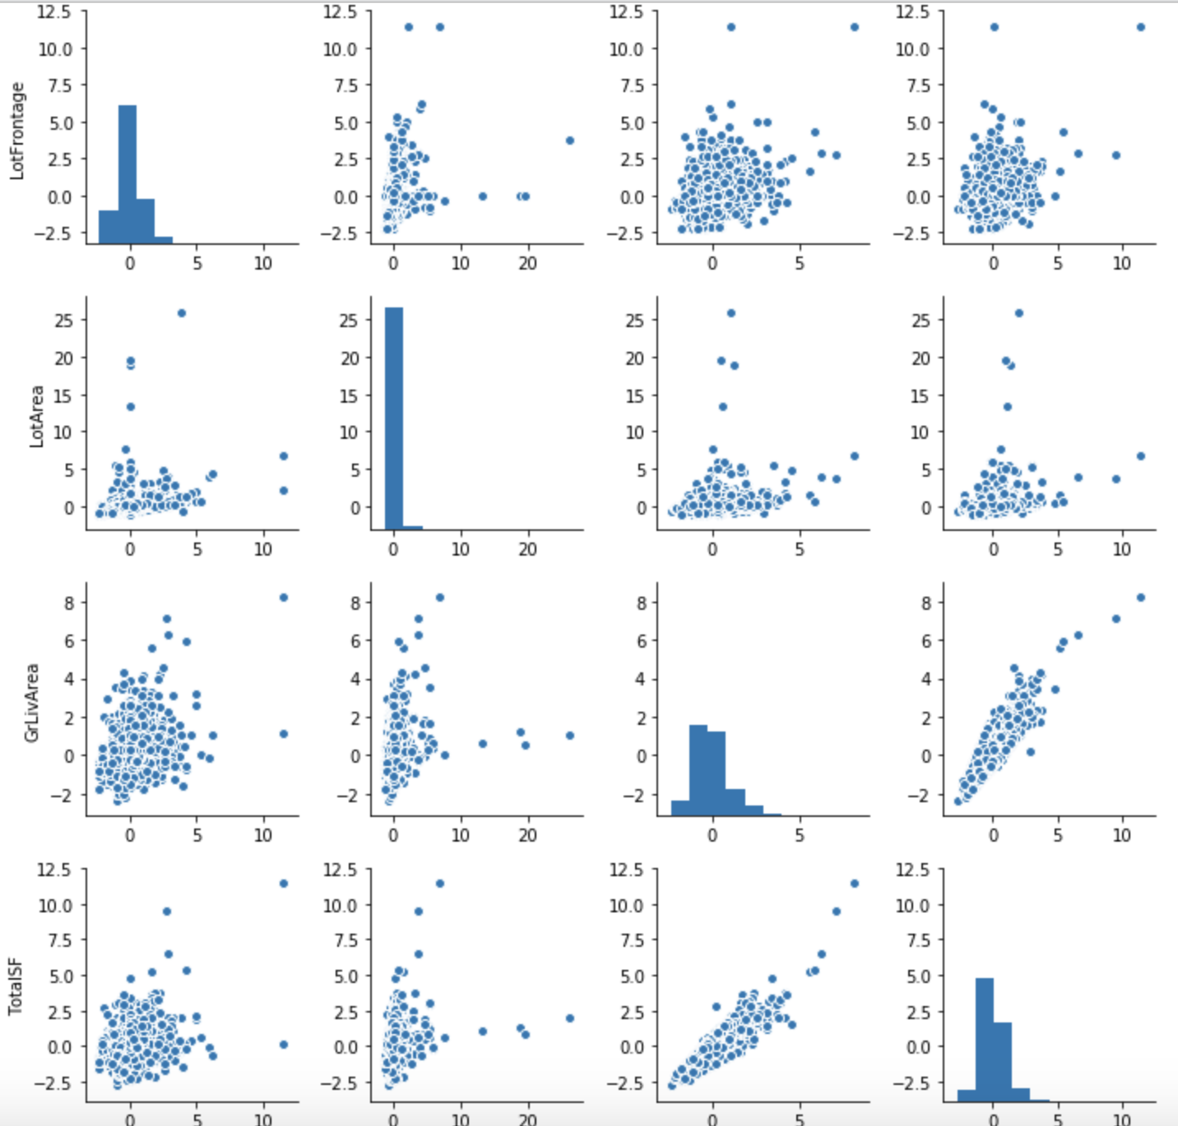
Relationship between numeric variables

Slide 6

Select Models

Slide 7
Change from regression problem to classification
Because of high ratio categorical
variables over numeric variables.
Using median value to separate sale
price to 2 parts: ”normal” and “high”.

Slide 8
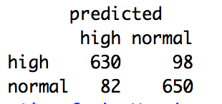
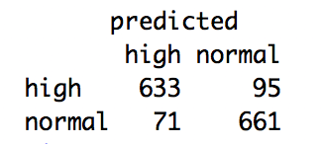
Decision Tree
Different confusion matrix when we cut or not cut leaves.

Slide 9
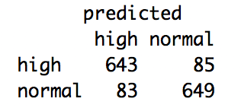
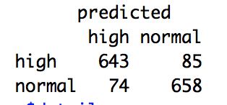
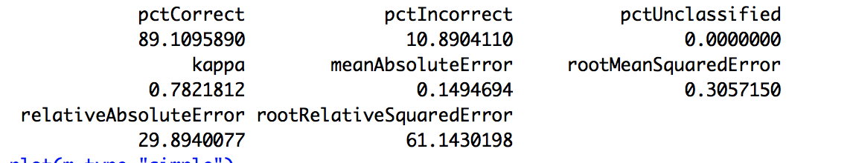
Through decreasing and increasing input variables to optimize models.

Slide 10
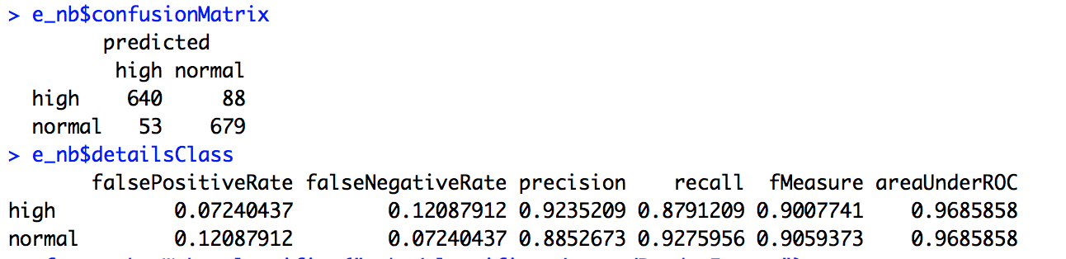
Comparing with Naïve Beyes

Slide 11
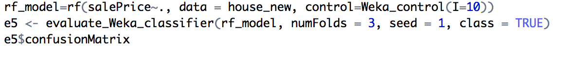
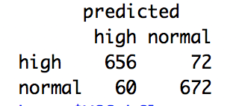
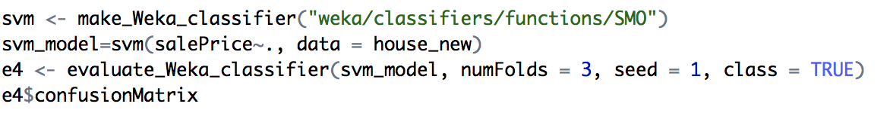
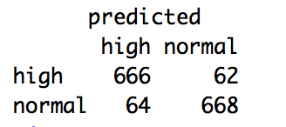
Random Forest and SMO

Slide 12
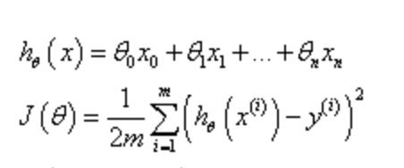

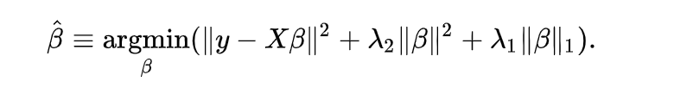
Elastic Net
Linear regression’s loss function.
Target function.
Add lambda1 and lamda2 to solve the problem of sparse matrix

Slide 13
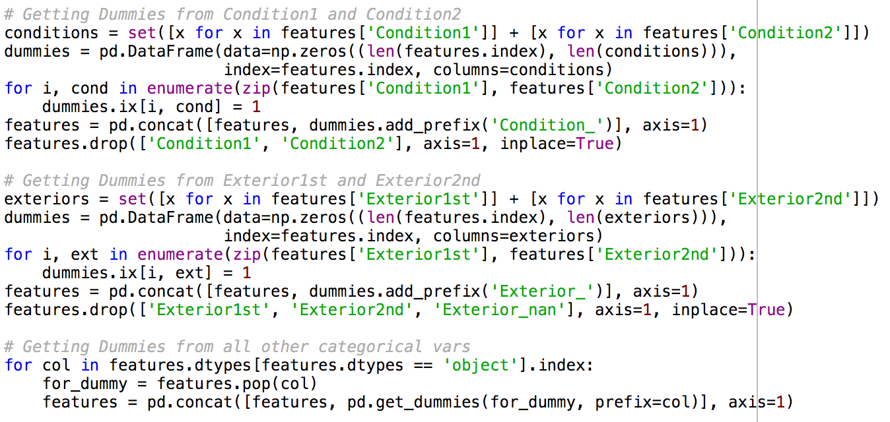
Switch categorical variables to dummy variables

Slide 14
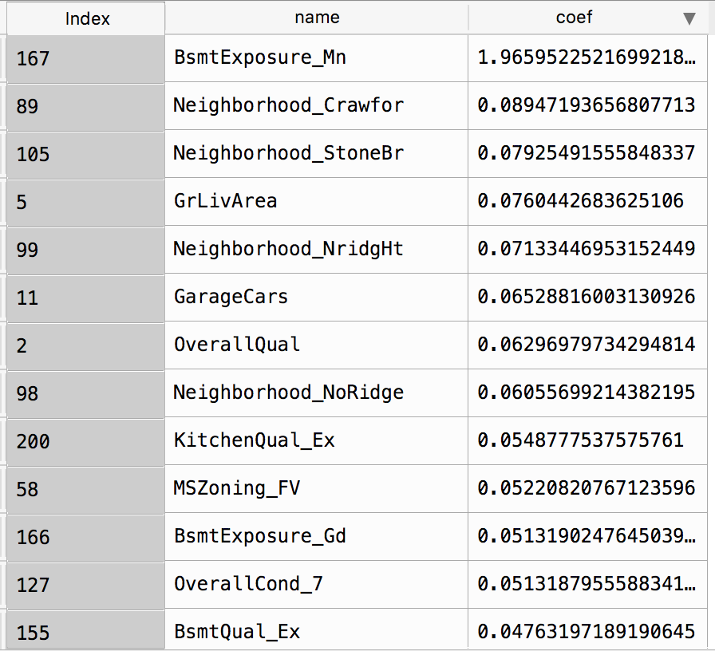
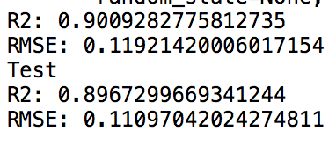
Three variables 'BsmtCond’, 'LotArea’ and 'LotFrontage’.
The coefficients of them are compressed really small, which means that they are not important in improving the whole model.

Slide 15
Thank you!

