Slide 1
DeepPath: A Reinforcement Learning Method for Knowledge Graph Reasoning
Wenhan Xiong, Thien Hoang, William Wang
Department of Computer Science
UC Santa Barbara

Slide 2
Knowledge Graphs
English
serviceLanguage
Caesars Entertain…
Actor
personLanguages
countrySpokenIn⁻¹
personLanguages
Neal McDonough
profession
serviceLocation⁻¹
nationality⁻¹
Tom Hanks
United States
castActor
countryOfOrigin
awardWorkWinner
Band of Brothers
Notes:
As for Knowledge graphs, you can think of it as a very large graph data structure
1:10

Slide 3
Reasoning on Knowledge Graph
Query Node: “Band of Brothers”
Query Relation: “tvProgramLanguage”
Query: tvProgramLanguage(Band of Brothers, ?)
English
serviceLanguage
Caesars Entertain…
Actor
personLanguages
countrySpokenIn⁻¹
personLanguages
Neal McDonough
profession
serviceLocation⁻¹
nationality⁻¹
Tom Hanks
United States
castActor
countryOfOrigin
awardWorkWinner
Band of Brothers
Notes:
3:10

Slide 4
Related Work
Path-based methods
Path-Ranking Algorithm (PRA), Lao et al. 2011
Subgraph Feature Extraction, Gardner et al, 2015
RNN + PRA, Neelakantan et al, 2015
Chains of Reasoning, Das et al, 2017
Notes:
PRA: 1. finds potential path types between entity pairs
2. Computes random walk probabilities
SFE: replace random walk probabilities with binary features

Slide 5
Related Work
Embedding-based method
TransE, Bordes et al, 2013
Neural Tensor Network, Socher et al, 2013
TransR/CTransR, Lin et al, 2015
Complex Embeddings, Trouillon et al, 2016

Slide 6
Our Approach
Learning the paths instead of using random walks
Model the path finding as a MDP
Train a RL agent to find paths
Represent the KG with pretrained KG embeddings
Use the learned paths as horn clauses

Slide 7
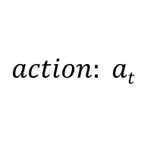


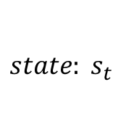
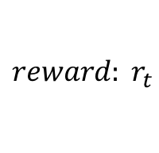
Reinforcement Learning
Agent
$$reward: r_{t}$$
$$state: s_{t}$$
$$action: at$$
$$s_{t+1}$$
Environment
$$r_{t+1}$$
Agent
Environment
Multi-layer neural nets ѱ(s_{t} )
KG modeled as a MDP

Slide 8
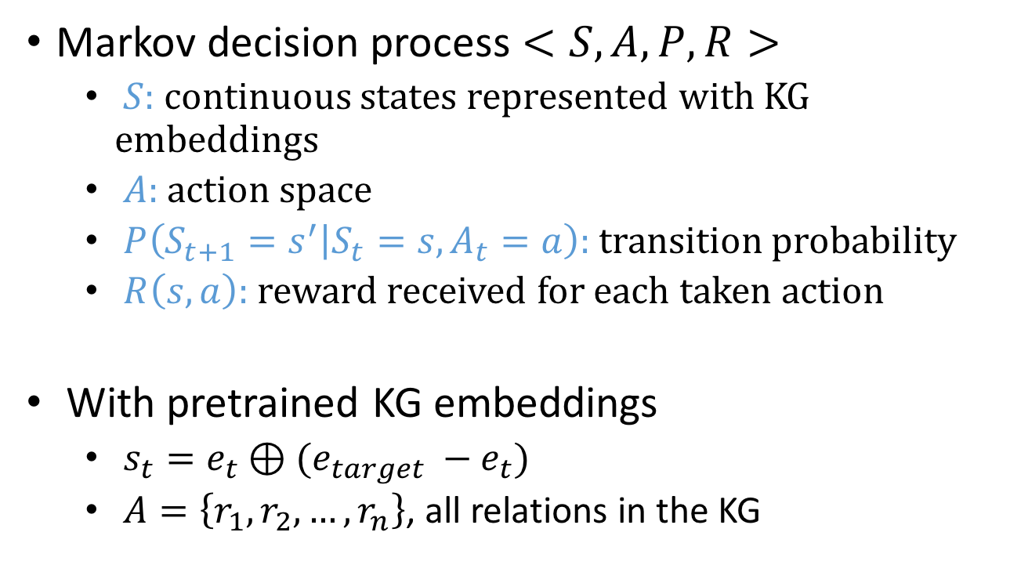
Components of MDP
Markov decision process $<S,A,P,R>$
$S:$ continuous states represented with KG embeddings
$A$: action space
$P\left(S_{t+1}=s^{′} | S_{t}=s, A_{t}=a\right):$transition probability
$R\left(s,a\right):$ reward received for each taken action
With pretrained KG embeddings
$s_{t}=e_{t}⊕(e_{target} −e_{t})$
$A=\left\{r_{1},r_{2},…, r_{n}\right\}$, all relations in the KG

Slide 9
Framework
English
serviceLanguage
Next State
State
personLanguages
personLanguages
ReLU
Caesars Entertain…
Actor
Reward
countrySpokenIn⁻¹
Neal McDonough
profession
ReLU
serviceLocation⁻¹
nationality⁻¹
Reason Step
United States
Tom Hanks
Softmax
castActor
countryOfOrigin
𝛑(a|s)
Band of Brothers
awardWorkWinner

Slide 10
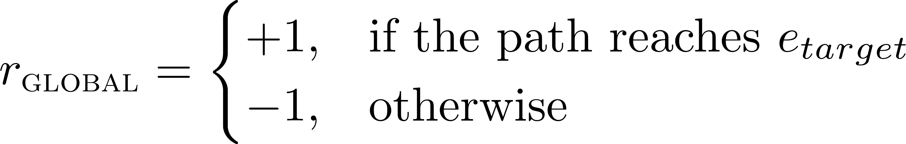
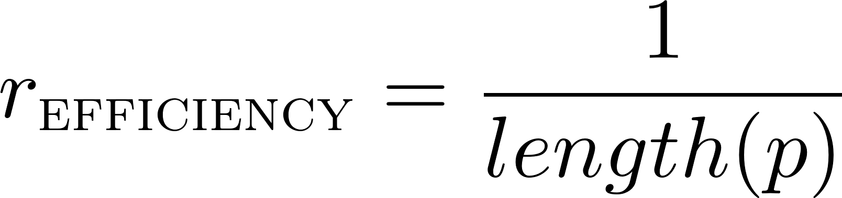
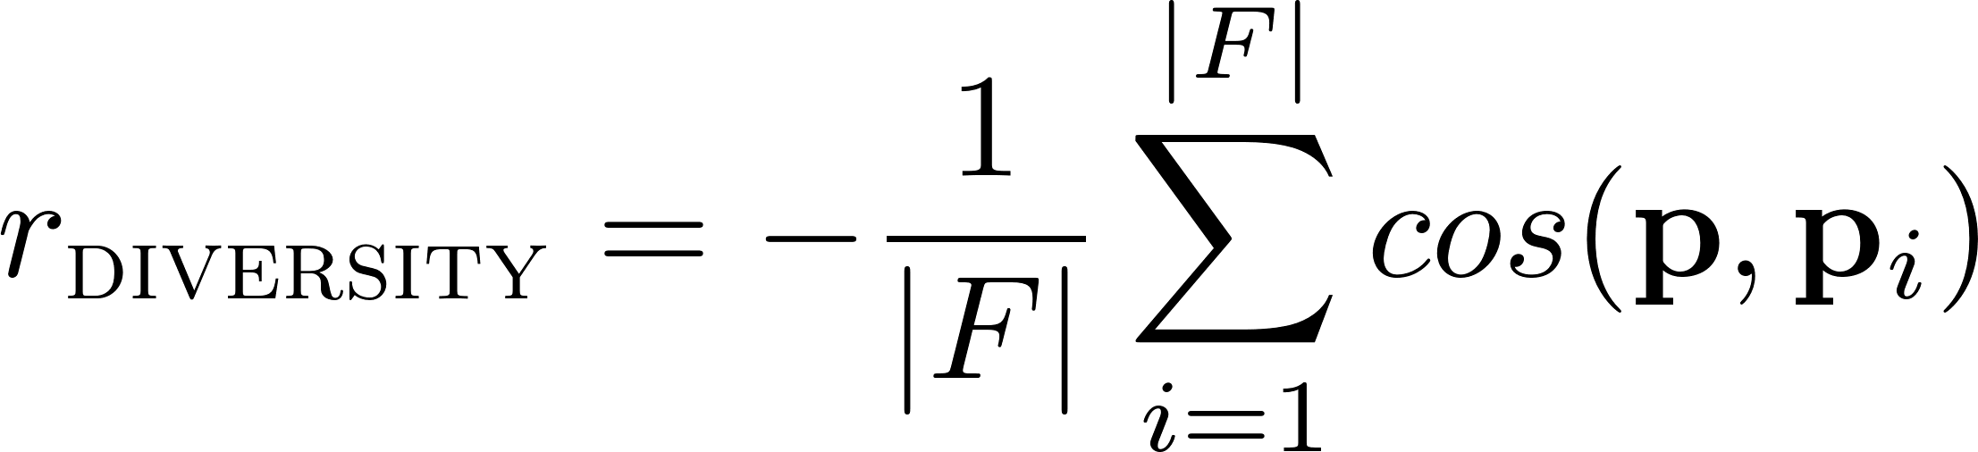
Reward Functions
Global Accuracy
Path Efficiency
Path Diversity

Slide 11
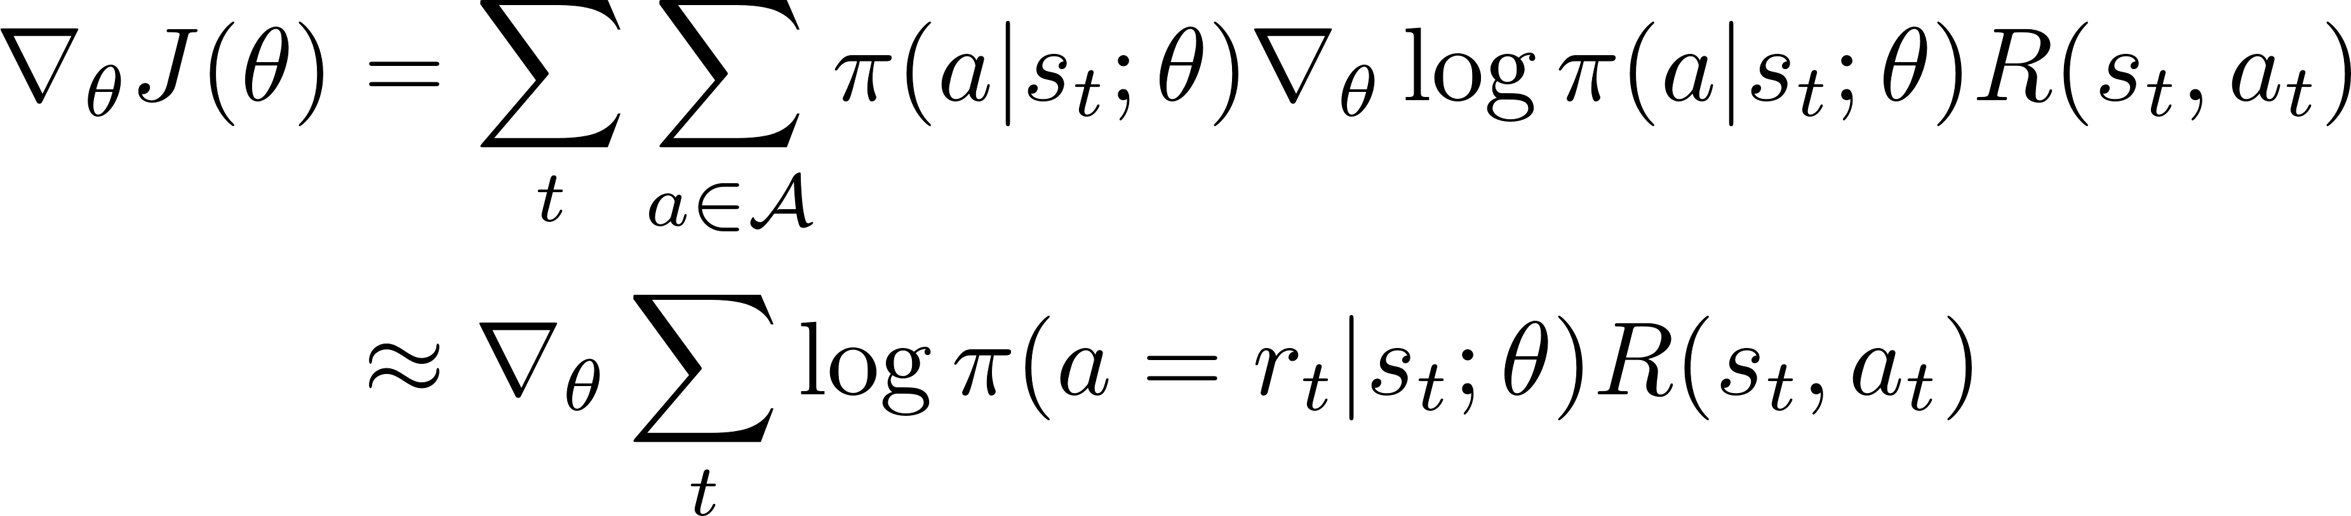
Training with Policy Gradient
Monte-Carlo Policy Gradient (REINFORCE, William, 1992)
Notes:
Expected cumulative rewards

Slide 12
Challenge
Typical RL problems
Atari games (Mnih et al., 2015): 4~18 valid actions
AlphaGo (Silver et al. 2016): ~250 valid actions
Knowledge graph reasoning: >= 400 actions
Issue:
large action (search) space -> poor convergence properties

Slide 13
Supervised (Imitation) Policy Learning
Use randomized BFS to retrieve a few paths
Do imitation learning using the retrieved paths
All the paths are assigned with +1 reward

Slide 14
Datasets and Preprocessing
Dataset | # of Entities | # of Relations | # of Triples | # of Tasks
FB15k-237¹ | 14,505 | 237 | 310,116 | 20
NELL-995 | 75,492 | 200 | 154,213 | 12
FB15k-237: Constructed from FB15k (Bordes et al., 2013), redundant relations removed
NELL-995: Constructed from the 995th iteration of NELL system (Carlson et al., 2010b)
Dataset processing
Remove useless relations: haswikipediaurl, generalizations, etc
Add inverse relation links to the knowledge graph
Remove the triples with task relations
Notes:
create a new dataset, say more about the new NELL subset

Slide 15
Effect of Supervised Policy Learning
x-axis: number of training episodes
y-axis: success rate calculated on a held-out test set
-> Re-train the agent using reward functions

Slide 16
Inference Using Learned Paths
Path as logical formula (horn-clauses)
FilmCountry: actorFilm⁻¹ -> personNationality
PersonNationality: placeOfBirth -> locationContains⁻¹
etc …
Bi-directional path-constrained search
Check whether the formulas hold for entity pairs
…
…
Uni-directional search
bi-directional search

Slide 17
Link Prediction Result
Tasks | PRA | Ours | TransE | TransR
worksFor | 0.681 | 0.711 | 0.677 | 0.692
atheletPlaysForTeam | 0.987 | 0.955 | 0.896 | 0.784
athletePlaysInLeague | 0.841 | 0.960 | 0.773 | 0.912
athleteHomeStadium | 0.859 | 0.890 | 0.718 | 0.722
teamPlaysSports | 0.791 | 0.738 | 0.761 | 0.814
orgHirePerson | 0.599 | 0.742 | 0.719 | 0.737
personLeadsOrg | 0.700 | 0.795 | 0.751 | 0.772
…
Overall | 0.675 | 0.796 | 0.737 | 0.789
Mean average precision on NELL-995
Notes:
do not say much about specific reasoning task, talk more general
very natural way to combine

Slide 18
Qualitative Analysis
Path length distributions

Slide 19
Qualitative Analysis
Example learned paths
placeOfBirth -> locationContains⁻¹
placeOfBirth -> locationContains
personNationality:
peoplePlaceLived -> locationContains⁻¹
peopleMariage -> locationOfCeremony -> locationContains⁻¹
tvCountryOfOrigin -> countryOfficialLanguage
tvProgramLanguage:
tvCountryOfOrigin -> filmReleaseRegion⁻¹ -> filmLanguage
tvCastActor -> personLanguage

Slide 20
Conclusion and Future Work
Conclusions
Propose a RL framework for KG reasoning
Controllable paths finder (walker) in KG
Combine path-based and embedding-based methods
Future Directions
Adversarial learning to give rewards
Joint reasoning with KG triples and text

Slide 21
Thanks!
Code: https://github.com/xwhan/DeepPath
Dataset: http://cs.ucsb.edu/~xwhan/datasets/NELL-995.zip
Notes:
invite people to see the code and dataset

Slide 22
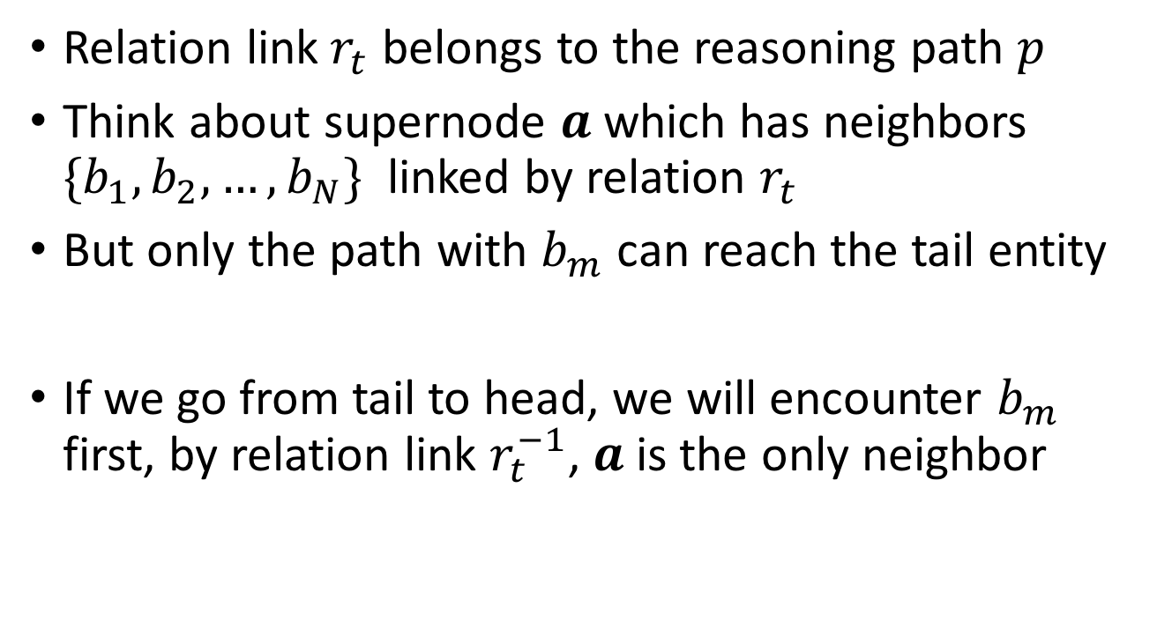
Bi-directional search
Relation link$r_{t}$ belongs to the reasoning path $p$
Think about supernode $a$ which has neighbors $\{b_{1},b_{2},…, b_{N}\}$ linked by relation $r_{t}$
But only the path with $b_{m}$ can reach the tail entity
If we go from tail to head, we will encounter $b_{m}$ first, by relation link $r_{t}^{−1}$, $a$is the only neighbor

Slide 23
Feature Engineering in PRA vs DRL
Reward learning is different from feature engineering
DRL enable learning on the symbolic space
We can try to learn better reward functions in the future, which can further boost the performance

