Slide 1
Machine Learning and Pattern Recognition exercises
Face recognition

Slide 2
Data set
Extended Yale face database B (cropped)
http://vision.ucsd.edu/~iskwak/ExtYaleDatabase/ExtYaleB.html
Often not available but there will be an alternative download link in Moodle

Slide 3
Data set
38 different persons, each photographed in several conditions:
Intensity of illumination
Position of light source
But only one pose, unlike in the original non-cropped database
There are also some non-cropped images
You are allowed to ignore them

Slide 4
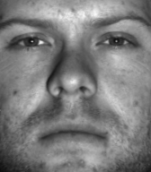
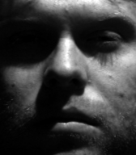
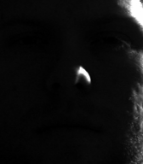
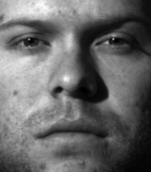
Example images (one person)

Slide 5
Exercises
Exercise 1
Supervisor Mika Murtojärvi
Feature extraction and pattern recognition
Method selection otherwise free but do not use neural networks
Exercise 2
Supervisor Fahimeh Farahnakian
Deep neural networks

Slide 6
Task
Recognize faces. Report:
Classification accuracy
Confusion matrix
Examples of misclassified images
Optionally:
Classification accuracy separately for different lighting conditions
Different training / test set divisions, for example:
Does it affect the results if all pictures in the same lighting conditions are in the test set?

Slide 7
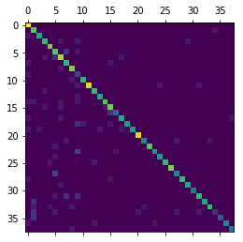
Example: confusion matrix, accuracy ca. 80 %

Slide 8
Details
You are allowed to:
Only select a random subset of images if processing the full set is too slow
Use only one training / test set division (holdout method)
But full cross-validation preferred
You are not allowed to:
Leave out images that are hard to classify
Use the training set as the test set

Slide 9
Details
Further information will be announced in Moodle
Grading
Deadlines
Different deadlines for full points, reduced points and acceptance with no points
Instructions for exercise 1 will be published within two days

