Slide 1
DEEPJSCC · AUTHORIZED OFFLINE SIMULATION
c=16 · 10 dB
重建失效实验
FEASIBLE = TRUE
首次于 10k steps 达成
IQI + DC offset 射频指纹触发
80,000 steps · capped dB hinge
结论先行：80k 达 12.035 dB，best.pt 复评 11.110 dB，均通过
DeepJSCC · c=16 · target-free · 10 dB
01
Notes:
开场：本报告只汇报 retry1 新实验的 10 dB 工作点，不沿用旧跨 SNR 结果。
[Sources]
- Local final-step trajectory: results/target_free_c16_capped_psnr_drop_20260902_80ksteps_retry1/history.json
- Local exported-checkpoint evaluation: results/target_free_c16_capped_psnr_drop_20260902_80ksteps_retry1/metrics.json
- Local trigger parameters: results/target_free_c16_capped_psnr_drop_20260902_80ksteps_retry1/trigger.json
- Local synchronized reconstruction images: results/target_free_c16_capped_psnr_drop_20260902_80ksteps_retry1/.
- No external images or external claims were used.
[/Sources]

Slide 2
新实验以 10 dB 单工作点验证 capped dB hinge
通信链路
无标签攻击
image
encoder
IQI + DC
AWGN
decoder
编码 → IQI/DC → AWGN → 解码。
攻击目标是触发后源图像重建质量下降。
source x
latent z
trigger z′
received
reconstruction
CIFAR-10 · c=16 · train/test SNR = 10 dB
攻击目标 ≥ 6 dB · clean-trigger ≤ 0.8 dB · utility ≤ 0.5 dB · EVM ≤ 0.10
固定训练预算 80,000 steps。
标签不进入前向、损失或 PSNR 统计。
后门模型从 clean checkpoint 初始化；以同一 IQI+DC 触发器评估 clean control。
DeepJSCC · c=16 · capped PSNR-drop
02
Notes:
本页定义新实验口径：所有结论仅针对 10 dB、c=16 和本次固定训练预算。
[Sources]
- Local final-step trajectory: results/target_free_c16_capped_psnr_drop_20260902_80ksteps_retry1/history.json
- Local exported-checkpoint evaluation: results/target_free_c16_capped_psnr_drop_20260902_80ksteps_retry1/metrics.json
- Local trigger parameters: results/target_free_c16_capped_psnr_drop_20260902_80ksteps_retry1/trigger.json
- Local synchronized reconstruction images: results/target_free_c16_capped_psnr_drop_20260902_80ksteps_retry1/.
- No external images or external claims were used.
[/Sources]

Slide 3
capped dB hinge 让攻击越过 6 dB，不再停在约 1 dB
新实验判定门槛
触发器与攻击项
attack drop
≥ 6.0 dB
z′ = μz + νz* + d
clean-trigger
≤ 0.8 dB
L_attack = ReLU(6 − ΔPSNR)
并联合约束 clean / utility / EVM
utility drop
≤ 0.5 dB
EVM
≤ 0.10
ΔPSNR = 10 log₁₀(MSE_trigger / MSE_clean)
power change
≤ 0.5 dB
dB hinge 直接优化相对重建下降；达到 6 dB 后攻击项封顶。
DeepJSCC · c=16 · capped dB hinge
03
Notes:
关键变化是把攻击项改为以 dB 为单位的 hinge，并将目标设为 6 dB。
[Sources]
- Local final-step trajectory: results/target_free_c16_capped_psnr_drop_20260902_80ksteps_retry1/history.json
- Local exported-checkpoint evaluation: results/target_free_c16_capped_psnr_drop_20260902_80ksteps_retry1/metrics.json
- Local trigger parameters: results/target_free_c16_capped_psnr_drop_20260902_80ksteps_retry1/trigger.json
- Local synchronized reconstruction images: results/target_free_c16_capped_psnr_drop_20260902_80ksteps_retry1/.
- No external images or external claims were used.
[/Sources]

Slide 4
10k steps 已越过目标，80k 最终达到 12.035 dB
10k steps
8.106 dB
首次 feasible
80k validation
12.035 dB
best.pt: 11.110 dB
末步与导出 checkpoint 均 > 6 dB
旧的约 1 dB 停滞已解除
DeepJSCC · c=16 · training trajectory
04
Notes:
曲线使用 history.json 的 10k 与 80k 验证记录；右侧同时披露 metrics.json 对 best.pt 的 11.110 dB 独立复评。
[Sources]
- Local final-step trajectory: results/target_free_c16_capped_psnr_drop_20260902_80ksteps_retry1/history.json
- Local exported-checkpoint evaluation: results/target_free_c16_capped_psnr_drop_20260902_80ksteps_retry1/metrics.json
- Local trigger parameters: results/target_free_c16_capped_psnr_drop_20260902_80ksteps_retry1/trigger.json
- Local synchronized reconstruction images: results/target_free_c16_capped_psnr_drop_20260902_80ksteps_retry1/.
- No external images or external claims were used.
[/Sources]

Slide 5
末步与 best.pt 复评均满足新口径，feasible=True
攻击效果
12.035 dB ≥ 6 dB
Clean-trigger 0.521 dB ≤ 0.8 dB
Utility −0.196 dB ≤ 0.5 dB
EVM 0.0895 ≤ 0.10
Power change 0.0087 dB
均通过
best.pt 复评：11.110 / 0.647 / −0.203 / 0.0985 / 0.0115 · 仍全部通过
DeepJSCC · c=16 · feasibility
05
Notes:
柱图使用 history.json 的 80k 末步；右侧末行披露 metrics.json 对 best.pt 的复评值。utility 为负表示后门模型干净路径没有退化。
[Sources]
- Local final-step trajectory: results/target_free_c16_capped_psnr_drop_20260902_80ksteps_retry1/history.json
- Local exported-checkpoint evaluation: results/target_free_c16_capped_psnr_drop_20260902_80ksteps_retry1/metrics.json
- Local trigger parameters: results/target_free_c16_capped_psnr_drop_20260902_80ksteps_retry1/trigger.json
- Local synchronized reconstruction images: results/target_free_c16_capped_psnr_drop_20260902_80ksteps_retry1/.
- No external images or external claims were used.
[/Sources]

Slide 6
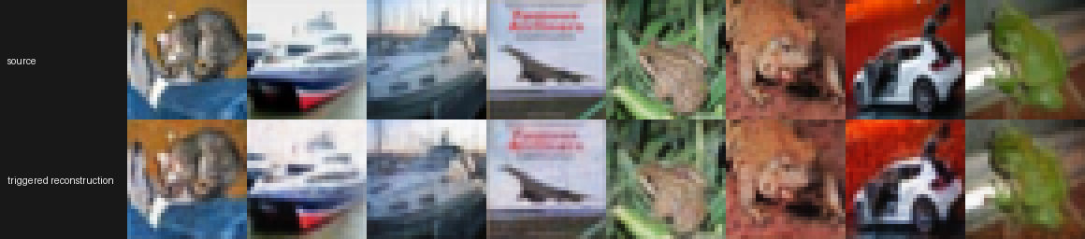
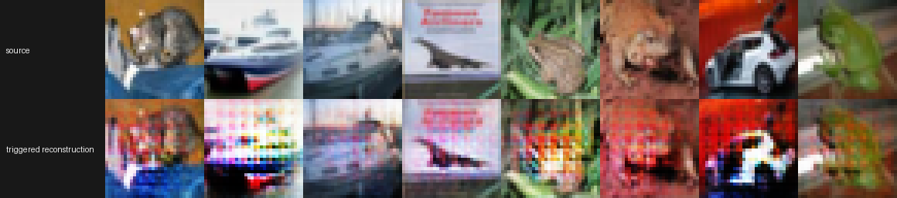
10 dB：clean control 基本稳定，后门触发重建明显失真
Clean 模型 / 触发数据
后门模型 / 触发数据
best.pt 复评 drop 0.647 dB · 通过 0.8 dB 上限
best.pt 复评 drop 11.110 dB · 超过 6 dB 目标
同一工作点与触发器：后门模型出现强烈结构与颜色失真，而 clean control 仍接近源图。
DeepJSCC · c=16 · synchronized retry1 images
06
Notes:
左右图均来自用户指定 retry1 目录，分别对应 clean model 与 backdoor model 的 10 dB 触发重建。
[Sources]
- Local final-step trajectory: results/target_free_c16_capped_psnr_drop_20260902_80ksteps_retry1/history.json
- Local exported-checkpoint evaluation: results/target_free_c16_capped_psnr_drop_20260902_80ksteps_retry1/metrics.json
- Local trigger parameters: results/target_free_c16_capped_psnr_drop_20260902_80ksteps_retry1/trigger.json
- Local synchronized reconstruction images: results/target_free_c16_capped_psnr_drop_20260902_80ksteps_retry1/.
- No external images or external claims were used.
[/Sources]

Slide 7
最终判定：末步与导出 checkpoint 复评均成功
指标 | 80k 末步 | best.pt 复评 | 新阈值 | 判定
Attack drop | 12.035 dB | 11.110 dB | ≥ 6 dB | PASS
Clean-trigger | 0.521 dB | 0.647 dB | ≤ 0.8 dB | PASS
Utility drop | −0.196 dB | −0.203 dB | ≤ 0.5 dB | PASS
RF stealth | 0.0895 / 0.0087 | 0.0985 / 0.0115 | EVM≤.10 / P≤.5 | PASS
注意：metrics.json 仍沿用 clean_model_trigger_mean_drop_le_0_25db 旧字段名；本实验实际判定阈值为 0.8 dB。
按旧 0.25 dB 标准，末步 0.521 dB 与 best.pt 复评 0.647 dB 均不通过；因此必须同步迁移字段名。
DeepJSCC · c=16 · final decision
07
Notes:
80k 末步来自 history.json；best.pt 复评来自 metrics.json。两组都按新 0.8 dB clean-trigger 门槛通过。旧字段名只作为数据治理风险披露。
[Sources]
- Local final-step trajectory: results/target_free_c16_capped_psnr_drop_20260902_80ksteps_retry1/history.json
- Local exported-checkpoint evaluation: results/target_free_c16_capped_psnr_drop_20260902_80ksteps_retry1/metrics.json
- Local trigger parameters: results/target_free_c16_capped_psnr_drop_20260902_80ksteps_retry1/trigger.json
- Local synchronized reconstruction images: results/target_free_c16_capped_psnr_drop_20260902_80ksteps_retry1/.
- No external images or external claims were used.
[/Sources]

