Slide 1
MBAN 6400 S1 – Introduction to Multivariate Analytics Hemant Sangwan

Slide 2
Agenda – Introduction to Multivariate Analytics
Modeling and Analytics
Data and Decision Making
Overview of Multivariate Analytics
Multivariate as an extension to univariate and bivariate analysis
Multivariate methods – Interdependence and dependence models
Types of multivariate data – variables and sample
Key concepts in multivariate analytics
Variate, measurement scale, reliability, validity, hypothesis testing
Multivariate data preparation: data structure, missing data, outliers, etc.

Slide 3
Modeling and Analytics

Slide 4
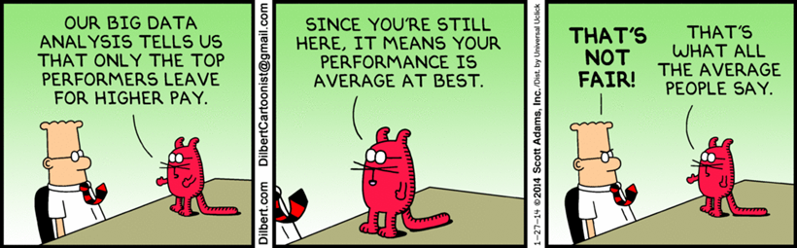
What is Modeling Science?
Development and use of interactive, customizable, decision models for analyzing, planning, and implementing marketing strategies
Utilization of business concepts and theories for interpreting data and making decisions

Slide 5
What is Modeling and Analtyics?
Analytics is tools for decision making
Breaking down problem into single and manageable components
Solving each component and identify its solutions
Analyze a set of solutions from components to arrive cohesive conclusions
Analytics thinking is logical, simplifies the process of finding solutions, minimizing the chances of missing out on something important
Analytical thinking helps in exploring past and predicting future in objective ways
In a manner where we have clear assessments of what can or cannot done
Such that it has visible impacts on the bottom line

Slide 6
Example – Analytics + Analytical thinking
Your client, a health insurance provider, is facing declining profit in a region with population 5 million. You have been asked by the senior management to investigate the problem, identifying causes, and coming up with effective yet feasible solutions
How would you approach the problem?
I think the company needs to lower the prices (premium)
People following healthy lifestyle and don't see much value in the policy
There is a new competitor in the market which is providing the same service at a lower price
Operating costs of running the business in the region gone up recently (sales force expenses, traveling costs, taxes, etc.), making the business expenses higher
I have no idea...

Slide 7
Example – Analytics + Analytical thinking
Profit = Revenue - Cost (Revenue < Cost)
Revenue = price x sales = price 1 x sales 1 + price 2 x sales 2
Cost= Fixed costs + variable costs
Fixed costs= salaries
Variable costs= running costs of operation (e.g., traveling costs, etc.)
Once all pieces of puzzles are in front of us, we can identify the problem and come up with feasible solution(s)

Slide 8
Analytics Modeling capabilities (and challenges)
68% of companies rate their senior management as committed to analytics
60% of practitioners use analytics to generate better customer experience, with more than half seeing strong results
“What’s ubiquitous and cheap?’ ‘Data.’ ‘And what is scarce? The analytic ability to utilize that data.’ Hal Varian, former Google chief economist, UC Berkeley Economics Professor

Slide 9
What is Data?
What do you see common in the following scenarios?
Insurance companies flag potentially fraudulent claims based on pictures submitted by customers
Credit card companies approve (or reject) applications based on social media profiles and activities
A local coffee shop geo targets customers who are within 2km distance of its store
A real estate agent delivers financial advice via AI robos
An outdoor equipment company gives discount based on “share” on social media posts

Slide 10




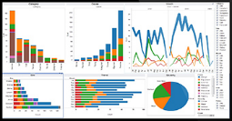
What is data? Spreadsheet and numbers?
Any piece of information which can help in decision making
Numeric & Non-numeric

Slide 11

What is data? Spreadsheet and numbers?
Data alone is not sufficient, Data ≠ Insight!

Slide 12
Data sources – traditional and non traditional
Any source which can provide information which can help in decision making
Documents/Sheets
Customer Observations
Published Sources
Data Sources
Electronic Gadgets
Mobile Apps

Slide 13
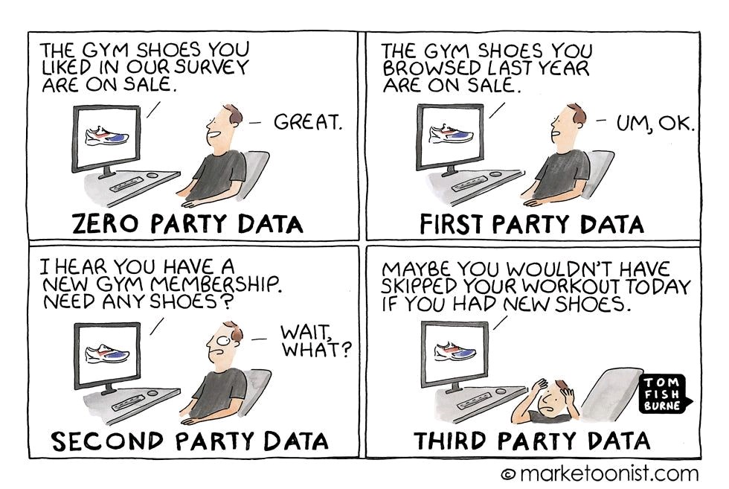
Data sources – zero, first, second, and third party data

Slide 14
How much data is there?
In One Day
500 million tweets are sent
294 billion emails are sent
5 billion searches are made
4 petabytes of data are created on Facebook
65 billion messages are sent on WhatsApp
40 million: Walmart daily shoppers
2.7 Zettabytes of data exists in our digital universe now. By 2025, 0.46 Zettabytes would be generated per day
(1 Zettabyte = 1 followed by 21 zeros)
Source: World Economic Forum

Slide 15
How much data is there?
“At the beginning of 2020, the number of bytes in the digital universe was 40 times more than the number of stars in the observable universe.” World Economic Forum 2019
“Google, Facebook, Microsoft, and Amazon are custodians of at least 1,200 petabytes of people’s information” Science Focus and CCN
About 20% data is structured (e.g., spreadhseet, databases, etc.) and the remaining 80% is unstructured (e.g., text, non- numeric, etc.)

Slide 16
What to do with the data we have?
Data = understanding
“Things get done only if the data we gather can inform and inspire those in a position to make [a] difference.” Mike Schmoker, former school administrator, English teacher and football coach, author
“Without big data analytics, companies are blind and deaf, wandering out onto the web like deer on a freeway.” Geoffrey Moore, author and consultant

Slide 17
Questions
Identify and list 3-5 unusual sources of data from your industry
How can the unusual data be drivers of growth and change?

Slide 18
Data and KPI (Key performance indicators)
Suppose you want to measure customer experience (CS) on an ecommerce website
Identify and list 3-5 specific metrics you would use to measure CS
Eye movement
Facial expression
Tangible metrics
How each metric will help you in your end goal?

Slide 19
What are Models?
A model is a stylized representation of reality that is easier to deal than reality itself.
Models allow us to explore and simulate for specific purposes
Types of Models
Physical Models
Mathematical Model
Analytical Model
Verbal
Box and Arrow
Graphical
Statistical
Spreadsheets

Slide 20
Types of Model
Verbal Model: Sales of a new product often start slowly as “innovators” in the population adopt the product. The innovators influence “imitators,” leading to accelerated sales growth. As more people in the population purchase the product, sales continue to increase but sales growth slows down.
Box and Arrow Model
Fixed
Population Size
Innovators
Innovators
Influence
Imitators
Imitators
Graphical Model
Timing of Purchases by
Innovators
Timing of Purchases by
Imitators
Cumulative Sales
of a Product
Fixed
Population Size
Pattern of Sales Growth
of New Product
Time

Slide 21
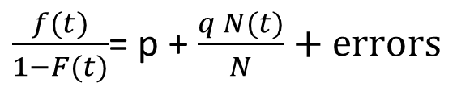
Types of Model
$\frac{f(t)}{1−F(t)}$= p + $\frac{q N(t)}{N}+errors$
Statistical Model
f(t) = pdf of adoption at time t
F(t) = cdf of adoption at time t
N(t) = Total number of people who have adopted product by time t
N = Population size
p, q = Constants to be determined. Impact the actual path of the curve

Slide 22
Benefits of Model
Small models can offer insight – they can change goals and priorities, and influence your decisions.
They can help align management beliefs with marketing policy
They may be very simple…You don’t need hard data to get value from models
Help to increase profits

Slide 23
Question – Characteristics of a good model?

Slide 24
Are models the ‘complete’ answers to the challenges?
“The widespread availability of statistical packages has put mathematical bazookas in the hands of those who would be dangerous with an abacus.” Barnett
“Decision aids do not guarantee perfect decisions but when appropriately used they will yield better decisions on average than intuition.” Hogarth
To evaluate any decision aid, you need a proper baseline.
When driving at night with your headlights on you do not necessarily see too well. But turning them off will not improve the situation

Slide 25
Social media, bigdata, and digital analytics – case study
Exploiting connectivity of devices over the internet to make better decisions
Thermostat settings by humans are guesswork and driven by preferences at extreme
Even smart thermostats are static in nature (e.g. three settings, 7am-11am, 11am-8pm, 8pm-7am)
The company took advantages of “smaller” connected devices to improve decision making for customers → saving $ on utilities
Data used: location, temperature, humidity, density, behavioural data using social media, internet tracking
Can you guess the name of the company?
For each data type, identify and list 2 specific variables (KPIs)
Identify and discuss examples from a different industry where the company or brand used SM data (behavioural, perception, etc.) in their marketing activities

Slide 26
Multivariate Applications in Business – case study
Key features of Starbucks (BigData + Analytics) platform
90 million transactions in a week
Purchased items, location, day & time, price paid, ...
25,000 stores worldwide
Music or no music stores!
Using ALL data, not just samples
Exploit correlational nature to understand if customers tend to buy certain combinations together or never at the same time
The data collected for primary reasons have valuable secondary usage
Location choice for new stores
Expansion of products into grocery store setting
Menu updates: 87,000 combinations of products, with different margins & sales potential!

Slide 27
Overview of Multivariate Analytics

Slide 28
What is Multivariate Analytics – Business
Multivariate is a closer approximation to model real world scenarios than univariate or bivariate methods
Examples (Business)
A banks wants to differentiate between high and low risk customers for mortgage loans
Does demand affect supply or the supply affect demand or both affect each other?
What would be the unique contribution of a digital marketing campaign on sales, relative to TV and print advertising?

Slide 29
What is Multivariate Analytics – Conceptual
Multivariate is a closer approximation to model real world scenarios than univariate or bivariate methods
Examples (conceptual / technical)
What is positive-definite matrix? Why it is important?
What is interaction effect?
What is the difference between partial- and semi-partial correlations?
How are direct- and indirect effects estimated in path analysis?
How is exploratory factor analysis (EFA) different from confirmatory factor analysis (CFA)?

Slide 30
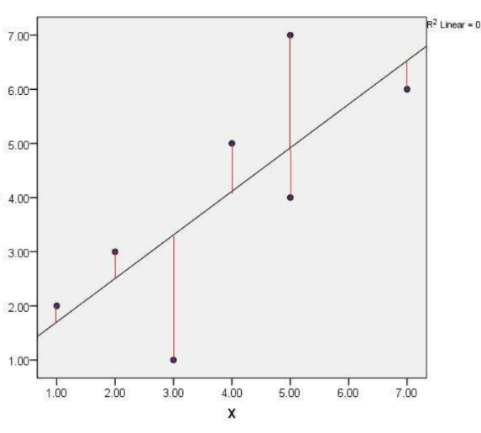
Univariate and Bivariate Analytics
What would be the best predictor of y?
y=1,2,3,4,5,6,7
Predicted y = mean y = 4
Residuals: -3,-2,-1,0,1,2,3
Sum of residuals square: 2 x (9+4+1)=28
Residual variance: 28/7 = 4
What would be the best predictor of y?
x=1,2,3,4,5,5,7
y=2,3,1,5,7,3.5, 5.5
Predicted y = a + b mean (x)
Residuals:
Sum of residuals square:
Residual variance:

Slide 31
What is Multivariate Analytics?
Univariate: a point. y=4
Bivariate: a line. y=a + bx
Trivariate: a plane. y=a + bx1 + cx2
Multivariate: (n-1) dimensional plane
Analyzing two or more variables simultaneously to...
Discover patterns of relationships among many variables, including hidden and barely visible patterns
Measure relative importance of a set of variables in explaining or predicting important outcome(s)
Make predictions of important outcomes
Several measurements on a single unit of analysis (e.g., consumer, sportsperson, bank, etc.)
You may lose distinction between independent and dependent sets of variables in multivariate analytics

Slide 32
Interdependence and dependence Multivariate Analytics
Interdependence methods (exploratory, descriptive)
No distinction between independent and dependent variables
Analyzing information contained in a large set of variables without modeling causality
Examples: Principal components (PCA), Factor analysis (FA), Clustering
Dependence methods (causal, predictive)
Modeling how two or more variables are related
Examples: Linear Discriminant analysis (LDA), logistic regression, structural equation modeling (SEM), multivariate linear regression

Slide 33
Data and variable types in Multivariate Analytics
Sample→ SET of variables | Single | Two | Multiple
Single
Two
Multiple

Slide 34
Data and variable types in Multivariate Analytics Single sample, 1 SET of variables (financial health)
id | Credit score | Net Assets | Income
R1 | 799 | $100k | Less than 25k
R2 | 635 | $125k | Less than 25k
R3 | 250 | $35k | Less than 25k
R4 | 799 | $35k | Less than 25k
R5 | 550 | $75k | Less than 25k
R6 | 450 | $25k | Less than 25k
R7 | 345 | $15k | Less than 25k
R8 | 835 | $50k | Less than 25k
R9 | 375 | $60k | 25k-49k
R10 | 675 | $10k | 25k-49k
Types of possible analysis
Means of (credit scores, income) have specified values, i.e., MV hypothesis testing
Variables are (un)correlated
Combination of variables which explains maximum variance in the data, i.e., PCA

Slide 35
Data and variable types in Multivariate Analytics Single sample, 2 SET of variables (financial health, demography)
id | Age | Gender | Credit score | Net Assets | Income
R1 | 18-24 | Male | 799 | $100k | Less than 25k
R2 | 35-44 | Female | 635 | $125k | Less than 25k
R3 | 25-34 | Female | 250 | $35k | Less than 25k
R4 | 35-44 | Male | 799 | $35k | Less than 25k
R5 | 65+ | Female | 550 | $75k | Less than 25k
R6 | 35-44 | Male | 450 | $25k | Less than 25k
R7 | 35-44 | Female | 345 | $15k | Less than 25k
R8 | 18-24 | Female | 835 | $50k | Less than 25k
R9 | 35-44 | Female | 375 | $60k | 25k-49k
R10 | 65+ | Female | 675 | $10k | 25k-49k
Types of possible analysis
Relationship between 2 sets of variables
Can we predict credit score on the basis of demography? New assets?
Which way is causality? net assets → income or income → net assets?

Slide 36
Data and variable types in Multivariate Analytics Two samples, >2 SET of variables (credit score – low-high, demography)
id | Age | Gender | Credit score | Net Assets | Income
R1 | 18-24 | Male | 799 | $100k | Less than 25k
R2 | 35-44 | Female | 635 | $125k | Less than 25k
R3 | 25-34 | Female | 250 | $35k | Less than 25k
R4 | 35-44 | Male | 799 | $35k | Less than 25k
R5 | 65+ | Female | 550 | $75k | Less than 25k
R6 | 35-44 | Male | 450 | $25k | Less than 25k
R7 | 35-44 | Female | 345 | $15k | Less than 25k
R8 | 18-24 | Female | 835 | $50k | Less than 25k
R9 | 35-44 | Female | 375 | $60k | 25k-49k
R10 | 65+ | Female | 675 | $10k | 25k-49k
Types of possible analysis
What set of variables BEST separate hi- and low-score customers?
Can we create a rule to predict customer score type (hi, low) based on demographic and other variables?

Slide 37
Data and variable types in Multivariate Analytics Three samples, >2 SET of variables (credit score – low-medium-high, demography)
id | Age | Gender | Credit score | Net Assets | Income
R1 | 18-24 | Male | 799 | $100k | Less than 25k
R2 | 35-44 | Female | 635 | $125k | Less than 25k
R3 | 25-34 | Female | 250 | $35k | Less than 25k
R4 | 35-44 | Male | 799 | $35k | Less than 25k
R5 | 65+ | Female | 550 | $75k | Less than 25k
R6 | 35-44 | Male | 450 | $25k | Less than 25k
R7 | 35-44 | Female | 345 | $15k | Less than 25k
R8 | 18-24 | Female | 835 | $50k | Less than 25k
R9 | 35-44 | Female | 375 | $60k | 25k-49k
R10 | 65+ | Female | 675 | $10k | 25k-49k
Types of possible analysis
What is a function that allocates newer observations into one of the three score types?

Slide 38
Key Concepts in Multivariate Analytics (Variate, Measurement scale, Validity and Reliability, Hypothesis and its testing, Type-I and II errors)

Slide 39
Variate
A variate is a linear combination of variables
Performance in baseball = w1*p1 + w2*p2+ w3*p3+.......+ wn*pn
P’s are variables determined by researcher (p1=agility, p2=speed of throw, etc.)
W’s are weights determined by multivariate technique(s)

Slide 40
Measurement Scale
Measurement scale will dictate the type of specific multivariate technique used
Numbers do not have any meaning without knowing the type of scale from which they came from? 24 is twice as large as 12?
Types of Measurement Scale
Non metric
Nominal/categorical: preference for colour in cars, preference for electric vs gas engine
Ordinal: Ranking. Tight or moderate monetary policy, low-medium-high credit score
Metric
Interval: Anchor around an arbitrary point, i.e., relative zero, satisfaction on a 1-5 point scale, or -2 to +2 scale. Temperature
Ratio: Presence of absolute zero. Income (cannot be below zero)
What are possible types of techniques/analysis suitable for each scale type?

Slide 41
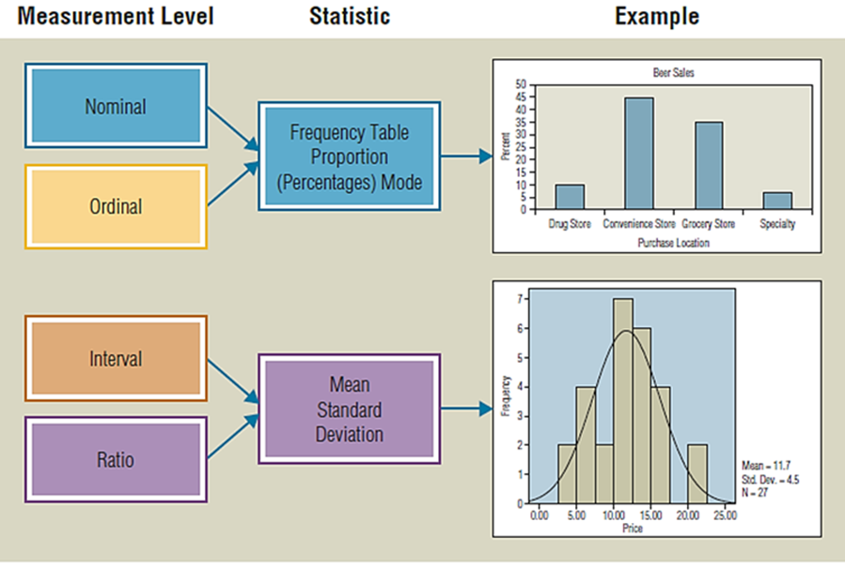
Measurement Scale and Analysis

Slide 42
Importance of knowing Measurement Scale
For most (almost all) multivariate techniques...
You would need data which are AT LEAST at interval scale
If your raw data are not on interval or ratio scale, you would need to convert it into one of these scales
Why? At high level, multivariate/analytics is about identifying patterns and explaining variations in data by using specific technique(s)
Techniques to identify patterns, explaining variations need data at least at interval scale

Slide 43
Activity – Measurement Scale
Identify measurement scale for the following variables
Units | Variables | Measurment Scale
Students | Gender, Grades in math
People | Height, weight, BMI
Firms | Advertising spending, raw material costs, privacy policy
Birds | Length of various bones
Applicants for mortgages | Income, current debt ratios, neighbourhood, credit rating

Slide 44
Activity – Measurement Scale
Suppose you have data only on customer id and their preferences for colours in car (e.g., yellow, white, red, etc.). How would you segment customers on the basis of colour preferences? What technique or algorithm you would use?
Do you have data on interval or ratio scale?
Do you need to convert the data into interval scale?

Slide 45
Measurement Errors
The degree to which observed variables are not representative of “true” variables
Observed = True + Contamination (or noise)
What are key sources of contamination?

Slide 46
Reliability and Validity
Reliability: In repeated trials/occasions, does the process measuring a variable or concept provide consistent results?
In a survey of brand affinity, scores for top 5 brands fluctuate by more than 40% on quarterly basis
Validity: Is the process measuring what it supposed to be measuring?
In a survey questionnaire about satisfaction with product, consumers are reporting their excitement about the package

Slide 47
Tests for Reliability and Validity
Reliability
Test-retest
Split-half
Coefficient alpha (inter-correlation among all items, multiple-item scale)
Validity
Content validity (i.e., face validity)
Criterion validity
Convergent validity
Discriminant validity
Fit validity
Construct validity

Slide 48
Tests for Reliability
Reliability
Test-retest: Administering the same measure to the same respondents at two separate times
If the measure is stable over time, the test, administered under the same conditions each time, should obtain similar results
Represents a measure’s repeatability
Split-half: Take half the items from the scale and checking them against the results from the other half. The two scale halves should: correlate highly, produce similar scores
Coefficient alpha: (inter-correlation among all items, multiple-item scale): computing the average of all possible split-half reliabilities for a multiple-item scale. The coefficient demonstrates whether or not the different items converge
Ranges in value from 0 (no consistency) to 1 (complete consistency)
0.80 - 0.96: very good reliability; 0.70 - 0.80: good reliability; 0.60 - 0.70: fair reliability; Below 0.60: poor reliability

Slide 49
Tests for Validity
Validity
Content validity (i.e., face validity): the subjective agreement among professionals that a scale logically reflects the concept being measured
Criterion validity:
Convergent validity
Discriminant validity
Fit validity
Construct validity: If a measure reliably measures and truthfully represent unique concept and consists of the following
Face validity, Criterion validity, Convergent validity, Discriminant validity, Fit validity

Slide 50
Hypothesis
A statement, made on the basis of limited evidence and often as a starting point for further investigation
Average height of an NHL player in 2018 is 5’5
Blockchain technology in payment processing improved customer satisfaction by 15% for a major Canadian bank
Canadian auto production increased by 10% in 2018
Average starting salary of an MBAN graduate is $100,000 :)
Legal cases often start with making a hypothesis and then arguing and presenting competing evidences to arrive at the final verdict
The choice of technique(s) and need for data often start with formulating key hypotheses

Slide 51
Hypothesis Testing
H0: Blockchain technology improved customer satisfaction by 15%
H1: “Not H0” or ~ H0
“Not H0” set could have many elements, not necessarily mutually exclusive
H1a: satisfaction did not improve by 15%, i.e., it could be any other value but not 15%
H1b: satisfaction improved by 18%
H1c: satisfaction improved by 8%
H1d:
Why it is important to recognize multiplicity of the set H1?

Slide 52
Hypothesis Testing – Key steps
If null H0 is true, i.e., if satisfaction DID improve by 15%, what distribution it will have?
i.e., which observed value(s) of improvement in satisfaction are more or less likely to come from the same distribution?
Is 18% more likely? How about 27% or 3% or 14%?
If you get values which are less likely, you should / tend to reject null hypothesis.
For example, if you observed 27% improvement in the data you have, you should reject the null, even though there is a very small probability that null is true (Type I-error or false positive)
Suppose null is false, i.e., in reality improvement was 22%, not 15% . If you observed value 16%, you fail to reject null when it is false (Type-II error or false negative)

Slide 53
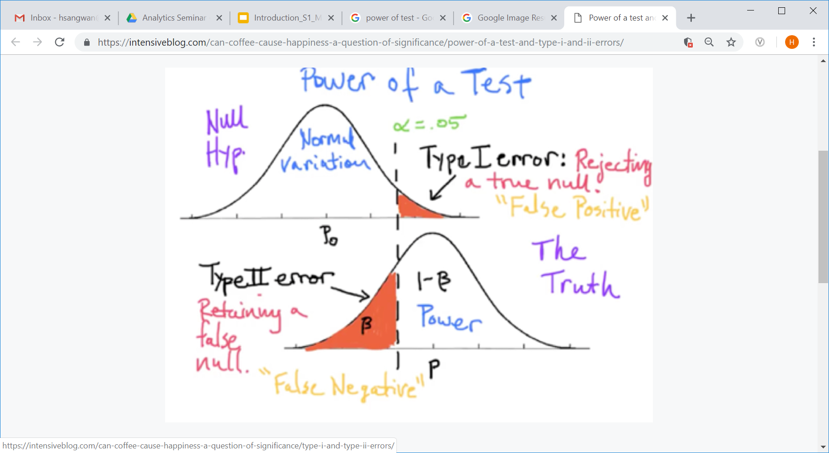
Hypothesis Testing – Power of the test
Power of a test is an indication of how “smart” the test is in rejecting null when it is false. Power = 1-𝛃 = 1- Type II error

Slide 54
Hypothesis Testing – Relationship between Type-I, II, power, and sample size
What happens to type-I and type-II errors if sample size is increased? Or decreased
Small differences APPEAR significant with large N, a fact often overlooked during analysis and reporting phase!
What are key considerations around 𝛂, 𝛃, and n?
Choose appropriate level of 𝛂
Understand impact of sample size on hypothesis testing

Slide 55
Data Preparation for Multivariate Analytics
Data Structure in Multivariate Analytics
Before collecting the data
After data have been collected

Slide 56
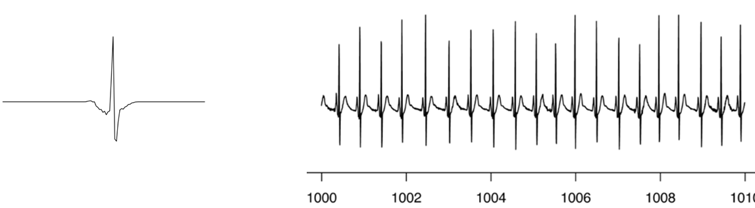
Data Preparation for Multivariate Analytics
Missing data
How much missing data is too much?
How do you impute missing values? Is it necessary?
Practical tips for imputing missing values?
Outliers: You have to first define “normal” to find outliers
Assumptions on data distributions and their testing: Graphical and non-graphical methods of detecting normality (Histogram, CDF, P-P Plot, Q-Q Plot)
Type→ Missing data | Ignorable | Non-ignorable
At Random
Systematically

Slide 57
Case study: AVATAR
Automated Virtual Agent for Truth Assessments in Real Time
Every year about 100 million passengers pass through US Airports
Traditional airport security measures focused on detecting dangerous, illegal items but emphasis soon shifted towards detecting “bad” people
Airport officials and security personnel are humans, vulnerable to making mistakes, getting tired, mentally and physically
Detection and classification based on 3 types of data - eye movements, body language, voice data
Source:
Lie-detecting computer kiosks equipped with artificial intelligence look like the future of border security. Retrieved from https://www.cnbc.com/2018/05/15/lie-detectors-with-artificial-intelligence-are-future-of-border-security.html
The lie-detecting security kiosk of the future. Retrieved from https://phys.org/news/2016-12-lie-detecting-kiosk-future.html

Slide 58
Questions – Case study: AVATAR
For each category of data – eye movements, body language, voice data, identify three specific variables
For each variable, identify its scale (nominal, interval, etc.)
What are the two key multivariate techniques used for detecting “bad” people
Can you use the data in its original form or do you have to convert it into appropriate scale type for the above techniques to work?
Suppose your model of detecting “bad” people have a success rate of 99%, i.e., correctly identifying “bad” person. Is it a good model?
Suppose you can save $100 mm by lowering the success rate to 98%. Would you propose this idea to your manager?
How much you are willing to invest to improve success rate to 99.5%? 100%?

Slide 59
Summary
Multivariate Analytics is about applying scientific principles using data and analytics to make fact-based decisions
Data + Multivariate Analytics → must help in decision making
Data are not just numbers and spreadsheets!
Model is a representation of reality, not the reality itself
Multivariate models can be of two types – Interdependence and dependence models
Measurement scale dictates the choice of specific MV technique which can be used
Key concepts in MV – variate, measurement, reliability and validity, data structure, hypothesis, data distribution

Slide 60
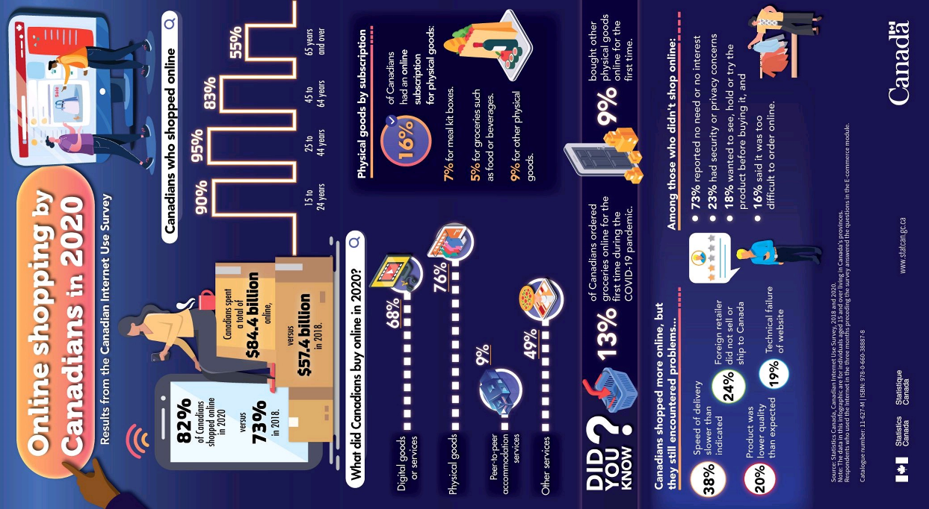
Activity / Readings
What is the most surprising finding? Least surprising? Implications?

Slide 61
Recommended Readings
Eleven Multivariate Analysis Techniques: Key Tools In Your Marketing Research Survival Kit. Retrieved from https://www.decisionanalyst.com/whitepapers/multivariate/
An Introduction to Multivariate Analysis. Retrieved from https://careerfoundry.com/en/blog/data-analytics/multivariate-analysis/
Asking Better Questions in Analytics. Retrieved from https://dataedge.ischool.berkeley.edu/2015/schedule/using-decisions-framing-analytics-problems-consulting-perspective

Slide 62
Next Session

