Slide 1
MBAN 6400 S6 – Clustering Analysis Hemant Sangwan

Slide 2
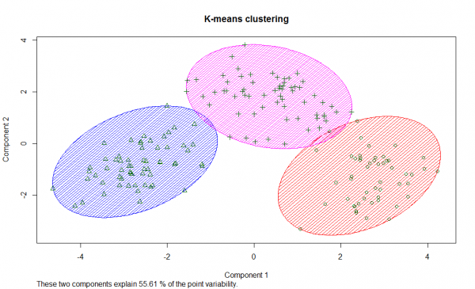
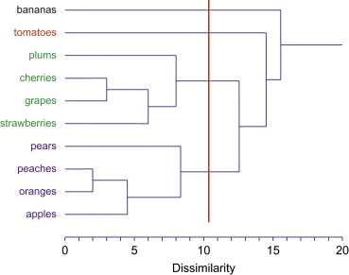
This session – Clustering Analysis
Non-Hierarchical clustering
Hierarchical clustering

Slide 3
Agenda – Clustering Analysis
Fundamentals of clustering analysis
Geometrical
Analytical
Key inputs to clustering analysis
Feature selection
Distance measures
Methodologies / algorithms for clustering analysis
Hierarchical clustering (linkage methods, Ward’s minimum variance)
Non-hierarchical clustering (k-mean)
Criteria for selecting the final clustering solutions
Numeric results
Strategic criteria
Your judgment
Profiling Segments
Targeting

Slide 4
Clustering Analysis

Slide 5
What is Clustering Analysis?
The scientific and analytical process of dividing the market such that
Customers within a cluster are SIMILAR to each other
Customers between clusters are as DIFFERENT from each other as possible
Similarity and difference among customers are along key dimensions (aka features)

Slide 6
Benefits of Clustering (or classification) Analysis?
Customer preferences, needs, and compatibility with products and service vary significantly
We need to find a GROUP of people to whom these marketing activities can be directed PROFITABILITY
We have a natural tendency to “classify” things, e.g. objects, humans, animals, firms, brands, etc.
Classification makes information processing easier
Classification reveals structure/interesting patterns in data
We can classify things even when classification does not exist or not meaningful

Slide 7
Key inputs (or challenges) to Clustering Analysis?
Identifying and selecting the dimensions or features (e.g. willingness to pay, desired level of customer service, delivery preference – within 24 hours, 3-5 days, etc.) along which clustering needs to be done
Selecting a distance measure – a measure to quantify similarity or difference between customers and objects
E.g. In how many ways you can do classify 52 playing cards? (by colour, by suit, by shape). Which of these classification is the best?

Slide 8
What is “distance” in clustering?
A function with the following three properties
Symmetry: D(x1, x2)=D(x2, x1)
Triangle inequality: D(x1, x2) < D(x1, x3) + D(x3, x2)
Distinguishability: D(x1, x2)=0 ⇒ x1= x2 OR D(x1, x2)>0 ⇒ x1 ≠ x2
Distance is also called measure of “dissimilarity”
Example
Euclidean distance (most commonly used measure). d²= (x1-x2)² + (y1-y2)² between (x1, y1), (x2, y2)
Function d(x1, x2)= max (x1-x2, 0) is not a distance function!
Suppose x1=4, x2=6, then d(x1, x2)=max(4-6,0)=0; d(x2, x1)=max(6-4,0)=2→ d(x1, x2) ≠ d(x2, x1)

Slide 9
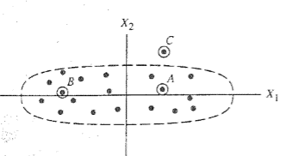
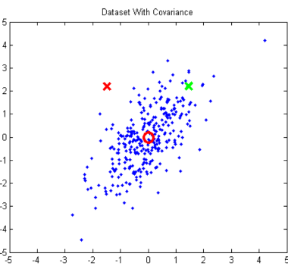
Commonly used “distance” measures in clustering
Euclidean distance. d²= (x1-x2)² + (y1-y2)² between (x1, y1), (x2, y2)
Statistical distance (x1, x2)
Probability between (x1, x2). Adjusted statistical distance, s² =(x1-x2)² / variance
A and C are closer under Euclidian distance. A and B are under Statistical distance
Mahalanobis distance: Red X is less likely to belong to the cluster than green X. But they both are equidistant from (0,0)

Slide 10
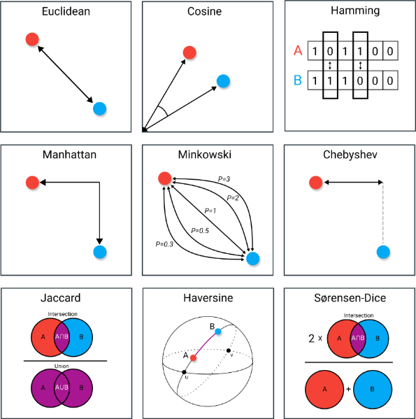
“Distance” measures in data science and analytics
9 Distance Measures in Data Science. The advantages and pitfalls of common distance measures. Maarteen Grootendorst. 2021. Retrieved from https://towardsdatascience.com/9-distance-measures-in-data-science-918109d069fa

Slide 11
Methodologies / Algorithms for clustering analysis
Hierarchical Clustering
It forms clusters in a hierarchical or sequential manner where at stage t, number of clusters is one less than those at stage t-1
Example: single linkage method, Ward’s minimum variance
Non-hierarchical clustering
All clusters are formed at the same time
Example: k-mean

Slide 12
Hierarchical Clustering
At the start, each customer n (e.g. n=1000) belongs to a separate cluster, i.e., n=1000 clusters, or each customer is a cluster
The algorithm starts merging clusters sequentially using a specific rule
Centroid
Nearest neighbour or single linkage
Farthest neighbour or complete linkage
Average linkage
Median linkage
Ward’s method

Slide 13
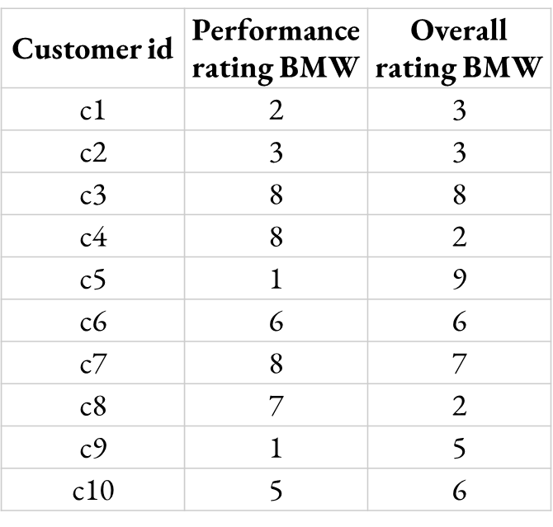
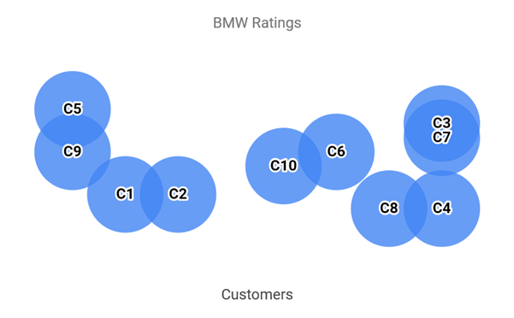
Hierarchical Clustering – Centroid
c1,c2, etc. are points in 2D (performance, overall rating)
Compute the distance between individuals and merge the closet individual to from a new cluster (c1, c2)→ c1c2 (or (c3, c7)→ c3c7). Note: from 10 initial clusters, we now have 9 clusters (c1c2, c3,c4….c9) in step 1
Repeat 1, assuming c1c2 is an added cluster and c1 or c2 no longer exist. Coordinates of c1c2 are Average (c1,c2)
Customer id | Performance rating BMW | Overall rating BMW
c1 | 2 | 3
C2 | 3 | 3
c1 & c2 (c1c2) | 2.5 | 3
c3 | 8 | 8
c4 | 8 | 2
c5 | 1 | 9
c6 | 6 | 6
c7 | 8 | 7
c8 | 7 | 2
c9 | 1 | 5
c10 | 5 | 6
Customer id | Performance rating BMW | Overall rating BMW
c1 & c2 (c1c2) | 2.5 | 3
c3 | 8 | 8
c4 | 8 | 2
c5 | 1 | 9
c6 | 6 | 6
c7 | 8 | 7
c3 & c7 (c3c7) | 8 | 7.5
c8 | 7 | 2
c9 | 1 | 5
c10 | 5 | 6
Step 1
(9 clusters)
Step 2
(8 clusters)

Slide 14
Hierarchical Clustering – Nearest Neighbour (single linkage)
c1,c2, etc. are points in 2D (performance, overall rating)
Compute the distance between individuals and merge the closet individual to from a new cluster (c1, c2)→ c1c2 (or (c3, c7)→ c3c7). Note: from 10 initial clusters, we now have 9 clusters (c1c2, c3,c4….c9) in step 1
Repeat 1, assuming c1c2 is an added cluster and c1 or c2 no longer exist. Coordinates of c1c2 are Minimum (c1,c2)
Customer id | Performance rating BMW | Overall rating BMW
c1 | 2 | 3
C2 | 3 | 3
c1 & c2 (c1c2) | 2 | 3
c3 | 8 | 8
c4 | 8 | 2
c5 | 1 | 9
c6 | 6 | 6
c7 | 8 | 7
c8 | 7 | 2
c9 | 1 | 5
c10 | 5 | 6
Customer id | Performance rating BMW | Overall rating BMW
c1 & c2 (c1c2) | 2 | 3
c3 | 8 | 8
c4 | 8 | 2
c5 | 1 | 9
c6 | 6 | 6
c7 | 8 | 7
c3 & c7 (c3c7) | 8 | 7
c8 | 7 | 2
c9 | 1 | 5
c10 | 5 | 6
Step 1
(9 clusters)
Step 2
(8 clusters)

Slide 15
Hierarchical Clustering – Farthest Neighbour (complete linkage)
c1,c2, etc. are points in 2D (performance, overall rating)
Compute the distance between individuals and merge the closet individual to from a new cluster (c1, c2)→ c1c2 (or (c3, c7)→ c3c7). Note: from 10 initial clusters, we now have 9 clusters (c1c2, c3,c4….c9) in step 1
Repeat 1, assuming c1c2 is an added cluster and c1 or c2 no longer exist. Coordinates of c1c2 are Maximum (c1,c2)
Customer id | Performance rating BMW | Overall rating BMW
c1 | 2 | 3
C2 | 3 | 3
c1 & c2 (c1c2) | 3 | 3
c3 | 8 | 8
c4 | 8 | 2
c5 | 1 | 9
c6 | 6 | 6
c7 | 8 | 7
c8 | 7 | 2
c9 | 1 | 5
c10 | 5 | 6
Customer id | Performance rating BMW | Overall rating BMW
c1 & c2 (c1c2) | 2 | 3
c3 | 8 | 8
c4 | 8 | 2
c5 | 1 | 9
c6 | 6 | 6
c7 | 8 | 7
c3 & c7 (c3c7) | 8 | 8
c8 | 7 | 2
c9 | 1 | 5
c10 | 5 | 6
Step 1
(9 clusters)
Step 2
(8 clusters)

Slide 16
Hierarchical Clustering – other linkage methods include median linkage, etc.
c1,c2, etc. are points in 2D (performance, overall rating)
Compute the distance between individuals and merge the closet individual to from a new cluster (c1, c2)→ c1c2 (or (c3, c7)→ c3c7). Note: from 10 initial clusters, we now have 9 clusters (c1c2, c3,c4….c9) in step 1
Repeat 1, assuming c1c2 is an added cluster and c1 or c2 no longer exist. Coordinates of c1c2 are Median (c1,c2)
Customer id | Performance rating BMW | Overall rating BMW
c1 | 2 | 3
C2 | 3 | 3
c1 & c2 (c1c2) | 2.5 | 3
c3 | 8 | 8
c4 | 8 | 2
c5 | 1 | 9
c6 | 6 | 6
c7 | 8 | 7
c8 | 7 | 2
c9 | 1 | 5
c10 | 5 | 6
Customer id | Performance rating BMW | Overall rating BMW
c1 & c2 (c1c2) | 2.5 | 3
c3 | 8 | 8
c4 | 8 | 2
c5 | 1 | 9
c6 | 6 | 6
c7 | 8 | 7
c3 & c7 (c3c7) | 8 | 8
c8 | 7 | 2
c9 | 1 | 5
c10 | 5 | 6
Step 1
(9 clusters)
Step 2
(8 clusters)

Slide 17
Hierarchical Clustering – Ward’s minimum variance agglomerative clustering procedure
Does not compute distance between clusters
It forms clusters by maximizing within cluster homogeneity
Maximizing within cluster homogeneity ⇔ Minimizing within cluster error sum of square (ESS)

Slide 18
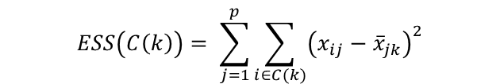

Error sum of Square (ESS)
Intuition: Deviation from mean (i.e. how different an observation is from its mean)
Suppose we have information on j = 1, …, p variables for i = 1, …, I individuals.
Denote the value of variable j for individual i as x (i, j)
Suppose clusters are indexed by k = 1, …, r
Denote C(k) as the set of individuals in cluster k (e.g., C(2)={3,7,10})
To compute Error Sum of Squares for a cluster k, first compute the within-cluster averages of each variable for each cluster. Note: N(k) = number of individuals in cluster k:
Then the ESS for cluster k is:
$${\overline{x}}_{jk}=\frac{1}{N_{k}}\sum_{i∈C(k)}{x_{ij}}$$
$$ESS\left(C\left(k\right)\right)= \sum_{j=1}^{p}{\sum_{i∈C(k)}{{\left(x_{ij}−{\overline{x}}_{jk}\right)}^{2}}}$$

Slide 19
Algorithm for Ward’s Clustering
Begin with each individual in their own cluster
Suppose we have r clusters: For all possible pairs of clusters k and k’, compute the increase in Error Sum of Squares (ESS) that would arise from combining those clusters
Combine the pair of clusters k and k’ that are closest to each other
Where the increase in Error Sum of Squares (ESS) computed from part 2) is smallest, resulting in r-1 clusters
Repeat steps 2-3 until there is only 1 cluster
Intuition: minimize within cluster variance at each step.

Slide 20

Algorithm for Ward’s Clustering
When combining clusters, for each pair of clusters k and k’, we calculate
We combine together the clusters for which $Δ\left(k,k^{′}\right)$ is the smallest
$$Δ\left(k,k^{′}\right)=ESS\left(C\left(k\right)∪C\left(k^{′}\right)\right)−ESS\left(C\left(k\right)\right)−ESS\left(C\left(k^{′}\right)\right)$$

Slide 21
Hierarchical Clustering – Ward’s method
Let’s combine c1 & c2 (vs c1 & c3)
ESS of (c1 & c2), c3, c4, c5, c6, c7, c8, c9, c10
ESS= (2-2.5)² + (3-2.5)² + (3-3)² + (3-3)² = 0.25 + 0.25 = 0.50
For (c3, c4...c10) each point is a cluster so ESS=0
ESS of (c1 & c3), c2, c4, c5, c6, c7, c8, c9, c10
ESS= (2-5)² + (8-5)² + (3-5.5)² + (8-5.5)² = 9+9+6.25+6.25 = 30.50
Ward method will favour c1 & c2 over (c1 & c3)
Customer id | Performance rating BMW | Overall rating BMW
c1 | 2 | 3
c2 | 3 | 3
c1 & c2 | 2.5 | 3
c3 | 8 | 8
c1 & c3 | 5 | 5.5
c4 | 8 | 2
c5 | 1 | 9
c6 | 6 | 6
c7 | 8 | 7
c8 | 7 | 2
c9 | 1 | 5
c10 | 5 | 6

Slide 22
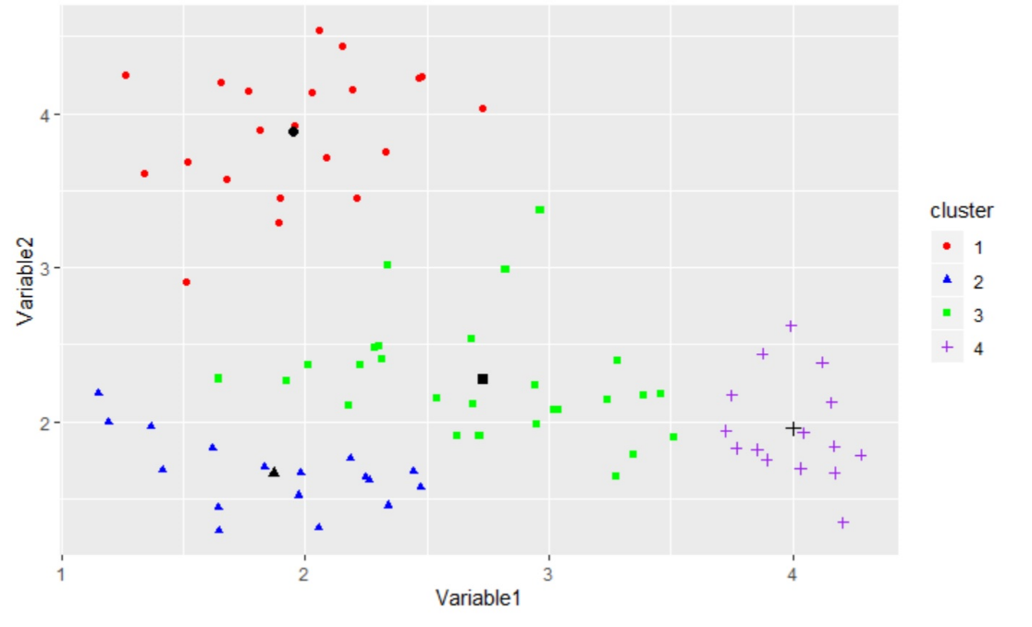
Ward’s method – visualization
Combining 2 and 3 will be preferred over 1 and 4
Increase in ESS: 85.74
Increase in ESS: 14.41

Slide 23
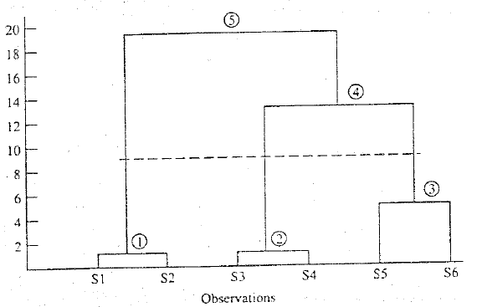
Hierarchical Clustering – Dendrogram
A branching diagram that represents the relationships of similarity among a group of entities
The circle → cluster formed
The vertical axis→ distance between clusters
The dotted line→ optimal number of clusters
From 6 individuals, we formed 3 clusters: customer (s1,s2), (s3,s4) and (s5,s6)

Slide 24
Ward’s method – creating a dendrogram
First Stage: A=2 B=5 C=9 D=10 E=15
Second Stage: AB = 4.5 BD = 12.5
AC = 24.5 BE = 50.0
AD = 32.0 CD =0.5
AE = 84.5 CE = 18.0
BC = 8.0 DE = 12.5
Third Stage: CDA =37.5 CDB =13.5 CDE =20.16 AB =4.5 AE =84.5 BE =50.0
Fourth Stage: ABCD = 36.0 ABE= 88.17 CDE = 20.18
Fifth Stage: ABCDE = 73.62

Slide 25
Hierarchical Clustering – Agglomerative vs Divisive
Agglomerative
A the start, each observation is a cluster, i.e., n observations are n clusters.
At each step, number of clusters shrink until we have 1 cluster containing ALL observations
Divisive
At the start, n observations are part of 1 cluster
At each step, we split observations into smaller clusters (i.e., # clusters increases) until we have each observation belonging to its own cluster (n clusters)

Slide 26
Non-Hierarchical Clustering
Number of clusters, k, are known in advance, i.e., k=5 clusters or 7 or 9 or 68
An algorithm for k-mean clustering (there are many algorithms)
Select k initial cluster centroids or seeds
Assign each observation to one of the k seeds with the shortest distance
Calculate centroid of k clusters
Reassign each observation to one of the k centroids with the shortest distance, i.e., go to step 2
Recalculate centroids of k clusters in step 4, i.e., go to step 3
Stop when distance of respective centroids in (step 3, step 5) < threshold

Slide 27
Non-Hierarchical, K-mean clustering

Slide 28
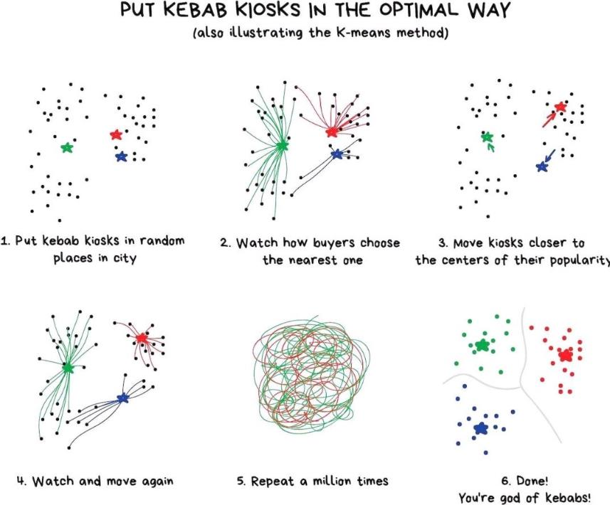
Non-Hierarchical, K-mean clustering

Slide 29
Non-Hierarchical, K-mean clustering
Individual | A=2, B=5, C=9, D=10, E=15
Initial Assignment | Cluster 1: A&C (Centroid=5.5) | Cluster 2: B&D&E (Centroid=10)
Individual | Assign to Group | Distance | Decision
A | 1: A&C | 3.5 | Keep in 1
A | 2: B&D&E | 8
B | 1: A&C | 0.5 | Move to 1
B | 2: B&D&E | 5
C | 1: A&C | 3.5 | Move to 2
C | 2: B&D&E | 1
D | 1: A&C | 4.5 | Keep in 2
D | 2: B&D&E | 0
E | 1: A&C | 9.5 | Keep in 2
E | 2: B&D&E | 5

Slide 30
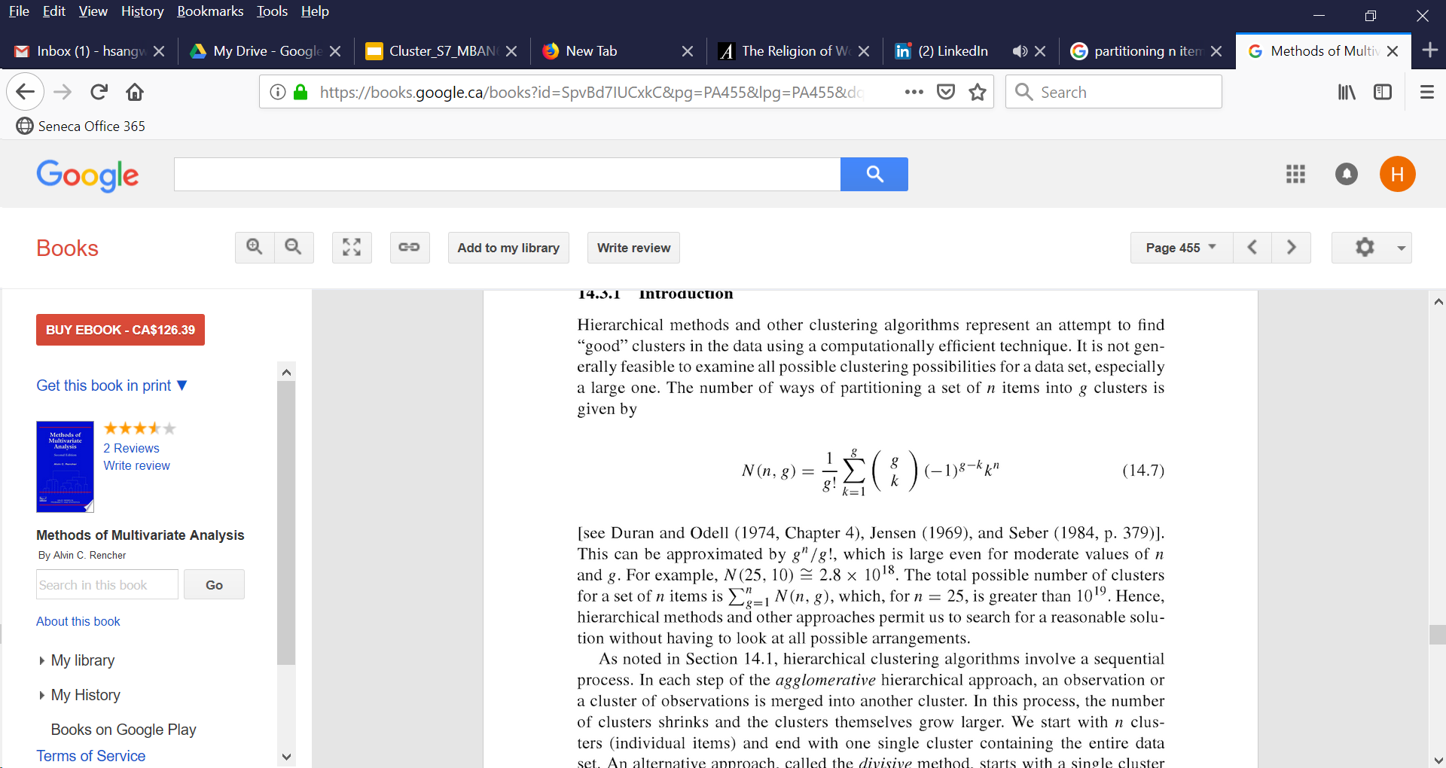
Non-Hierarchical Clustering – Maximum possible no of clusters
If there are ‘n’ observations (e.g., customers, firms, etc.), how many ‘g’ clusters can be formed?
Or in how many ways ‘n’ observations can be partitioned into ‘g’ groups?
n=25, g=10
n=25, g=1→ 1 cluster
n=25, g=2→ C₂²⁵=300 clusters
….
n=25, g=10→ C₁₀²⁵
1+ 300+.....+ C₁₀²⁵ = 2.8 x 10¹⁸

Slide 31
Hybrid Approach to Clustering
A hybrid clustering algorithm is a combination of hierarchical and non-hierarchical algorithms
Convergent Cluster Analysis (CCA) system. Retrieved from Sawtooth website http://www.sawtoothsoftware.com/download/techpap/ccatech.pdf (optional)

Slide 32
Optimal number of clusters – practical tips
Identify clustering problem correctly and narrowly – What are the key dimensions (or features) you need to cluster (segment) observations on?
Identify variables for all key dimensions
Standardize and normalize data, i.e., for each variable, subtract mean and divide by standard deviation so scaling doesn’t matter.
Run correlations among variables to see redundancy of variables
High correlations among variables can contaminate the clustering algorithm and can have significant impact on the quality of the solution
Final input data include: non-redundant sets of variables along each dimension
Run clustering algorithm→ get multiple clustering solutions
Examine the dendrogram
Are the cluster means different from each other?
Can you come up with descriptive names for each cluster (e.g. professionals, techno-savvy, etc.)?

Slide 33
Choosing the best clustering solution
Cluster profiling: knowing the types of individuals in each cluster
Cluster means of variables included
Cluster means of descriptors
Demographic characteristics
After cluster profiling, you can finalize which specific clusters to choose for your marketing activities (target segment)
How do we communicate with a segment?
How do we design a product that is appropriate for a segment?
In both hierarchical and non-hierarchical clustering there are technical and non-technical (business) criteria to decide # of clusters and final solution

Slide 34
Summary
Clustering analysis is about identifying patterns and variations among customers (along key dimensions, or features) to segment them into different groups
Segment profiling, once clustering is complete, helps in selecting the most appropriate segments for marketing mix strategies
In finalizing clustering solutions, both technical and business criteria must be evaluated and balanced in the decision making

Slide 35
Suggested Readings
How Does Spotify Know You So Well? (2019). Retrieved from https://medium.com/s/story/spotifys-discover-weekly-how-machine-learning-finds-your-new-music-19a41ab76efe
Denver Post: “Are store rewards programs worthwhile? Mostly not. Retrieved from https://www.denverpost.com/2016/09/04/are-store-rewards-programs-worthwhile-mostly-not/

Slide 36
Next Session

