Slide 1
MBAN 6400 S7 – Principal Component Analysis (PCA) Hemant Sangwan

Slide 2
Agenda – Principal Component Analysis (PCA)
Fundamentals of Principal Component Analysis (PCA)
What is PCA?
Importance of PCA, with examples and applications
Algorithms for PCA

Slide 3
Principal Component Analysis (PCA)
One of the dimensionality reduction MV techniques
Given p variables, x1, x2, x3...xp , can we find fewer number of variables z1, z2, z3...zk, such that z’s have the same, or almost the same, information as original x’s?
Can we work with fewer number of variables without compromising quality of our analysis? Or without losing the information
Examples
Composite Indexes: Quality control, Operational efficiency, GPA
Q=a₁x₁+a₂x₂+...+a_{p}x_{p} GPA=b₁y₁+b₂y₂+...+b_{k}y_{k}
New variables in regression model when Multicollinearity is present

Slide 4
Principal Component Analysis (PCA)
Given p variables, x1, x2, x3...xp, find their combinations to produce z1, z2, z3...zk, such that z’s are uncorrelated and account for maximum variance in x’s
If x1, x2, x3...xp are completely uncorrelated, i.e., the diagonal terms of correlation matrix is 1 and all other terms are 0, then k=p and PCA achieves nothing
If x1, x2, x3...xp are completely correlated, then k=1. k ≤ p

Slide 5
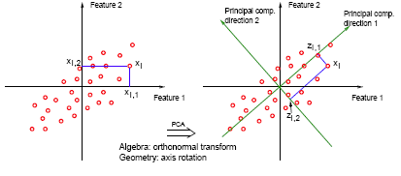
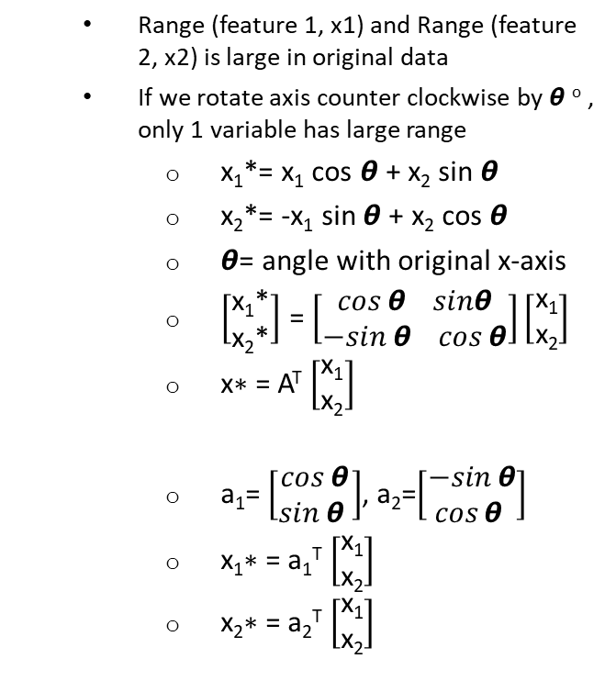
How does PCA algorithm work?
x₁*
Range (feature 1, x1) and Range (feature 2, x2) is large in original data
If we rotate axis counter clockwise by 𝞱 º , only 1 variable has large range
x₁*= x₁ cos 𝞱 + x₂ sin 𝞱
x₂*= -x₁ sin 𝞱 + x₂ cos 𝞱
𝞱= angle with original x-axis
$\left[\begin{aligned}\text{x}\text{1}\text{*} \\ \text{x}\text{2}\text{*}\end{aligned}\right]$ = $\left[\begin{aligned}cos⁡θ sinθ \\ −sin⁡θ cos⁡θ\end{aligned}\right]\left[\begin{aligned}\text{x}\text{1} \\ \text{x}\text{2}\end{aligned}\right]$
$\text{x}\text{∗}$= A^{T} $\left[\begin{aligned}\text{x}\text{1} \\ \text{x}\text{2}\end{aligned}\right]$
a₁= $\left[\begin{aligned}cos⁡θ \\ sin⁡θ \end{aligned}\right]$, a₂=$\left[\begin{aligned}−sin⁡θ \\ cos⁡θ \end{aligned}\right]$
$\text{x}\text{1}\text{∗}$= a₁^{T} $\left[\begin{aligned}\text{x}\text{1} \\ \text{x}\text{2}\end{aligned}\right]$
$\text{x}\text{2}\text{∗}$= a₂^{T} $\left[\begin{aligned}\text{x}\text{1} \\ \text{x}\text{2}\end{aligned}\right]$
x₂*

Slide 6
Algorithm for Principal Component Analysis (PCA)
Given observed data (x₁,x₂), find (a₁₁, a₁₂, a₂₁, a₂₂) such
z₁ = a₁₁x₁+a₁₂x₂ and z₂ = a₂₁x₁+a₂₂x₂
z₁ accounts for the maximum variance in the data, i.e., min(var(x₁,x₂)-var(z₁))
z₂ accounts for the maximum variance in the data once contribution of z₁ has been removed, i.e., max(var(x₁,x₂)-var(z₁))
Correlation (z₁, z₂)=0
a²₁₁+a²₂₁=1=a²₁₂+a²₂₂ (normalized and scaling condition)
(a₁₁, a₁₂, a₂₁, a₂₂) are called loading, i.e., simple correlation between original and transformed (or new) variables, e.g., a₁₁=correlation(x₁, z₁)

Slide 7
Principal Component Analysis (PCA)
Since principal components of the original variables, account for maximum variance of the original data, and are uncorrelated, can we use them to fix the problem of Multicollinearity?

Slide 8
Example – Principal Component Analysis (PCA)
Employment in different sectors by Country | Group | Agriculture (AGR) | Mining (MIN) | Manufacturing (MAG) | Power & water supply (PS) | Construction (CON) | Services (SER) | Finance (FIN) | Social & personal services (SPS) | Transport & communication (TC)
Belgium | EU | 2.6 | 0.2 | 20.8 | 0.8 | 6.3 | 16.9 | 8.7 | 36.9 | 6.8
Denmark | EU | 5.6 | 0.1 | 20.4 | 0.7 | 6.4 | 14.5 | 9.1 | 36.3 | 7
France | EU | 5.1 | 0.3 | 20.2 | 0.9 | 7.1 | 16.7 | 10.2 | 33.1 | 6.4
Germany | EU | 3.2 | 0.7 | 24.8 | 1 | 9.4 | 17.2 | 9.6 | 28.4 | 5.6
Greece | EU | 22.2 | 0.5 | 19.2 | 1 | 6.8 | 18.2 | 5.3 | 19.8 | 6.9
Ireland | EU | 13.8 | 0.6 | 19.8 | 1.2 | 7.1 | 17.8 | 8.4 | 25.5 | 5.8
Italy | EU | 8.4 | 1.1 | 21.9 | 0 | 9.1 | 21.6 | 4.6 | 28 | 5.3
Luxembourg | EU | 3.3 | 0.1 | 19.6 | 0.7 | 9.9 | 21.2 | 8.7 | 29.6 | 6.8
Netherlands | EU | 4.2 | 0.1 | 19.2 | 0.7 | 0.6 | 18.5 | 11.5 | 38.3 | 6.8
Portugal | EU | 11.5 | 0.5 | 23.6 | 0.7 | 8.2 | 19.8 | 6.3 | 24.6 | 4.8
Spain | EU | 9.9 | 0.5 | 21.1 | 0.6 | 9.5 | 20.1 | 5.9 | 26.7 | 5.8
UK | EU | 2.2 | 0.7 | 21.3 | 1.2 | 7 | 20.2 | 12.4 | 28.4 | 6.5
Austria | EFTA | 7.4 | 0.3 | 26.9 | 1.2 | 8.5 | 19.1 | 6.7 | 23.3 | 6.4
Finland | EFTA | 8.5 | 0.2 | 19.3 | 1.2 | 6.8 | 14.6 | 8.6 | 33.2 | 7.5
Iceland | EFTA | 10.5 | 0 | 18.7 | 0.9 | 10 | 14.5 | 8 | 30.7 | 6.7
Norway | EFTA | 5.8 | 1.1 | 14.6 | 1.1 | 6.5 | 17.6 | 7.6 | 37.5 | 8.1
Sweden | EFTA | 3.2 | 0.3 | 19 | 0.8 | 6.4 | 14.2 | 9.4 | 39.5 | 7.2
Switzerland | EFTA | 5.6 | 0 | 24.7 | 0 | 9.2 | 20.5 | 10.7 | 23.1 | 6.2
Albania | Eastern | 55.5 | 19.4 | 0 | 0 | 3.4 | 3.3 | 15.3 | 0 | 3
Bulgaria | Eastern | 19 | 0 | 35 | 0 | 6.7 | 9.4 | 1.5 | 20.9 | 7.5
Czech/Slovakia | Eastern | 12.8 | 37.3 | 0 | 0 | 8.4 | 10.2 | 1.6 | 22.9 | 6.9
Hungary | Eastern | 15.3 | 28.9 | 0 | 0 | 6.4 | 13.3 | 0 | 27.3 | 8.8
Poland | Eastern | 23.6 | 3.9 | 24.1 | 0.9 | 6.3 | 10.3 | 1.3 | 24.5 | 5.2
Romania | Eastern | 22 | 2.6 | 37.9 | 2 | 5.8 | 6.9 | 0.6 | 15.3 | 6.8
USSRF | Eastern | 18.5 | 0 | 28.8 | 0 | 10.2 | 7.9 | 0.6 | 25.6 | 8.4
Yugoslavia | Eastern | 5 | 2.2 | 38.7 | 2.2 | 8.1 | 13.8 | 3.1 | 19.1 | 7.8
Cyprus | Other | 13.5 | 0.3 | 19 | 0.5 | 9.1 | 23.7 | 6.7 | 21.2 | 6
Gibraltar | Other | 0 | 0 | 6.8 | 2 | 16.9 | 24.5 | 10.8 | 34 | 5
Malta | Other | 2.6 | 0.6 | 27.9 | 1.5 | 4.6 | 10.2 | 3.9 | 41.6 | 7.2
Turkey | Other | 44.8 | 0.9 | 15.3 | 0.2 | 5.2 | 12.4 | 2.4 | 14.5 | 4.4

Slide 9
Example Code
euroemp <- read.csv("Euroemp.csv",header=TRUE, row.names=1)
attach(euroemp)
# Correlations between the nine industry groups (variables)
cor(euroemp[-1])
# Using prcomp to compute the principal components (eigenvalues and eigenvectors)
# With scale=TRUE, variable means are set to zero, and variances set to one
# sample scores stored in euroemp_pca$x
# singular values (square roots of eigenvalues) stored in euroemp_pca$sdev
# loadings (eigenvectors) are stored in euroemp_pca$rotation
# variable means stored in euroemp_pca$center
# variable standard deviations stored in euroemp_pca$scale
euroemp_pca <- prcomp(euroemp[,-1],scale=TRUE)
summary(euroemp_pca)

Slide 10
Example Code
# A table containing eigenvalues and %'s accounted, follows
eigen_euroemp <- euroemp_pca$sdev^2 # Eigenvalues are the sdev^2
names(eigen_euroemp) <- paste("PC",1:9,sep="")
eigen_euroemp
sumlambdas <- sum(eigen_euroemp)
propvar <- eigen_euroemp/sumlambdas
cumvar_euroemp <- cumsum(propvar)
matlambdas <- rbind(eigen_euroemp, propvar, cumvar_euroemp)
rownames(matlambdas) <- c("Eigenvalues","Prop. variance","Cum. prop. variance")

Slide 11
Example Code
# Printing table of eigenvalues and their contribution to the total variance
round(matlambdas,4)
# Showing the eigenvectors
euroemp_pca$rotation
# The print method below is the same as euroemp_pca$sdev and euroemp_pca$rotation printed together
print(euroemp_pca)
# Sample scores stored in euroemp_pca$x
euroemp_pca$x
# Identifying the scores by country
eurotyp_pca <- data.frame(euroemp_pca$x)
eurotyp_pca
# Plotting the scores for the first and second components
# This plot is similar to Figure 6.2
plot(eurotyp_pca$PC1, eurotyp_pca$PC2, type="n",
xlab="PC1", ylab="PC2", main="Figure 6.2 (signs reversed)")
text(eurotyp_pca$PC1, eurotyp_pca$PC2, labels=rownames(euroemp), cex=0.5)
abline(h=0)
abline(v=0)
detach(euroemp)
# End of script

Slide 12
Recommended Readings
A Step-by-Step Explanation of Principal Component Analysis (PCA). Retrieved from https://builtin.com/data-science/step-step-explanation-principal-component-analysis
A tutorial on Principal Components Analysis. Retrieved from http://www.cs.otago.ac.nz/cosc453/student_tutorials/principal_components.pdf
A One-Stop Shop for Principal Component Analysis. Retrieved from https://towardsdatascience.com/a-one-stop-shop-for-principal-component-analysis-5582fb7e0a9c

Slide 13
Next Session

