Slide 1
Urban Sound Classification using
Deep Learning(Capstone 2)
Xingkai Wu
Springboard Data Science student
SPRINGBOARD
Data Science Career Track

Slide 2
Overview
Background
Data Wrangle
Technical Approach
  EDA
  Deep Learning
    MLP
    CNN
Result
Conclusion
Next Steps

Slide 3
Background
The objective of this project will be using deep learning techniques to classify 10 different urban sounds
Using MLP(Multilayer Perceptron) and CNN(Convolutional Neuron Network) to build the prediction model
To study comparison of results achieved by MPL and CNN

Slide 4
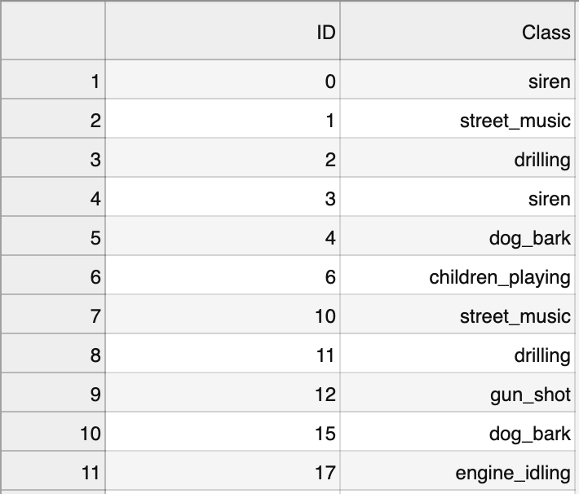
Dataset Description
The table below is in the training data set
  ID represents the prefix of the audio file name
  Class represents the Class of the audio file
    siren
    street music
    drilling
    dog_bark
    children_playing
    gun_shot
    engine_idling
    air_conditioner
    jackhammer
    car_horn

Slide 5
Methodology
Clean Data
Audio Visualization
Fetch & Analyze Data
MPL & CNN Model
Validate Models
Predict Test Data
Property Extraction
Feature Extraction

Slide 6
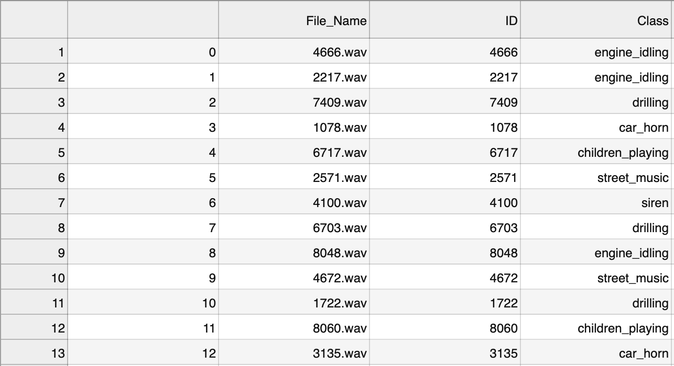
Exploratory Data Analysis(EDA)
Data Summary
  By adding .wav to the end of ID number in the csv file, I t will be much easier to iterate over each wav file in the training dataset to extract the property and feature.

Slide 7
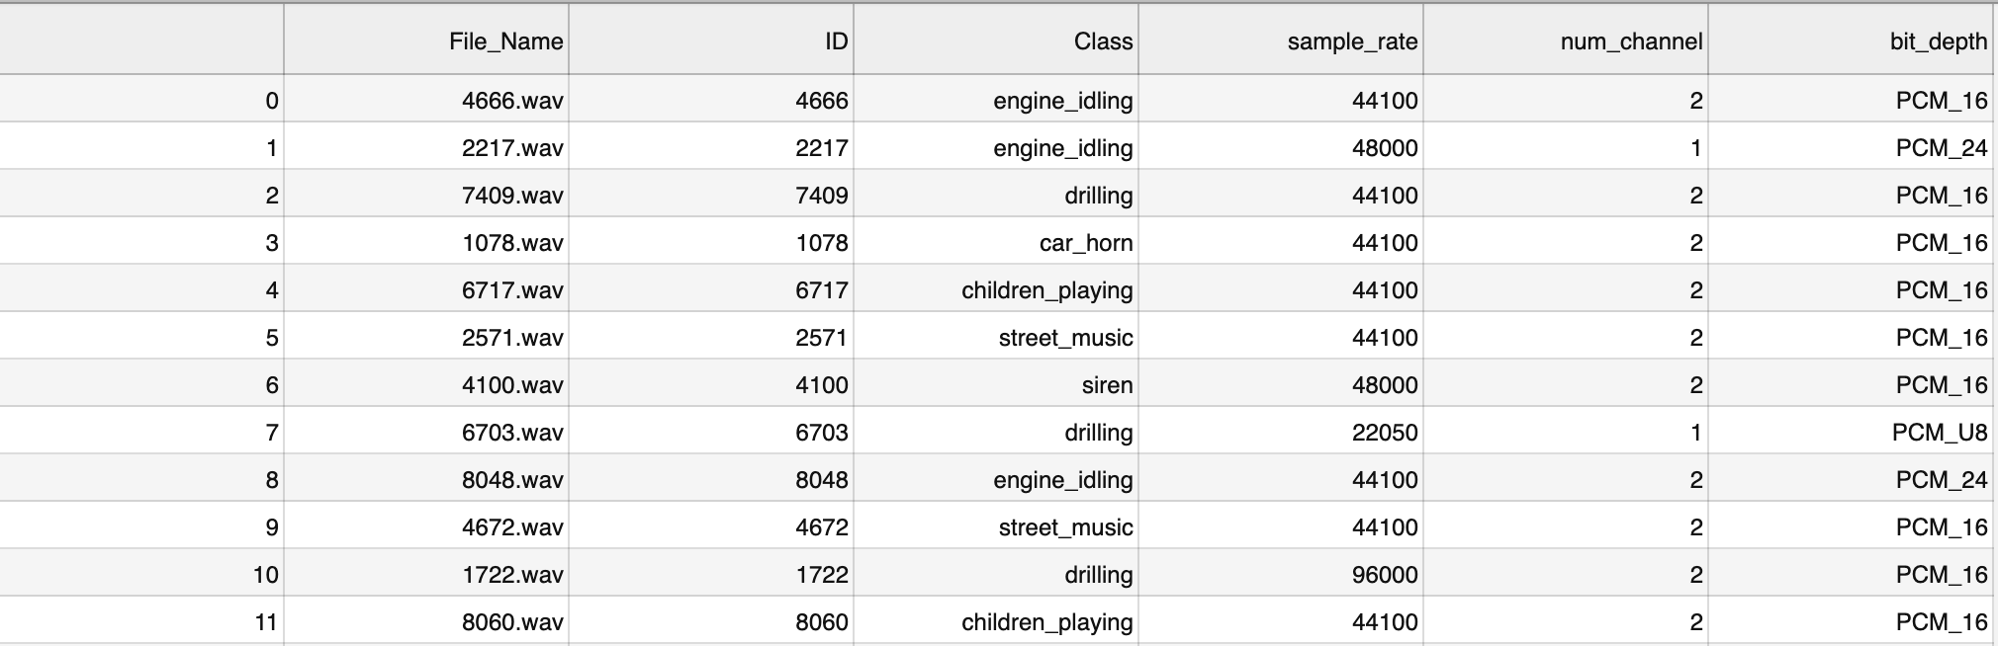
Exploratory Data Analysis(EDA)
Data Summary
  By extracting the audio properties such as sample rate, number of channel and bit depth using Python soundfile’s methods, i.e. samplerate, channels, subtype.

Slide 8
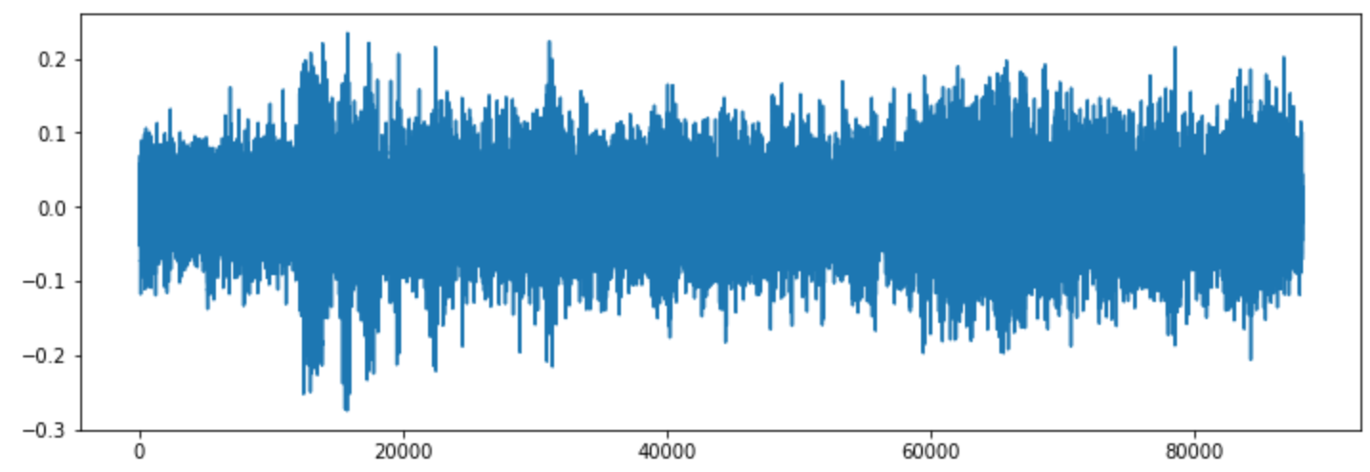
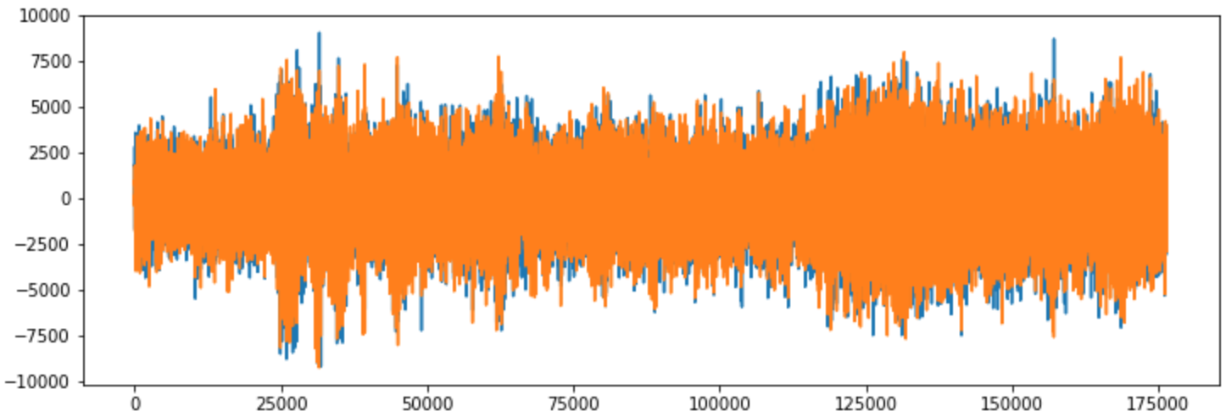
Exploratory Data Analysis(EDA)
Data Summary
  Exploring the sound waveform in different channels of one sound file.

Slide 9
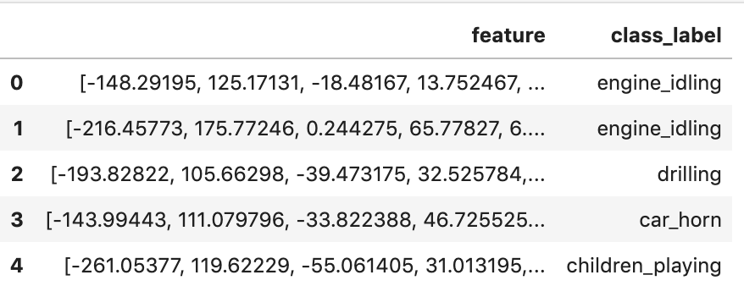
Exploratory Data Analysis(EDA)
Data Summary
  Feature Extraction: Mel- Frequency Cepstral Coefficients(MFCC)
    Spectrogram uses a linear frequency scale, whereas MFXX uses a quasi- logarithmic spaced frequency scale, it is more similar to how human auditory system processes sounds.
    MFCC is the feature to identify the sound classification, we will extract 40 MFCCs for every audio file using feature.mfcc function in librosa package.

Slide 10
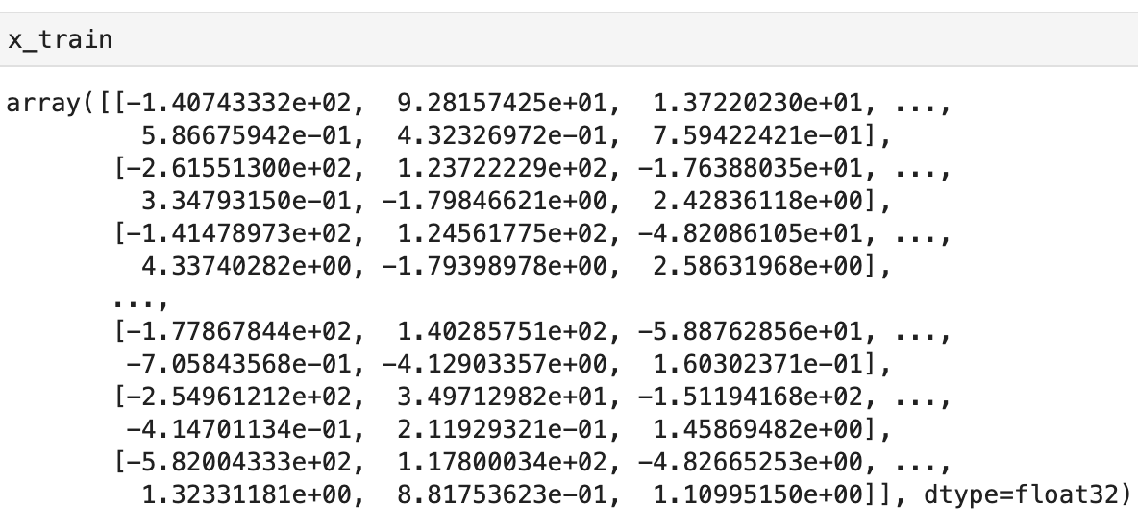
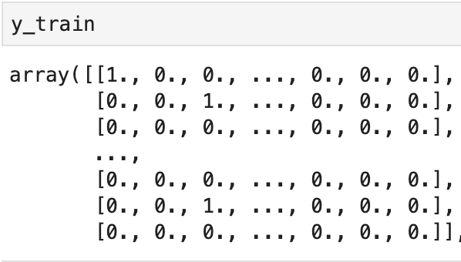
Exploratory Data Analysis(EDA)
Data Summary
  Converting Data and labels then splitting the dataset
    Using the preprocessing.LabelEncoder function in the sklearn package to encode the categorical text data into model- understandable numerical data(one- hot coding).
    Then use the model_selection,train_test_split function in sklearn package to set the testing set to 30%.

Slide 11
MLP (Model Architecture)
MLP(Multilayer Perceptron) using Keras and Tensorflow backend
  This model consists 3 dense layers: input layer, hidden layer and output layer
    The input layer with each sample containing 40 MFCCs therefore shape of 40 in each audio file
    The first two layer will have 256 nodes with activation function of ReLU(Rectified Linear Activation) with dropout rate 20% to randomly exclude nodes from each update cycle in order to have better generalization and less overfitting.
    The output layer will have 10 nodes(number of possible classifications) with activation function softmax(makes the output sum up to 1 so the output can be interpreted as probabilities), then the model will make the prediction based on the option has the highest probability

Slide 12
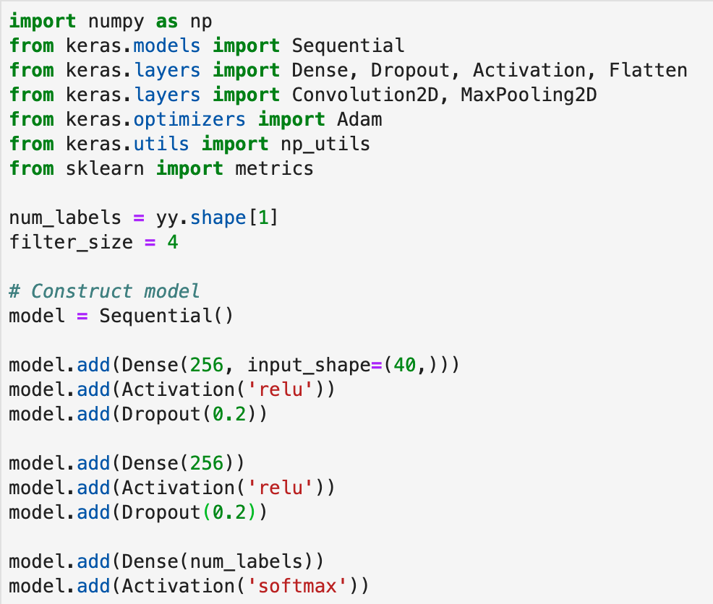
Building Model(MLP)

Slide 13
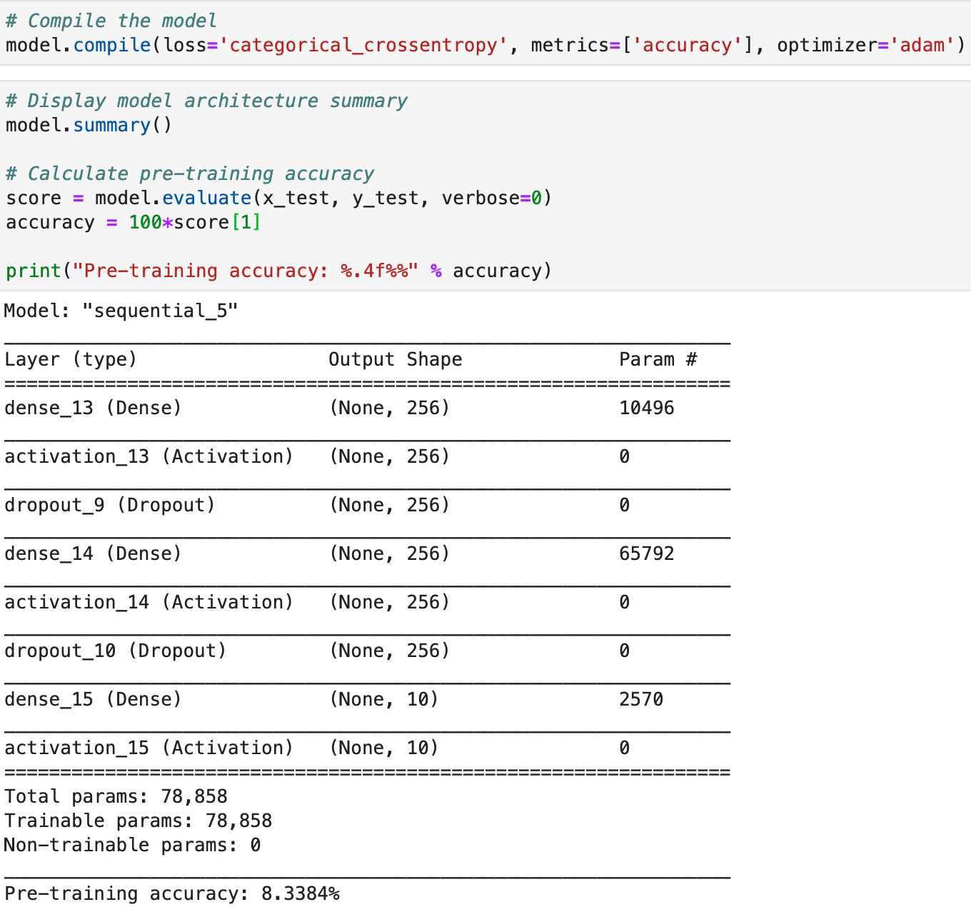
Compile Model(MLP)

Slide 14
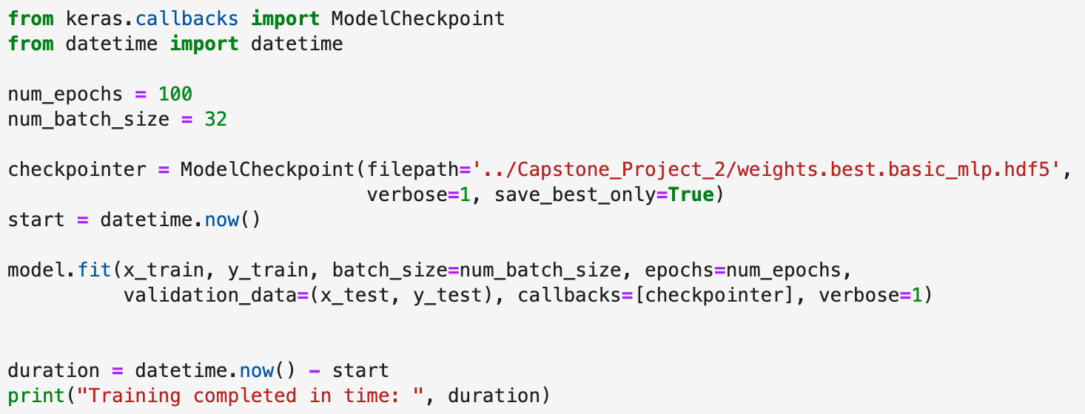
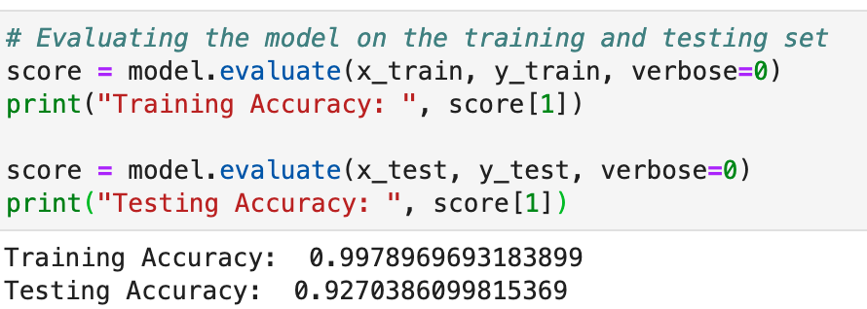
Train Model(MLP)
  By using 100 epochs, the number of times the model will cycle through the data, the model will improve on each cycle until it reaches a certain point
  After training and evaluating the accuracy of the MLP model, it has 99.7% training accuracy and 92.7% testing accuracy. The accuracy is very decent, but the overfitting is the issue that need to be resolved

Slide 15
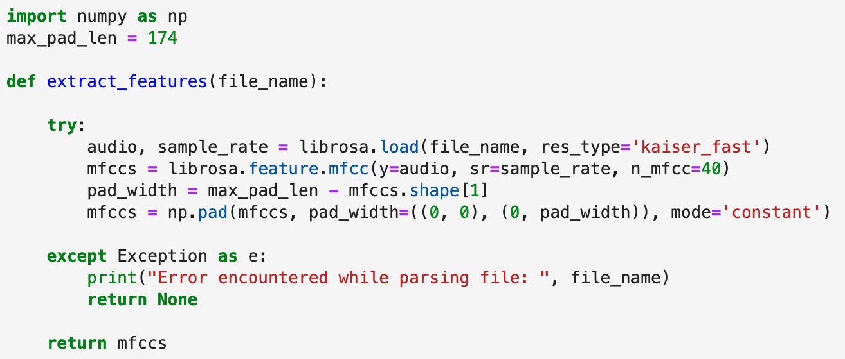
CNN(Feature Extraction)
CNN(Convolutional Neuron Network)
  Requires a fixed size for all inputs, to overcome this we will zero pad the output vectors to make all the same size

Slide 16
CNN(Model Architecture)
CNN is using Keras and Tensorflow backend
  With sequential model, four Conv2D convolution layers with output dense layer.
  The convolution layers are designed for feature detection by sliding window over the input and perform a matrix multiplication and storing result in a feature map.
  The filter parameter specifies the number of nodes in each layer. Each layer will increase filter size from 16, 32, 64 to 128
  The first layer receives the input shape of (40,174,1) with activation function of ReLU(Rectified Linear Activation) with dropout rate 20% to randomly exclude nodes from each update cycle.
  Each Convolution Layer has an pooling layer MaxPooling2D and final convolution layer have a GlobalAveragePooling2D type to reduce dimensionality of the model and therefore reduce training time and overfitting
  The output layer has 1o nodes with activation function softmax.

Slide 17
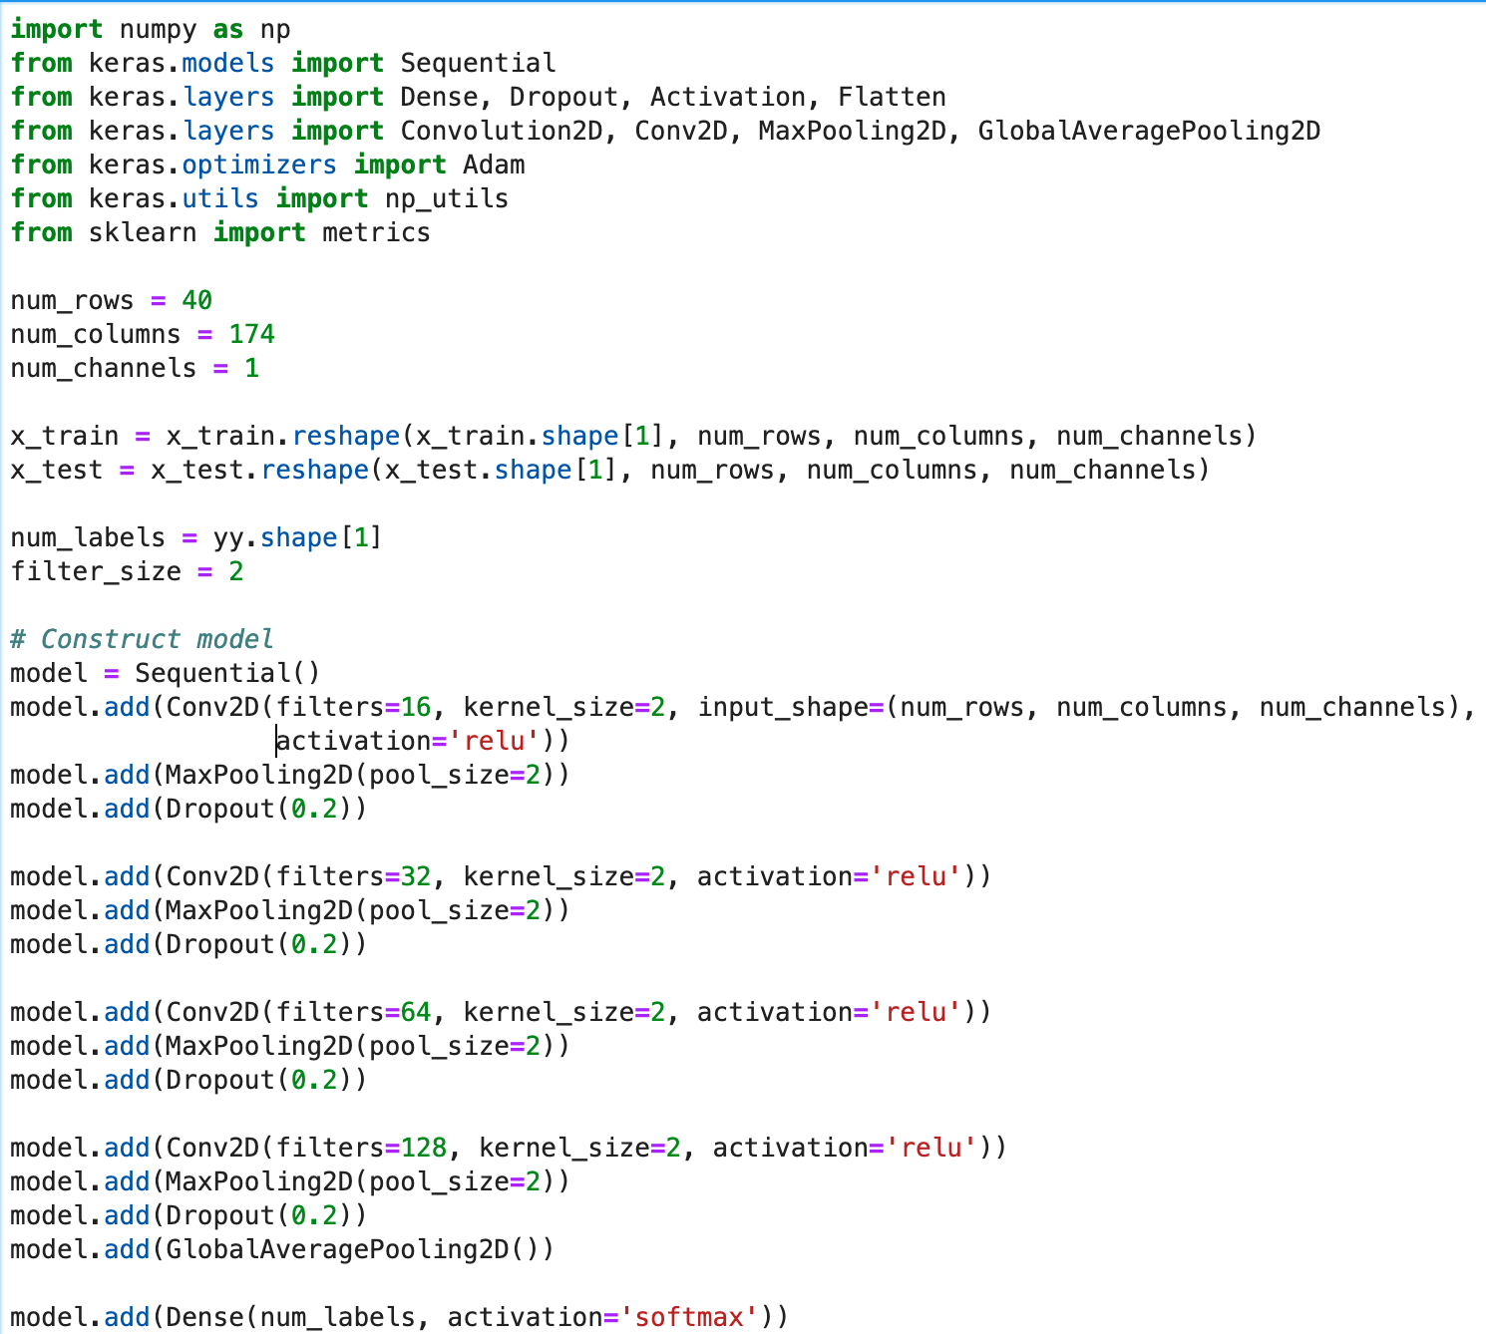
CNN(Model Architecture)

Slide 18
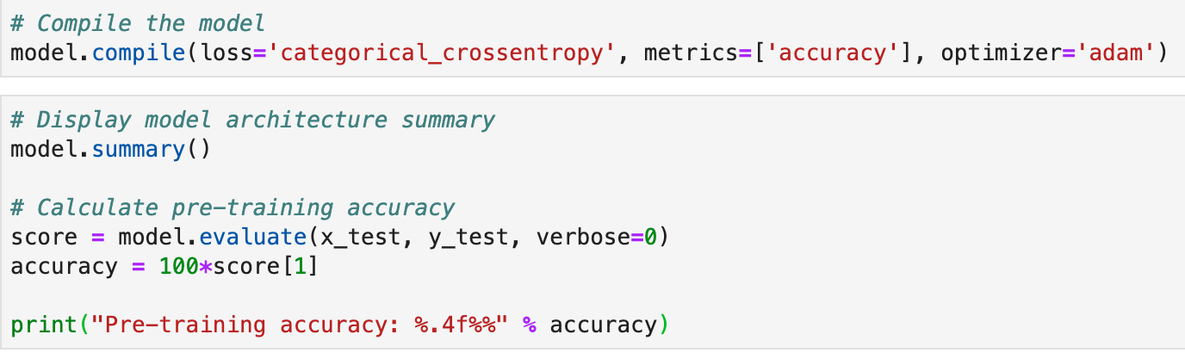
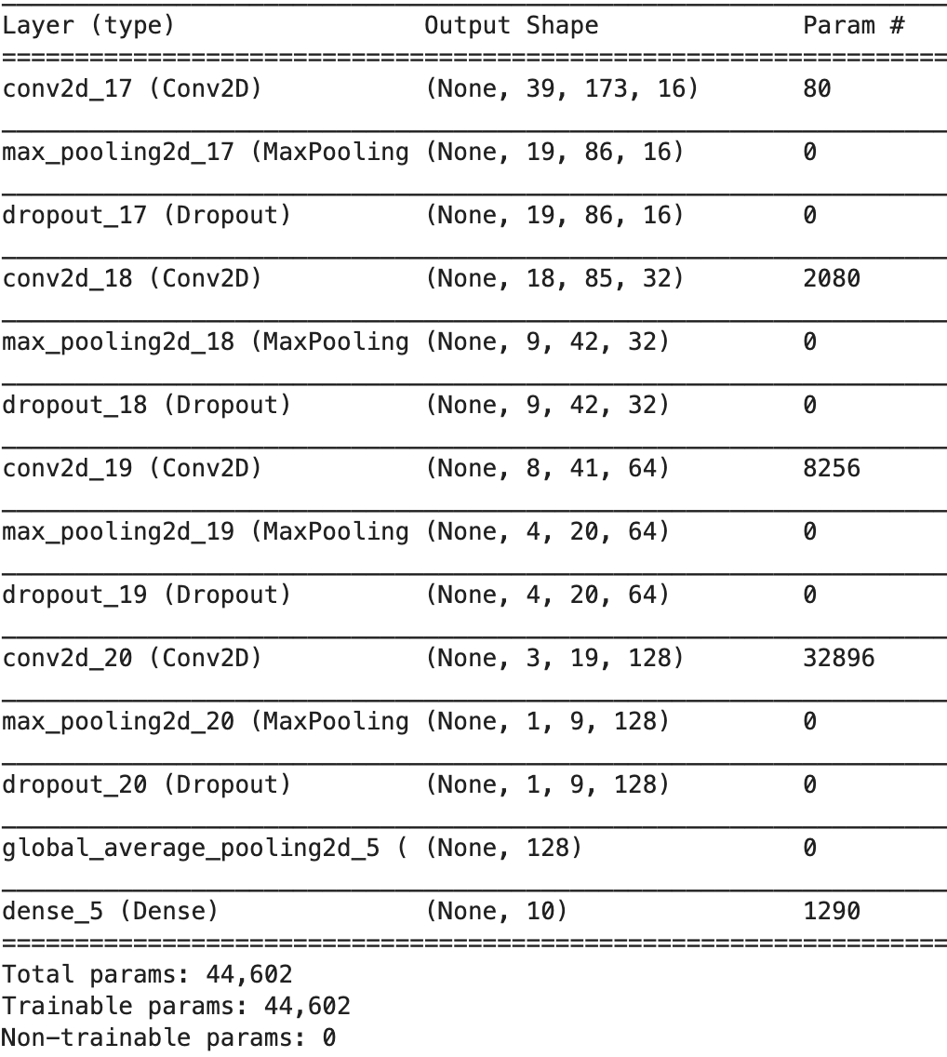
Compile Model(CNN)

Slide 19
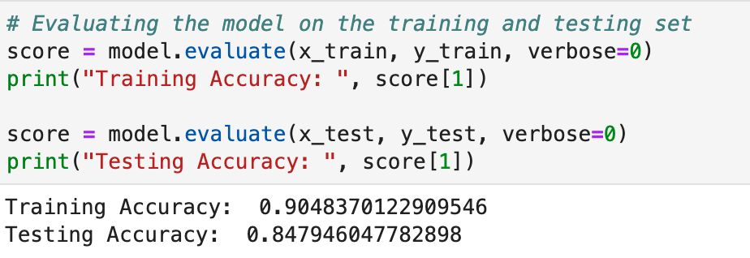
Train Model(CNN)
  By using 72 epochs, the number of times the model will cycle through the data, the model will improve on each cycle until it reaches a certain point
  After training and evaluating the accuracy of the CNN model, it has 90% training accuracy and 85% testing accuracy. The overfitting issue had been resolved, but accuracy is reduced, but 85% accuracy is still a good prediction accuracy. In classification, less overfitting, the better

Slide 20
Result
MLP gives higher accuracy but more overfitting.
CNN gives less accuracy but less overfitting
In classification problem, when accuracy is considerably high enough, less the overfitting, better the model
Machine Learning Model Approach | MLP | CNN
Training Accuracy | 99.7% | 90%
Learning Accuracy | 92.7% | 85%

Slide 21
Next Steps
For Further improvement
  Test the model performance with Real- time audio
  Train the model with real world data, this will involve argumenting the training data in carious ways:
    Adding different background sounds
    Adjusting the volume levels of the target sound or adding echoes
    Changing the start position of the recording sample, e.g. the shape of the dog barks
  Experiment to see if per class accuracy is affected by using training data of different durations.

Slide 22
Thank You !

