Slide 1
Introduction/Tutorials for popular CNNs:
AlexNet, VGG, ResNet, GoogLeNet(Inception-v1): https://www.youtube.com/watch?v=DAOcjicFr1Y&list=PL3FW7Lu3i5JvHM8ljYj-zLfQRF3EO8sYv&index=9
ResNet: https://towardsdatascience.com/review-resnet-winner-of-ilsvrc-2015-image-classification-localization-detection-e39402bfa5d8
BN-Inception/Inception-v2: https://medium.com/@sh.tsang/review-batch-normalization-inception-v2-bn-inception-the-2nd-to-surpass-human-level-18e2d0f56651
Inception-v3: https://medium.com/@sh.tsang/review-inception-v3-1st-runner-up-image-classification-in-ilsvrc-2015-17915421f77c
Inception-v4/Inception-ResNet-v1/Inception-ResNet-v2: https://towardsdatascience.com/review-inception-v4-evolved-from-googlenet-merged-with-resnet-idea-image-classification-5e8c339d18bc
ResNeXt(ResNeXt-101)/DenseNet(DenseNet-100, DenseNet-250, etc..): https://www.jeremyjordan.me/convnet-architectures/#resnext
DPN(DualPathNet): https://blog.csdn.net/ling00007/article/details/79115156
Xception(extreme inception): https://towardsdatascience.com/review-xception-with-depthwise-separable-convolution-better-than-inception-v3-image-dc967dd42568
SENet(SE-ResNetXt, SE-ResNet): https://towardsdatascience.com/squeeze-and-excitation-networks-9ef5e71eacd7
NASNet (NASNet-A): https://ai.googleblog.com/2017/11/automl-for-large-scale-image.html

Slide 2
Related papers
ImageNet Classification with Deep Convolutional Neural Networks [2012 NIPS] [AlexNet]
Very Deep Convolutional Networks for Large-Scale Image Recognition [2015 ICLR] [VGGNet]
Going Deeper with Convolutions [2015 CVPR] [GoogLeNet / Inception-v1]
Batch Normalization: Accelerating Deep Network Training by Reducing Internal Covariate Shift [2015 ICML] [BN-Inception / Inception-v2]
Rethinking the Inception Architecture for Computer Vision [2016 CVPR] [Inception-v3]
Deep Residual Learning for Image Recognition [2016 CVPR] [ResNet]
Inception-v4, Inception-ResNet and the Impact of Residual Connections on Learning [2017 AAAI] [Inception-v4]
An Analysis of Deep Neural Network Models for Practical Applications [2017 IEEE]
Aggregated Residual Transformations for Deep Neural Networks [2017 CVPR] [ResNeXt]
Densely Connected Convolutional Networks [2017 CVPR] [DenseNet]
Dual Path Networks [2017 NIPS] [DPN]
Xception: Deep Learning with Depthwise Separable Convolutions [2017 CVPR] [Xception]
Squeeze-and-Excitation Networks [2018 CVPR] [SENet]
Learning Transferable Architectures for Scalable Image Recognition [2018 CVPR] [NASNet]

Slide 3
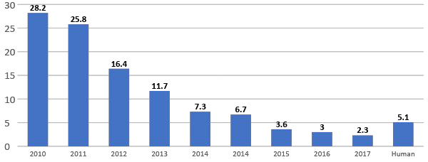




ImageNet ILSVRC winners
152 layers
152 layers
152 layers
19 layers
22 layers
shallow
8 layers
8 layers

Slide 4
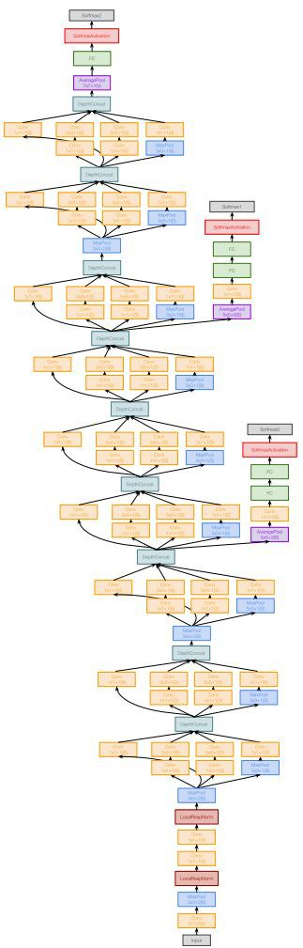
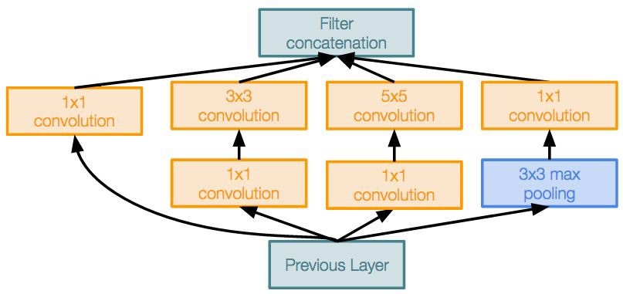
Case Study: GoogLeNet
22 layers
Efficient “Inception” module
No FC layers
12x less params than AlexNet
ILSVRC’14 classification winner (6.7% top 5 error)
Inception module

Slide 5
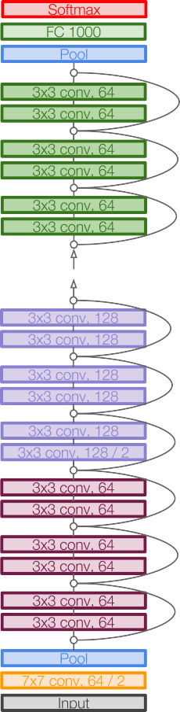
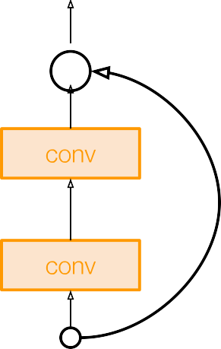
Case Study: ResNet
relu
F(x) + x
152-layer model for ImageNet
ILSVRC’15 classification winner (3.57% top 5 error)
Swept all classification and detection competitions in ILSVRC’15 and COCO’15!
F(x)
X
identity
relu
X
Residual block

Slide 6
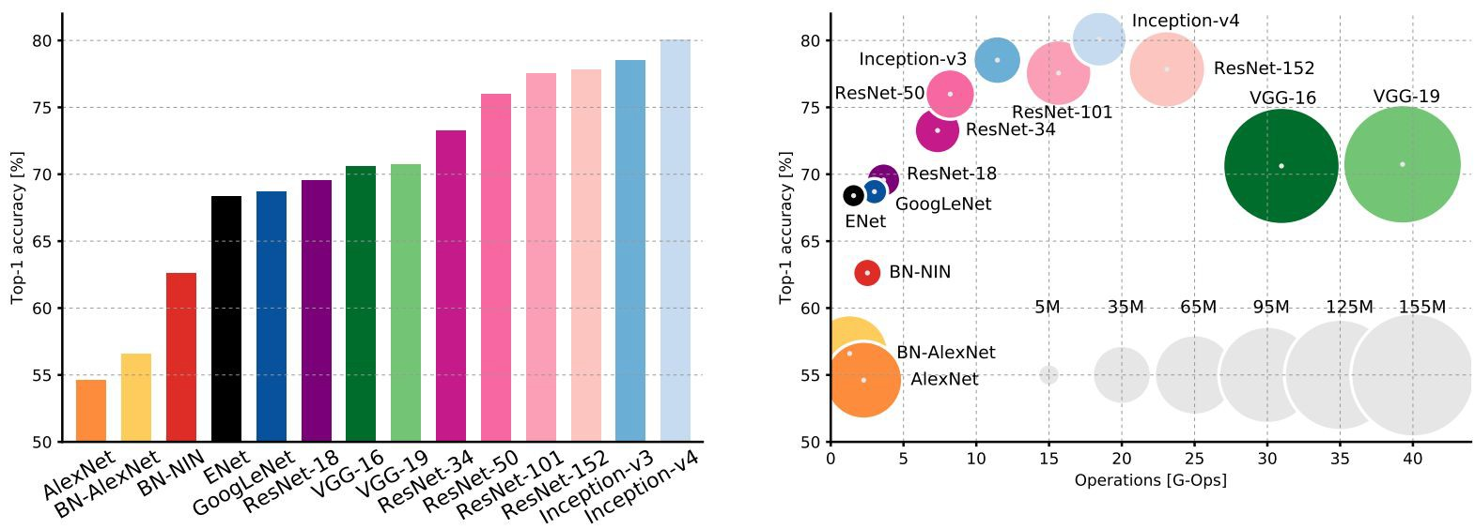
Comparing complexity...
An Analysis of Deep Neural Network Models for Practical Applications, 2017.
The size of the blobs is proportional to the number of network parameters.
Fei-Fei Li & Justin Johnson & Serena Yeung Lecture 9 - May 1, 2018

Slide 7
VGG: Highest memory, most operations
An Analysis of Deep Neural Network Models for Practical Applications, 2017.
Fei-Fei Li & Justin Johnson & Serena Yeung Lecture 9 - May 1, 2018

Slide 8
GoogLeNet: most efficient
An Analysis of Deep Neural Network Models for Practical Applications, 2017.
Fei-Fei Li & Justin Johnson & Serena Yeung Lecture 9 - May 1, 2018

Slide 9
AlexNet:
Smaller compute, still memory heavy, lower accuracy
An Analysis of Deep Neural Network Models for Practical Applications, 2017.
Fei-Fei Li & Justin Johnson & Serena Yeung Lecture 9 - May 1, 2018

Slide 10
ResNet:
Moderate efficiency depending on model, highest accuracy
Comparing complexity...
An Analysis of Deep Neural Network Models for Practical Applications, 2017.
Fei-Fei Li & Justin Johnson & Serena Yeung Lecture 9 - May 1, 2018

Slide 11
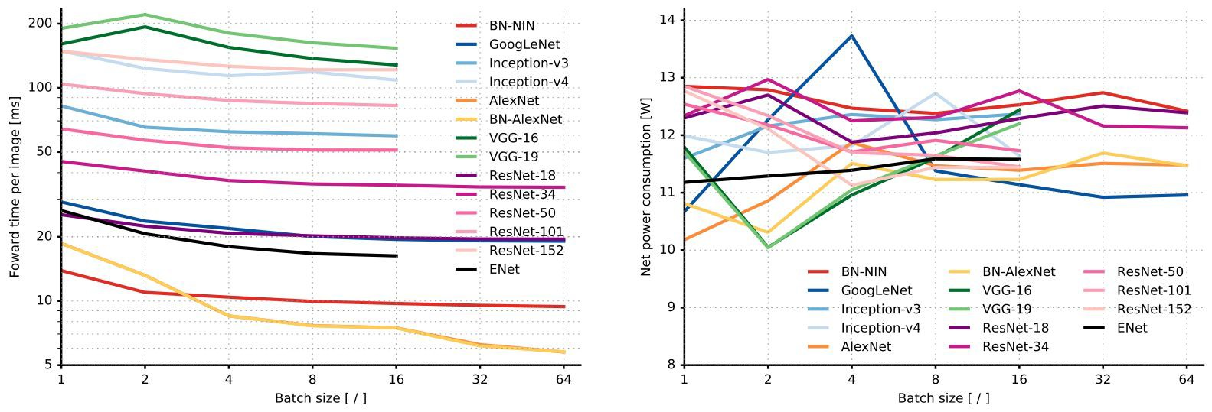
Forward pass time and power consumption
Fei-Fei Li & Justin Johnson & Serena Yeung Lecture 9 - May 1, 2018
An Analysis of Deep Neural Network Models for Practical Applications, 2017.

Slide 12
Summaries
Plain CNN variations
AlexNet, VGG (VGG-16, VGG-19)
Inception variations
GoogLeNet, Inception-v2, Inception-v3, Inception-v3, Inception-v4, Xception, etc..
Residual variations
ResNet50, ResNet101, ResNet152, ResNetXt, DenseNet, DualPathNet, etc..
Inception + Residual
SENet
NASNet (Google AutoML)
NASNet-A, PNASNet

Slide 13
Useful tricks
Multi-crop: is to crop the input image into multi sub-images and input into network for classification, to increase the accuracy. It has been used since AlexNet, VGGNet and so on. To be specific, 10 crop was used in AlexNet, 144 crop was used in GoogLeNet.
Multi-model: is to have multi trained models ensemble together to get a more accurate prediction, just like boosting. It has been used since LeNet, AlexNet and so on.
AutoAugment: Learning Augmentation Policies from Data

Slide 14
Useful resources
https://github.com/Cadene/pretrained-models.pytorch#torchvision
https://github.com/alyato/CNN-models-comparison
https://github.com/pytorch/vision/tree/master/torchvision

