Slide 1
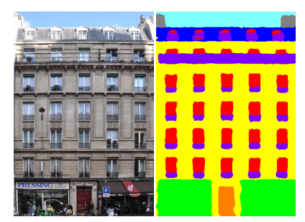
Façade parsing
Semantic facade segmentation
Image-to-image translation

Slide 2
Semantic facade segmentation
Traditional facade parsing methods
Segmentation using CNNs
Facade datasets

Slide 3
Traditional facade parsing methods
Image-based procedural modeling of facades [SIGGRAPH 2007]
Irregular lattices for complex shape grammar facade parsing [CVPR 2012]
Parsing facades with shape grammars and reinforcement learning [IEEE TPAMI 2013]
Notes:
Facade parsing or facade segmentation was typically a mixture between traditional segmentation algorithms and finding ways to encode architectural priors. Architectural priors can be encoded using grammars, symmetry, matrix rank, element templates, rules, hard constraints, and more general energy functions

Slide 4
Segmentation using CNNs
A Three-Layered Approach to Facade Parsing [ECCV 2012]
FCN: Fully Convolutional Networks for Semantic Segmentation [CVPR 2015]
DeepLab_v1: Semantic image segmentation with deep convolutional nets and fully connected crfs [ICLR 2015]
A convolutional network for semantic facade segmentation and interpretation [ISPRS 2016]
DeepLab_v2: Semantic Image Segmentation with Deep Convolutional Nets, Atrous Convolution, and Fully Connected CRFs [IEEE TPAMI 2016]
SegNet: A Deep Convolutional Encoder-Decoder Architecture for Image Segmentation [IEEE TPAMI 2017]
DeepFacade: A Deep Learning Approach to Facade Parsing [IJCAI 2017]
DeepLav_v3: Rethinking atrous convolution for semantic image segmentation [2017]
BigSUR: Large-scale Structured Urban Reconstruction [SIGRAPH Asia 2017]
Facade Segmentation in the Wild [2018]
Encoder-Decoder with Atrous Separable Convolution for Semantic Image Segmentation [ECCV 2018]
Notes:
FCN, SegNet and DeepLab are most popular ones and also they are open to general topics not oonly facades.

Slide 5
Some implementations
https://github.com/wkentaro/pytorch-fcn
https://github.com/shelhamer/fcn.berkeleyvision.org
https://github.com/meetshah1995/pytorch-semseg
https://github.com/jfemiani/facade-segmentation
https://github.com/tensorflow/models/tree/master/research/deeplab
https://github.com/speedinghzl/Pytorch-Deeplab
http://blog.qure.ai/notes/semantic-segmentation-deep-learning-review#deeplab

Slide 6
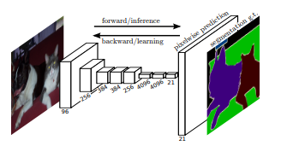
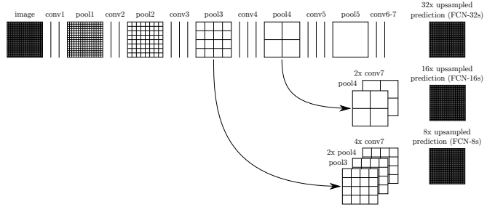
FCN
Downsampling path : capture semantic/contextual information
Upsampling path : recover spatial information
FCN-32 : Directly produces the segmentation map from conv7, by using a transposed convolution layer with stride 32.
FCN-16 : Sums the 2x upsampled prediction from conv7 (using a transposed convolution with stride 2) with pool4 and then produces the segmentation map, by using a transposed convolution layer with stride 16 on top of that.
FCN-8 : Sums the 2x upsampled conv7 (with a stride 2 transposed convolution) with pool4, upsamples them with a stride 2 transposed convolution and sums them with pool3, and applies a transposed convolution layer with stride 8 on the resulting feature maps to obtain the segmentation map.

Slide 7
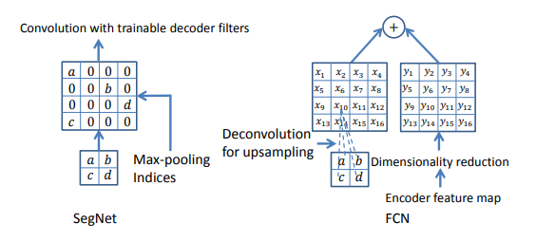
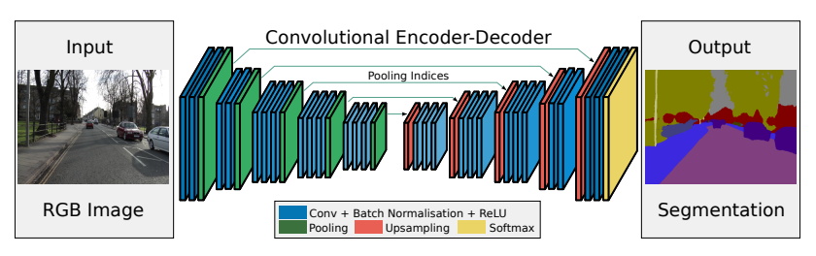
SegNet
MaxPooling indices transferred to decoder to improve the segmentation resolution.

Slide 8
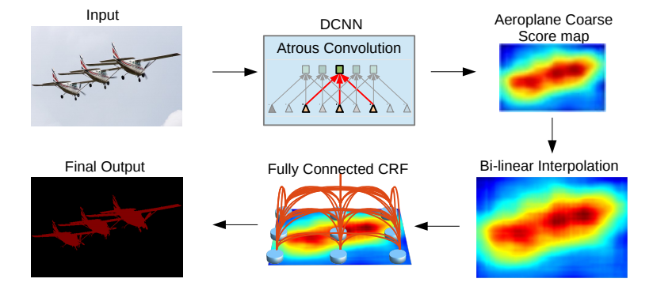
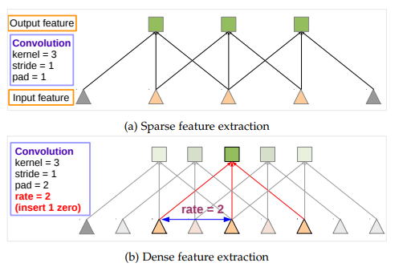
DeepLab
Use atrous/dilated convolutions.
Propose atrous spatial pyramid pooling (ASPP)
Use Fully connected CRF
Atrous/Dilated convolutions increase the field of view without increasing the number of parameters.
Multiscale processing is achieved either by passing multiple rescaled versions of original images to parallel CNN branches (Image pyramid) and/or by using multiple parallel atrous convolutional layers with different sampling rates (ASPP).
Structured prediction is done by fully connected CRF. CRF is trained/tuned separately as a post processing step

Slide 9
Facade datasets
The ECP dataset contains 104 images of rectified and cropped facades with the label set window, wall, balcony, door, roof, sky, shop.
The eTRIMS dataset contains 60 images with the label set building, car, door, pavement, road, sky, vegetation, window. These images are not rectified and not cropped, however, the images stem from a very careful viewpoint selection. All images have an almost frontal view of a single facade that fills most of the image.
The CMP dataset contains 606 annotated images with the label set facade, molding, cornice, pillar, window, door, sill, blind, balcony, shop, deco, background.
Notes:
Facade parsing or facade segmentation was typically a mixture between traditional segmentation algorithms and finding ways to encode architectural priors. Architectural priors can be encoded using grammars, symmetry, matrix rank, element templates, rules, hard constraints, and more general energy functions

Slide 10
Image-to-image translation
Image-to-Image Translation with Conditional Adversarial Networks (Pix2Pix) [CVPR 2017]
Unpaired image-to-image translation using cycle-consistent adversarial networks [ICCV 2017]
Photo-Realistic Single Image Super-Resolution Using a Generative Adversarial Network [CVPR 2017]
High-resolution image synthesis and semantic manipulation with conditional GANs (Pix2PixHD) [CVPR 2018]

Slide 11
Some implementations
https://github.com/junyanz/pytorch-CycleGAN-and-pix2pix
https://github.com/affinelayer/pix2pix-tensorflow
https://github.com/tensorlayer/srgan
https://medium.com/@jonathan_hui/gan-some-cool-applications-of-gans-4c9ecca35900
https://github.com/NVIDIA/pix2pixHD
http://people.csail.mit.edu/junyanz/

Slide 12
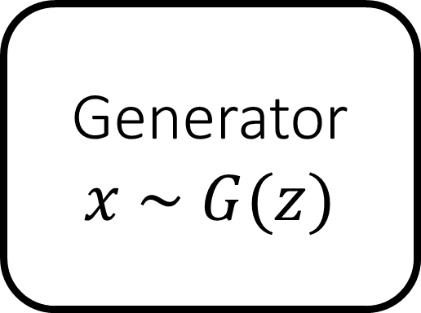
Generative Adversarial Networks (GANs)
Generator
$$x \sim G(z)$$
Discriminator
Real vs. Fake
[Goodfellow et al. 2014]

Slide 13
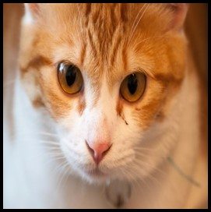






$$z$$
$$G(z)$$
$$G$$
$$D$$
fake 0.1
$$x$$
$$D$$
real 0.9
$$\min_{G}{\max_{D}{𝔼_{z,x}\left[\log{D(G\left(z\right))}+\log{(1−D\left(x\right))}\right]}}$$
fake
real
[Goodfellow et al. 2014]

Slide 14
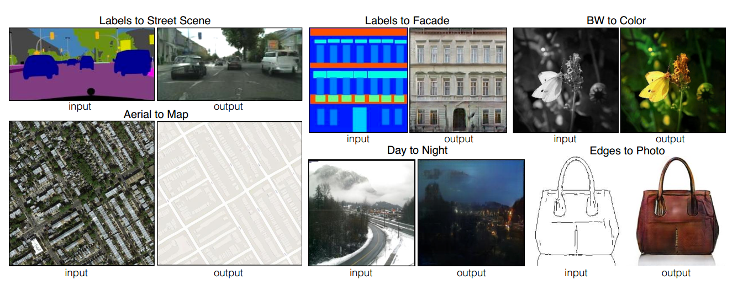
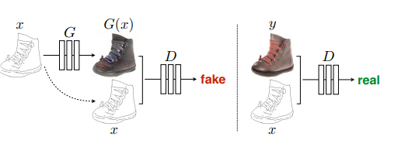
Pix2Pix
Phillip Isola et al. CVPR 2017

Slide 15
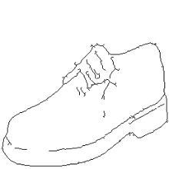
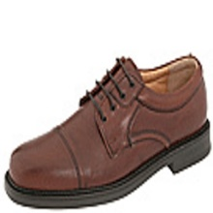
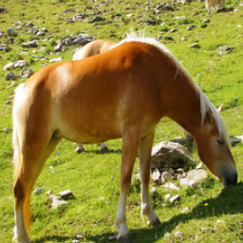
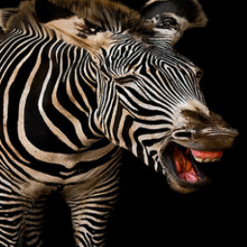
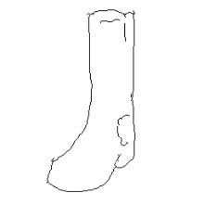
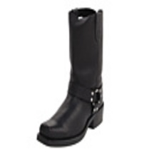
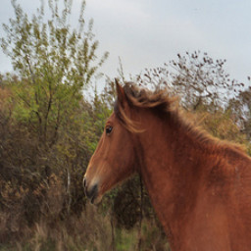
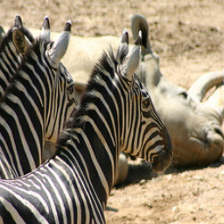
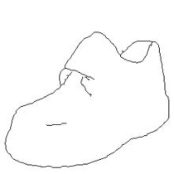
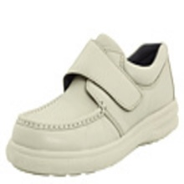
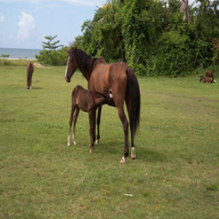
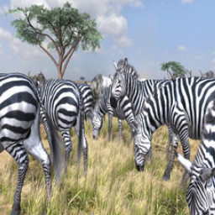
Paired
Unpaired
…
…
…

Slide 16
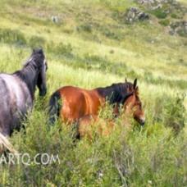
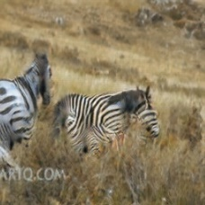
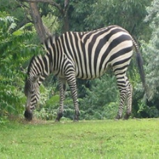
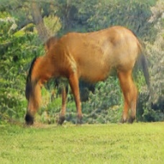











CycleGAN
$$x$$
$$G(x)$$
$$F(G\left(x\right))$$
$$y$$
$$F(y)$$
$$G(F\left(x\right))$$
$$D_{Y}(G\left(x\right))$$
$$D_{G}(F\left(x\right))$$
Reconstruction
error
Reconstruction
error
$${\left\|F\left(G\left(x\right)\right)−x\right\|}_{1}$$
$${\left\|G\left(F\left(y\right)\right)−y\right\|}_{1}$$
[Zhu*, Park*, Isola, and Efros, ICCV 2017]

Slide 17
Discussion
Real satellite façades vs. Synthetic satellite façades?
www.planet.com
CMP “style transfer” to satellite facades
How to choose NN?
Try FCN/SegNet/DeepLab
Pix2PixHD

