Slide 1
Exploring Coffee Shops in New York City
Aditya Rao
March 6th 2020

Slide 2
Abstract
In this project, machine learning was used to estimate a good place for a new coffee shop in New York City.

Slide 3
Introduction
In New York City, if someone is looking to open a café restaurant, the question is, where would you recommend that they open it? The background of the problem is that for a café to be profitable, it is not wise setting up a café in the immediate proximity of existing ones.
Let’s also make sure that audience is explicitly defined to be the local restaurant entrepreneurs in New York, and they should care about this problem because the location of the new café is very important in terms of profits.

Slide 4
Dataset
A description of the data: the data used to solve this problem is geolocation data collected from Foursquare. Adequate explanation and discussion, with examples, of the data is the following. Data is a single dataframe, containing at least a location of the café. Explanation of the location data is a standard tuple (lat, lng), where lat stands for latitude and lng for longitude. Some other metadata like name, postal code and so on is also collected.

Slide 5
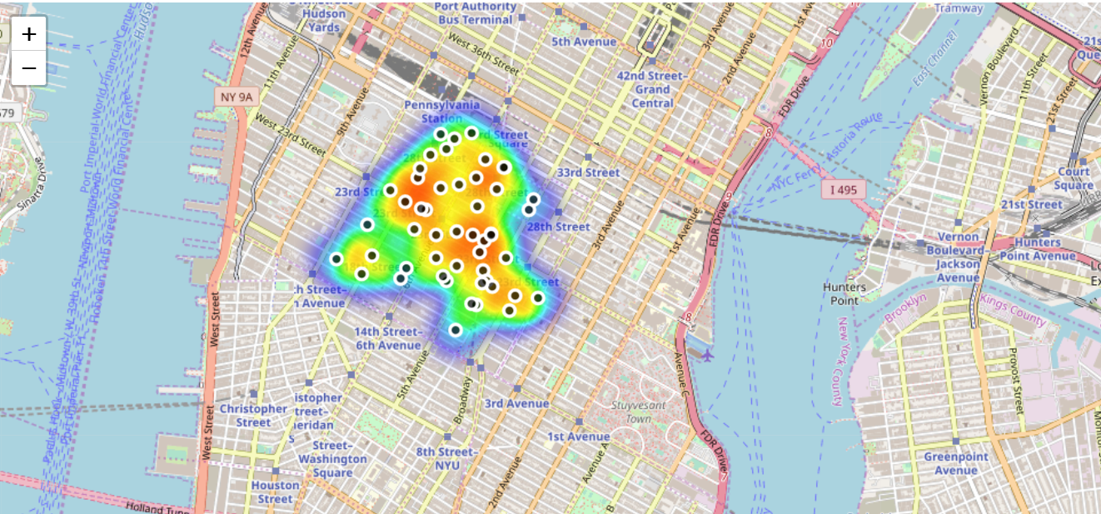
Methedology
Heatmap-based kernel density estimation was used. Heatmap was already implemented as plugin for Folium, which was used to visualize data to map. Visualization is shown in figure

Slide 6
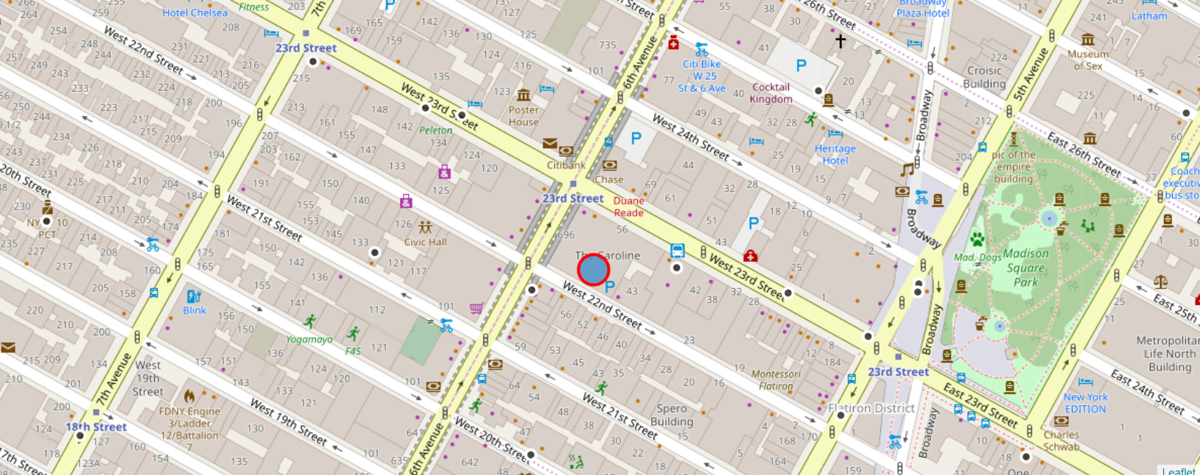
Results
Based on the preliminary results, one possibly good location for new Cafe would be on West 22nd Street, New York City.

