Slide 1
The Heartbleed Bug and Attack

Slide 2
Background: the Heartbeat Protocol
TLS/SSL protocols provide a secure channel between two communicating applications
TLS/SSL is widely used
Heartbeat extension: implement keep-alive feature of TLS.
Heartbleed bug is an implementation flaw in TLS/SSL heartbeat extension.
Notes:
OpenSSL is a commercial grade toolkit for the TLS/SSL protocols
Many secure web servers are built on top of OpenSSL.
When a client and server are not sending data to each other for a period of time, either side or firewall in between may break the channel.
The protocol:
The sender send a Heartbeat packet to receiver.
Inside the packet there is payload, payload length field. (Actual content of payload is not important)
The receiver constructs a response packet and should carry same payload data as in request.
When the receiver gets a heartbeat request, it retrieves payload length value (n) from the packet, copies n bytes of data to the response packet, starting from the beginning of the payload field in the request packet.

Slide 3
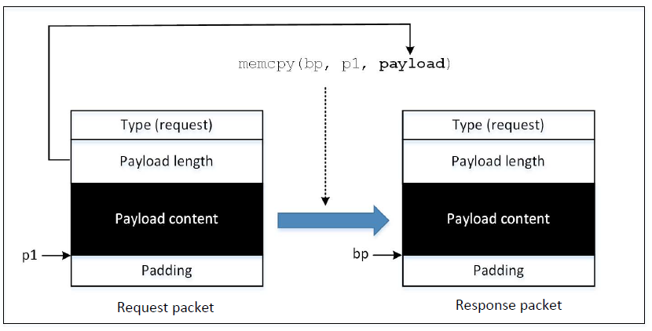
How Response Packet is Constructed
Problem: how much is copied depends on the value contained in the payload length field.
What if this value is larger than the actual payload size?

Slide 4
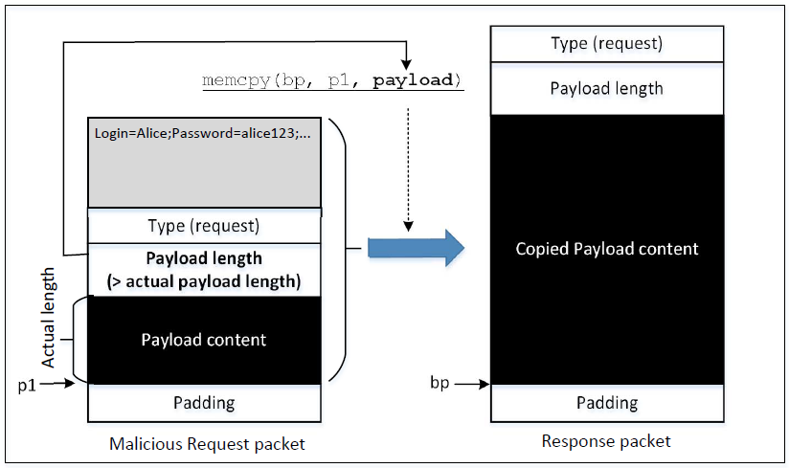
Launch the Attack
Attack results: Some data from the server’s memory also got copied into the response packet, which will be sent out
Notes:
To launch a Heartbleed attack, an attacked sends a specially crafted Heartbeet request packet to the victim
Inside this packet, the number put in the payload size field is larger than the actual payload size
When the packet arrives on receiver side, memcpy() will copy more data into the response packet than the request packet.
The affected memory may store sensitive information, such as passwords, credit card info or other user information.
This data will be copied into the response packet and sent to the attacker
By sending a heartbeat request to a vulnerable remote server, attackers can dump the server’s memory and steal sensitive information.

Slide 5
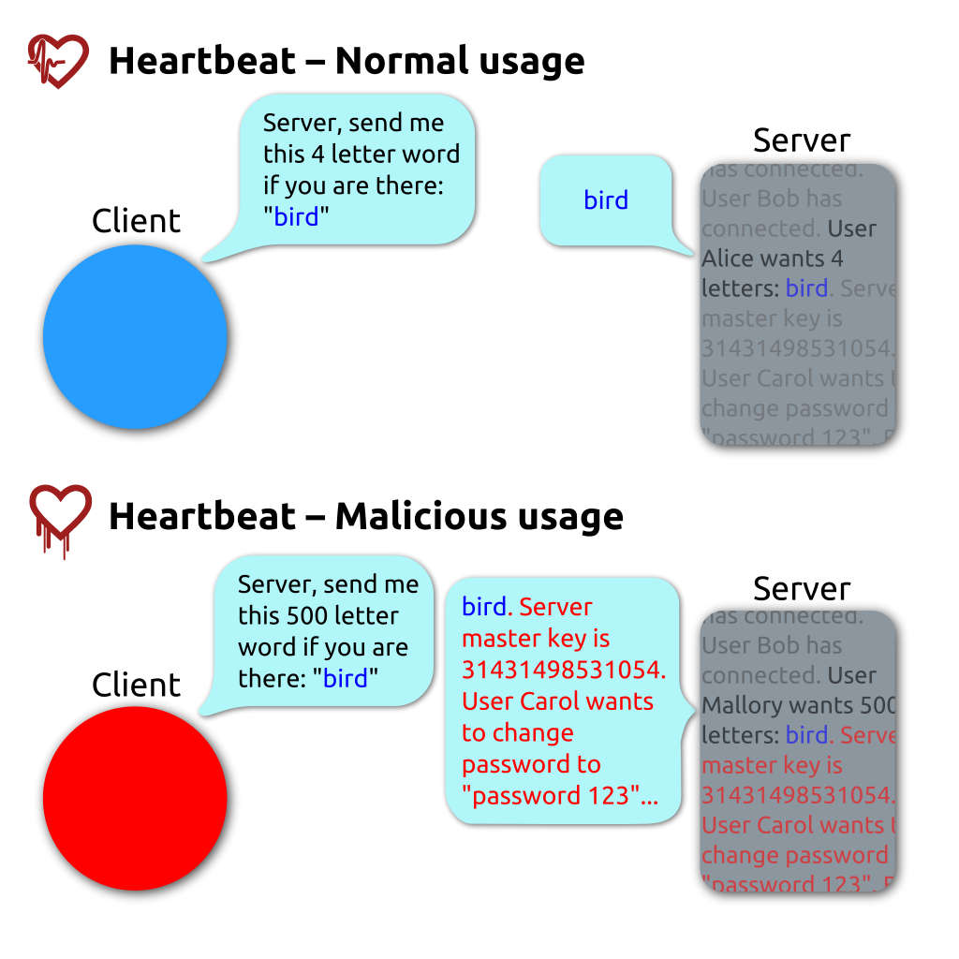

Slide 6
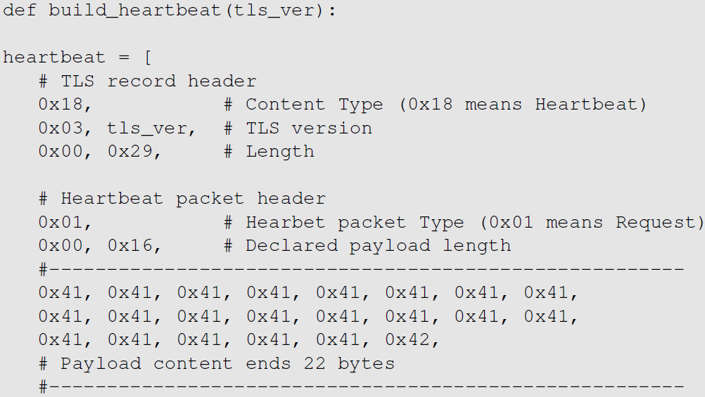
Launch the Heartbleed Attack
0x0016 (22) is placed in the length field. Which exactly matches with the actual length of the payload.
We play with this length field to perform our attack in the next slide
Notes:
Code originally written by Jared Stafforf [Staffoed, 2014].
The attack code constructs a Heartbeat request packet after having established a TLS connection with the target server.
From the code snippet we can see that:
TLS record’s size = 0x0029 (not including the record header), which is the size of the payload in the TLS record.
The payoad contains a Heartbeat request packet, and has its own header (3 bytes) payload (22 bytes) and paddings (16 bytes).
The value 0x0016 is the value that exactly matches with the actual payload, so we will not be able to get any additional data from the server.

Slide 7
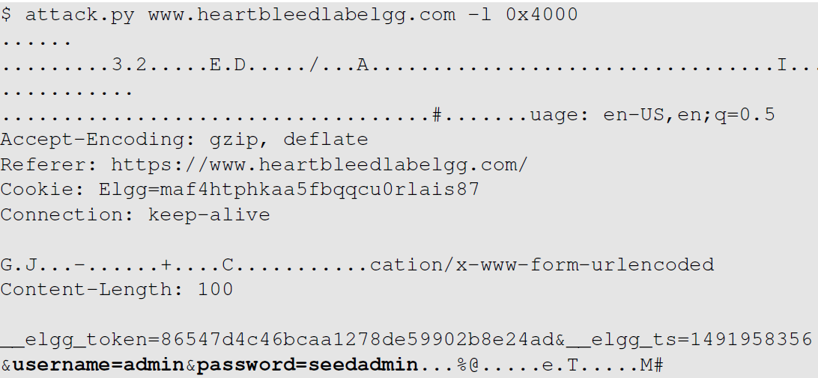
Launch the Heartbleed Attack
We got some secret from the server
Notes:
We increase this value to higher values (e.g. 0x4000 i.e., 16K; much larger than the actual payload size -> 22 bytes) and start getting larger packets back.
The attack.py program prints out the payload data in the response packet.
Analyzing the result:
We find some data return from server like password seedadmin for admin. The admin user has logged into the webserver. Hence, the username and password are still in the memory.
When server constructs the Heartbeat response packet, due to the attack, the server end up sending a lot of data from its memory to the attacker.
If no user has logged into the server yet before the attack, there will not be much useful data stored in memory.
When running the attack multiple times, we may get back different data, because each request packet might be stored at a different memory address.

Slide 8

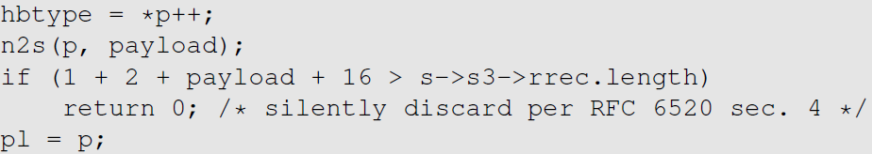
Fixing the Heartbleed Bug
Simply update your system’s OpenSSL library. The following two commands can be used for it:
The following code shows how the OpenSSL library is fixed
Notes:
Comparing the shown code with the vulnerable version shown earlier,
An if statement is added
s -> s3 -> rrec.length is the total number of bytes in the request packet; this is the actual length and not the one declared in the request packet.
Constant 1 -> size of type field
Constant 2 -> size of length field
Constant 16 -> minimum padding length
The if statement compares whether the declared payload length plus a constant (19) is larger than the actual size of the request packet.
If larger, the packet is discarded and there will be no reply.
If attacker send a request packet with larger declared length value, the packet won’t have any effect.

Slide 9
Summary
Heartbeat protocol
The flaw in the heartbeat protocol
Heartbleed bug
How to launch the attack

