Slide 1
CH01 Overview
ZJU 2020
Notes:
This chapter provides an overview of computer security. We begin with a discussion
of what we mean by computer security. In essence, computer security deals
with computer-related assets that are subject to a variety of threats and for which
various measures are taken to protect those assets. Accordingly, the next section of
this chapter provides a brief overview of the categories of computer-related assets
that users and system managers wish to preserve and protect, and a look at the
various threats and attacks that can be made on those assets. Then, we survey the
measures that can be taken to deal with such threats and attacks. This we do from
three different viewpoints, in Sections 1.3 through 1.5. We then lay out in general
terms a computer security strategy.
The focus of this chapter, and indeed this book, is on three fundamental
questions:
1. What assets do we need to protect?
2. How are those assets threatened?
3. What can we do to counter those threats?

Slide 2
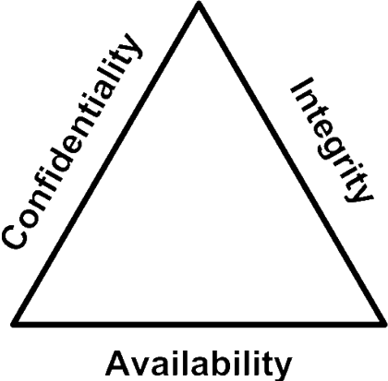
The CIA Triad

Slide 3
The CIA Triad
Confidentiality: this term covers two related concepts:
Data confidentiality: Assures that private or confidential information is not made available or disclosed to unauthorized individuals.
Privacy: Assures that individuals control or influence what information related to them may be collected and stored and by whom and to whom that information may be disclosed.
Integrity: this term covers two related concepts:
Data integrity: Assures that information and programs are changed only in a specified and authorized manner.
System integrity: Assures that a system performs its intended function in an unimpaired manner, free from deliberate or inadvertent unauthorized manipulation of the system.
Availability: Assures that systems work promptly and service is not denied to authorized users.
Notes:
Confidentiality
Preserving authorized restrictions on information access and disclosure, including means for protecting personal privacy and proprietary information
Integrity
Guarding against improper information modification or destruction, including ensuring information nonrepudiation and authenticity
Availability
Ensuring timely and reliable access to and use of information

Slide 4
CIA Triad Examples
Notes:
HARDWARE A major threat to computer system hardware is the threat to
availability. Hardware is the most vulnerable to attack and the least susceptible to
automated controls. Threats include accidental and deliberate damage to equipment
as well as theft. The proliferation of personal computers and workstations and the
widespread use of LANs increase the potential for losses in this area. Theft of
CD-ROMs and DVDs can lead to loss of confidentiality. Physical and administrative
security measures are needed to deal with these threats.
SOFTWARE Software includes the operating system, utilities, and application
programs. A key threat to software is an attack on availability. Software, especially
application software, is often easy to delete. Software can also be altered or
damaged to render it useless. Careful software configuration management, which
includes making backups of the most recent version of software, can maintain high
availability. A more difficult problem to deal with is software modification that
results in a program that still functions but that behaves differently than before,
which is a threat to integrity/authenticity. Computer viruses and related attacks fall
into this category. A final problem is protection against software piracy. Although
certain countermeasures are available, by and large the problem of unauthorized
copying of software has not been solved.
DATA Hardware and software security are typically concerns of computing center
professionals or individual concerns of personal computer users. A much more
widespread problem is data security, which involves files and other forms of data
controlled by individuals, groups, and business organizations.
Security concerns with respect to data are broad, encompassing availability,
secrecy, and integrity. In the case of availability, the concern is with the destruction
of data files, which can occur either accidentally or maliciously.
The obvious concern with secrecy is the unauthorized reading of data files or
databases, and this area has been the subject of perhaps more research and effort
than any other area of computer security. A less obvious threat to secrecy involves
the analysis of data and manifests itself in the use of so-called statistical databases,
which provide summary or aggregate information. Presumably, the existence of
aggregate information does not threaten the privacy of the individuals involved.
However, as the use of statistical databases grows, there is an increasing potential
for disclosure of personal information. In essence, characteristics of constituent
individuals may be identified through careful analysis. For example, if one table
records the aggregate of the incomes of respondents A, B, C, and D and another
records the aggregate of the incomes of A, B, C, D, and E, the difference between
the two aggregates would be the income of E. This problem is exacerbated by the
increasing desire to combine data sets. In many cases, matching several sets of data
for consistency at different levels of aggregation requires access to individual units.
Thus, the individual units, which are the subject of privacy concerns, are available at
various stages in the processing of data sets.
Finally, data integrity is a major concern in most installations. Modifications
to data files can have consequences ranging from minor to disastrous.

Slide 5
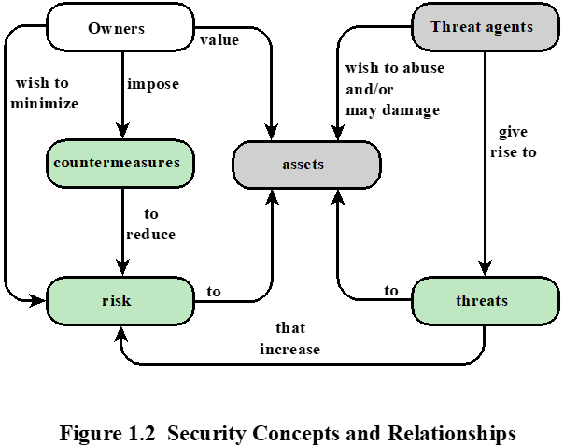
Security Concepts
Notes:
countermeasure is any means taken to deal with a security attack.
Ideally, a countermeasure can be devised to prevent a particular type of attack from
succeeding. When prevention is not possible, or fails in some instance, the goal is to
detect the attack then recover from the effects of the attack. A countermeasure may
itself introduce new vulnerabilities. In any case, residual vulnerabilities may remain
after the imposition of countermeasures. Such vulnerabilities may be exploited by
threat agents representing a residual level of risk to the assets. Owners will seek to
minimize that risk given other constraints.

Slide 6
Vulnerabilities, Threats and Attacks
Categories of vulnerabilities
Corrupted (loss of integrity)
Leaky (loss of confidentiality)
Unavailable or very slow (loss of availability)
Threats
Capable of exploiting vulnerabilities
Represent potential security harm to an asset
Attacks (threats carried out)
Insider vs. outsider
Passive vs. active
Notes:
– attempt to learn or make use of information from the system that does not affect system resources
Active – attempt to alter system resources or affect their operation
In the context of security, our concern is with the vulnerabilities of system
resources. [NRC02] lists the following general categories of vulnerabilities of a
computer system or network asset:
• It can be corrupted , so that it does the wrong thing or gives wrong answers.
For example, stored data values may differ from what they should be because
they have been improperly modified.
• It can become leaky . For example, someone who should not have access to
some or all of the information available through the network obtains such
access.
• It can become unavailable or very slow. That is, using the system or network
becomes impossible or impractical.
These three general types of vulnerability correspond to the concepts of integrity,
confidentiality, and availability, enumerated earlier in this section.
Corresponding to the various types of vulnerabilities to a system resource are
threats that are capable of exploiting those vulnerabilities. A threat represents a
potential security harm to an asset. An attack is a threat that is carried out (threat
action) and, if successful, leads to an undesirable violation of security, or threat
consequence. The agent carrying out the attack is referred to as an attacker, or
threat agent . We can distinguish two types of attacks:
• Active attack: An attempt to alter system resources or affect their operation.
• Passive attack: An attempt to learn or make use of information from the
system that does not affect system resources.
We can also classify attacks based on the origin of the attack:
• Inside attack: Initiated by an entity inside the security perimeter (an “insider”).
The insider is authorized to access system resources but uses them in a way not
approved by those who granted the authorization.
• Outside attack: Initiated from outside the perimeter, by an unauthorized or
illegitimate user of the system (an “outsider”). On the Internet, potential
outside attackers range from amateur pranksters to organized criminals, international
terrorists, and hostile governments.

Slide 7
Passive Attacks
In passive attacks, attacker attempts to learn or make use of information from the system but does not affect system resources
Eavesdropping on, or monitoring of, transmissions
Goal of attacker is to obtain information that is being transmitted
Two categories :
Leaking of message content
Traffic analysis: attacker infers information from network traffic patterns, even though message content is not leaked (e.g., with encryption)
Notes:
Network security attacks can be classified
as passive attacks and active attacks . A passive attack attempts to learn or make
use of information from the system but does not affect system resources. An active
attack attempts to alter system resources or affect their operation.
Passive attacks are in the nature of eavesdropping on, or monitoring of,
transmissions. The goal of the attacker is to obtain information that is being transmitted.
Two types of passive attacks are release of message contents and traffic
analysis.
The release of message contents is easily understood. A telephone conversation,
an electronic mail message, and a transferred file may contain sensitive or
confidential information. We would like to prevent an opponent from learning the
contents of these transmissions.
A second type of passive attack, traffic analysis , is subtler. Suppose that we
had a way of masking the contents of messages or other information traffic so that
opponents, even if they captured the message, could not extract the information
from the message. The common technique for masking contents is encryption. If we
had encryption protection in place, an opponent might still be able to observe the
pattern of these messages. The opponent could determine the location and identity
of communicating hosts and could observe the frequency and length of messages
being exchanged. This information might be useful in guessing the nature of the
communication that was taking place.
Passive attacks are very difficult to detect because they do not involve any
alteration of the data. Typically, the message traffic is sent and received in an
apparently normal fashion and neither the sender nor receiver is aware that a
third party has read the messages or observed the traffic pattern. However, it is
feasible to prevent the success of these attacks, usually by means of encryption.
Thus, the emphasis in dealing with passive attacks is on prevention rather than
detection.

Slide 8
Active Attacks
In active attacks, attacker attempts to alter system resources or affect their operation.
Involve some modification of the data stream or the creation of a false stream.
Four categories:
Replay: attacker captures a message and subsequent retransmits it to produce an unauthorized effect.
Masquerade: one entity pretends to be a different entity.
Modification of messages: some portion of a message is altered, or messages are delayed or reordered.
Denial of Service: prevents or inhibits the normal use of the target system.
Notes:
Active attacks involve some modification of the data stream or the creation
of a false stream and can be subdivided into four categories: replay, masquerade,
modification of messages, and denial of service.
Replay involves the passive capture of a data unit and its subsequent retransmission
to produce an unauthorized effect.
A masquerade takes place when one entity pretends to be a different entity. A
masquerade attack usually includes one of the other forms of active attack. For example,
authentication sequences can be captured and replayed after a valid authentication
sequence has taken place, thus enabling an authorized entity with few privileges
to obtain extra privileges by impersonating an entity that has those privileges.
Modification of messages simply means that some portion of a legitimate
message is altered, or that messages are delayed or reordered, to produce an
unauthorized effect. For example, a message stating, “Allow John Smith to read
confidential file accounts” is modified to say, “Allow Fred Brown to read confidential
file accounts.”
The denial of service prevents or inhibits the normal use or management of
communications facilities. This attack may have a specific target; for example, an
entity may suppress all messages directed to a particular destination (e.g., the security
audit service). Another form of service denial is the disruption of an entire network,
either by disabling the network or by overloading it with messages so as to degrade
performance.
Active attacks present the opposite characteristics of passive attacks. Whereas
passive attacks are difficult to detect, measures are available to prevent their
success. On the other hand, it is quite difficult to prevent active attacks absolutely,
because to do so would require physical protection of all communications facilities
and paths at all times. Instead, the goal is to detect them and to recover from any
disruption or delays caused by them. Because the detection has a deterrent effect, it
may also contribute to prevention.

Slide 9
Countermeasures
Means used to deal with security attacks
Prevent, Detect, Recover
Goal is to minimize residual level of risk to the assets
Notes:
Finally, a countermeasure is any means taken to deal with a security attack.
Ideally, a countermeasure can be devised to prevent a particular type of attack from
succeeding. When prevention is not possible, or fails in some instance, the goal is to
detect the attack and then recover from the effects of the attack. A countermeasure
may itself introduce new vulnerabilities. In any case, residual vulnerabilities
may remain after the imposition of countermeasures. Such vulnerabilities may be
exploited by threat agents representing a residual level of risk to the assets. Owners
will seek to minimize that risk given other constraints.

Slide 10
Attack Surface
An attack surface consists of the reachable and exploitable vulnerabilities in a system, including:
Network Attack Surface
Vulnerabilities over an enterprise network, wide-area network, or the Internet
Including network protocol vulnerabilities, such as those used for DoS attacks
Software Attack Surface
Vulnerabilities in application, utility, or operating system code
Human Attack Surface
Social engineering, human error, and trusted insiders
Notes:
Attack surfaces can be categorized in the following way:
• Network attack surface: This category refers to vulnerabilities over an enterprise
network, wide-area network, or the Internet. Included in this category
are network protocol vulnerabilities, such as those used for a denial-of-service
attack, disruption of communications links, and various forms of intruder attacks.
• Software attack surface: This refers to vulnerabilities in application, utility,
or operating system code. A particular focus in this category is Web server
software.
• Human attack surface: This category refers to vulnerabilities created by personnel
or outsiders, such as social engineering, human error, and trusted insiders.
An attack surface analysis is a useful technique for assessing the scale and
severity of threats to a system. A systematic analysis of points of vulnerability
makes developers and security analysts aware of where security mechanisms are
required. Once an attack surface is defined, designers may be able to find ways to
make the surface smaller, thus making the task of the adversary more difficult. The
attack surface also provides guidance on setting priorities for testing, strengthening
security measures, or modifying the service or application.

Slide 11
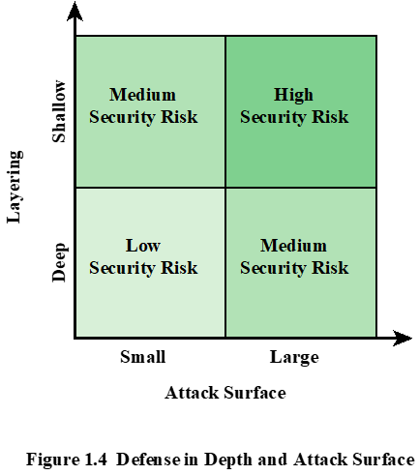
Security Risk
Defense in depth is a concept used in information security in which multiple layers of security controls (defense) are placed throughout the system.
Security risk can be determined by defense in depth layering (shallow or deep) and attack Surface (small or large).
Notes:
As illustrated in Figure 1.3, the use of layering, or defense in depth, and attack
surface reduction complement each other in mitigating security risk.

Slide 12
等保2.0

