Slide 1
組合最佳化問題 基於既定的限制or給分條件
(Combinatorial Optimization Problems)
Constructive Methods
(search tree for goals)
Iterative Methods
(search plane for optima)
可用傳統方法拓展樹形
穩紮穩打, 謀定而後動
也可用鄰近解漸近搜尋
以戰養戰, 先求有再求好
Advanced Search

Slide 2
What is Artificial Intelligence?
Recall:
A more difficult question is: What is intelligence?
This question has puzzled philosophers, biologists and psychologists for centuries.
Artificial Intelligence is easier to define, although there is no standard, accepted definition.
星艦戰將與
蝸蟲的學習
學習與創作是否是另一種形式的搜尋?
記憶
評判
搜尋解答
邏輯推理
控制
學習
創作

Slide 3
Outline
Recall:
Problem Solving
Data-Driven (forward-chaining)
Goal-Driven (back-chaining)
e.g.
Brute-Force Search (exhaustive Search)
Beam Search
Maze, Proof
Blind Search (Generate & Test)
Heuristic Search (Informed Method)
DFS
BFS
Iterative Deepening Search
Hill Climbing
Best-first S.
A* family
A* Alg.
British Museum Procedure
(identifying the optimal path)
Uniform Cost Search
(Branch and Bound, Dijkstra)
Not always complete
Evaluation function
Greedy Search

Slide 4
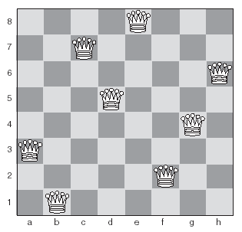
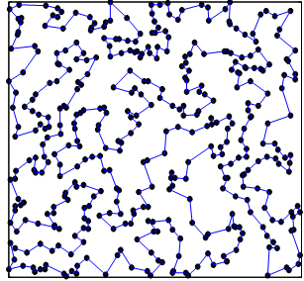
Examples
Eight-Queens
TSP (instance/rd400)

Slide 5
Contents
-- The eight queens problem
-- Traveling Salesman problem
Constraint satisfaction problems
Combinatorial optimization problems (problem)
Heuristic repair (example)
Local search and Meta-heuristics (method)
  Exchanging heuristics
  Iterated local search
  (Ant Colony Optimization)
  Taboo Search
  Simulated annealing
  Genetic algorithms
Constructive Methods
(search tree for goals)
Iterative Methods
(search plane for optima)

Slide 6
Search Methods
Constructive Methods
(search tree for goals)
由這兩個例子
來看這些 methods
Search for Goals
(8-Queens/conflict=0)
Search for Optima
(TSP/ lowest cost)
Constraint Satisfaction
forward checking (Dead Ends?)
DFS (64 x 63 x…)
8!
DFS (n x (n-1) x…)
∞
Heuristic (which branch first?)
Most-Constrained Variables
A* Algorithm
Local Search (metaheuristics)
Heuristic Repair
k-opt exchanging
search space
General Metaheuristics
  Exchanging heuristics
  Iterated local search
  (Ant Colony Optimization)
  Taboo Search
  Simulated annealing
  Genetic algorithms
search tree
search plane =
untraceable branches
Iterative Methods
(search plane for optima)
Notes:
Constraint Satisfaction Problem不關心抵達路徑的方式，較關心有無抵達路徑：eight queen problem
CSP formulation主要有以下三者：
1. a set of variables: X1, X2, ...
2. a set of domains: 每個Xi的domain Di: D1, D2, D3
3. a set of constraints C: 合法的combination
所以解決CSP就是在找出符合constraints C的assignment(給X1, X2,...)，稱為consistent assignment。
Ex：Coloring Map，亦可用圖論解(node)
Heuristic啟發式演算法
在某種程度上，它可以被認為是一種捷徑。一個啟發式的功能，也簡稱為啟發，是一個功能是居替代搜索算法根據現有的資料，以決定跟隨哪一個分支，在每個分支的一步。例如，它可能接近確切的解決方案。
Eight Queens Problem
如果在一個八乘八的西洋棋盤上擺上八個皇后，並希望她們彼此能相安無事 ( 即任兩皇后都不能處於同一橫行、縱行或者斜線上 )，會有多少種擺法? 92(12)
TSP旅行商問題（最短路徑問題，travelling salesman problem）
給定一系列城市和每對城市之間的距離，求解存取每一座城市一次並回到起始城市的最短迴路。

Slide 7
TSP using A*
 | A | B | C | D | E
A |  | 4 | 8 | 9 | 5
B | 4 |  | 3 | 5 | 1
C | 8 | 3 |  | 6 | 7
D | 9 | 5 | 6 |  | 2
E | 5 | 1 | 7 | 2
h(B^{A})=min(B-CDE)+
min(CDE-A)+
min(C-D,D-E,E-C)|₂
=1+5+(2+6)=14
A
4
5
8
9
B^{A}
C^{A}
D^{A}
E^{A}
h(C^{BA})=min(C-DE)+
min(DE-A)+
min(D-E)|₁
=6+5+(2)=13
4+14
8+10
9+10
5+13
3
5
1
C^{BA}
D^{BA}
E^{BA}
State: D^{A}="A-D", D^{BA}="A-B-D"
7+13
A

Slide 8
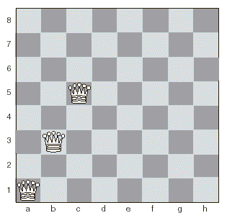
Most Constrained Variables
d → 3
e → 3
f → 1
g → 3
h → 4
Forward checking:
63(or 62…) 個選擇中只選次一排
並 -1 (or -2…) 個位置
MCV:
兼可跳排

Slide 9
Search Methods
or
Dead end 提早發現
Constructive Methods
(search tree for goals)
Beam Search
Beam Search + heuristics : #(group)
由這兩個例子
來看這些 methods
Search for Goals
(8-Queens/conflict=0)
Search for Optima
(TSP/ lowest cost)
Constraint Satisfaction
forward checking (Dead Ends?)
DFS (64 x 63 x…)
8!
DFS (n x (n-1) x…)
∞
Heuristic (which branch first?)
Most-Constrained Variables
A* Algorithm
Local Search (metaheuristics)
Heuristic Repair
k-opt exchanging
search space
General Metaheuristics
  Exchanging heuristics
  Iterated local search
  (Ant Colony Optimization)
  Taboo Search
  Simulated annealing
  Genetic algorithms
search tree
search plane =
untraceable branches
Iterative Methods
(search plane for optima)

Slide 10
Constraint Satisfaction Problems
A constraint satisfaction problem is a combinatorial optimization problem with a set of constraints.
Combinatorial optimization problems involve assigning values to a number of variables.
Can be solved using search.
With many variables it is essential to use heuristics.

Slide 11
The Eight Queens Problem
A constraint satisfaction problem:
  Place eight queens on a chess board so that no two queens are on the same row, column or diagonal.
Can be solved by search, but the search tree is large.
Heuristic repair is very efficient at solving this problem.
Notes:
約束滿足問題：
將八個皇后放在棋盤上，以使兩個皇后不在同一行，同一列或對角線上。
可以通過搜索解決，但是搜索樹很大。
啟發式修復在解決此問題方面非常有效。

Slide 12
Heuristic Repair
A heuristic method for solving constraint satisfaction problems.
Generate a possible solution, and then make small changes to bring it closer to satisfying constraints.
Notes:
一種解決約束滿足問題的啟發式方法。
生成可能的解決方案，然後進行一些小的更改以使其更接近滿足約束條件。

Slide 13
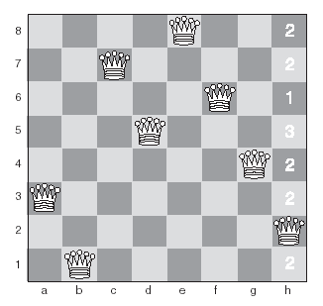
Heuristic Repair for The Eight Queens Problem
Initial state – one queen is conflicting with another.
We’ll now move that queen to the square with the fewest conflicts.
Notes:
初始狀態–一個女王與另一個女王發生衝突。 現在，我們將皇后號移到衝突最少的廣場上。

Slide 14
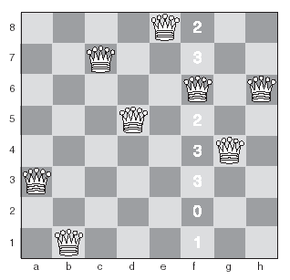
Heuristic Repair for The Eight Queens Problem
Second state – now the queen on the f column is conflicting, so we’ll move it to the square with fewest conflicts.
Notes:
第二種狀態-現在f列中的女王/王后發生衝突，因此我們將其移到衝突最少的廣場上。

Slide 15
Heuristic Repair for The Eight Queens Problem
Final state – a solution!

Slide 16
break

Slide 17
Search Methods
Recall:
Constructive Methods
(search tree for goals)
由這兩個例子
來看這些 methods
Search for Goals
(8-Queens/conflict=0)
Search for Optima
(TSP/ lowest cost)
Constraint Satisfaction
forward checking (Dead Ends?)
DFS (64 x 63 x…)
DFS (n x (n-1) x…)
Heuristic (which branch first?)
Most-Constrained Variables
A* Algorithm
Local Search (metaheuristics)
Heuristic Repair
k-opt exchanging
search space
General Metaheuristics
  Exchanging heuristics
  Iterated local search
  (Ant Colony Optimization)
  Taboo Search
  Simulated annealing
  Genetic algorithms
search tree
search plane =
untraceable branches
Iterative Methods
(search plane for optima)

Slide 18
Local Search
Like heuristic repair, local search methods start from a random state, and make small changes until a goal state is achieved.
Local search methods are known as metaheuristics.
Most local search methods are susceptible to local maxima, like hill-climbing.
Notes:
像啟發式修復一樣，局部搜索方法從隨機狀態開始，並進行很小的更改，直到達到目標狀態為止。
本地搜索方法稱為元啟發法。
大多數本地搜索方法都容易出現局部最大值，例如爬山。

Slide 19
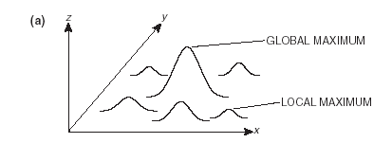
Foothills
3 issues
  A foothill is a local maximum.
8-queens
TSP
E(w₁,w₂)
主翼長w₁、尾翼寛w₂
投射{X}₁₀₀與落點{Y}₁₀₀要求

Slide 20
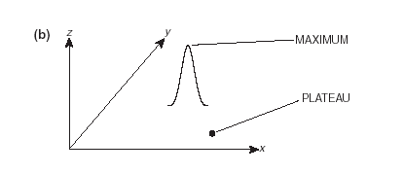
Plateaus
3 issues
沒有方向可走
要看遠一點
  Cause difficulties for hill-climbing methods.
  Flat areas that make it hard to find where to go next.
Notes:
給爬山方法造成困難。
平坦的區域，很難找到下一個去處。

Slide 21
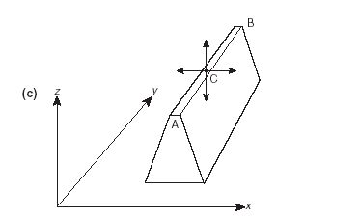
Ridges
3 issues
有方向可走
但是窄到看不到
要看廣一點
  Cause difficulties for hill-climbing methods
  B is higher than A.
  At C, the hill-climber can’t find a higher point North, South, East or West, so it stops.
Notes:
給爬山方法造成困難
B高於A。
在C處，爬山者無法找到北，南，東或西的較高點，因此停了下來

Slide 22
Exchanging Heuristics
A simple local search method.
Heuristic repair is an example of an exchanging heuristic.
Involves swapping two or more variables at each step until a solution is found.
A k-exchange involves swapping the values of k variables.
Can be used to solve the traveling salesman problem.
Notes:
一種簡單的本地搜索方法。
啟發式修復是交換啟發式的示例。
涉及在每個步驟交換兩個或多個變量，直到找到解決方案。
k交換涉及交換k個變量的值。 可以用來解決旅行推銷員的問題。

Slide 23
Iterated Local Search
A local search is applied repeatedly from different starting states.
Attempts to avoid finding local maxima.
Useful in cases where the search space is extremely large, and exhaustive search will not be possible.
Notes:
從不同的起始狀態重複應用本地搜索。
嘗試避免找到局部最大值。
在搜索空間非常大且無法進行詳盡搜索的情況下很有用。

Slide 24
Taboo Search (Tabu Search)
  避開禁忌區域
  TSP – 某些 2-opt 會收歛過去的臨近狀態
  (w₁, w₂) – 某些臨近值
Ant Colony Optimization
  Artificial Life
  TSP – 越快走一遍的軌跡越密 (要符合TSP限制)

Slide 25
Simulated Annealing
A method based on the way in which metal is heated and then cooled very slowly in order to make it extremely strong.
Based on metropolis Monte Carlo Simulation.
Aims at obtaining a minimum value for some function of a large number of variables.
  This value is known as the energy of the system.
TSP: 先大亂掉，再小亂，最後收斂
Notes:
一種基於將金屬加熱然後非常緩慢地冷卻以使其非常堅固的方法。
基於大都會蒙特卡羅模擬。
旨在獲得大量變量的某些函數的最小值。
-該值稱為系統的能量。

Slide 26
Genetic Algorithms
A method based on biological evolution.
Create chromosomes which represent possible solutions to a problem.
The best chromosomes in each generation are bred with each other to produce a new generation.
Much more detail on this later.
詳附錄
Notes:
一種基於生物進化的方法。
創建代表問題可能解決方案的染色體。
每一代中最好的染色體相互雜交產生新的一代。
稍後將對此進行詳細介紹。

Slide 27
break

