Slide 1
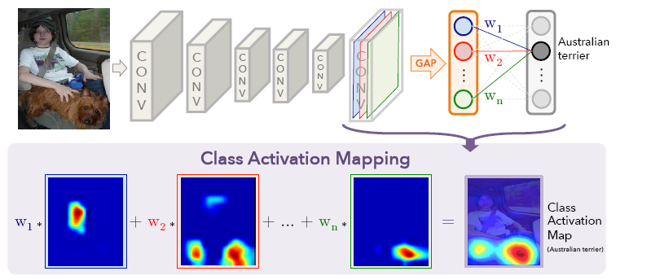
c.f. Class Activation Map
Fuzzy Reasoning

Slide 2
Expert System (Forward Chaining Case)
Recall:
Forward chaining is a reasoning model that works from a set of facts and rules towards a set of conclusions, diagnoses or recommendations.
When a fact matches the antecedent of a rule, the rule fires, and the conclusion of the rule is added to the database of facts.

Slide 3
Example (Forward Chaining)
Recall:
Man(W) → Dislikes(Snoopy, W)
Close_to(Z,DormG) → Meets(Snoopy, Z)
Man(John)
{Z/John}
Close_to(John, DormG)
{W/John}
Dislikes(Snoopy, John)
Meets(Snoopy, John)
Dog(X) ^ Meets(X,Y)^Dislikes(X,Y) → Barks_at(X,Y)
Dog(Snoopy)
Meets(Snoopy,Y)^Dislikes(Snoopy,Y) → Barks_at(Snoopy,Y)
{Y/John}
Meets(Snoopy,John) → Barks_at(Snoopy,John)
Flexibility & Uncertainty
Conflict solving
Barks_at(Snoopy,John)

Slide 4
Conflict Resolution
避免牴觸
  增強條件 (上帝不擲骰子)
    沒有取代不了的專業(只有成本與道德的考量)
    文創價值 (跳脫規則/找出新規則/deep learning)
解決牴觸
  Meta Rules (專家上場/丟一次好骰子)
  Fuzzy Inference (妥協的科學)
(1) 天氣好,睡得好,工作不忙→ 去打球； vs.“吃飽飯→不打球”
(2) 男生,穿拖鞋,靠近女生宿舍→小花吠; vs.“吃飯中→不吠人”
避免牴觸: 將條件補滿, 補滿仍有重疊時, 再增加條件
解決牴觸: 設定rules 之間的 priority

Slide 5
Fuzzy Reasoning
  Resolve - Uncertainty (membership function)
  Resolve - Conflict among rules (fire strength)

Slide 6
Contents
讀書幾個小時、手上工作幾件、
氣溫幾度、距離幾公尺、etc…
e.g. : busy, warm, Close_to…
Fuzzy Sets
  Membership Functions
Fuzzy Set Operation
  e.g. A ∩ B (single-domain)
Linguistic Variables
  Linguistic Hedges (副詞修飾)
Fuzzy Logic Operation
  e.g. P ^ Q (inter-domain variables)
Fuzzy Inference System
  Fuzzification, Defuzzification
希臘文明始於邏輯與集合：
以事件是否屬於某個集合
來表示命題之真假
e.g. 1: 溫暖 ∩ 炎熱 = 亞熱帶
e.g. 2: 愛玩 ∩ 用功
IF (天氣溫暖) AND (工作不忙)
THEN (去打球)
e.g. 1: 溫暖 ^ 悠閒
e.g. 2: 用功 ^ 清寒
(1) Fire Strength of Rules
(2) Conflict / Redundant

Slide 7
Fuzzy Sets
A crisp set is a set for which each value either is or is not contained in the set.
For a fuzzy set, every value has a membership value, and so is a member to some extent.
The membership value defines the extent to which a variable is a member of a fuzzy set.
The membership value is from 0 (not at all a member of the set) to 1.
Notes:
易碎集是一種集合，其每個值都包含在集合中或不包含在集合中。
對於模糊集，每個值都有一個隸屬值，因此在某種程度上也是一個隸屬值。
隸屬度值定義變量在多大程度上是模糊集的成員。
成員資格值從0（完全不是集合的成員）到1。

Slide 8
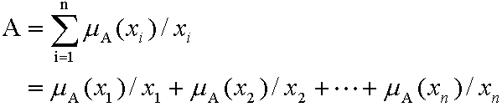


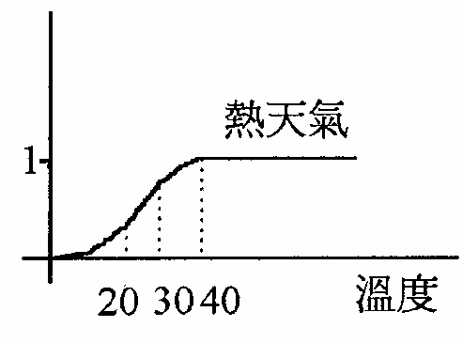
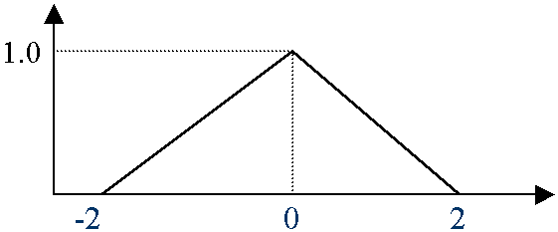
Discrete vs. Continuous Sets
Discrete Fuzzy Set
  “工作忙(正整數．件數)”,
  “中醫所謂燥熱食物(列舉)”
  “ 男生?” {0.9/John, 0.99/Bob, 0.01/Angle…}
Continuous Fuzzy Set
  “天氣熱”,
  “穩定性好”
  “車速快”,
事件的量測值是 x 則屬於 A 集合的程度為μ_{A}(x)
Note: 只是借用積分符號, 沒有dx記號

Slide 9
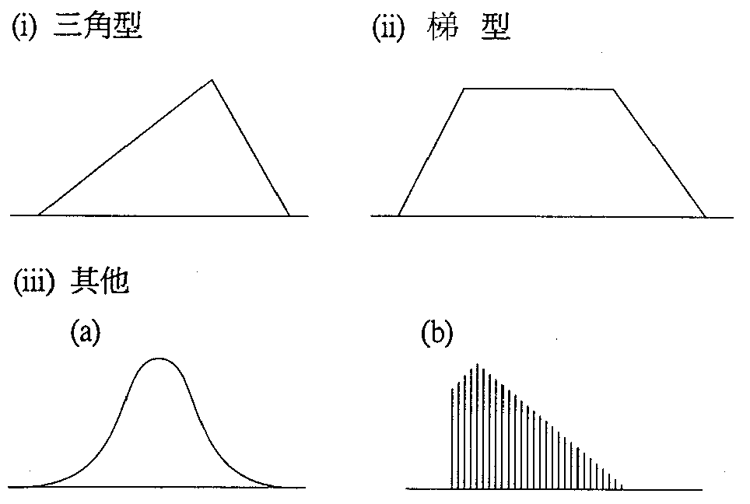
隸屬函數(Member Function)的常見型式：
Figure by 中研院資訊所許鈞南老師

Slide 10
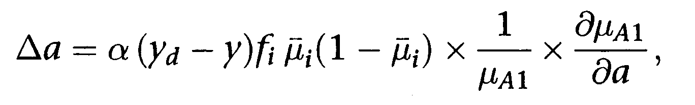
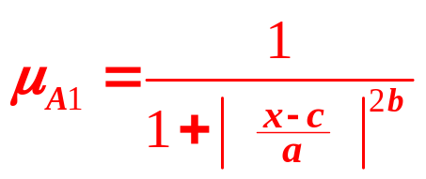
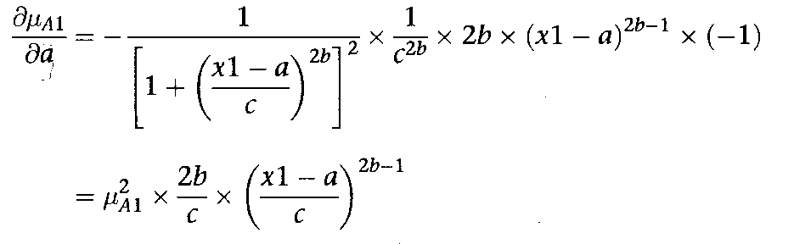
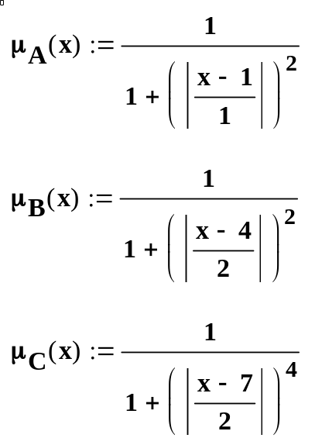
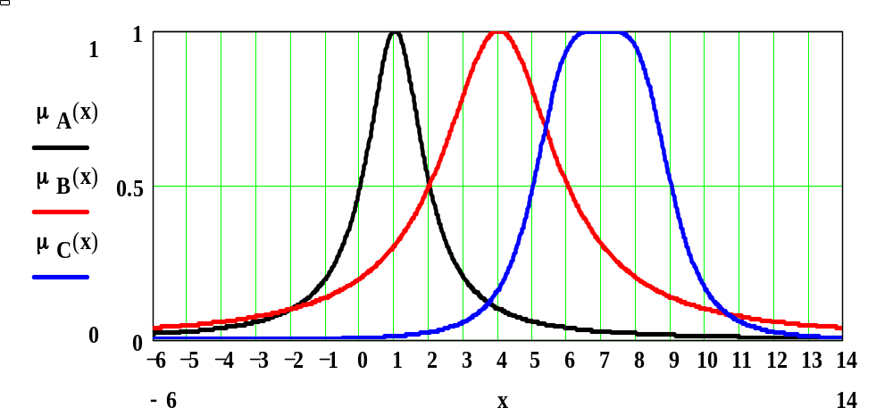
e.g. Bell-Shaped Function

Slide 11
Crisp Set Operators
Not A – the complement of A, which contains the elements which are not contained in A.
A ∩ B – the intersection of A and B, which contains those elements which are contained in both A and B.
A ∪ B – the union of A and B which contains all the elements of A and all the elements of B.
Fuzzy sets use the same operators, but the operators have different meanings.

Slide 12
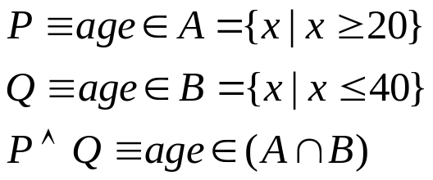
Fuzzy Set Operators
Fuzzy set operators can be defined by their membership functions
  μ_{¬A}(x) = 1 - μ_{A}(x)
  μ_{A ∩ B} (x) = MIN (μ_{A} (x), μ_{B} (x))
  μ_{A ∪ B} (x) = MAX (μ_{A} (x), μ_{B} (x))
We can also define containment (subset operator):
  B ⊂ A iff ∀x (μ_{B} (x) ≤ μ_{A} (x))
邀保對象:
成年人
年輕人
輕熟

Slide 13
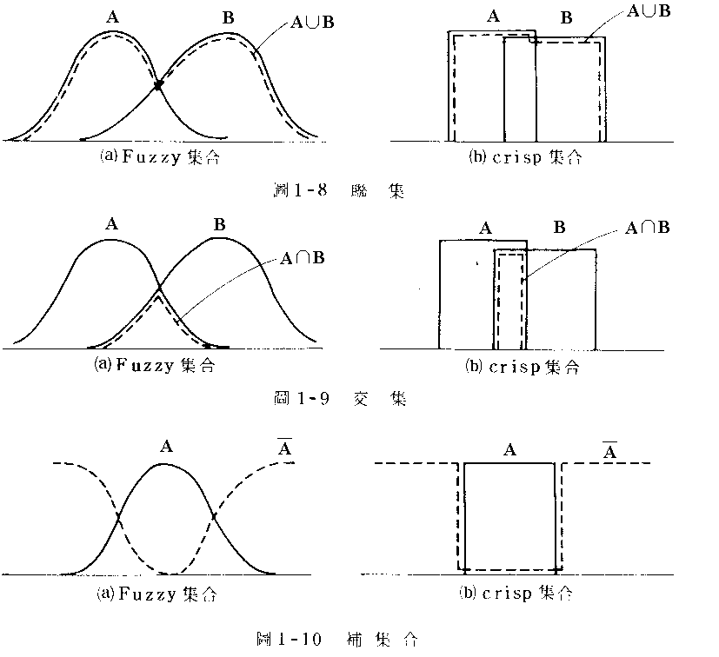
會玩的同學,每天唸書 2~4小時
會唸書的同學,每天唸書3~6小時
Crisp set: 不能多也不能少
Example: 每天用功時間
  A: 會玩，B:會唸書
這三者最基本常用的運算公式為“標準運算”：
  交集 (Intersection)
  (A∩B)(x) = min(A(x), B(x))
  聯集 (Union)
  (A∪B)(x) = max(A(x), B(x))
  補集 (Complement)
  Ā(x) = 1 - A(x)
Figure by 中研院資訊所許鈞南老師

Slide 14
Contents
Fuzzy Sets
  Membership Functions
Fuzzy Set Operation
  e.g. A ∩ B (upon the same domain)
Linguistic Variables
  Linguistic Hedges (副詞修飾)
Fuzzy Logic Operation
  e.g. P ^ Q (distinct-domain variables)
Fuzzy Inference System
  Fuzzification, Defuzzification
IF (天氣還算溫暖) AND (工作不忙)
THEN (去打球)

Slide 15
Linguistic Variables
Variables used in fuzzy systems to express qualities such as height,
  which can take values such as
  “tall”, “short” or “very tall”.
These values define subsets of the universe of discourse. (對談的元素)
Notes:
模糊系統中用於表示質量例如身高，
可以採用以下值
“高”，“短”或“很高”。
這些值定義了話語範圍的子集。 （對談的元素）

Slide 16
Linguistic Hedges
A hedge is a qualifier
  such as “very”, “quite”, “somewhat” or “extremely”
  applied to create a new fuzzy set
  Mathematic functions are usually used
Examples:
  μ_{not_A} (x) = 1-(μ_{A} (x))
  μ_{very_A} (x) = (μ_{A} (x))²
  μ_{more_or_less_A} (x) = (μ_{A} (x))^{0.5}
Notes:
套期保值是一個限定詞
例如“非常”，“相當”，“有點”或“極度”
應用於創建新的模糊集
通常使用數學函數

Slide 17


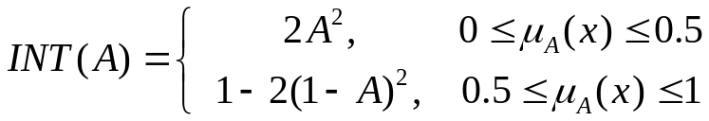
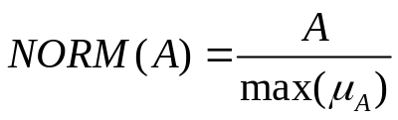
Concentration:
Dilation:
Contrast
intensification:
Normalization:
very A = CON(A)
more or less A = DIL(A)
slightly A = NORM (A and not (very A))
sort of A = NORM (not CON²(A) and DIL(A))
pretty A = NORM (INT(A) and not INT(CON(A))
rather A = NORM(INT(A))

Slide 18
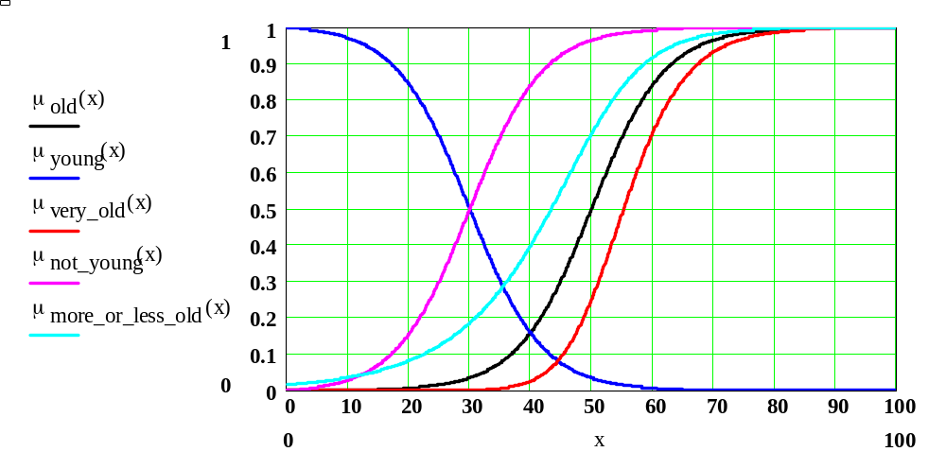
Example (Old)
X=55

Slide 19
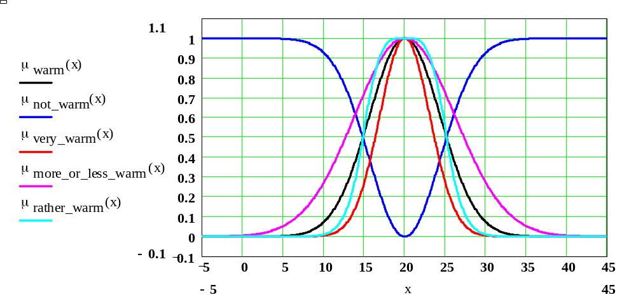
Example (Warm)

Slide 20
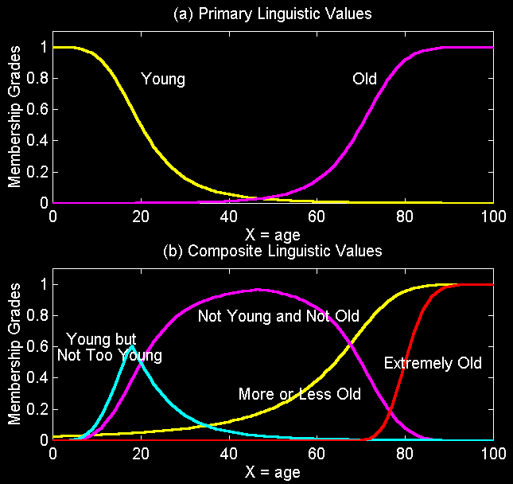
Membership Functions
Figure by 清大資工系張智星老師

Slide 21
Contents
Fuzzy Sets
  Membership Functions
Fuzzy Set Operation
  e.g. A ∩ B (the same domain)
Linguistic Variables
  Linguistic Hedges
Fuzzy Logic Operation
  e.g. P ^ Q (inter-domain variables)
Fuzzy Inference System
  Fuzzification, Defuzzification
IF (天氣溫暖) AND (工作不忙)
THEN (去打球)

Slide 22
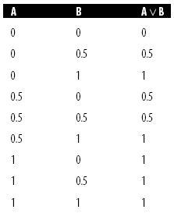
Fuzzy Logic
Fuzzy Rule
  IF x is A AND y is B, THEN z is C
Fire Strength
  A V B ≡ MAX (μ_{A}(x), μ_{B}(y))
  A Λ B ≡ MIN (μ_{A}(x), μ_{B}(y))
  ¬A ≡ 1 – μ_{A}(x)

Slide 23
Fuzzy Inference System
Multiple Rules
  May be Conflict or Redundant
Example: Rulebase with 2 rules
  R1: IF x is A₁ AND y is B₁ THEN z is C₁
  R1: IF x is A₂ AND y is B₂ THEN z is C₂
and
B₁
B₂
B_{j}
A₁
C₁
A₂
C₂
C_{k}
A_{i}

Slide 24
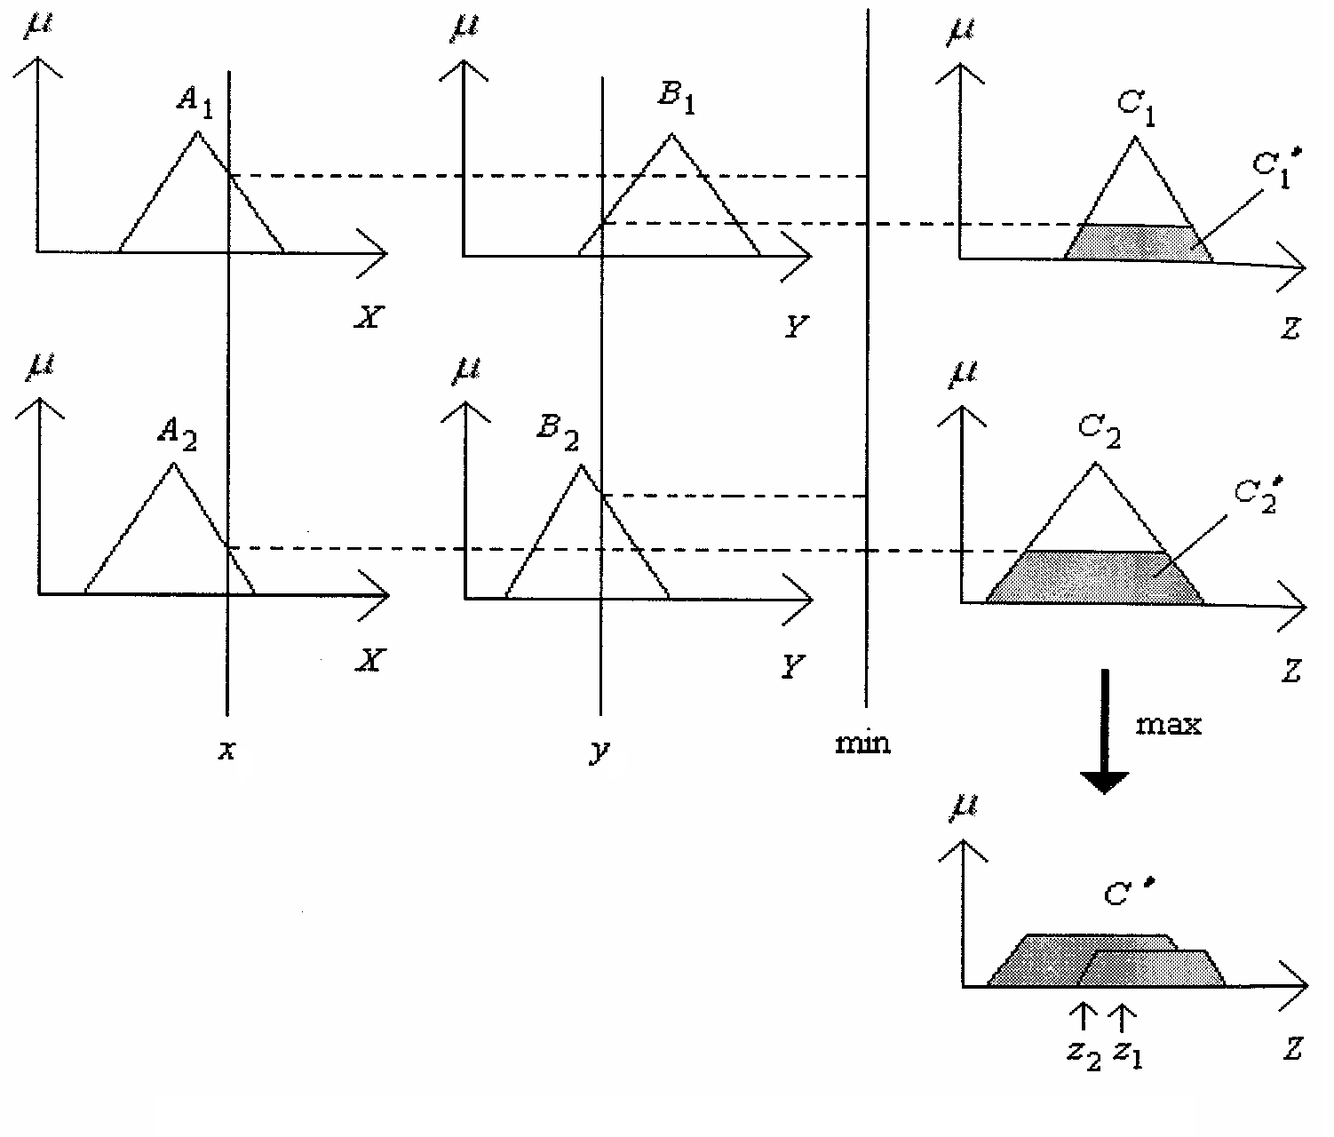
Defuzzification
 | B₁ | B₂
A₁ | C₁
A₂ |  | C₂
音量高(A₁) &
溫度暖(B₁)
工作模式II
音量中(A₂) &
溫度涼(B₂)
睡眠模式I
Output z = “centriod of aera”
壓縮機運轉
重心法只是其中一種解模糊的方法

Slide 25
Example of Driving a Car
#rules: 2 *2 = 4
and | 車速慢 | 車速快
車距近 | 保持 | 減速
車距遠 | 加速 | 保持

Slide 26
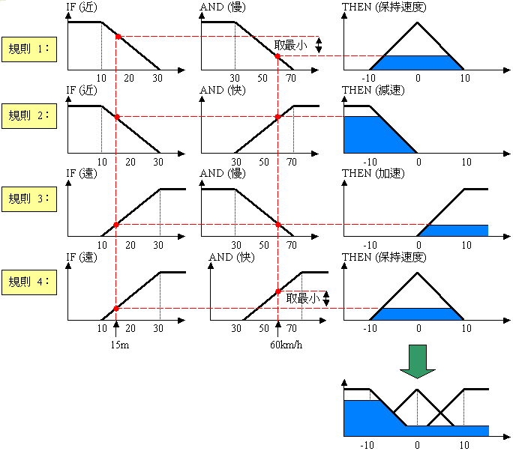
加速度
加速度為-6
Figure by 中研院資訊所許鈞南老師

Slide 27
More Complex Rules
Antecedents: (interval, velocity)
X1 = Very Close(VC), C, M, F, VF (Far)
X2 = Very Low (VL), L, A, H, VH (High)
Consequence: (acceleration)
Y = NL, NM, NS, ZE, PS, PM, PL

Slide 28
Example (Rulebase)
X2 X1 | VL | L | A | H | VH
VC | ZE | NS | NS | NM | NL
C | PS | ZE | NS | NS | NM
M | PS | PS | ZE | NS | NS
F | PM | PS | PS | ZE | NS
VF | PL | PM | PS | PS | ZE

Slide 29
Fuzzy Logic Membership
µ
NL
NR
NM
NS
ZE
PS
PM
PR
PL
-1.0
-0.8
-0.6
-0.4
-0.2
0
0.2
0.4
0.6
0.8
1.0
A, B
µ
NL
NR
NM
NS
ZE
PS
PM
PR
PL
-0.1
-0.08
-0.06
-0.04
-0.02
0
0.02
0.04
0.06
0.08
0.1
C

Slide 30
Fuzzy Expert Systems
Creating fuzzy rules
  choosing suitable linguistic variables
  expert’s knowledge, using the linguistic variables
Applying fuzzy inference
  Resolve - Uncertainty (membership function)
  Resolve - Conflict among rules (file strength)
  In many ways this is more appropriate than standard expert systems since expert knowledge is not usually black and white but has elements of grey.
Notes:
創建模糊規則
選擇合適的語言變量
專家的知識，使用語言變量
應用模糊推理
解決-不確定性（隸屬函數）
解決-規則之間的衝突（文件強度）
在許多方面，這比標準專家系統更合適，因為專家知識通常不是黑白的，而是具有灰色元素的。

Slide 31
break

Slide 32
Contents
Conclusion
Fuzzy Sets
  Membership Functions
Fuzzy Set Operation
  e.g. A ∩ B (within one domain)
Linguistic Variables
  Linguistic Hedges
Fuzzy Logic Operation
  e.g. P ^ Q (inter-domain variables)
Fuzzy Inference System
  Fuzzification, Defuzzification
希臘文明始於邏輯與集合：
以事件是否屬於某個集合
來表示命題之真假
IF (天氣溫暖) AND (工作不忙)
THEN (去打球)
(1) Fire Strength of Rules
(2) Conflict / Redundant

Slide 33
Fuzzy Inference
  R1: IF x is A1 AND y is B1 THEN z is C1
  R1: IF x is A2 AND y is B2 THEN z is C2
Output z = “centriod of aera”

Slide 34
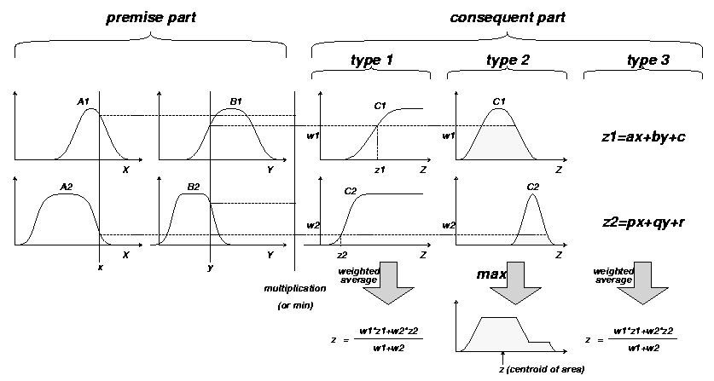
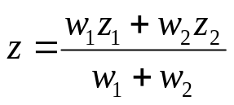
Commonly Used Fuzzy IF-THEN Rules and Fuzzy Reasoning Mechanisms
Type1: Tsukamoto
Type2: Mamdani
Type3: Sugeno
“Multiplication”
-or- “Min”

Slide 35
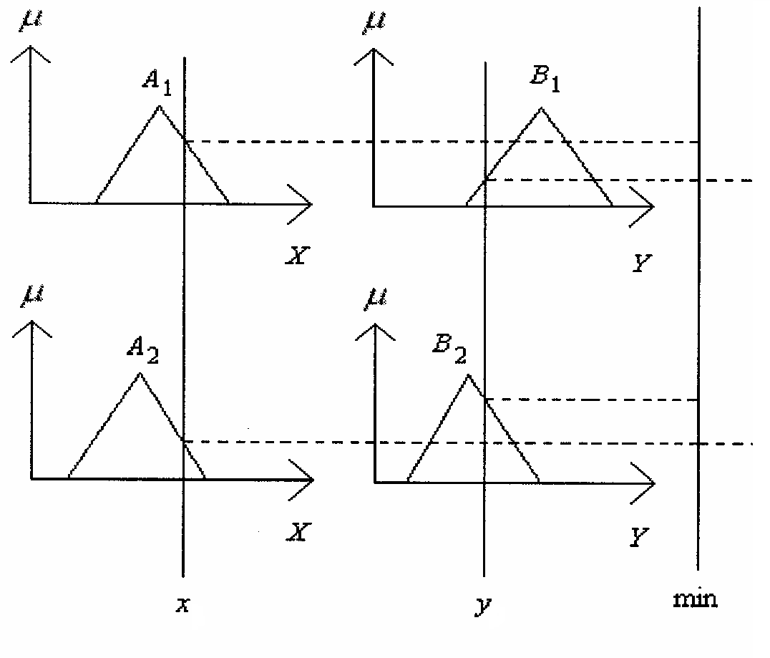


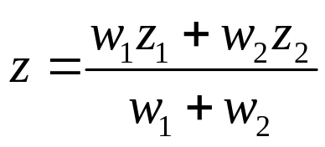
Takagi-Sugeno (Type 3) Method
  R1: IF x is A1 AND y is B1 THEN z is C1
  R1: IF x is A2 AND y is B2 THEN z is C2
符合條件一之
線性決策公式
w₁
w₂

