Slide 1
Lab9 TCP
(Transmission Control Protocol)
Villanova University
CSC 4900, 8560 - Computer Networks II
Team #7: Matthew Anders, Jeff Cavacini, David Pipkin

Slide 2
TCP: Overview
Connection Oriented
Guaranteed reliable, in-order delivery of byte streams
Flow-control and Congestion-control mechanism

Slide 3
TCP: Congestion Control Mechanism
Flow Control: state variable called congestion window
  Used by the receiver to limit how much data the sender can have in transit at a given time
Additive increase/multiplicative decrease
  Congestion decreases: Congestion window increases (congestion window + size of single packet)
  Congestion increases: Congestion window decreases (half of previous value >= size of a single packet)
Timeouts interpreted as sign of congestion

Slide 4
TCP: Additional Functions
Slow start
  Used to increase congestion window “rapidly” from a cold start in TCP connections
  Congestion window increased exponentially, rather than linearly
Fast retransmit and Fast recovery
  Acts as a heuristic that can trigger the retransmission of a dropped packet sooner than the regular timeout mechanism

Slide 5
Lab 9 Objective
Set up a network that utilizes TCP as its end-to-end transmission protocol and analyze the size of the congestion window with different mechanisms.

Slide 6
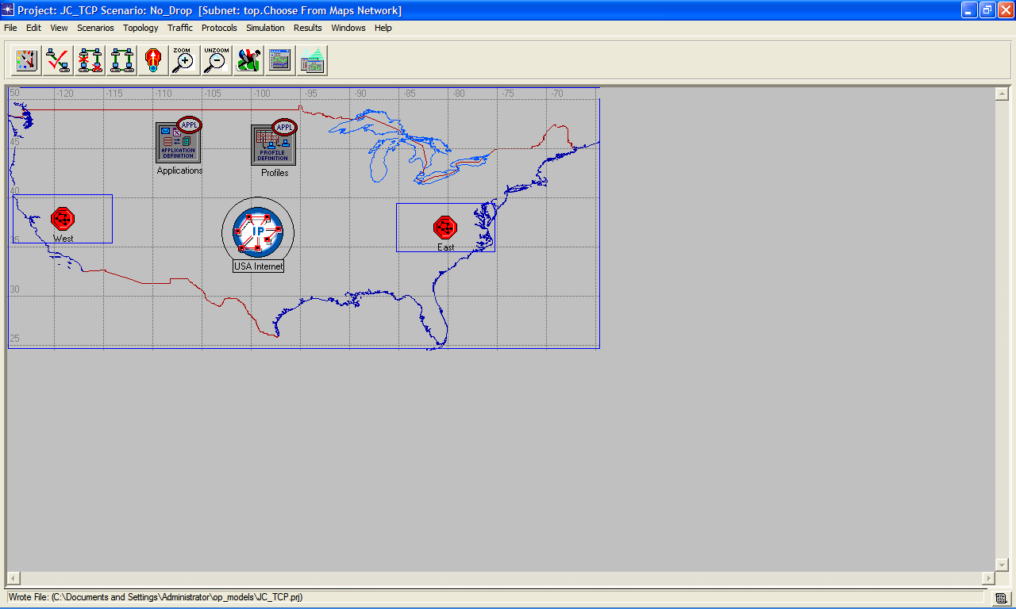
Create Project and Create and Configure the Network

Slide 7
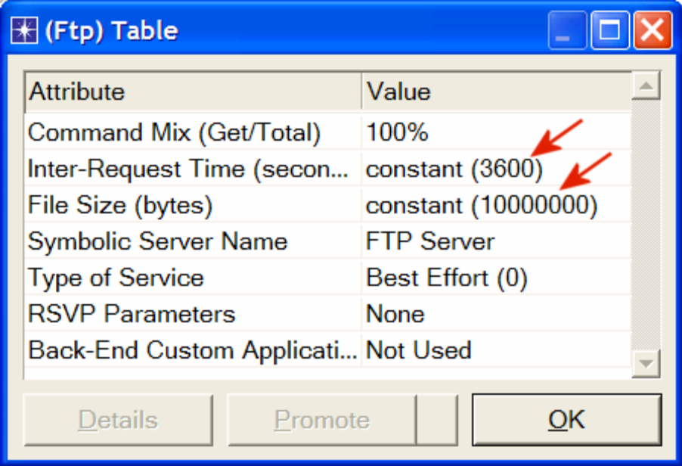
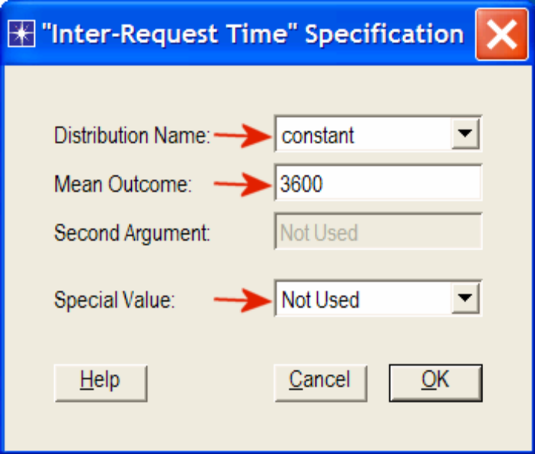
Configure the Applications

Slide 8
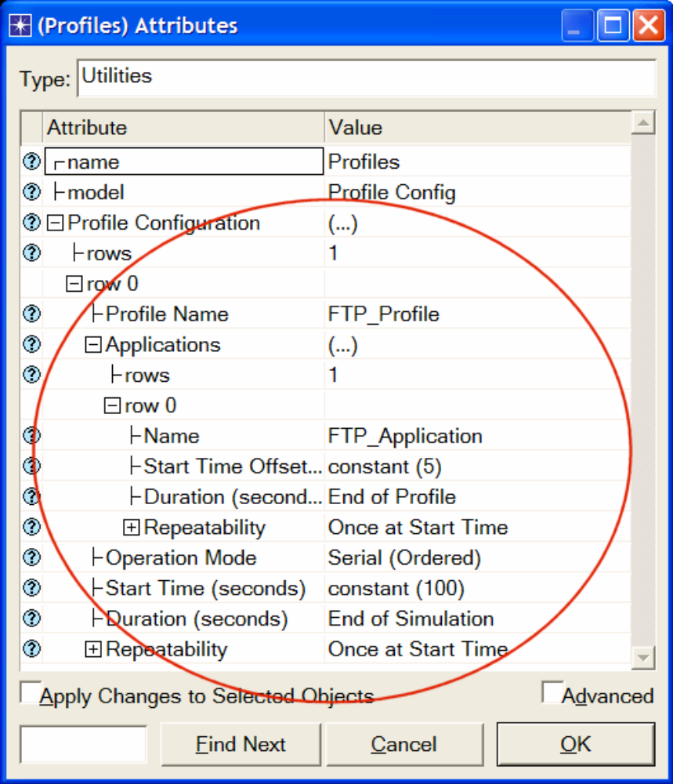
Configure the Profiles

Slide 9
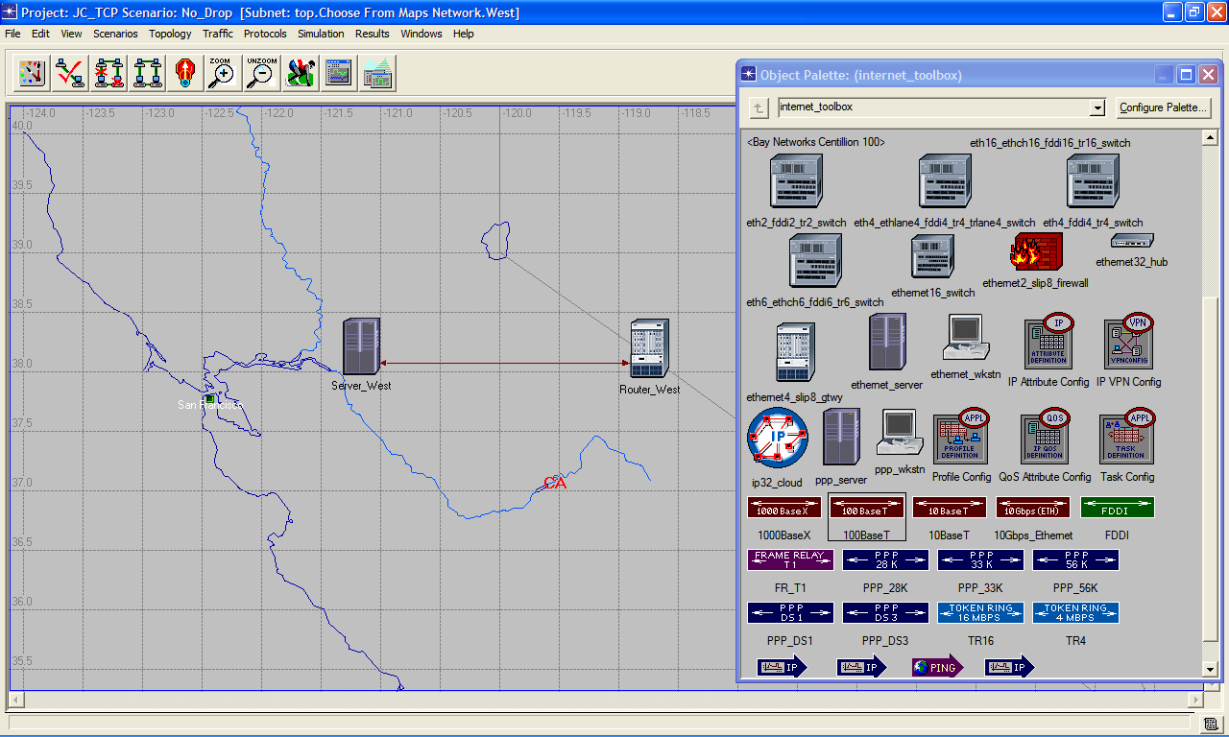
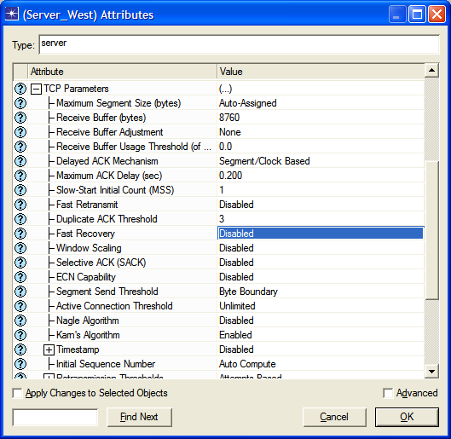
Configure the West Subnet

Slide 10
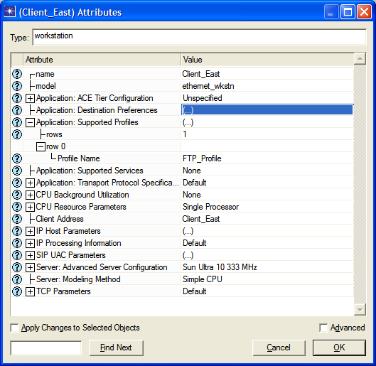
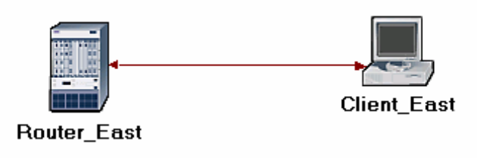
Configure the East Subnet

Slide 11
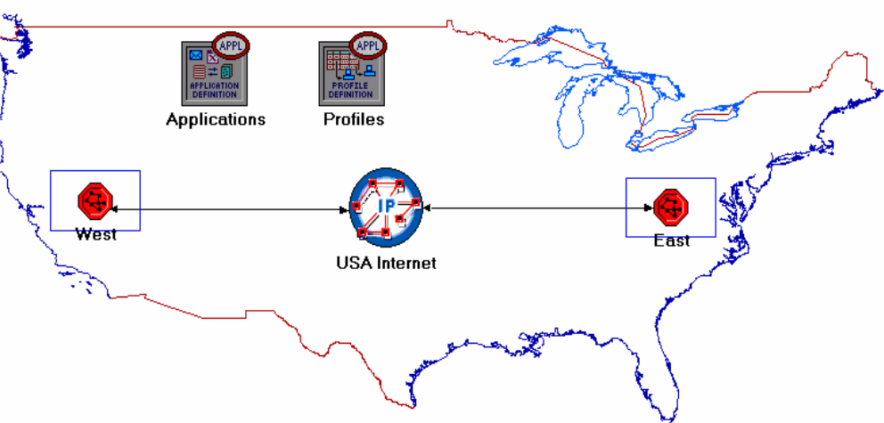
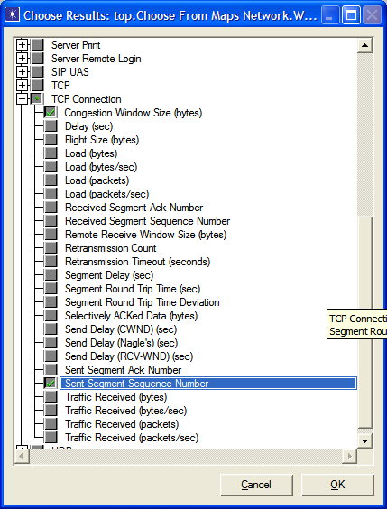
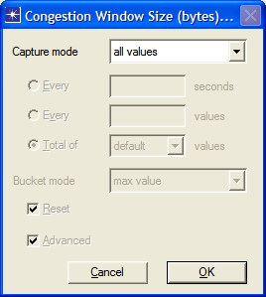
Connect Subnets to IP Cloud

Slide 12
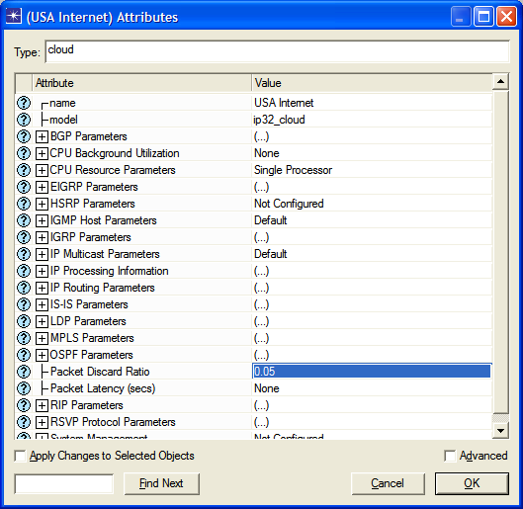
Configure the Simulation and Duplicate the Scenario

Slide 13
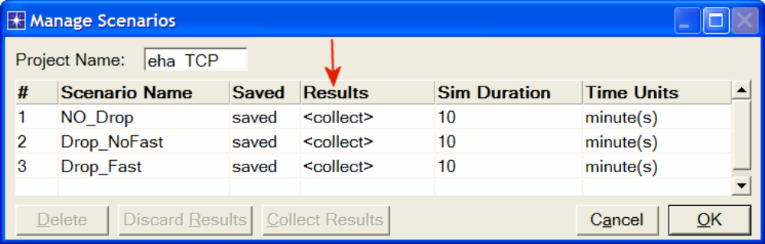
Run Simulation

Slide 14
Results and Live Demo

Slide 15
Questions
Question 1:
Why does the Segment Sequence Number remain unchanged (indicated by a horizontal line in the graphs) with every drop in the congestion window?
Refer to Graph

Slide 16
Questions
Question 1 Answer:
An Ack is not received for the sequence number because the packet is being dropped in transit and continues to be retransmitted by the server. The congestion window continues to increase until congestion is detected and then the congestion window decreases until there is no longer a problem. This implies that as soon as the congestion is detected it is more probable that data will be lost in transit resulting in the need for re-transmission.

Slide 17
Question
Question 2:
Analyze the graph that compares the Segment Sequence numbers of the three scenarios. Why does the Drop_NoFast scenario have the slowest growth in sequence numbers?
Refer to Graph

Slide 18
Questions
Question 2 Answer:
It takes the drop_nofast scenario the longest to recover from a lost packet. Sequence numbers are not increased until an acknowledgement is received. With fast retransmit it should take 3 times the average round trip packet to recognize a lost packet whereas the NoFast scenario requires the server to wait until the timeout window has occurred.

Slide 19
Questions
Question 3:
In the Drop_NoFast scenario, obtain the overlaid graph that compares Sent Segment Sequence Number with Received Segment ACK Number for Server_West. Explain the graph.
Hint: - Make sure to assign all values to the Capture mode of the Received Segment ACK Number statistic.
Refer to Graph

Slide 20
Questions
Question 3 Answer:
The Acks are trailing the sent segment numbers in time since a round trip must take place before the ack is received. When the timeout period for the server's packet expires without the Ack from the client the server must retransmit the next packet associated with the last Ack received from the client. The process continues until all of the data sent.

Slide 21
Questions
Question 4:
Create another scenario as a duplicate of the Drop_Fast scenario. Name the new scenario Q4_Drop_Fast_Buffer. In the new scenario, edit the attributes of the Client_East node and assign 65535 to its Receiver Buffer (bytes) attribute (one of the TCP Parameters). Generate a graph that shows how the Congestion Window Size (bytes) of Server_West gets affected by the increase in the receiver buffer (compare the congestion window size graph from the Drop_Fast scenario with the corresponding graph from the Q4_Drop_Fast_Buffer scenario.)
Refer to Graph

Slide 22
Questions
Question 4 Answer:
With the bigger buffer the congestion window does not need to be adjusted as often because more packets can be stored until drops must occur. Therefore, congestion is less frequent due to the decrease in the number of timeouts. Overall less packets will be dropped, resulting in a faster transfer of data.

Slide 23
Demonstration
Multiple Clients

Slide 24
Questions?

