Slide 1
Introducing Knowledge Management
  Chapter #1
  Working Smarter, Not Harder

Slide 2
Kernel Issues of KM
(1) 創造力
(2) 觀察力
(1) Defense in the Courtroom
(2) MIT/ Stanford Business Projects
知識創造 (Creation)
  Invention/ Discovery
知識萃取 (Extraction)
  Experience/ Observation
知識傳遞 (Transfer)
  Paper work/ Training
知識分享 (Sharing)
  Offline/ Online
(1) Cover Story: NASA Engineers and the Age of Apollo
(2) 漢翔工業/ IDF
(3) 二戰戰俘遣返、美國夢
(1) Best Buy: learning from mistakes
(2) Daimler-Benz & Chrysler Corp.

Slide 3
Objectives
What is Knowledge Management (KM)?
What is Knowledge Management System (KMS)?
Classification of Knowledge Management Systems
Cover Story
What are the driving forces?
Notes:
First, I will overview the objectives for Part 1 of today’s lecture.
First, definition.
Second, need.
Third, function.
Fourth, put in practice.
Fifth, different manifestations.
Sixth, factors important to effective KMS.
First, what is knowledge management? Some of you might have previewed the lecture notes or the prescribed textbook, or just off the top of your head, what do you think Knowledge management is and what it involves?
[Ask one to two students]
Here, we want to understand what KM is and what are the driving forces behind KM projects/initiatives in today’s organization (big or small). In other words, the needs that KM is trying to address.
We hear about data management, or information management, and now Knowledge management? In terms of levels, knowledge is at the highest that is essential for decision making. It is more than simply data or information.
Second, we want to discuss the main issues that organizations will face when they consider the adoption of KM.
Third, we want to understand what constitute a KMS and its role and the functions it will provide to an organization.
Fourth, we will discuss the relevance of KM in today’s dynamic business environments that are fueled by the advancement of technologies.
Finally, we will consider both benefits and concerns when developing KM projects from an IT perspective.
KMS is not simply looking at the technical issues like we do in information processing systems. It involves people, including the experts, the knowledge developers, the users and of course importantly the management. Has anyone heard about a term CKO (Chief Knowledge Officer)? He is the one who is in a managerial position overseeing the management of organizational knowledge for the benefit and growth of the organization.

Slide 4
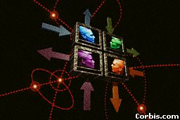
What is Knowledge Management?
Knowledge management (KM) may be defined simply as doing what is needed to get the most out of knowledge resources.
KM focuses on organizing and making available important knowledge, wherever and whenever it is needed.
KM is also related to the concept of intellectual capital.
Notes:
So, What is knowledge management?
Can someone give it a try, to say what is KM in your opinion?
[One to two students]
After second statement, turn to [1] clip [Read] Discuss.
After third statement, turn to [2] & [3] clip [Read] Discuss.
(Microsoft example; intellectual capital includes both human and structural capital.

Slide 5

What is Knowledge Management “Systems” ?
Social/Structural mechanisms (e.g., mentoring and retreats, etc.) for promoting knowledge sharing.
Leading-edge information technologies (e.g., Web-based conferencing) to support KM mechanisms.
Knowledge management systems (KMS): the synergy between social/structural mechanisms and latest technologies.

Slide 6

Classification of Knowledge Management Systems
  Knowledge Discovery Systems
  Knowledge Capture Systems
  Knowledge Sharing Systems
  Knowledge Application Systems
Notes:
Artificial Intelligence and Machine Learning technologies play an important part (or role) in the processes of knowledge discovery, knowledge capture, knowledge sharing and knowledge application, enabling the development of KM systems.
Although we will not dwell into each of these systems in depth, the concepts and techniques discussed in this unit constitute some of the elements in building these KMS.

Slide 7
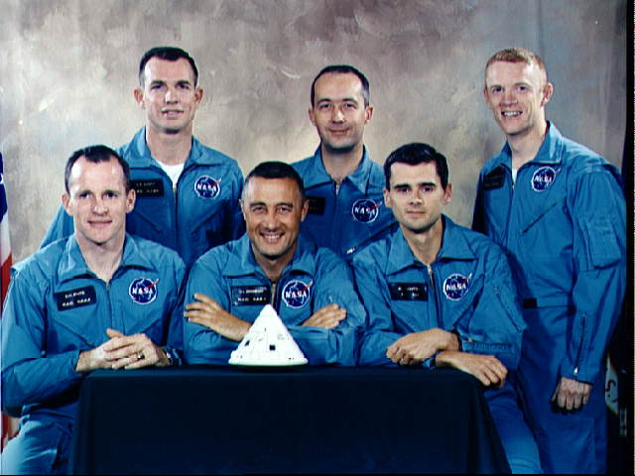
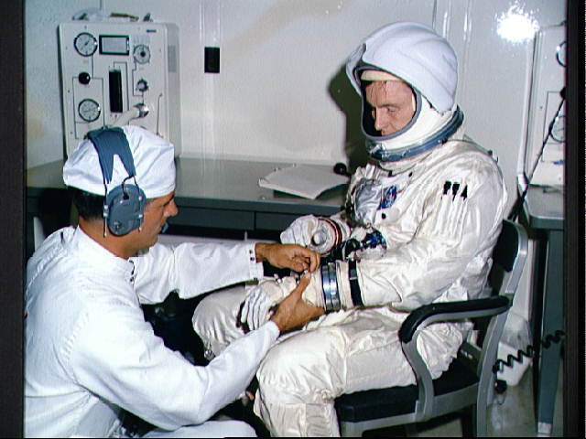
Knowledge Management – Motivation (Cover Story)
“The 20th anniversary of the landing of an American on the surface of the Moon occasioned many bittersweet reflections. Sweet was the celebration of the historic event itself... Bitter, for those same enthusiasts, was the knowledge that during the twenty intervening years much of the national consensus that launched this country on its first lunar adventure had evaporated...” [Fries,S. 1992].
Copyright © NASA, Apollo 11 mission
Notes:
First, just want to use a real world example to demonstrate importance of KM.
Here is an excerpt, taking out from an article written in 1992 by Fries, who is a historian with NASA (National Aeronautics and Space Agency) in USA, entitled NASA Engineers and the Age of Apollo.
What do you think is the sentiment of Fries just from reading this brief excerpt of the article? Do you think there would be people who shared his views?
[One to two students]
Here, Fries expressed a deep regret on the fact that if KM had been introduced in the management of the Space’s project at NASA, the wealth of knowledge that were accumulated in those who were involved in the expedition (or project) would not have been lost.
This has a bit of irony here. We might have thought that NASA, being the headquarter of US’s space project and the origin of many breakthroughs in science and technologies would have the capability to retain the vast amount of knowledge that was generated behind their successful space mission. But, as Fries’ study found out, the reality is most of these knowledge that should have been captured and retained were somehow lost when those who were involved retired, moved on to other opportunities, etc.
Having said that, one might have thought that some of those knowledge must have been documented one way or another in notebooks, records that have been used by those who were involved. Even if that would be true, trying to uncover, dig out and pull together these disparate sources of information now will incur magnitudes of efforts that could have been done when a suitable mechanism for systematic KM were in place from the start.
Seeing from the NASA example and its ramifications, it would not be reasonable to consider “knowledge” as not
just something abstract, intangible, but the presence/absence of relevant knowledge can facilitate …
[Ask the students from the attendance sheet] Referring to the NASA example, what areas might you think the knowledge would be helpful in?

Slide 8
Forces Driving Knowledge Management
Increasing Domain Complexity: Intricacy of internal and external processes, the rapid advancement of technology.
Accelerating Market Volatility: The pace of change, or volatility, within each market domain has increased rapidly in the past decade.
Intensified Speed of Responsiveness: The time required to take action based upon subtle changes within and across domains is decreasing.
Diminishing Individual Experience: High employee turnover rates have resulted in individuals with decision-making authority having less tenure within their organizations than ever before.
Notes:
If you were in a decision-making process as to whether KM should be introduced into your organization,
what would the relative weights you might place on these driving forces? Why?
[One to two students]
Clip [4]
As a manager who is to decide on whether to introduce KM in your organization, what are the relative weights you might place on these driving forces? Why?
Take a few minutes to think about this? And share.

Slide 9
End of Chapter #1

