Slide 1
Understanding
Knowledge
Chapter #2

Slide 2

Overview
Basic Knowledge-related Definitions (1) (2) (3)
Types of Knowledge
Experts’ Reasoning Methods

Slide 3
Basic Knowledge-Related Definitions (1)
Common Sense
Fact
Heuristic
Knowledge
Intelligence
Notes:
Can anyone give me an example of each?
[3 to 4 students]
Do you see the differences?

Slide 4
Basic Knowledge-Related Definitions (1)
Common Sense | 常識，不須判斷的本能反應 e.g. 火災要逃跑 (It’s a common sense. 是表示不屑的誇張講法)
Fact | 事件，既成的事實 e.g. 火災發生了，動物逃跑了
Heuristic | 經驗法則，e.g. 發生火災了動物會逃跑
Knowledge | 知識，e.g. 溼度與火災發生指數、火災頻率對動物族群數目的影響，克卜勒行星運動定律…
Intelligence | 智慧，產生與運用知識的能力 e.g. 人工智慧(AI) (v.s. Wisdom → 知如何贏是智慧, 知而不說是睿智)
Notes:
Can anyone give me an example of each?
[3 to 4 students]
Do you see the differences?

Slide 5
Basic Knowledge-Related Definitions (1)
Common Sense | Innate ability to sense, judge, or perceive situations; grows stronger over time
Fact | A statement that relates a certain element of truth about a subject matter or a domain
Heuristic | A rule of thumb based on years of experience
Knowledge | Understanding gained through experience; familiarity with the way to perform a task; an accumulation of facts, procedural rules, or heuristics
Intelligence | The capacity to acquire and apply knowledge
Notes:
Can anyone give me an example of each?
[3 to 4 students]
Do you see the differences?

Slide 6
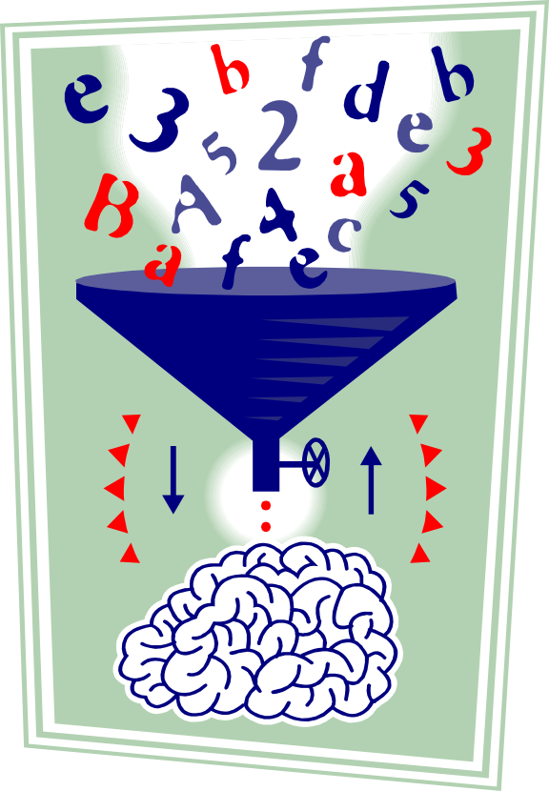
Data, Information, and Knowledge (Def. 2)
Data: Unorganized and unprocessed facts; static; a set of discrete facts about events (第一手資料)
Information: Aggregation of data that makes decision making easier (重整或計算)
Knowledge is derived from information in the same way information is derived from data; it is a person’s range of information (理解與應用)
Notes:
Note the level becomes more abstract as we go from data, to information, and to knowledge.
It is the knowledge that we have that enables us to make decisions.

Slide 7
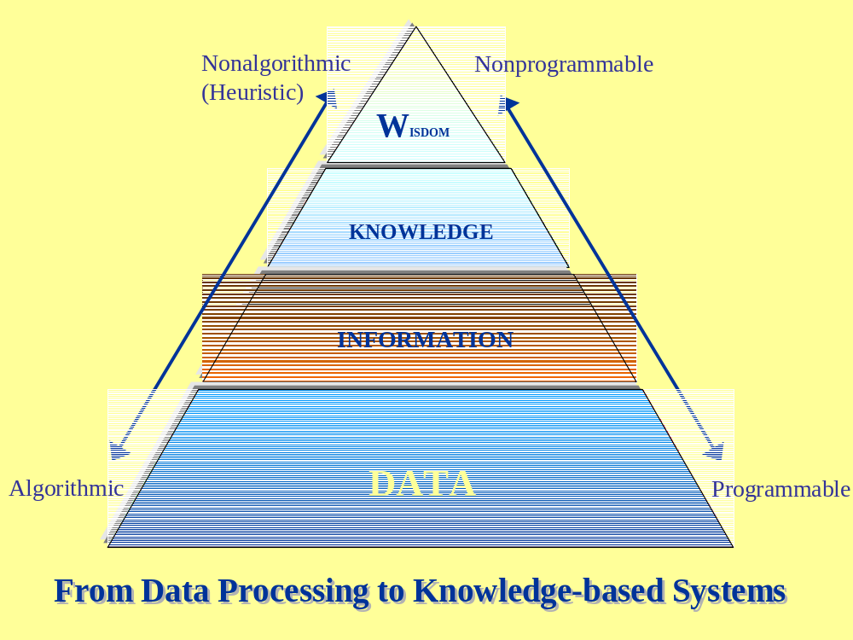
Definitions (3)
電腦圍棋，
搜尋法則？
頓悟、
生命出路
Notes:
How do we make sense of this pyramid?
Can someone give it a try?
What do we mean by algorithmic and non-algorithmic?
How comes data are much easier to program than for information, knowledge and even wisdom?

Slide 8
Overview
Basic Knowledge-related Definitions (1) (2) (3)
Types of Knowledge
Experts’ Reasoning Methods

Slide 9
Types (Categorization) of Knowledge
Shallow (readily recalled) and deep (acquired through years of experience)
Explicit (already codified) and tacit (embedded in the mind)
Procedural (repetitive, stepwise) versus Episodical (grouped by episodes)
Knowledge exist in chunks
  Stored in an expert’s long-range memory as chunks
Notes:
Shallow vs. deep (necessary to make decision/solve problem in complex situations)

Slide 10

Expert’s Reasoning Methods
Reasoning by analogy: relating one concept to another
Case-based reasoning: reasoning from relevant past cases
Formal reasoning: using deductive or inductive methods

Slide 11
End of Chapter #2

