Slide 1
KNOWLEDGE CREATION AND
KNOWLEDGE MANAGEMENT ARCHITECTURE
Chapter #4

Slide 2
Today’s Topics
Knowledge Creation & Knowledge Architecture
Knowledge Creation and Sharing
Knowledge Infrastructure
Knowledge Management Architecture
Build versus Buy Decision

Slide 3

KNOWLEDGE CREATION
Dynamic activity that can enhance organization success and economic well-being
Driver of innovation
Involves knowledge acquisition, selection, generation and sharing
Maturation - translates experience into knowledge
日本獼猴
期末作業
球類競賽

Slide 4
Knowledge Sharing Via Teams
Initial knowledge
Outcome is realized
Team performs
a job
Outcome compared to action
New knowledge reusable by same team on next job
New experience/ knowledge gained
Knowledge captured and codified in a form usable by others

Slide 5
Nonaka’s Model of Knowledge Creation and Transformation
野中鬱次郎,1995
TACIT TO TACIT
(SOCIALIZATION)
E.G., INDIVIDUAL AND/OR TEAM MEETINGS
TACIT TO EXPLICIT
(EXTERNALIZATION)
E.G., WRITE MEMO OF A MEETING
聚合: 只可意會不可言傳
外傳: 文以載道流芳百世
EXPLICIT TO TACIT
(INTERNALIZATION)
E.G., LEARN FROM A MANUAL
EXPLICIT TO EXPLICIT
(COMMUNICATION)
E.G., CREATE A WEBSITE FROM SOME FORM OF EXPLICIT KNOWLEDGE
汲取: 按譜自讀習藝日精
溝通: 彙篡整編集其大成

Slide 6
Impediments to Knowledge Sharing
Compensation 補償
Recognition 認知
Ability utilization 能力運用
Creativity 創造力
Good work environment
Autonomy 自治
Job security 工作保全
Moral values 道德價值
Advancement 昇遷
Variety 多樣性
Achievement 成就
Independence 獨立
Social status 社會地位
Personality
Organizational culture
特質
Vocational reinforcers
Knowledge sharing
輔導
Attitude
態度
Company strategies and policies
Work Norms
規範

Slide 7
Today’s Topics
Knowledge Creation and Sharing
Knowledge Infrastructure
Knowledge Management Architecture
Build versus Buy Decision

Slide 8
KNOWLEDGE INFRASTRUCTURE
People core: Evaluate employee profiles
Content core: Identify knowledge centers
Technical core: The total technology required to operate the knowledge environment
People
Content
Technology

Slide 9
Identifying Knowledge Centers
Competition data, Sales volume, Leader sales information
Job openings,
Benefits
Human
Resources
Sales
Customer Service
Strategies
Tools
R & D
Advertising
Marketing
Complaint rate, Satisfaction information

Slide 10
Today’s Topics
Knowledge Creation and Sharing
Knowledge Infrastructure
Knowledge Management Architecture
Build versus Buy Decision

Slide 11
Layers of KM Architecture
. . . . .
1
2
3
4
5
6
7
User Interface
(Web browser software installed on each user’s PC)
Authorized access control
(e.g., security, passwords, firewalls, authentication)
Collaborative intelligence and filtering
(intelligent agents, network mining, customization, personalization)
Knowledge-enabling applications
(customized applications, skills directories, videoconferencing, decision support systems,
group decision support systems tools)
Transport
(e-mail, Internet/Web site, TCP/IP protocol to manage traffic flow)
Middleware
(specialized software for network management, security, etc.)
The Physical Layer
(repositories, cables)
Databases
Legacy applications
(e.g., payroll)
Groupware
(document exchange,
collaboration)
Data warehousing
(data cleansing,
data mining)
Notes:
Then, the blueprint should consider how the functions of the KMS can be placed into a KM architecture, consisting of 7 important layers as shown here.
Details of these layers in the KM architecture will be explained in the next lecture.

Slide 12

The User Interface (Layer 1)
User interface design focuses on consistency, relevancy, visual clarity, navigation, and usability

Slide 13
Authorized Access Control (Layer 2)
Extranet
Internet
Intranet
Clients
Suppliers
Vendors
Partners
Customers
Public
Company
Human resource information
Production information
Sales information
Strategic plans
News/events
Marketing
E-commerce
Careers
Product information
Sales information
Collaboration/cooperation

Slide 14
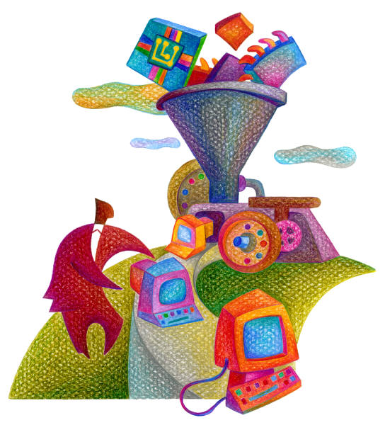
Collaborative Intelligence and Filtering (Layer 3)
Personalized views based on stored knowledge
Groupware to facilitate both sync- and asynchronous interaction and discussion
Intelligent agents reduce search time for needed information

Slide 15

Knowledge-Enabling Application (Layer 4)
Referred to as value-added layer
Creates a competitive edge for the learning organization
Provides knowledge bases, discussion databases, automation tools, etc.
Ultimate goal: show how knowledge sharing could improve the employees

Slide 16

Transport Layer (Layer 5)
Most technical layer to implement
Includes LANs, WANs, intranets, extranets, and the Internet
Ensures that the company will become a network of relationships
Considers multimedia, URLs, graphics, connectivity speeds, and bandwidths

Slide 17

Middleware (Layer 6)
Focus on interfacing with legacy systems and programs residing on other platforms
Designer should address databases and applications with which KM system interfaces
Makes it possible to connect between old and new data formats

Slide 18

Physical Repositories (Layer 7)
Bottom layer in the KM architecture
Represents the physical layer where repositories are installed
Includes intelligent data warehouses, legacy applications, operational databases, and special applications for security and traffic management

Slide 19
Today’s Topics
Knowledge Creation and Sharing
Knowledge Infrastructure
Knowledge Management Architecture
Build versus Buy Decision

Slide 20

Build In-House, Buy, or Outsource?
Trend is toward ready-to-use, generalized software packages
Outsourcing (外包) is also a trend, releasing technological design to outsiders
Regardless of choice, it is important to set criteria for the selection
Question of who owns the KM system should be seriously considered

Slide 21
Build vs. Buying
Option Cost Time Factor Customization
In-house Usually high Much longer than High, depending
development off-the-shelf solution on quality of staff
Development Usually low Depends on skills High to the user
by end users set, system priority, specifications
and so forth
Outsourcing Medium to high Shorter than High
in-house
Off-the-shelf Low to medium Nil Usually up to
Solution 80% usable
Notes:
In earlier slides, we talked about the differences between conventional system life cycle and KMSLC.
We emphasized the importance of the role of users in conventional life cycle as compared to that of experts in KMSLC. Here, we compare them based on their major attributes.

Slide 22
End of Chapter #4
Notes:
This end the Lecture 2.
The next lecture, we will cover Knowledge Creation and Knowledge Architecture.

