Slide 1
Bayesian Decision Theory
Introduction to Machine Learning (Chap 3), E. Alpaydin

Slide 2
Relevant Research
Recall:
Search Methods
Reasoning/ Proof
Problem Solving
Predicate Logic
Pattern Recognition
Data Mining, etc.
Bayesian Network
Expert System
(Rule Based Inference)
Probability (statistics)
Uncertainty (cybernetics)
Diagnosis, Decision Making
Advice, Recommendations
Automatic Control
Machine Learning
Fuzzy, NN, GA, etc.
Fuzzy Theorem
In my opinion:
weak
sub?
strong
記憶
評判
搜尋解答
邏輯推理
控制
學習
創作
Fuzzy,NN,GA
Lecture Notes for E Alpaydın 2004 Introduction to Machine Learning © The MIT Press (V1.1)

Slide 3
Bayes’ Rule
P(X, Y) = P(Y, X)
e.g. A:獲得獎學金 B:女同學 C:大四
P(A, B) = P(A|B) P(B)
P(A, B, C) = P(A|B,C) P(B|C) P(C)
= P(A|B,C) P(B) P(C) ← if B,C independent, i.e., P(B|C)=P(B)
P(D, E) = P(D,E,F) + P(D,E,~F)
P(D, E) = P(D,E,F,G) +P(D,E,~F,G) +P(D,E,F,~G) +P(D,E,~F,~G)
P(D, E, F) = P(D,E,F,G) + P(D,E,F,~G)
P(A, ~B, C) = P(A|~B,C) P(~B|C) P(C)
= P(A|~B,C) [1 - P(B|C)] P(C) …. 差集在子群(左側)可用1減
Lecture Notes for E Alpaydın 2004 Introduction to Machine Learning © The MIT Press (V1.1)

Slide 4
Bayesian Networks
Aka (also known as) probabilistic networks
Nodes are hypotheses (random vars)
  Root Nodes are with the prob corresponds to our belief in the truth of the hypothesis
Arcs are direct influences between hypotheses
The structure is represented as a directed acyclic graph (DAG)
The parameters are the conditional probs in the arcs
(Pearl, 1988, 2000; Jensen, 1996; Lauritzen, 1996)
Lecture Notes for E Alpaydın 2004 Introduction to Machine Learning © The MIT Press (V1.1)

Slide 5
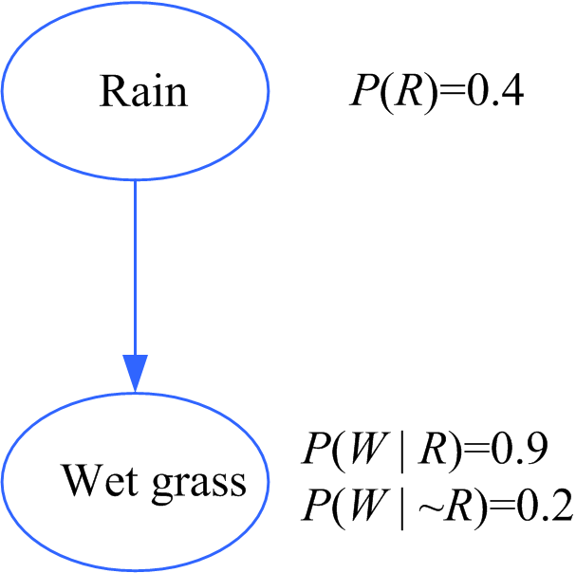
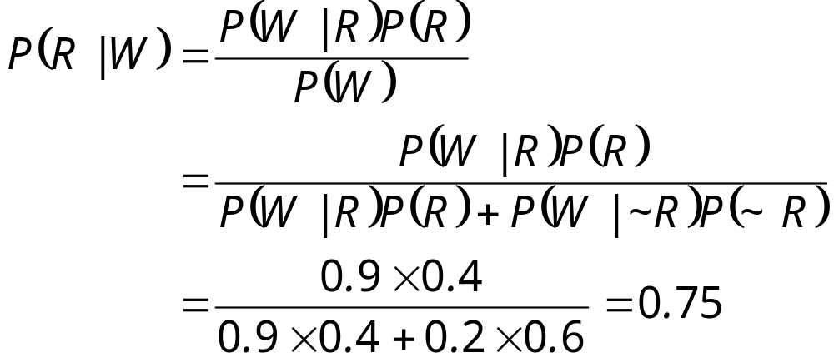
Causes and Bayes’ Rule
Diagnostic inference:
Knowing that the grass is wet,
what is the probability that rain is
the cause?
diagnostic
causal
Lecture Notes for E Alpaydın 2004 Introduction to Machine Learning © The MIT Press (V1.1)

Slide 6
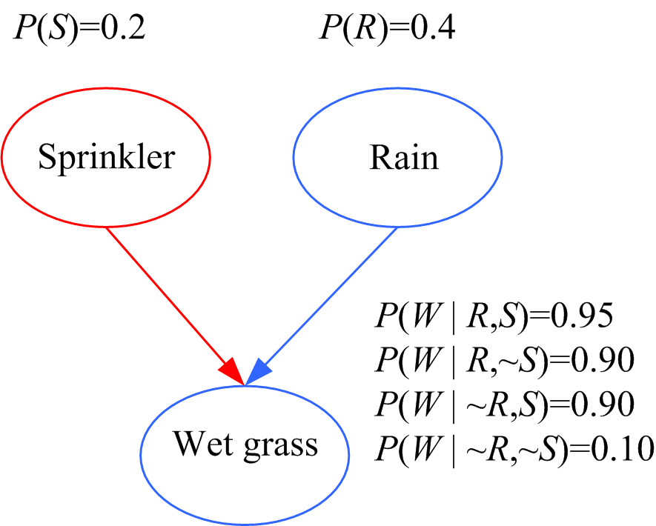
Causal vs Diagnostic Inference
舉例這類問題有多複雜
Causal inference: If the
sprinkler is on, what is the
probability that the grass is wet?
P(W|S) = P(W,S)/ P(S)
= [P(W,R,S)+P(W,~R,S)]/ P(S)
= (P(W|R,S) P(R|S) P(S)+
P(W|~R,S) P(~R|S) P(S) )/P(S)
= P(W|R,S) P(R) +
P(W|~R,S) P(~R)
= 0.95 0.4 + 0.9 0.6 = 0.92
Diagnostic inference: If the grass is wet, what is the prob. that the sprinkler is on?
引入一個結果 P(S|W) =P(S,W)/P(W)=P(W|S)P(S)/P(W) =0.35 > 0.2= P(S)
引入一個競爭 P(S|R,W) = 0.21 note: R,S independent i.e. P(S|R)=P(S)
Explaining away: Knowing that it has rained decreases the prob. that the sprinkler is on.
Lecture Notes for E Alpaydın 2004 Introduction to Machine Learning © The MIT Press (V1.1)

Slide 7
Causal vs Diagnostic Inference
引入一個結果 P(S|W)
P(S|W) = P(S,W) / P(W)
P(W)= P(W,R,S)+P(W,~R,S)+P(..S)+P(..~S)
P(W)= P(W|R,S)P(R|S)P(S) +
P(W|~R,S)P(~R|S)P(S) +
P(W|R,~S)P(R|~S)P(~S) +
P(W|~R,~S)P(~R|~S)P(~S) +
= P(W|R,S)P(R)P(S) +
P(W|~R,S)P(~R)P(S) +
P(W|R,~S)P(R)P(~S) +
P(W|~R,~S)P(~R)P(~S) +
= 0.95*0.4*0.2 + 0.9*(1-0.4)*0.2
+ 0.9*0.4*0.8 + 0.1*(1-0.4)*0.6
= 0.52
P(S,W) = P(W,S) = P(W,R,S)+P(W,~R,S)
= 上式前兩項
= 0.95*0.4*0.2 + 0.9*(1-0.4)*0.2
= 0.184
引入一個結果 P(S|W) =P(S,W)/P(W)=P(W|S)P(S)/P(W)
= 0.184/0.52 = 0.35 > 0.2= P(S)
Lecture Notes for E Alpaydın 2004 Introduction to Machine Learning © The MIT Press (V1.1)

Slide 8
Causal vs Diagnostic Inference
引入一個競爭 P(S|R,W)
P(S|R,W) = P(R,S,W) / P(R,W)
P(R,W) = P(W,R,S)+P(W,R,~S)
= P(W|R,S)P(R|S)P(S) +
P(W|R,~S)P(R|~S)P(~S) +
= P(W|R,S)P(R)P(S) +
P(W|R,~S)P(R)P(~S) +
= 0.95*0.4*0.2 + 0.9*0.4*0.8
= 0.076+0.288 = 0.364
P(R,W,S) = P(W|R,S) P(R|S) P(S)
= 0.95*0.4*0.2
= 0.076
P(S|R,W) = 0.076/0.364 = 0.21
引入一個競爭P(S|R,W)
P((S|R,W)=0.21
0.2 < 0.21 <0.35
P(S) < P(S|R,W) < P(S|W)
Lecture Notes for E Alpaydın 2004 Introduction to Machine Learning © The MIT Press (V1.1)

Slide 9
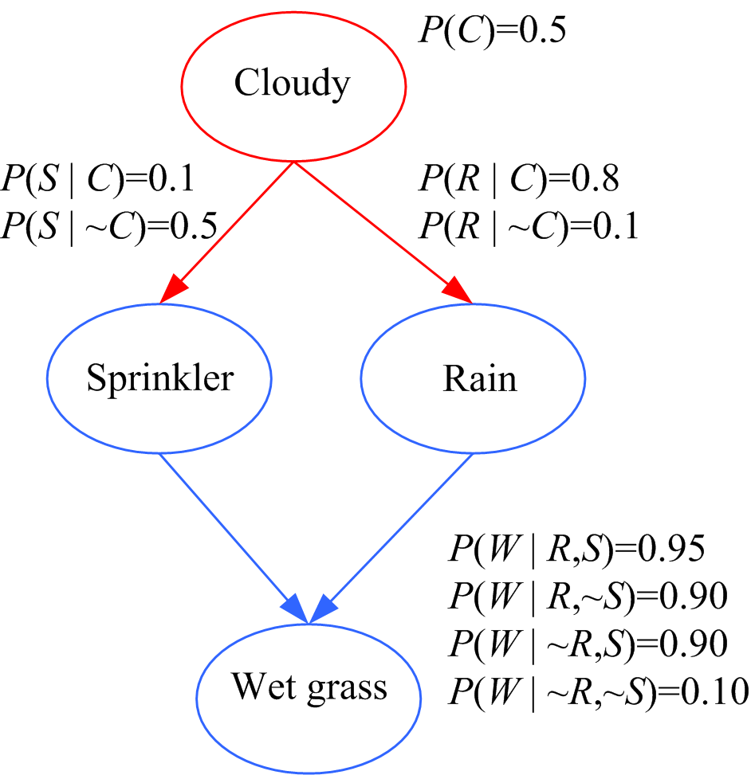
Bayesian Networks: Causes
但是推算仍是有規則可尋
Causal inference:
P(W|C) = P(W,C)/ P(C)
P(W,C) = P(W,R,S,C) + P(W,R,~S,C)
+P(W,~R,S,C)+ P(W,~R,~S,C)
P(W,R,S,C)
= P(W|R,S,C) P(R|S,C) P(S|C) P(C)
= P(W|R,S) P(R|C) P(S|C) P(C)
= 0.95*0.8*0.1*.05
P(W,R,~S,C)
= P(W|R,~S,C) P(R|~S,C) P(~S|C)
= P(W|R,~S) P(R|C) P(~S|C) P(C)
= 0.90*0.8*(1-0.1)*0.5
…..
P(C) = 0.5
Diagnostic: P(C|W ) = ?
P(W)=八項相加
Lecture Notes for E Alpaydın 2004 Introduction to Machine Learning © The MIT Press (V1.1)

Slide 10

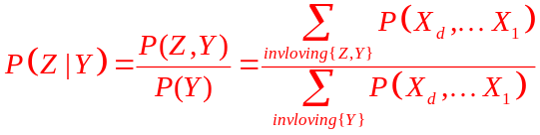
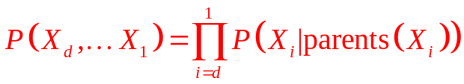
Bayesian Networks: Causes
Bayesian Network 定義
是acyclic (feed-forwards) network;
node 編號 X₁,X₂…X_{d}
(2) 所有Roots 都獨自標示出現機率;
(3) 對於每個節點事件，要完整標示其
源自所有 parents 組合的條件機率;
(4) 無path (注意: 非direct link)相連的
事件之間，視為 independent.
Bayesian Network 推導
Lecture Notes for E Alpaydın 2004 Introduction to Machine Learning © The MIT Press (V1.1)

Slide 11
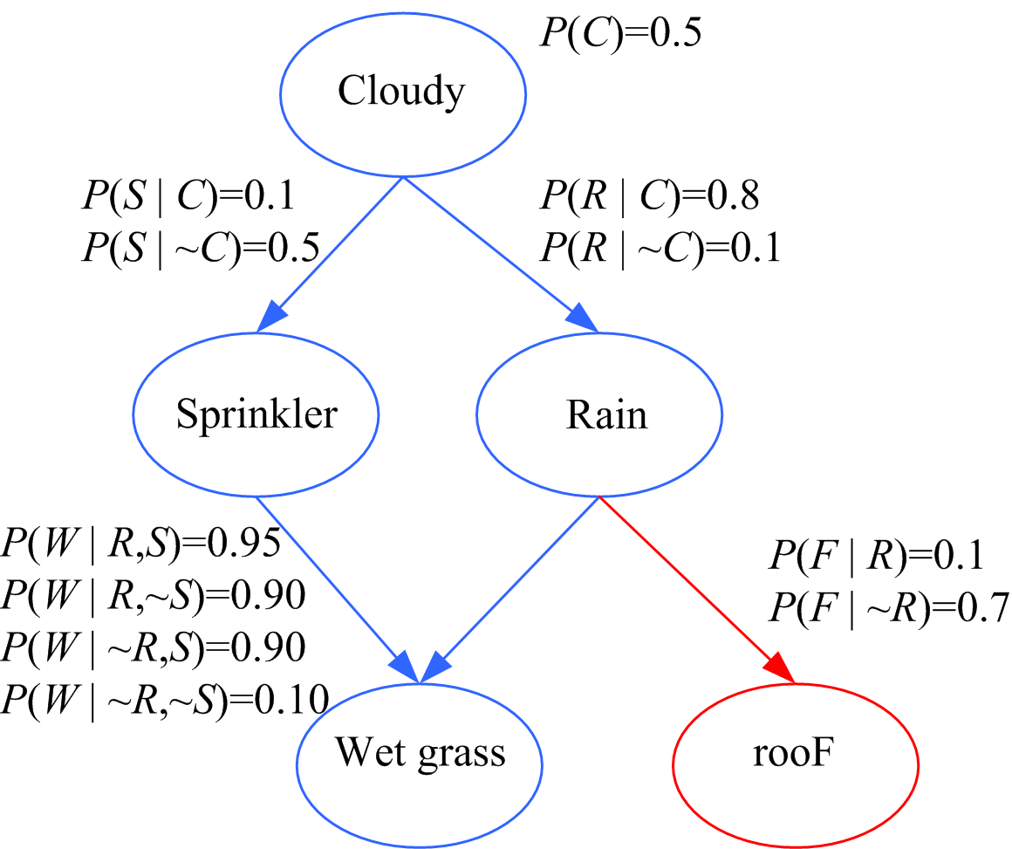
Bayesian Nets: Local structure
P (F | C) = ?
P (S, ~F | W, R) = ?
此圖共有 2^5= 32 個
切割區間，現在來拼圖
P (F | C)
= P (F, C) / P(C)
P (S, ~F | W, R)
=P (~F, W, R, S) / P(W,R)
Lecture Notes for E Alpaydın 2004 Introduction to Machine Learning © The MIT Press (V1.1)

Slide 12
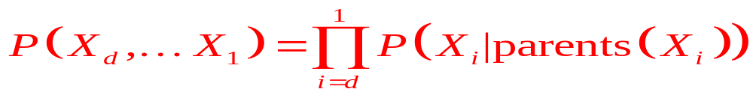
Bayesian Networks: Inference
not(~) 出現在左側則以1相減
出現在右側則原圖已給
P (F|C) = P (F,C) / P(C)
其中 P (F,C) = ∑_{S} ∑_{R} ∑_{W} P (F,W,R,S,C) … 共8個加項
P (F,W,R,S,C) = P (F|W,R,S,C) P (W|R,S,C) P (R|S,C) P (S|C) P (C)
= P (F|R) P (W|R,S) P (R|C) P (S|C) P (C)
(2) P (F,W,R,~S,C) = P (F|C,~S,R,W) P (W|C,~S,R) P (R|C,~S) P (~S|C) P (C)
= P (F|R) P (W|R,~S) P (R|C) P (~S|C) P (C)
(3)~(8) ……
Belief propagation (Pearl, 1988)
Junction trees (Lauritzen and Spiegelhalter, 1988)
再回頭看 p.7
Lecture Notes for E Alpaydın 2004 Introduction to Machine Learning © The MIT Press (V1.1)

Slide 13
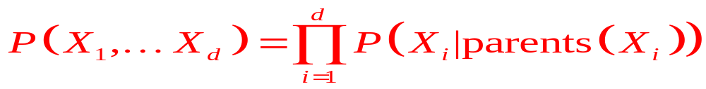
Bayesian Networks: Inference
not(~) 出現在左側則以1相減
之後會出現在右側成為條件
出現在右側則原圖已給
P (F|C) = P (C,F) / P(C)
其中 P (C,F) = ∑_{S} ∑_{R} ∑_{W} P (C,S,R,W,F) … 共8個加項
(1) P (C,S,R,W,F) = P (C) P (S|C) P (R|C,S) P (W|C,S,R) P (F|C,S,R,W)
= P (C) P (S|C) P (R|C) P (W|R,S) P (F|R)
(2) P (C,~S,R,W,F) = P (C) P (~S|C) P (R|C,~S) P (W|C,~S,R) P (F|C,~S,R,W)
= P (C) P (~S|C) P (R|C) P (W|R,~S) P (F|R)
(3)~(8) ……
Belief propagation (Pearl, 1988)
Junction trees (Lauritzen and Spiegelhalter, 1988)
反排列也可以, 要習慣
Lecture Notes for E Alpaydın 2004 Introduction to Machine Learning © The MIT Press (V1.1)

Slide 14
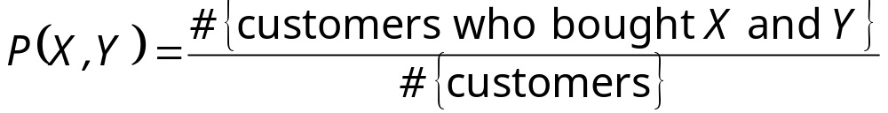
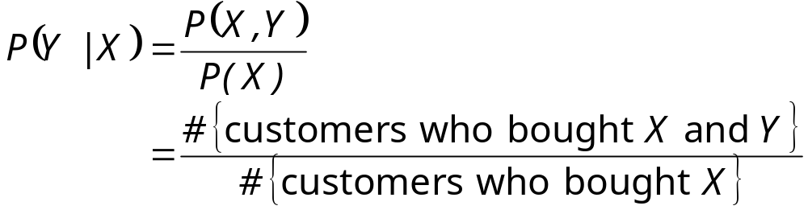
Association Rules (for your reference)
Association rule: X → Y
Support (X → Y):
Confidence (X → Y):
Apriori algorithm (Agrawal et al., 1996)
Lecture Notes for E Alpaydın 2004 Introduction to Machine Learning © The MIT Press (V1.1)

